Slide 1
drought
By hannah,ori,kaitlyn

Slide 2
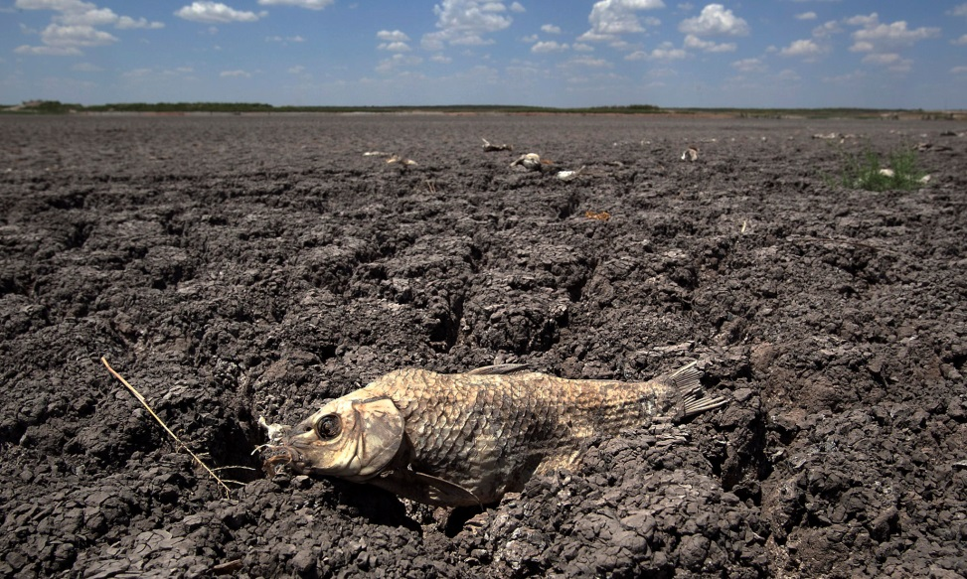
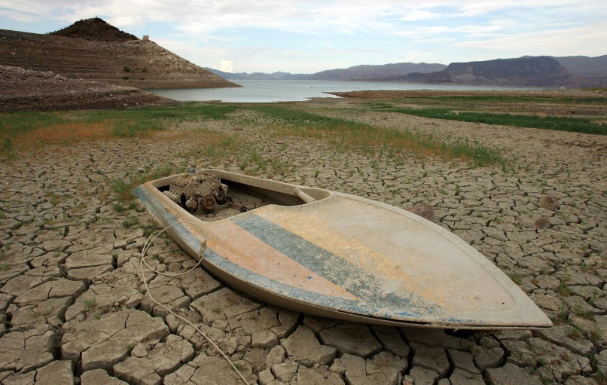
What is a drought?
A drought is wen it has not rained for a long time.
The ground gets like dry dust.

Slide 3
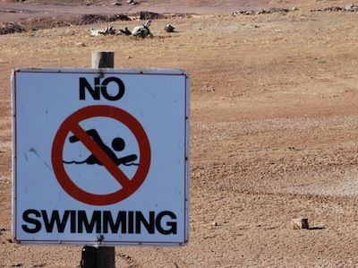
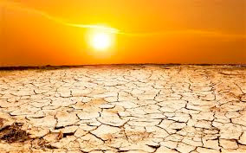
What damage can it do?
There was a drought so bad it broke down a farm.
Sometimes it can start forest fires and make animals passaway.

Slide 4
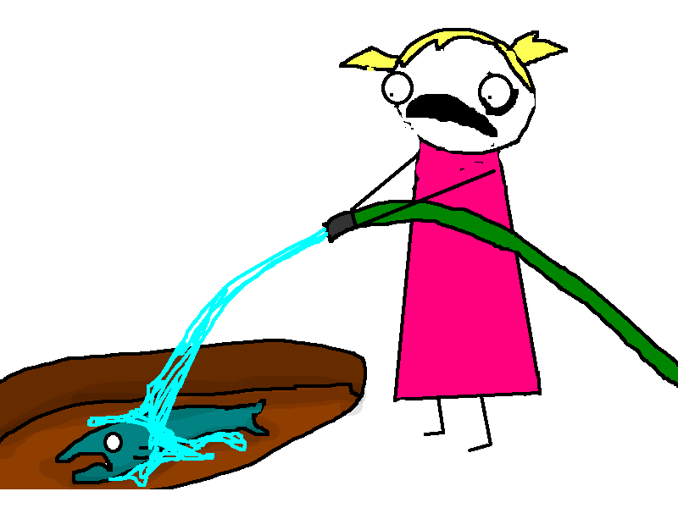
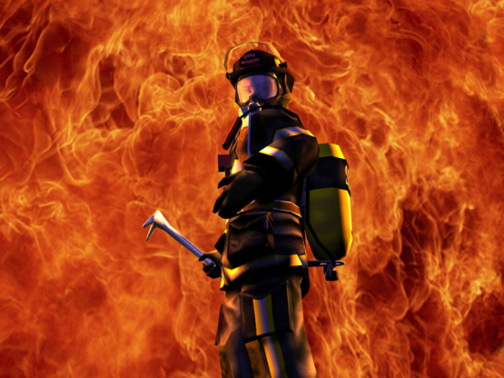
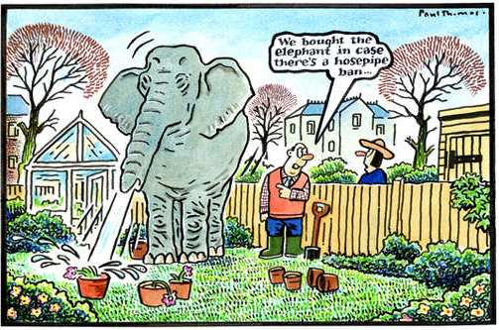
What can we do?
We can use less water.
We can send out fire planes to put out forest fire.

