Slide 1
Tornado
By Orla , Rhys, Freddie

Slide 2
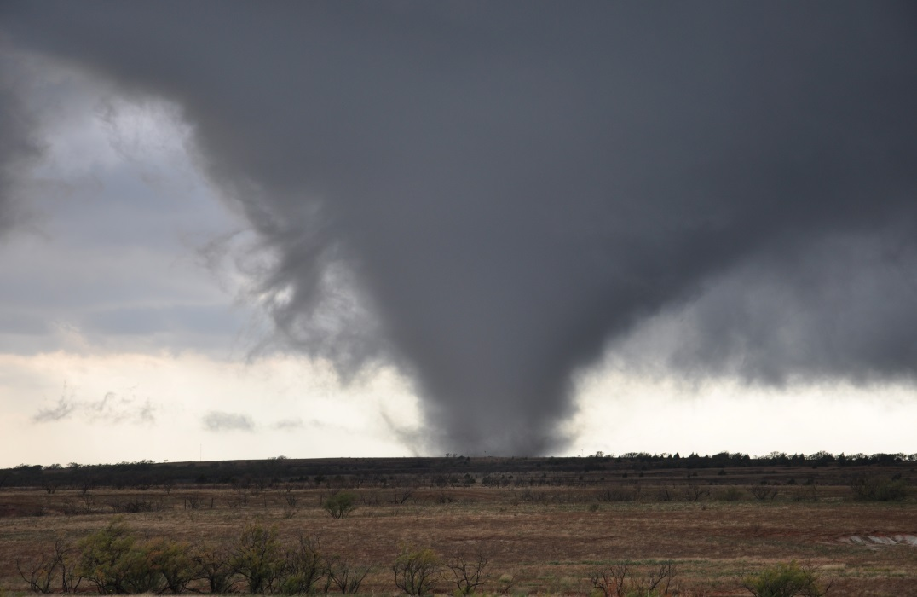
What is a tornado?
A tornado is a violent windstorm.
Tornado alley is a place with over lots of tornadoes in america.

Slide 3
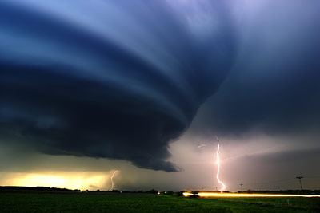
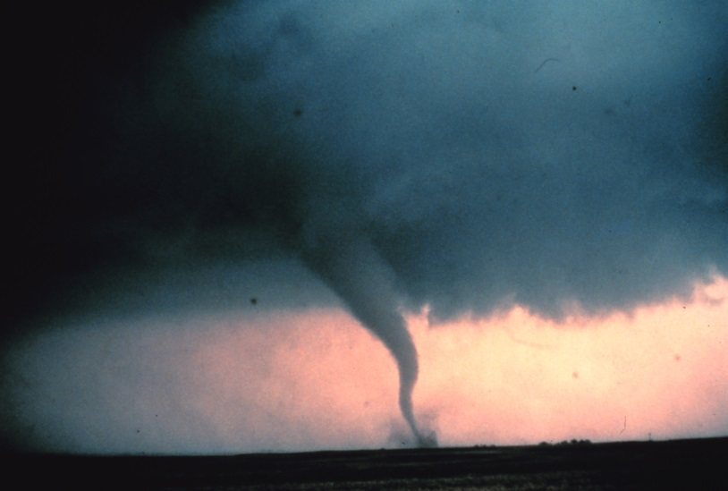
What makes it happen?
It is made out of hot air and wind.
A tornado forms when winds start to whirlround at bottom of a thunder.

Slide 4
What damage can it do?
A tornado can damage a house and car.

Slide 5
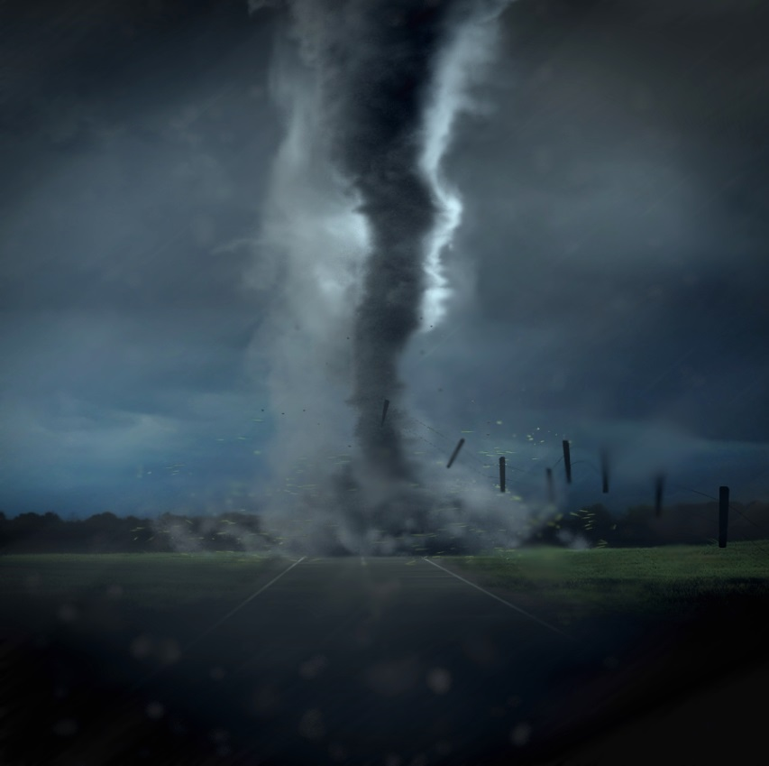
What can we do?
Dig a hole in the ground.
We can go in a basment.

