Slide 1
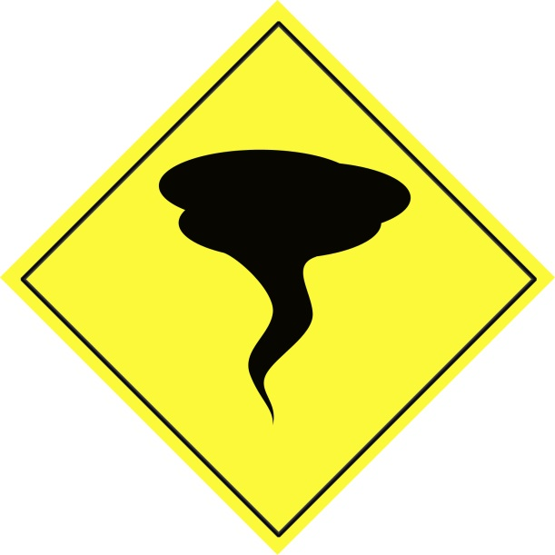
Tornado
By liam liamT and Riley

Slide 2
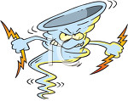
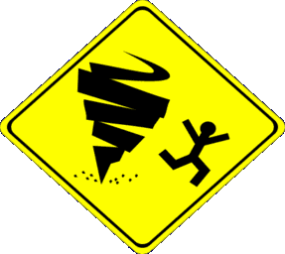
What is it tornado ?
A tornado is violent wind what spins in a sercel.

Slide 3
what makes it happen
Wind spins around at the bottom of a thunder
Cloud.

Slide 4
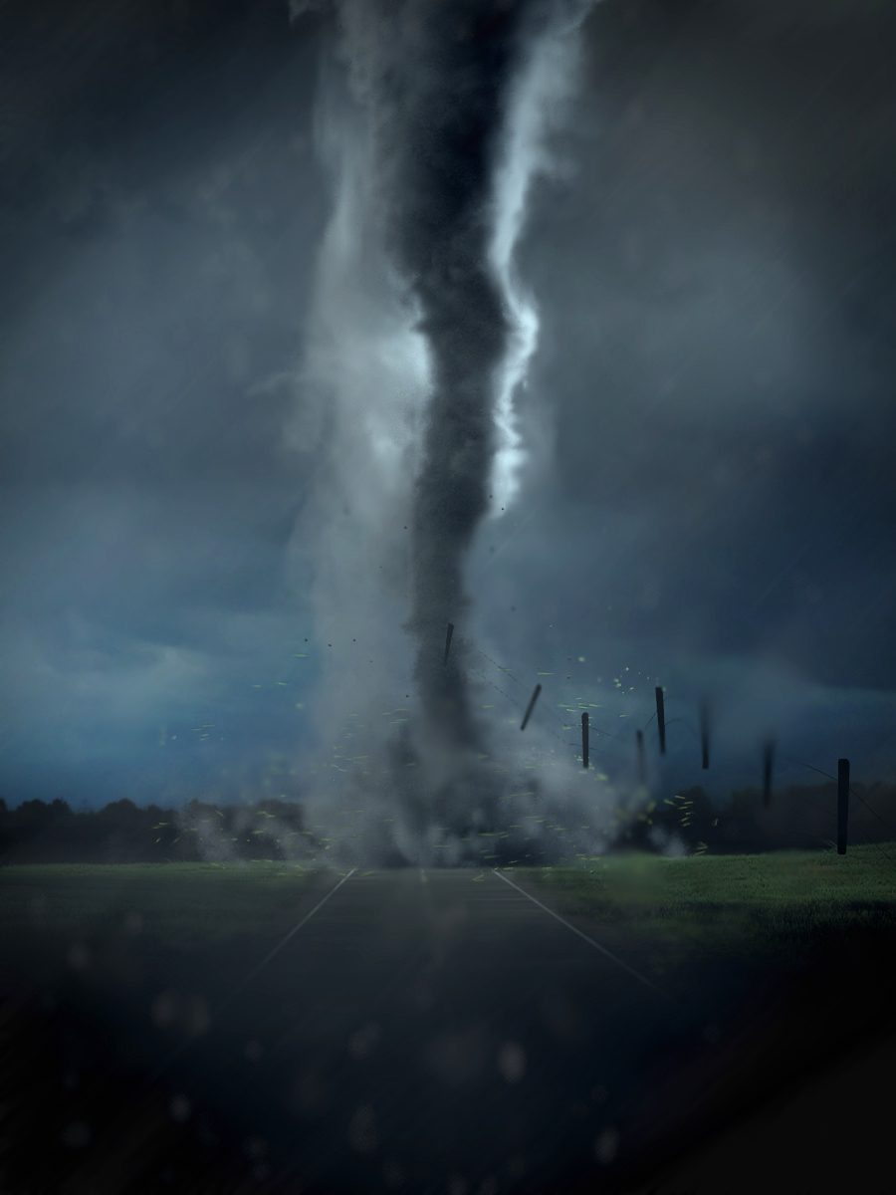
What damage can it do?
A tornado can lift up a houes and car.

Slide 5
What can we do?
Hide under ground in a cellar

