Slide 1
Snow Blizzard
By Aidan stuart / Alexa

Slide 2
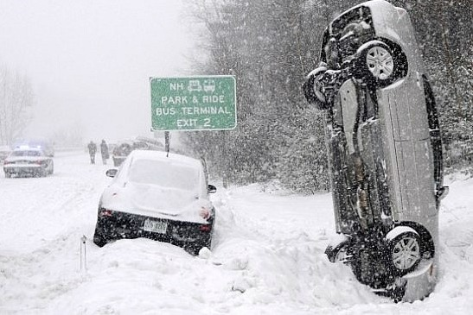
What is it ?
a snow Blizzard is strong wind and snow mixt together.

Slide 3
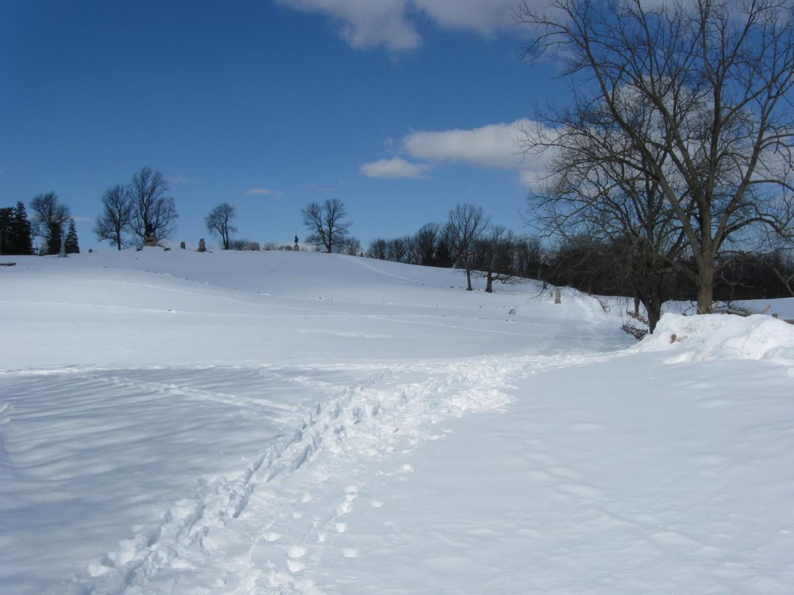
What makes a snow blizzard happen?
You need 3 different things to make a snow Blizzard .
Snow .
Cold air .
Strong wind .

Slide 4
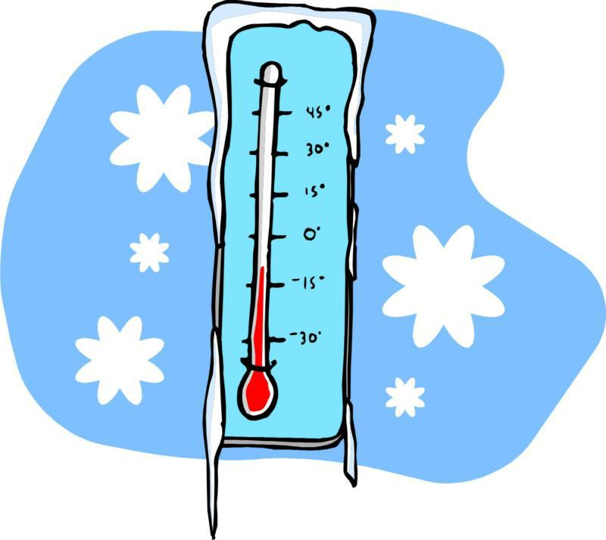
What Damage can it do ?
It can make it not safe to travel.

Slide 5
What can we do
Warning not to travel.

