Slide 1
Food chaines
By Gavin

Slide 2
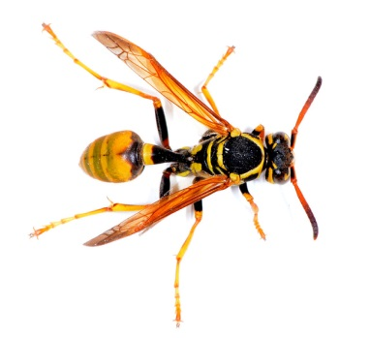
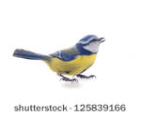
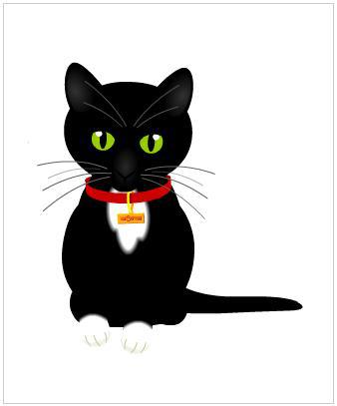
Food chain 1
prdoasr
predator
prey
Predator
Predator

Slide 3
Food chain 2

