Slide 1
Food chain
By dylan

Slide 2
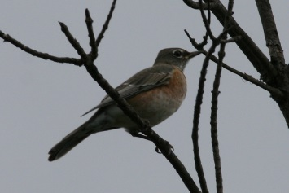
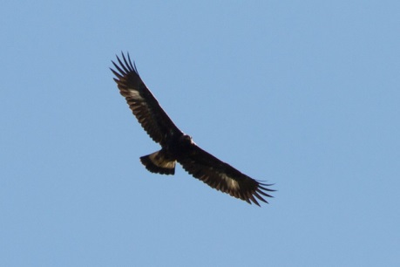
First food chain
consumer
producer
consumer
consumer
Pray4

Slide 3
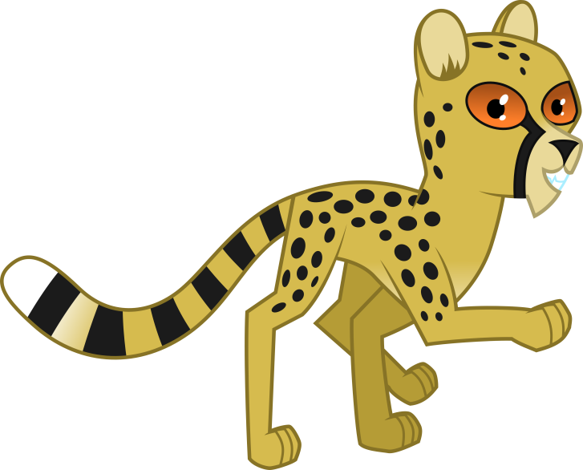
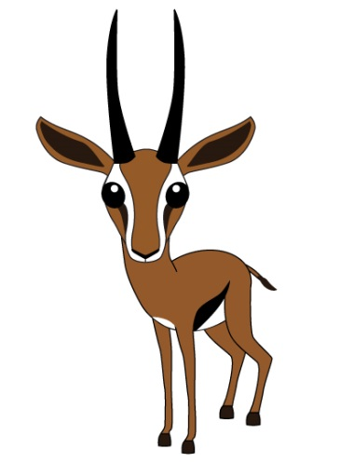
Second food chain
COMSUMER
COMSUMER
producer
COMSUMER

Slide 4
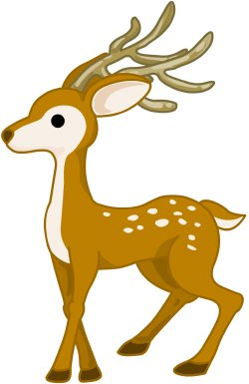
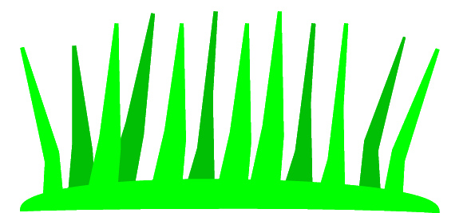
Thord food chain
COMSUMER
r
COMSUMER
producer

Slide 5
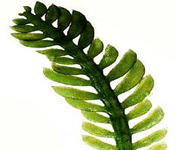
4^{th food chain}
COMSUMER
COMSUMER
COMSUMER

