Slide 1
Keep people safe
By Ebony JACK STUART.

Slide 2
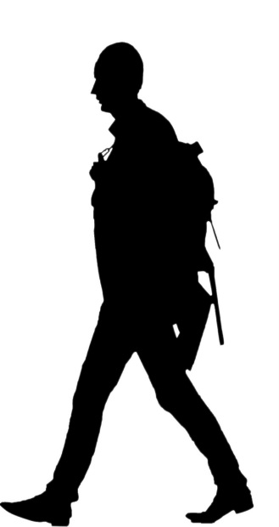
The chavler was waking down the road and some men came to beat him up.

Slide 3
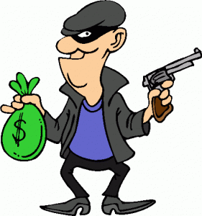
They robd him and ran away leavd him half dead on the road.

Slide 4
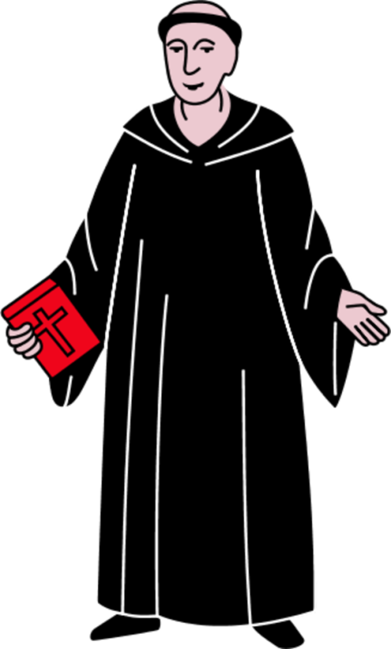
The first man came was a preest he eggnord him.

Slide 5
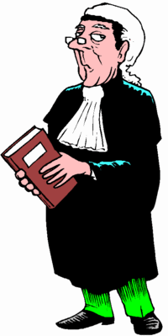
The second man was a lawyer and he ignored him too.

Slide 6
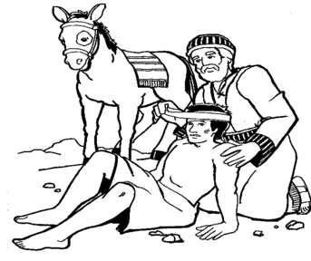
The next man helpt him he cleand him up.

Slide 7
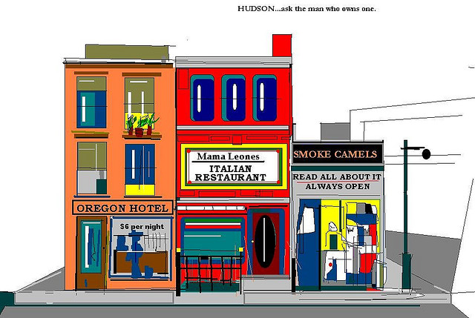
He whent to the nearist howtel he said pleas look after this man.

