Slide 1
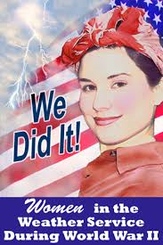
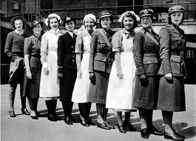
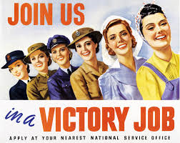
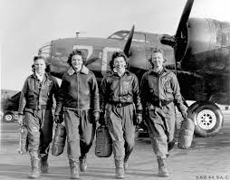
Women at War

Slide 2
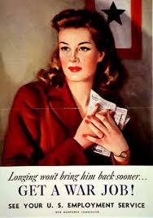
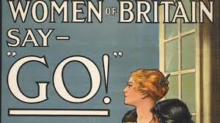
Contents
Jobs
Age and Relationships
Age and Relationships Part 2
Fashion
Fashion Part 2
Housewives
School
Voluntary
Land Girls
Canary girls
Women's Role

Slide 3
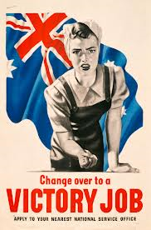
Jobs
In the war there was so many jobs for females/women to do! Even if they were doing male jobs. There are a few jobs I will list such as:
Doctors
Miners
Farmers
Scientists
School teachers
There are also so much more that I have not listed but you can find out about on the internet!

Slide 4
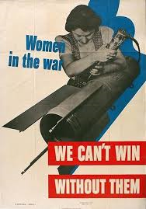
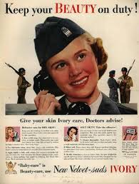
Age and Relations
At the start only single women 20-30 were signed up to war, but half way through the year of 1943 90% of single women and 80% started working in factories and on the land of the armed forces.

Slide 5
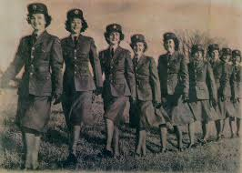
640,00 women joined the armed forces
55,000 with guns serving essentials
80,000 in the land army
And many more who flew unarmed air crafts, drove ambulances and were nurses!
These are numbers are amazingly high and that shows how much women were important to the War!!!!

Slide 6
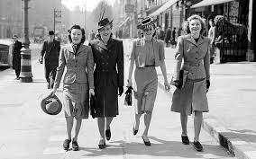
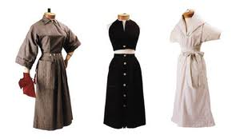
Fashion
As soon as the men left for war the women's lifestyle became a bit different. They loved fashion ( we still do ) but that was one of the parts of their life that had to be changed. They eventually learned to live with what they had instead of what they wanted. Even if fashion wasn’t important because everybody was focused on the war, people still dressed fancy before and after the war. Their everyday inside clothes were hats dresses, gloves and stockings. And they wore trousers, jumpers and jackets outside the house.

Slide 7
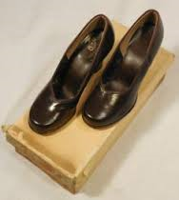
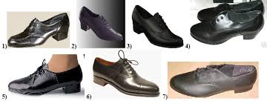
More Fashion
Their shoes were very simple. They were either oxfords, pumps or sandals. Because of the law to limit fabrics ect women's clothing had to be changed. It was hard because the always thought their clothing and appearance had to sparkle.

Slide 8
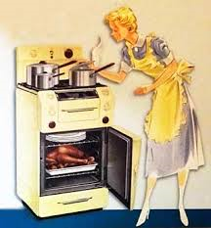
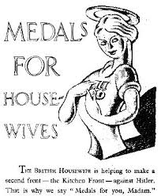
Housewives
Women who went out to work played a vital part in the war effort. If you stayed at home you were important as well. Housewives were looking after the house and Family, they also looked after their neighbours children to let them go to work. War time shortages meant that everyday tasks became quite difficult. Food was rationed and housewives had to spend time queuing for their share.

Slide 9
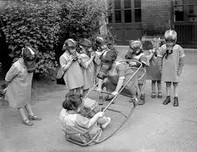
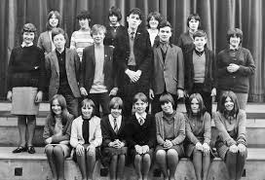
School
Many teachers was evacuated with their schools. Like the children they had to leave the classes/schools and learn to live with strangers rather than their mums and dads!
With the staggering amounts of men away to war there was a terrible shortage of teachers. Women who were retired or were married got brought back into the classes to teach. ( Which was difficult because there was a shortages of classes!)

Slide 10
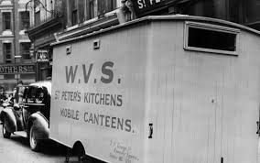
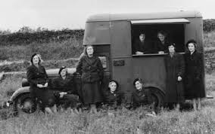
Voluntary
Staggering amounts of women helped with the war effort by doing voluntary work. The women’s voluntary service was founded in 1938. By 1945 the WVS had over 1 MILLION MEMBERS !!! They were out on the streets every night during the Blitz providing help and refreshments. Women working for the WVS set up mobile canteens to provide tea and sandwiches for exhausted rescue workers and victims of the air raid.

Slide 11
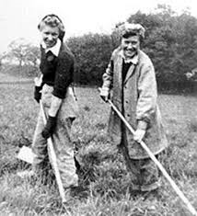
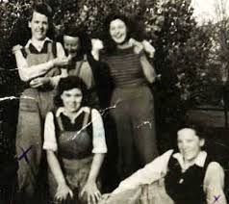
Land Girls
When the land girls were around they did a wide range of jobs, such as: Milking cows, lambing, managing poultry, ploughing, gathering crops, digging ditches, catching rats and taking out farm maintenance work. Thousands of women worked in Timber crops, chopping down trees and running sawmills.

Slide 12
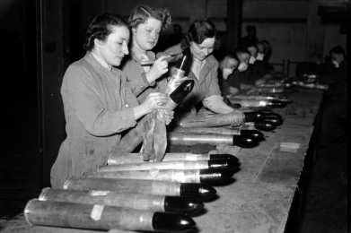
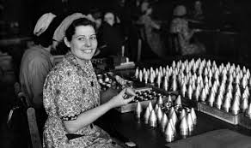
Canary Girls
Around 950,000 British worked in munitions factories during the Second World War, making weapons and bullets. Munitions work was often well-paid, but involved long hours, sometimes up to seven days a week. Workers were also at serious risk from accidents with dangerous machinery or when working with highly explosive material.

Slide 13
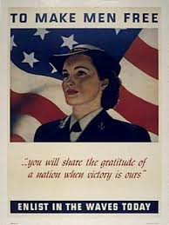
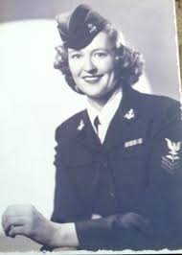
Navy Service
The women who were in the Navy were involved in loading torpedoes onto submarines and planning battle progresses in operation rooms. They did office work, learnt communications and signalling, weather forecasting, engineering and driving.

Slide 14
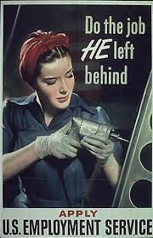
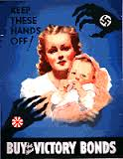
Women's Role
In WW2 women played a very important in fact VITAL PART in the war and in the country's success! But, as with World War One, women at the end of World War Two, found that the advances they had made were greatly reduced when the soldiers returned from fighting abroad.

Slide 15
Sources of info
Jobs http://resources.woodlands-junior.kent.sch.uk/homework/war/jobs.html
Age and Relations http://primaryhomeworkhelp.co.uk/war/women.htm Numbers of Female http://primaryhomeworkhelp.co.uk/war/women.htm
Fashion and More fashion All found on http://glamourdaze.com/world-war-two-fashion/1940s-womens-dress-code
Housewives, Voluntary and school facts were all found in women at war book
Land girls All facts found on http://www.bbc.co.uk/history/ww2peopleswar/timeline/factfiles/nonflash/a6652055.shtml
Canary Girls http://www.mylearning.org/women-at-war-the-role-of-women-during-wwii/p-4670/
Navy service http://caber.open.ac.uk/schools/stanway/Wrens.htm
Women's role http://www.historylearningsite.co.uk/women_WW2.htm

Slide 16
Edited,
Created, Designed,
Information found
BY……
CHARLIE MARSHALL!!!!!
Thanks for watching!!
( It is under the Marshall Law that you
Copy any of my work !!! © )

