Slide 1
The Battle of Britain

Slide 2
Contents
When it started.
Battle of Britain's name.
Getting ready.
Who won the battle of Britain?
Bombers.
Spitfire’s and Messerschmitt's.
Adolf Hitler.
The prime minister of Britain.

Slide 3
When it started
The Battle of Britain started on July 10th, 1940. The battle of Britain was a very important battle in ww2, because Germany and Hitler had taken over most of the main European country's. Britain was one of the last country’s that Hitler and Germany hadn’t taken control of.

Slide 4
Battle of Britain's name
The name the battle of Britain came from one of Winston Churchill's speeches. He quoted “the battle of France is over. The battle of Britain is now to begin”.

Slide 5
Getting ready
Germany needed to get ready to invade Britain so they started to attack towns and army defences on the southern coast. They soon discovered that Britain's Royal Air Force was a challenging opponent. The Germans then thought they should focus on defeating the royal air force so they started to bomb airport runways and the British radar.

Slide 6
Who won?
Although the Germans had lots more pilots & planes we had a few advantages such as we were fighting over our land and therefor had our radar(the radar helped us to see where the German planes were coming from so we had a little time to get our planes and start defending).
So long story short we won the battle of Britain.
☺☺☺☺☺☺☺☺☺☺☺☺☺☺☺☺☺☺☺☺☺☺☺☺
☺☺☺☺☺☺☺☺☺

Slide 7
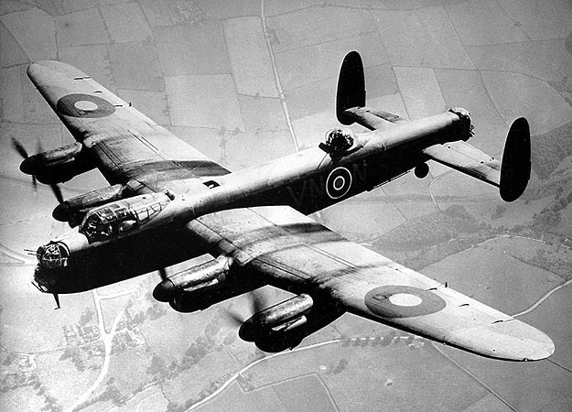
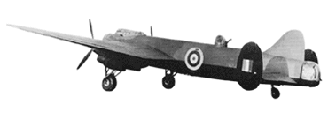
Bombers
Lancaster bomber
Manchester bomber
The first bomber that was made for ww2 was a Manchester Bomber, that failed. Which put them back to the drawing board and then they came up with the Lancaster bomber. The original prototype of a Lancaster was made from a converted Manchester bomber frame and first flew on January 9th 1941.
Extra facts
The Lancaster had 7 crew members, had a maximum speed of 287 mph (462km/h) at 11,500 feet (3505m) and had a range of 2,53 miles (4,072 km).

Slide 8
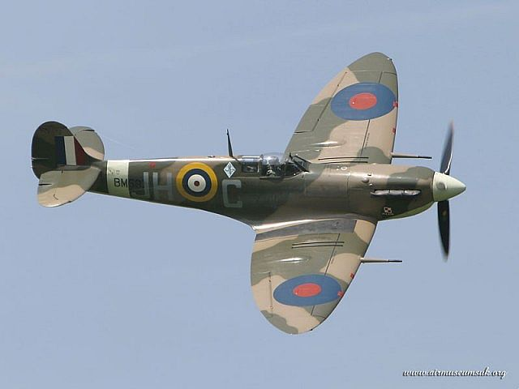
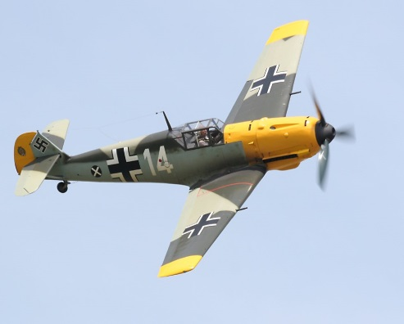
Spitfire’s and Messerschmitt’s
SPITFIRE
MESSERSCHMITT
The Spitfire was invented by R J Mitchell (for more information on Mitchell click HERE) for Britain at war.
The Messerschmitt was invented by Willy Messerschmitt (for more information on willy click HERE) for Germany at war.

Slide 9
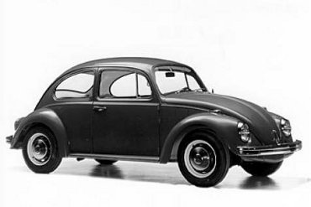
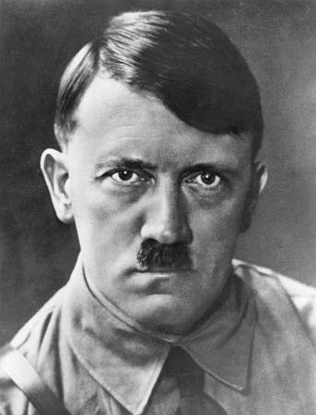
Adolf Hitler WW1
Hitler invented the beetle (the car not the bug).
Adolf Hitler was born on the 20 April 1889 in a small Austrian town called Braunau.
Hitler was a small confident man and was a brave soldier in world war 1, was promoted to the rank of Corporal, was wounded twice (in 1916 and 1918) and was awarded several medals.
In October 1918(during ww1) Hitler was blinded in a mustard gas attack(mustard gas[Yperite] was one of the most lethal poisonous chemicals used in the war). Germany surrendered while Hitler was in hospital and Hitler went into a state of great depression- he spent most of his time in tears.

Slide 10
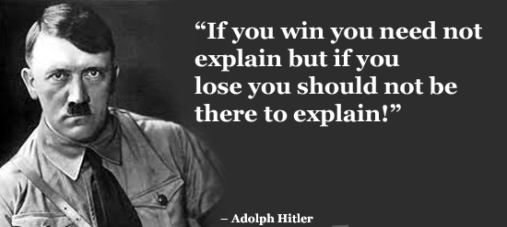
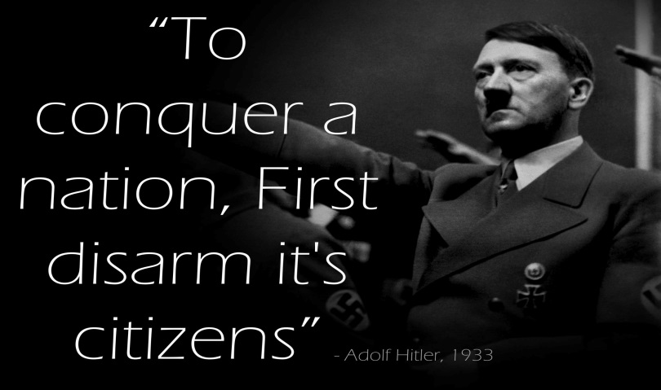
Adolf Hitler WW2
In world war 2 Hitler lead Germany and succeeded most of the way, basically until he got to Britain ☺.
Here are some of Hitler's quotes.

Slide 11
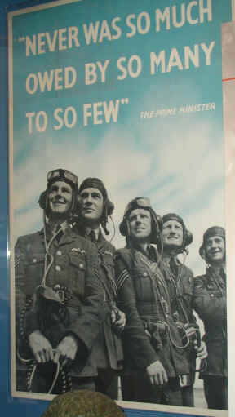
The Prime Minister “never in the field of human conflict was so much owed by so many to so few”
The person who said “never in the field of human conflict was so much owed by so many to so few”, was …
Winston Churchill
This is the original poster from Winston Churchill.

Slide 12
Credits
By
Jack George Storey

