Slide 1
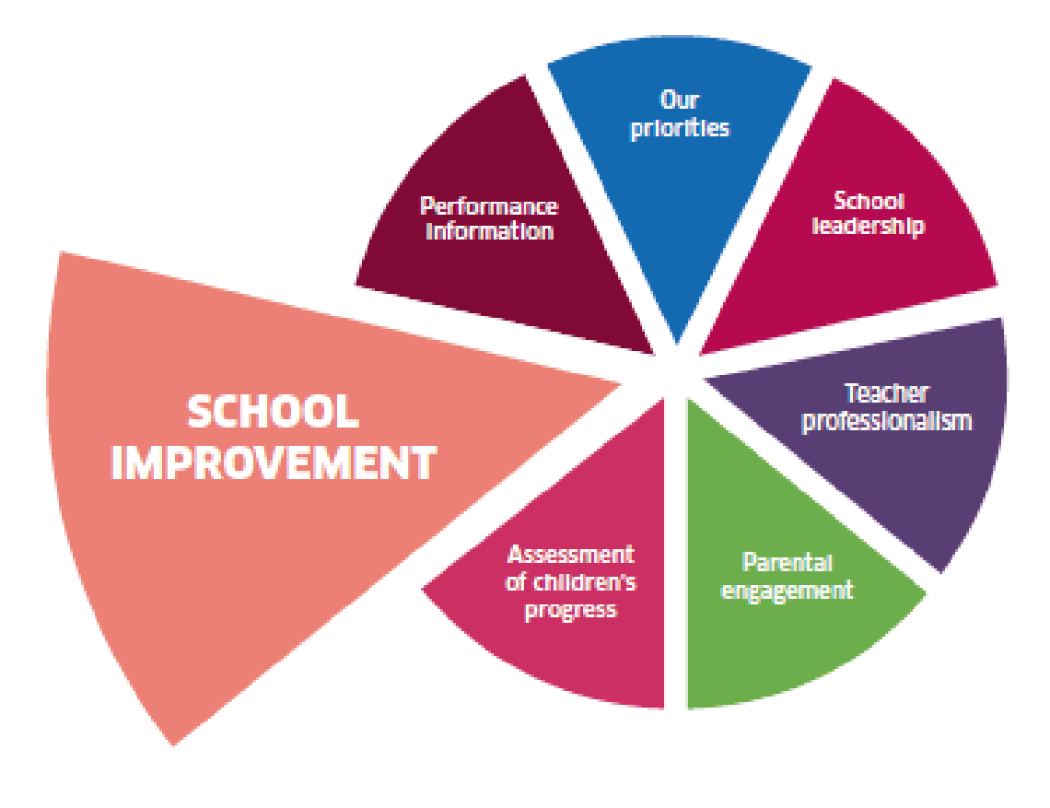
School Improvement Planning
Working Together Learning Together
Review of last year 2018/19 and a look forward to this year 2019/20

Slide 2
What is School Improvement Planning?
A school improvement plan is a method of identifying and agreeing specific areas to be improved during the school year. Parents are invited to be part of this process.
Progress is monitored and successes and next steps are identified and reported back to parents during the year and at the end of the year.
A copy of the full school improvement plan is available on request.
You can be involved by giving us your views and feedback , by taking part in school activities, attending meetings and by giving us ideas how to share information with you.
In our recent Survey Monkey Survey we received 26 responses out of 75 families in the school. 35% of our families completed this.

Slide 3
Review of 2018/19 Priorities
Priority - To raise attainment in numeracy.
What have we done and how well have we done? | Next Steps
Numeracy Bricks Intervention was introduced using Pupil Equity Funding and targeted children received this intervention. It has shown Increased confidence in the children and it is reported by the teacher that they seem to be much more able to transfer skills into new contexts and they seem to “get” number better. The children themselves report that that they feel they are more confident in their numeracy skills and they are enjoying numeracy more. | Continue with this intervention and track the children’s progress
Working Memory and Numeracy with Nurture was introduced. This games based intervention to improve working memory is in its early stages but the children have reported great enjoyment of this and they say it has helped their confidence and made their numbers “pop”. Children who worked on both of these interventions made great gains. | Continue with this intervention and track the children’s progress
We reviewed our Maths and Numeracy programme across the school. We divided numeracy and maths to help with pace of learning. | Introduce “Developing Number Knowledge programme” in P1/2 next session to ensure firm number knowledge and skills are strong.
Growth Mindset work was carried out with teachers, pupils, parents and learners across the school. This is being incorporated into our whole school ethos. Our Growth Mindset group met to evaluate and promoted it in the school and their project was completed Their aim was to teach all pupils across the school about Growth vs Fixed Mindsets and help them to understand what having a Growth Mindset looks like, sounds like and feels like in their day to day learning and how it can impact on both their achievement and their well being. | Continue to imbed as part of our school ethos and learning and teaching.

Slide 4
Review of 2018/19 Priorities
Priority – To further develop STEM (Science, Technology, Engineering and Maths) across the School and to provide our children with meaningful stimulating STEM opportunities.
What have we done and how well have we done? | Next Steps
Our Partnership with Dupont continues to develop STEM. Children are challenged and are given the opportunity to apply skills and previous knowledge through their work. | Continue to develop STEM opportunities through partnership with DTF and our World of Work.
We were visited by people from out with the region to find out more about our partnership working and they highlighted our excellent practice.
We worked with Royal Highland Educational Trust to plan and implement a Food and farming Day and Farmer’s Market. This enhanced pupil learning in food science linked with Science, Health and Well Being and literacy. | Continue to work with a range of new partner agencies to develop STEM opportunities. Be involved in a pilot to develop Scottish STEM Quality Mark in schools.
We now have a whole school Digital Literacy Programme to develop all aspects of Technologies. | Implement across the whole school next session.
Staff received training on equality, gender imbalance and unconscious bias. This raised awareness of how to review our resources, language used and opportunities given across the school. | Share this information with parents and reflect on current practice in the school.

Slide 5
Review of 2018/19 Priorities
Priority - To develop PLAY/Enquiry Learning/Discovery Learning opportunities across the school.
What have we done and how well have we done? | Next Steps
Developed play areas in P1/2, P2/3 and P4 and children have more opportunities to learn through play. Skills based learning has been evident - problem solving, leadership skills, creativity and leading their own learning. The children are able to talk about their play and what they have been learning and skills being developed. During their play the children are observed to be motivated, engaged and challenging themselves. Introduction of working memory games in the senior classes have shown the children to be very motivated by these games and enjoy the challenges they bring. | Continue to develop PLAY opportunities across the school. Staff to attend further training to enhance what we have already.
Introduction of working memory games in the senior classes have shown the children to be very motivated by these games and enjoy the challenges they bring. | Revisit contexts for learning to give the children more opportunity to lead their own learning and learn through enquiry and investigation and creativity.

Slide 6
Summary of responses from our Survey Monkey Parent Feedback in May 2019
85% of parents who completed the survey said their child liked school
80% of parents feel their child is safe at school
Some parents commented on how they are concerned about the behaviour of 1 or 2 pupils in the school.
Some parents commented that they felt that bullying was an issue at school
88% felt their children get the help they need with their learning
92% agreed that the school supports their child’s emotional wellbeing
84% feel that the school encourages the children to treat others with respect.
58% of parents had not experienced bullying, 35% felt their children had been bullied. These parents felt that the approach used for dealing with bullying needed to be improved.
58% of parents felt that the new homework diaries are not used well and do not make them more involved in their child’s learning. Some parents feel they should be used better to communicate between home and school.
84% felt that they are encouraged to be involved in the life of the Parent Council and kept well informed.
Main point to address are – Behaviour, understanding of inclusion, bullying and expectations of homework diaries – See our Priorities for next year

Slide 7
Look Forward to 2019/20 Priorities
Priority | To continue to raise attainment in Numeracy
What we aim to do | Introduce Number Talks from P3-7 classes to give the children more opportunities to explain their numerical thinking, challenge each other’s thinking and to further develop their mental strategies. Development work on concrete, pictorial and abstract materials and resources to support learning Start to implement Developing Number Knowledge Programme at P1/2 Build on current practice on PLAY across the school to develop numeracy and maths skills. Creation of real life contexts for the development of maths and numeracy Continue with moderation opportunities in school and in the cluster across all areas of literacy and numeracy related to all aspects of the moderation cycle
Priority | To review our current contexts for learning (topics) and create new ones.
What we aim to do | Undertake Self evaluation of our current context for learning (topics) – what is working well?, What do we need to improve? Relate to creativity, investigation, enquiry, play, pupil lead, skills and choice. Create new opportunities for contexts for learning (topics) with staff, pupils and parents

Slide 8
Look Forward to 2019/20 Priorities
Priority | To establish support systems in school to improve the wellbeing of our pupils. (Pupil Equity Funding)
What we aim to do | Introduce Emotion Works to encourage children to be able to talk about how they feel and their emotions. To further develop an ethos of nurturing approaches across the whole school. Further develop and enhance KiVA ( bullying programme with a focus on relationships) with staff, pupils and parents. Review Authority Bullying Policy in line with our procedures and update our bullying policy and procedures. Work with parents around “better relationships better learning” (nurture, bullying, Respect for All, Restorative Approaches, inclusion so they have a better understanding of these approaches and how they can be involved to truly work in partnership to support their children.
We will keep you informed throughout the year about our progress with these priorities. There will be opportunities for you to attend parent events, so we look forward to seeing you at these. If you would like anymore information about any of this then please get in touch.

