Slide 1


Online Safety
Notes:
Introduction
- So we are all here today to share information with you all about keeping our children safe online.
- We are community Police Officers, part of our role is giving talks to kids……mainly about online safety.
- So obviously we are Police Officers but we are also parents ourselves, my kids have phones etc…..
- My point is that today is not to judge anyone's parenting choices, we all have one thing in common and that is wanting to keep our children safe

Slide 2

Some questions we will answer today:
What online harms are your children exposed to?
What can you do to protect your children and develop their resilience?
What to do if an incident occurs and where to get support?

Slide 3


This is what we grew up with…..
Notes:
- Now I feel we (as in our generation) have the short straw, we seem to come under the category of ‘growing up with the internet’ and we didn’t really, I was 21, 22 before I had facebook, night out, camera…….
- So we have the job of keeping ourselves up to date, our kids safe but also our elders, Spanish lottery story…..

Slide 4


….and this is what children today are growing up with.
Notes:
- So our kids are growing in an online world, it's happening, it's here to stay…….
- we as adults can separate the online world from the real world
- they can't, they are not mature enough so that’s why we need to be there to guide them

Slide 5




Notes:
- Quick quiz, nobody is getting away with the easy answers here.
- so apps, they can have pages and pages on apps, most of which we know, they might be games
- so yubo – social platform, friend version of tinder
- discord – social platform, gamers etc……..
- so i wasn’t familiar with these apps, but just be aware, have a quick look at what they have downloaded, be aware, quick google search to double check what the app is as this is another way for your child to be speaking to someone that we are completely unaware of.

Slide 6






Children aged 10-13
64% 48% 44% 21% 18%
Children aged 14-16
64% 62% 58% 50% 35%
Parents
73% 52% 52% 50% 38%

Slide 7


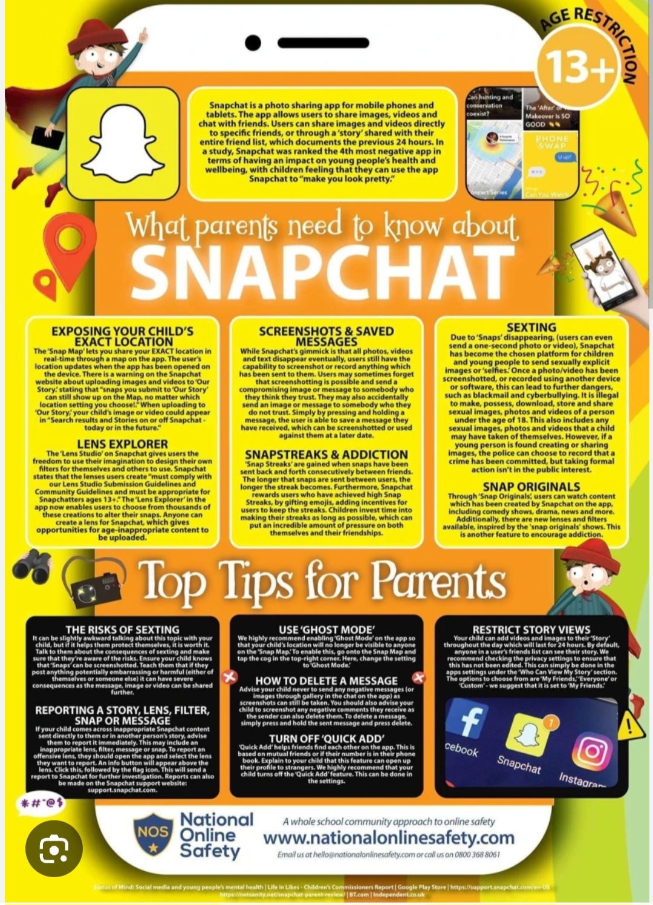

Slide 8

………………………………Groupchats
!
Notes:
So as I have said we do our inputs to the kids and I thought it would be beneficial to share a few examples of what we tell them with yourselves so that we can do this from our side, the teachers are doing their side, and you can reiterate it from home.
Group-chats, bane of all our lives
So obviously they are kids, they will make mistakes, they will say stuff that they wont understand the consequences of, they think because its online it doesn’t count
The way I try and get through to them is to say if they are happy for mums/teachers etc……if not then that suggests they are maybe saying or sharing something they shouldn’t be
The only way to keep on top of this is to monitor, check, daily, if need be, my son can be in numerous chats…….i will decide what he does on that phone and I will delete anything that needs deleted

Slide 9
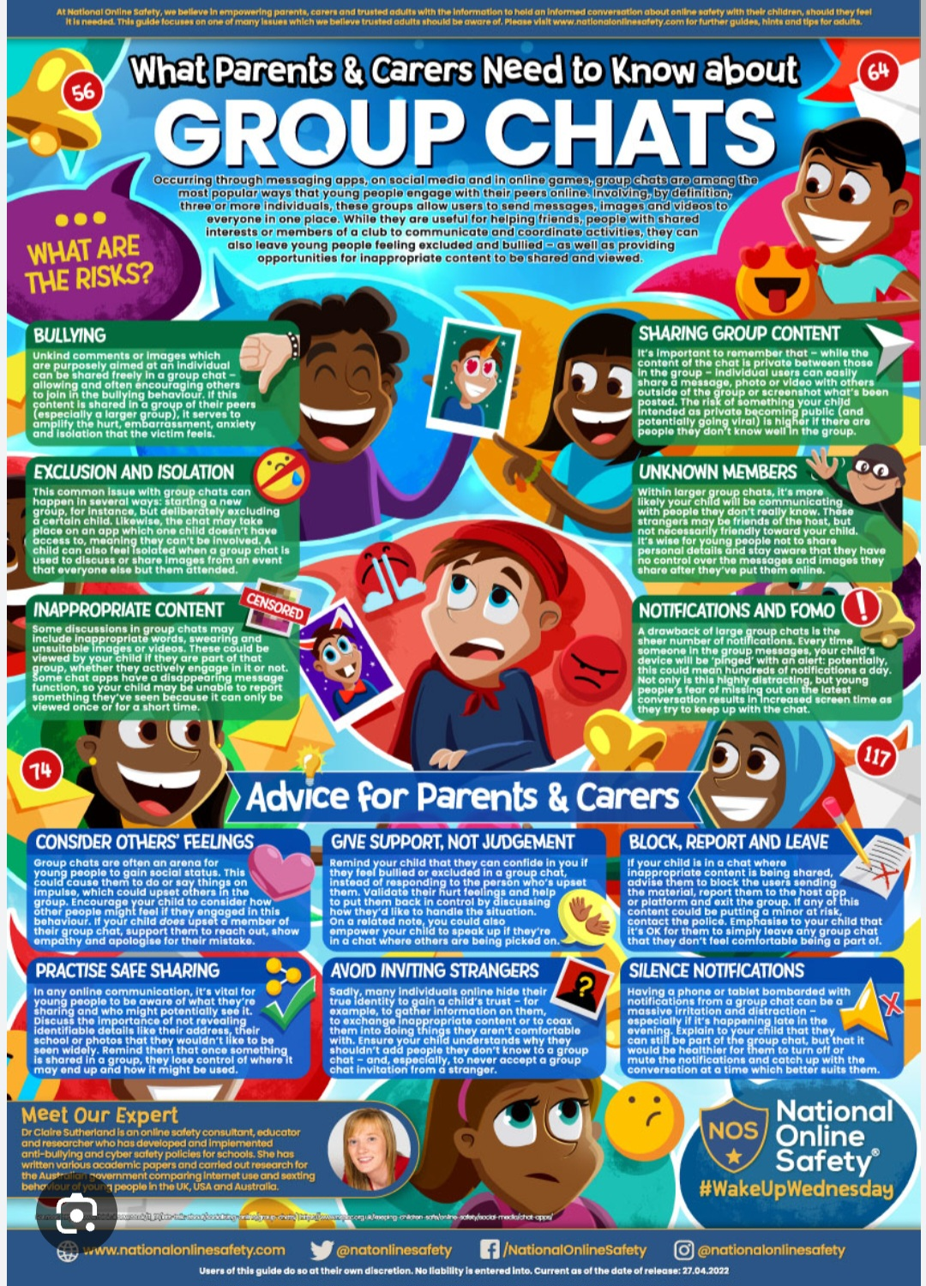
- Education is key - Open communication - Monitor activity - ‘Leave the chat’ option

Slide 10
Hate Crime: Any crime which is perceived by the victim, or any other person as being motivated by malice or ill will towards a group. Age, Disability, Race, Religion, Sexual orientation, Transgender Identity, Sexual Characteristics
Notes:
- So I just wanted to go over a fairly new bit of legislation which came into play in 2021, perceived by anyone!
- we grew up with the phrase ‘sticks and stones’ that phrase really isn’t relevant anymore, words are harmful, they can have a massive effect, and whether or not we agree with it, words can be classed as criminal now.
- so group chats are where they are getting caught out, saying certain words, a bit of peer pressure, and that can now com under the hate crime legislation.
- we as police officers have very little discretion when it comes to Hate crimes

Slide 11

What is a digital footprint?
Notes:
- So digital footprint is basically the trail of data we leave behind whenever we use the internet and to be fair most of our p7s are pretty switched o to that this means
- again, we just explain the consequences they could face if they post something on the internet, I remind them that once something is shared online, it becomes very difficult for you to control, even if you delete it, screenshots, groupchats etc….
YouTube story
So again, just explain to them that things they post when they are younger, could affect them later on in life, including if they want to go to colleges, get jobs such as teachers or police officers, how easy it is to do a quick search on your name etc

Slide 12
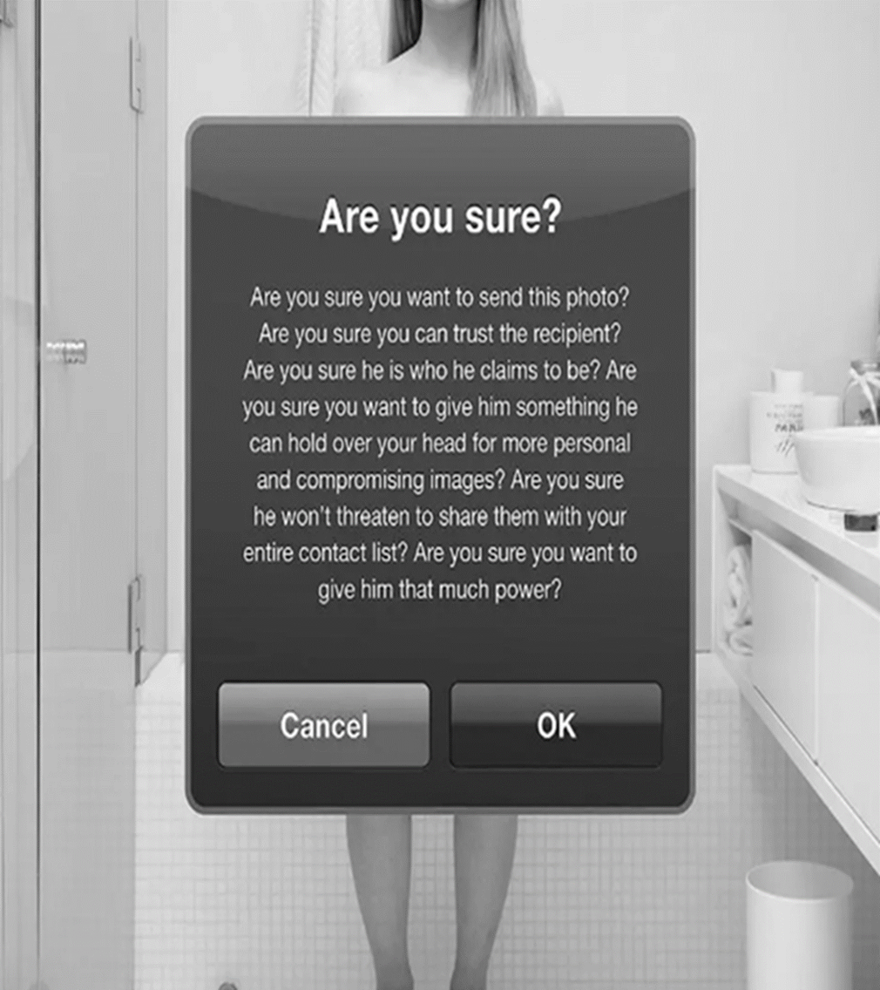

26% of the 14-17 year olds surveyed had sent a nude or sexual selfie to someone they were interested in
Source: Internet Watch Foundation
Notes:
- so onto sharing photos, the one we all dread, I understand we are primary school level here but we do want to get the message to them as young as possible
- read slide – read the message
So this is a particularly difficult subject,

Slide 13
Different scenarios to consider:
https://youtu.be/hZIYSCE-ZjY
https://youtu.be/WsbYHI-rZOE

Slide 14
Spotting Online Grooming - Increased Secrecy - Sudden changes in Behaviour - Isolation - Developing an obsession with an online ‘friend’

Slide 15

Sextortion…..
….is financially motivated sexual extortion which involves the threat of sharing sexual information, images or clips to extort money from people, whether images actually exist or not.

Slide 16
Sextortion (cyber-enabled blackmail)

Slide 17

What should you do if your child is being sextorted?

Slide 18


More information about sextortion can be found on Police Scotland website:
If this has happened, your child has been a victim of a crime and it is not their fault
Do not panic. The police will take your case seriously.
Do not pay. In some cases, even when money is paid the criminals share the videos or images anyway.
Do not talk any further to the criminals. Screenshot any communication and profile details as evidence.
Report the incident. Report the matter to us by calling 101 and your social media platform website.

Slide 19

Protecting your children from online exposure
Phishing
Business Email Compromise
VIDEO
How phone scammers are using AI to imitate voices
Bank Mandate Fraud
Ransomware
Notes:
https://youtu.be/F4WZ_k0vUDM

Slide 20
AI AND DEEP FAKE – Deep learning
The three inevitable’s: 1) AI will happen 2) AI will become smarter than Humans 3) Bad things will happen as a result of AI
Fraudsters are leveraging AI to create audio and video, as well as images that appear real, these are known as deep fakes.
Impersonations of bank employees, government officials AND YOUR CHILDREN!!
Extorsion scams via calls or what's app
How to avoid deep fake scams:
Do not assume a phone call, email, text message or video clip is genuine
Validate a caller's identity.
Avoid clicking on links or opening attachments in emails, texts and social media, particularly if they are not from a trusted source
Sharing too much information via social media
Protect your digital identity and accounts by enabling additional controls such as robust security settings, two-factor authentication and strong and unique login credentials
Create a safe word for you family

Slide 21




What can you do?
Develop a relationship of trust
Show interest in applications and platforms used by children
Talk to them about image sharing
Have open and non-judgemental conversations about online harms
Use parental settings and strong passwords to keep accounts safe
Teach your children about support and help available to them

Slide 22
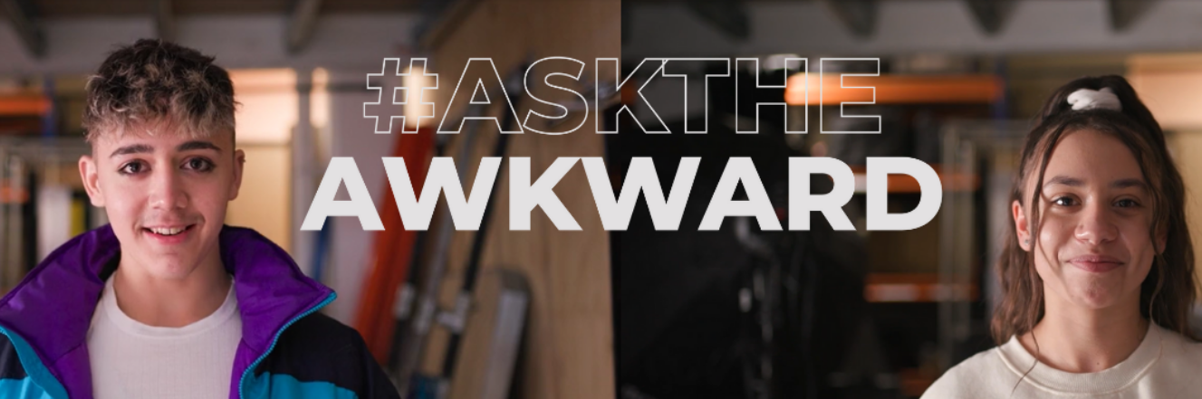
Be informed
Have open conversations
Discuss risks
Explore together
Establish balance and boundaries
Monitor activity
Parental controls
Block and report
Set-up devices and accounts together

Slide 23
Ensure that:
Avoid:
You listen to them carefully
Victim blaming or showing judgement
You let them know they’ve done the right thing by telling you
Taking away device, banning or blocking access to internet
Tell them it’s not you’re fault
Making promises
You explain the next steps and that you will need to report it

Slide 24











Help and support
#AskTheAwkward
Helps you to prepare for conversations with your child about online harms.
Tips and information on how to protect your child from dangers of online world.
Safety settings for your child's devices and apps and guidance to tackle online issues they may face.
Useful information about apps and games your child may be using and what to look out for.
Tool for under 18s in the UK to confidentially report sexual images and videos of themselves and remove them from the internet.
Notes:
Police – Emergency and non-emergency numbers, non-emergency online form
Helplines and services – Phone numbers and online portals run by charities, government and not for profit organisations

