Slide 1
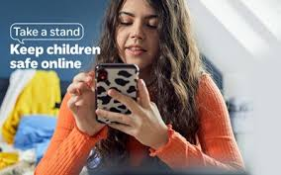
Keeping Your Children Safe Online.
What To Do When Something Goes Wrong.
Dumfries High School Cluster – February 2025
Notes:
Technology is changing all the time and as parents, carers and education staff we are often playing catch up when it comes to it. Sometimes it can be difficult to know what to do for the best and how to speak to our children about their activities on social media and how they use their devices.

Slide 2
Introduction and Housekeeping
Who am I?
Nickie Reynolds – Education Safeguarding Manager
Notes:
At this stage I will go over my role and outline the purpose of the talk for the next 20 minutes or so, encouraging parents to contribute to the conversation around the presentation. At this point I may give some examples of the phone calls that come in to me for advice.
I am Nickie Reynolds – My role is to help advice, guide and support schools around the themes of safeguarding and child protection. I probably do take a lot of calls from primary and secondary schools around issues relating to technology.
I am also a parent and I have survived the teenage years relatively unscathed. One of the things that was new to me was the impact of technology on the life of my daughter and our family – so tonight I can share my professional and personal life with you.

Slide 3

Your takeaway from the next 20 minutes:
An understanding of why children and young people send images
An understanding of what they might be sending and the impact of sending images.
The role of support agencies/trusted adults
School
Police Scotland
Social Work
Parents and Carers
Modelling good behaviour
Notes:
I am going to de-mystify what children are sending and not sending and what we can do to help children when they have sent an image, or an image/request has been sent to them .
One of your takeaways is that schools work in partnership with Police Scotland and Social Work colleagues. Our school staff are amazing, but our children are in their care for 6 hours a day – SW and PS can help to fill the gap when education can’t; they are not be aware what media platforms,!
I am going to touch on modelling good behaviour on our own devices and social media platforms. As we do at home and in the community, we all probably lead by example with our children and the same should be the same for the use of devices and being on social media.
Perhaps encouraging have time free from a device, being aware what media platforms, your children are on – are they age and stage appropriate. Talk to them about what they are doing on line – what is the attraction of certain sites etc.

Slide 4

As a starter for ten…
Sharing photos, videos and live streams online is part of daily life for many people, enabling them to share their experiences, connect with friends and record their lives.
Photos and videos can be shared via messaging apps or posted on social media and image sharing platforms. It is important to note that children and young people send a variety of images and videos, most of which are not nude, semi-nude, and/ or exploitative or intended to be so.
Not all young people send nudes and semi-nudes, but many are asked to send them or receive images and videos of others with or without consent.
While most children and young people are not creating or sharing these types of images and videos, the potential risks and impact can be significant depending on the nature of the image.
It is therefore important that practitioners/parents working with our children and young people know how to respond if they are the recipient or the sender of an inappropriate image.
Notes:
We need to understand what images are being sent when they step over the threshold as being dangerous and harmful.

Slide 5
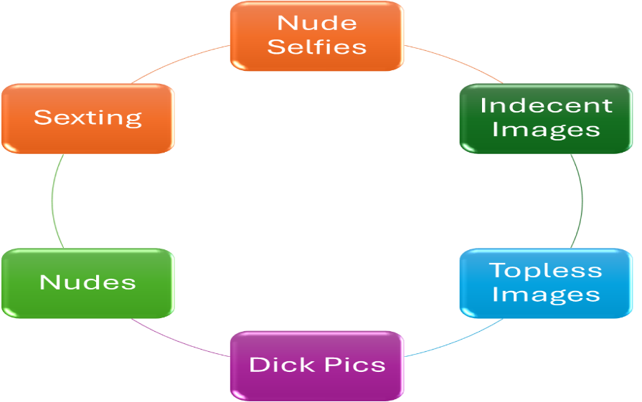
What some children are sending?
Notes:
Excuse the language in some of the terms but this is the range of images that children are sending on or may be receiving.

Slide 6
Why are the doing it?
To increase their self-esteem.
To explore or prove their sexuality.
Feeling like they ‘owe’ their boyfriend or girlfriend and being made to feel guilty if they do not.
Being in a relationship with someone and fully trusting them
They are in a long distance or online relationship and want to have sexual relationship.
As a dare or joke.
It is not seen as a big deal.
It is part of flirting,
Taking risks and pushing boundaries.
Notes:
Some of the examples could be seen as typical behaviour of an older child/teenager – pushing boundaries and taking risks.

Slide 7
What is the impact on children if inappropriate images are sent.
Feel embarrassed or ashamed.
Blame themselves.
Be vulnerable to bullying behaviour.
Be vulnerable to being exploited.
Stay off school and this affects their attainment.
Start to self-harm and may consider taking their own lives.
Have anxiety attacks.
They may become withdrawn and do not seem themselves.
Notes:
As already mentioned from a police colleague you will be aware of the signs and indicators but underneath all of that may be the worries and concerns that children may have if they have sent or shared an image.
These may be some of the behaviours school staff notice with the children they are working with. Our staff notice lots of things that we don’t see or notice at home.

Slide 8
What are the Risks of Children sharing inappropriate images?
Losing control of the image
Blackmail and bullying behaviour
Being involved in sharing the images of others
Experiencing online harassment
Notes:
These are some of the issues we know our children worry about.
Once images are out there it is difficult to control who sees them that is why security settings are so important.
We also know the old saying of fly with the crows and get shot with the crows – children can become involved in sharing images as they are influenced by their peer group but being part of this can have an impact too.
Finally, the online harassment may come from people they know only online – the keyboard warriors that our children may be communicating with online.

Slide 9
When does it become a serious concern?
There may be evidence or a concern that the child is:
Subjected to peer pressure.
Being blackmailed, harassed, or threatened.
Being groomed or coercion.
Involved/communicating with an adult.

Slide 10
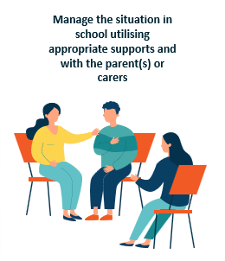
What help is at hand?
School:
All schools have a child protection coordinator.
All secondary aged children will have a named person – pupil support teacher.
They will support your child by:
Gathering all the information they need and assessing the risk.
Notes:
When your child is at concerns, they all have a trusted adult they can talk with. As the CPC and named person know your child and work with other supporting agencies they will be best placed to manage the response to any disclosures. If there are no child protection concerns and the school feels they can respond to the disclosure and support the child withing their own setting using the staff and resources that are available to them. It way well be that children are reminded about online safety, they may move lessons in health and wellbeing to cover topics. The school may work one to-one with your child or do group work if there is a group impacted by the online activities. Schools also rely on other partners so they may suggest to your child and to you that the school police officer may have a role to play or in a secondary school the youth support worker may have a role.

Slide 11
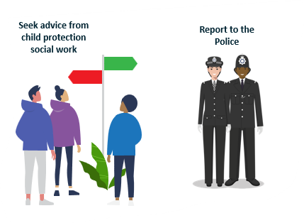
The Role of Police Scotland and Social Work
The incident involves an adult as a perpetrator.
There is reason to believe that the child or young person has been coerced, blackmailed, or groomed, or if there are concerns about their consenting capacities.
What you know about any images which suggests the content shows sexual acts unusual for the child or young person’s stage of development or are violent in nature.
Any images which show sexual acts involving a child or young person under the age of thirteen.
You have reason to believe that the child or young person is at an immediate risk of harm (for example, they are suicidal or self-harming).
The child or young person is at immediate risk contact Police Scotland on 999.
Notes:
When the school makes the assessment, they will communicate with you and let you know they are passing the information on as there is a child protection concern.
When the police become involved, their intention is not to criminalise children.
SW and PS colleagues are there to offer that help and support as well. So if the CPC says a referral is going to be made do not panic as they are there to help not hinder. The school will be still helping and supporting your child through this they and you are not alone.

Slide 12
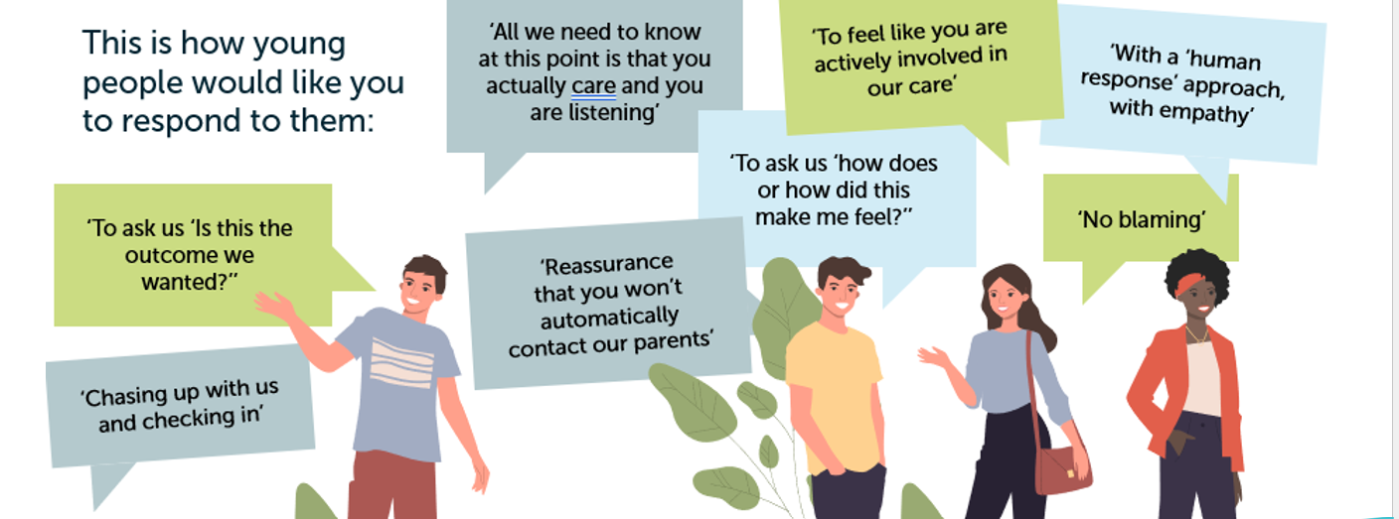
What do our Children Need From Us?
Notes:
Our children have rights and if they are the sender of images or the recipient, they need our help and support and it is helpful if we follow the advice and expectations that children have from us. The comments from our children highlight the GIRFEC approach we are taking in all our schools.
The no blaming aspect is really important and as a parent is good advice for us to follow…

Slide 13
How do I help my child who has received or sent an image?
Try not to shout at them or make them feel like it is their fault. They are worried and need your help and advice.
Reassure them and offering support – remind them they can always talk to you, another trusted adult in or a charity such as Childline.
Asking open questions such as "what happened?" rather than asking "why have you done it?", as the latter may stop them from opening to you.
Talk to them about how to treat others online and what is and is not appropriate online behaviour.
Remind them that people might not always be who they say they are online, so they should be careful about talking to anyone they do not know.
Speak with the Child Protection Coordinator at school if your child agrees. Schools can keep an eye on the situation and help stop images or videos being shared. They can also support any other children who have been affected and can refer your child to agencies who can provide further help and advice.
Explore the social media platforms, apps and games children and young people are using to familiarise with the site and platforms they are on.
Notes:
Some basic advice on how we as parents and carers can help with our children are impacted by online inappropriate behaviour/activities. The school will communicate with you and it is vital that you have an open line of communication with them – the staff are there to help, not to hinder.

Slide 14

Sources of Help

Slide 15
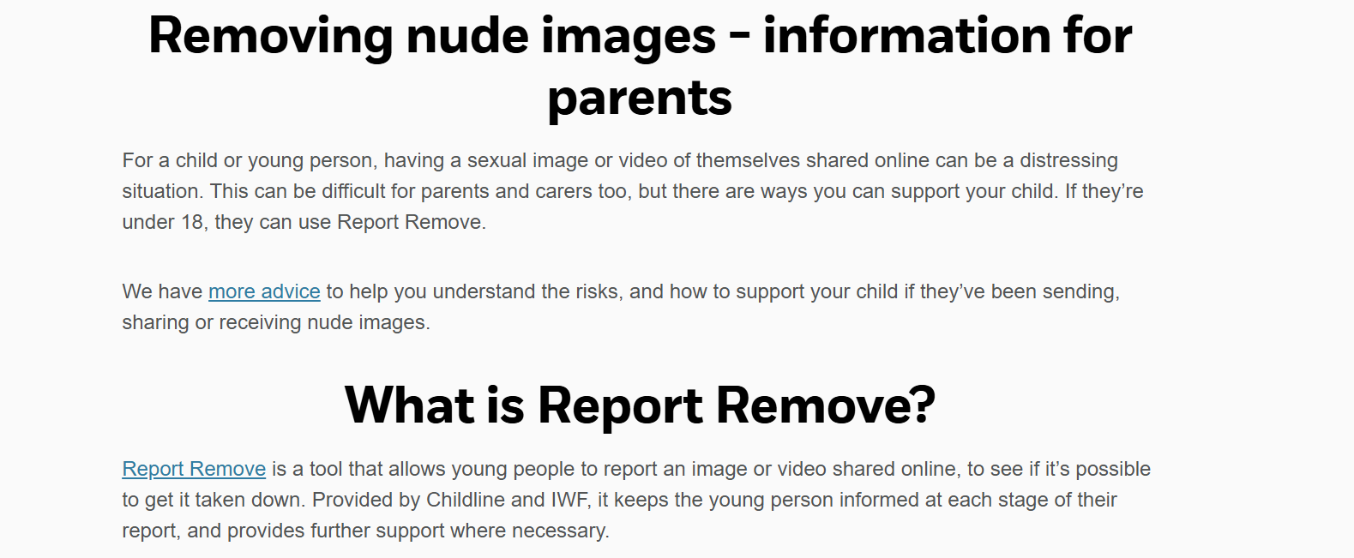
Remove nude images shared online | NSPCC
Notes:
Report and remove is a source of help that is available to you and your child. The service will advice on the possibility of removing the image and it keeps our children informed at every stage of the process.

Slide 16
Scenarios
Kyle
How should this be managed? – School? Social Work? Police Scotland?
Kyle is 13 years old and has been showing pornographic images on his phone in school to his friends. He has shared some of the images via Airdrop. He showed it to some of the girls in his class who were embarrassed; the boys started mocking the girls, calling them names and making sexualised comments towards them.
Notes:
Speak to CP Officer in school to seek advice regarding appropriate next steps, and who should lead on this. This case can probably be managed in a school setting.
What would be a proportionate response for a) Kyle, B) the other pupils in his class C) what would be the teachable moment for the class?
Talk to Kyle find out where he found the images and who introduced him to them.
Explore with Kyle why he is looking at these images.
Explain why this is illegal to download and share especially with his peers.
Recognise that Kyle’s classmates have been subjected to sexual harassment and offer support if required.
Talk to Kyle’s parents about him accessing pornographic material on his phone.
Potentially ask a School Police Officer to talk to the pupils as a whole school approach in relation to the law around sharing images.
Look at staff training around internet safety and digital resilience.
Teach the class using the RSHP curriculum around unhealthy messages gained from pornography.

Slide 17
Mia –
How should this one be managed?
Mia is 13 years old and has a boyfriend called Jack (aged 16) that she met online four months ago. They started chatting on their private stories and then started using videocalls and FaceTime. They speak every day and can spend hours online. Jack encouraged Mia to send him pictures of her undressing and in her underwear. He promised that he would keep them to himself and not share them with anyone else. Jack then asked Mia to send him more explicit photos. Mia really didn’t want to, but Jack said if she didn’t send them, then he would share all the other photos he already had and post them publicly on his story.
Mia’s parents are furious at her, her dad is not talking to her and her mum is struggling with what has happened
School?
Social Work?
Police Scotland?
Parents?
Notes:
Report the concern to CP Officer in school as Jack’s behaviour should be reported to Police Scotland and child protection social work. This situation involves criminality and abuse of power within relationships.
The CP Officer should speak and offer support to Mia as soon as possible about her contact with Jack online, and the requirement to share the information with outside agencies for further investigation.
Take care to avoid victim blaming and to reassure Mia that what Jack is doing is not her fault.
The CP Officer should take advice from police and social work regarding next steps to ensure that any potential investigation is not compromised. .
Teachable moment-
Speak with pupils about relationships online and about accepting ‘random’ adds on social media – discuss how we decide who becomes a friend, and the intensity of online relationships, and age and stages of development,
Speak about the short term and longer term consequences of sending images online, enthusiastic consent, power in relationships and ‘sextortion’
Make sure that young people are aware of Report Remove and of how to report the sharing of intimate images –Report Remove, IWF website, also CEOP and Childline
What other supports does Mia have now? How can she access help moving forward – friends, school counsellors, how can staff make school a more supportive environment for Mia?
Mia’s parents also need to calm down and try to be more supportive and understand why Mia did what she did – she was coerced into this behaviour.

Slide 18
And finally…
https://www.childline.org.uk/info-advice/bullying-abuse-safety/online-mobile-safety/sexting/
https://www.stopitnow.org.uk/scotland/
https://www.theupstreamproject.org.uk/
My child is gaming with strangers – what should I do?
Notes:
The main thing to remember is that the school and the staff are here to help. Communicate with them, work with them and have conversations with your children about the social media sites they are on, check the age limits too – do not be afraid of social media and the activities of your children.

