Slide 1
Golf
By Ethan

Slide 2
The birth place of golf
The first record of golf in Scotland dates back to the 15th century. In 1457 golf was banned by parliament because it was a distraction from military training. The ban was repealed in 1502 and that same year King James IV of Scotland made the first documented purchase of golf clubs. King James IV founded a golf course that Mary Queen of Scots played on in 1567.

Slide 3
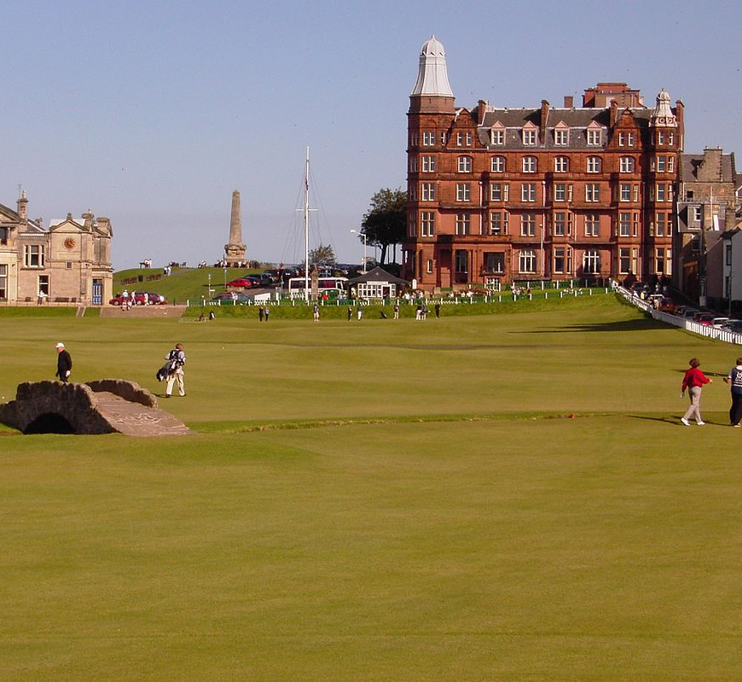
Golf facts and rules
The oldest golf course in the world is The Old Course in St Andrew's in Scotland. 1552 is when people first got to play there.
You need a ball, clubs and a tee.
You can carry up to fourteen golf clubs in your golf bag.
You can only ask advice from your teammate.
The best score is 58 scored by Jim Furyk.
The aim is to get the ball into the hole with as little hits as possible.
This Photo by Unknown author is licensed under CC BY-SA.

Slide 4
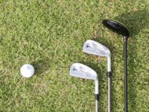
Golf Equipment
To play golf you will need:
Golf Clubs
There are different types of Golf Club
Wood – Long range clubs used at the beginning of every hole when you tee off.
Irons – Used after teeing off. These have really angled club heads.
Putters – These have short shafts and smaller club heads.
You will also need golf balls, tees, golf shoes and a golf bag.

Slide 5
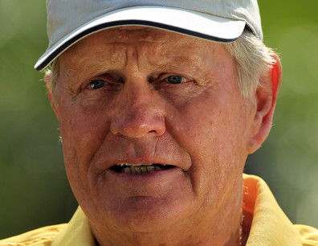
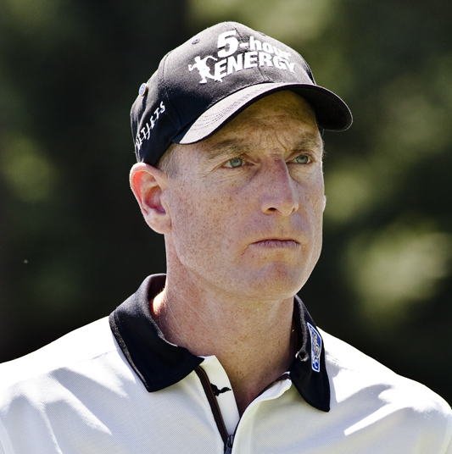
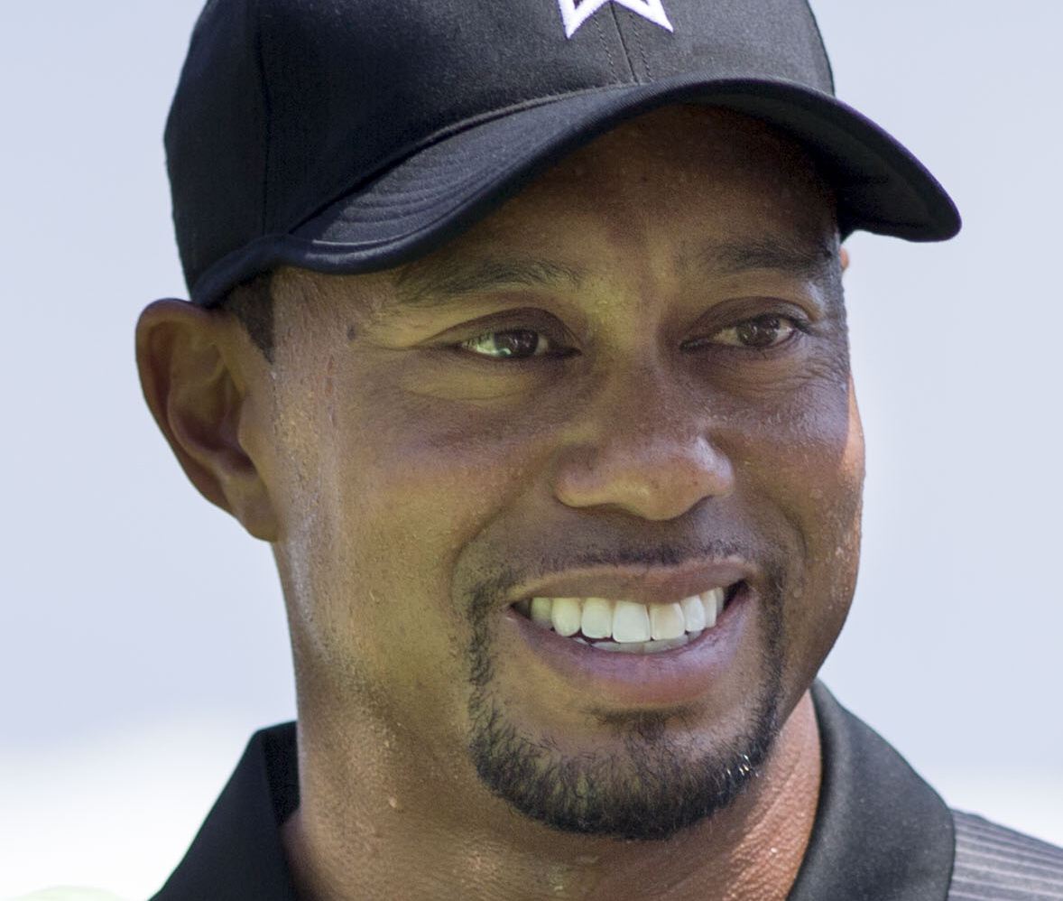
Famous Golfers
Jack Nicklaus
Jim Furyk
Tiger Woods

Slide 6
THE END
Thank you for watching

