Slide 1
St Pius Numeracy Information Early Years
Parent Information

Slide 2
What is Conceptual Number?
An active and engaging approach to Numeracy lessons.
Pupils use concrete materials and learning aids to support and challenge their thinking across all stages.
Develops pupils understanding of what concepts like addition, subtraction, multiplication and division actually mean rather than rote learning.
Encourages to share their mathematical thinking through methods such as discussion and pictorial as well as written.
Encourages children to develop a positive attitude and understand that mistakes are to be learned from and not feared.

Slide 3
5 Principles of counting
Each object to be counted must be touched or ‘included’ exactly once as the numbers are said.
Number names must be said once, and always in the conventional order.
Starting point and order in which the objects are counted doesn’t affect how many there are.
Arrangement of the objects doesn’t affect how many there are.
Last number said tells ‘how many’ in the whole collection – does not describe last object touched.

Slide 4
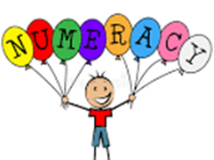
Early Numeracy
Counting
Ordering
Numeracy Vocabulary
Songs and rhymes
Registration, school lunches, tidying up, count up and count down timers
Link with literacy (i.e. Goldilocks and the 3 bears, Hungry Caterpillar)
Sorting and matching activities - how many in each group
Ordering numerals – washing line
Board games
Numicon, Lego, Duplo,

Slide 5
How could you help?
Discuss your child’s learning with them.
Demonstrate real life uses for Numeracy e.g. money, going to the shops, awareness of numbers in the environment, simple counting, skip counting.
Encourage a growth mind-set towards Numeracy - I can't do it YET.
Encourage your children to demonstrate their mathematical thinking in different ways.
Allowing your children time to explore different solutions before offering support.

Slide 6
At this stage...
Find a quiet place at home
Talk about the number of the day
Join the local library
Ask your child to count 1-20. If they don’t know, help remind them.
Establish a daily routine, i.e talk about time
Talk about numbers in the environment
Number Name– try to remind them of these.
Outdoor learning opportunities

Slide 7
Numeracy and Maths in the classroom

Slide 8
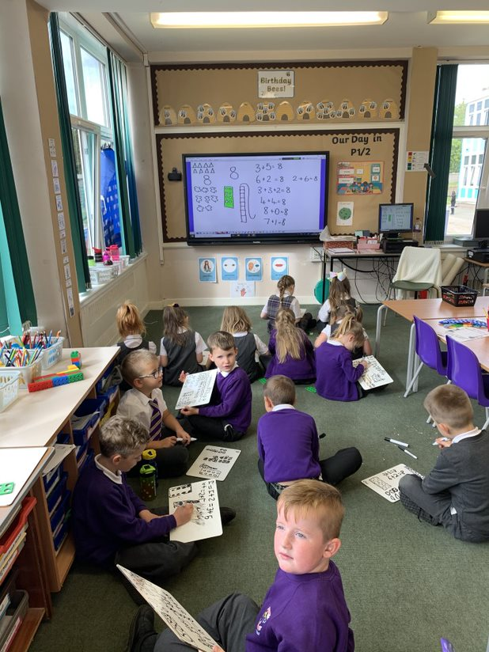
Number Talk
We always begin Numeracy and Maths lessons with Number Talk. This usually lasts between 5-15 minutes.
Number Talk helps children understand the value of a number and it encourages them to share their thinking out loud.
Have a look at Miss Mackay doing a Number Talk on our blog.

Slide 9
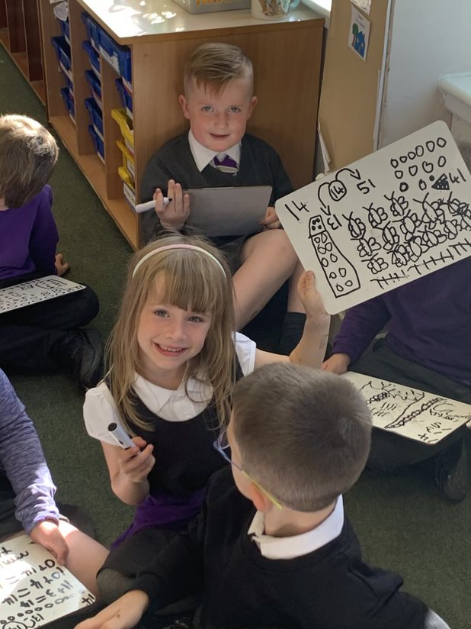
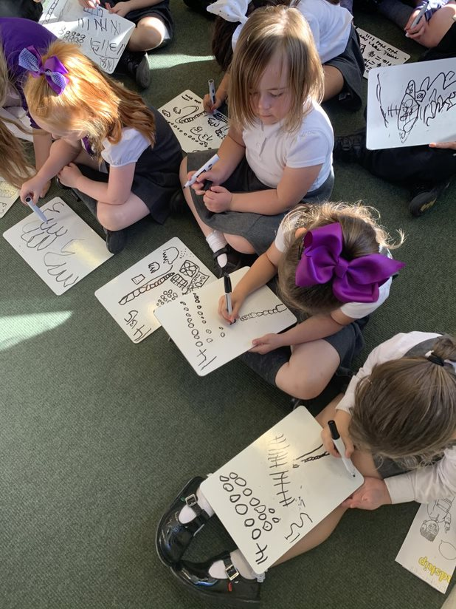
Strategies we use in Number Talk

Slide 10
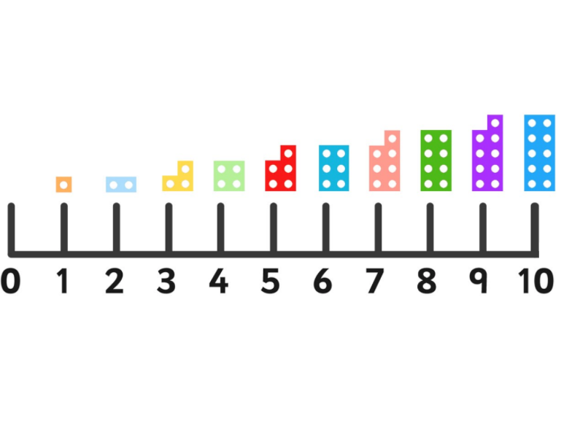
Numicon
Numicon is a resource we use from P1- P7. It helps children see and feel maths. The holes in the Numicon Shapes represent numbers 1-10.
We use Numicon when ordering numbers, identifying numbers before and after and missing numbers. Numicon can also be used for addition and subtraction.

Slide 11
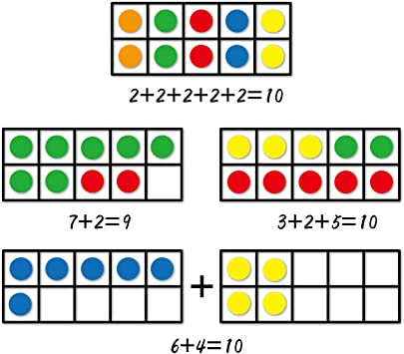
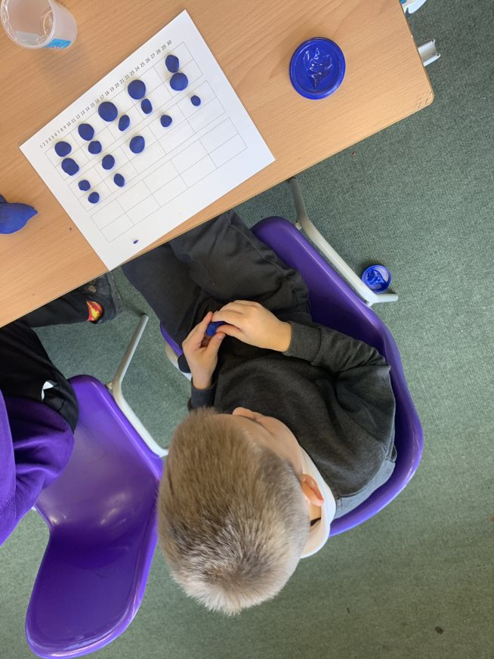
Ten Frames
A Ten Frame can be used to help number recognition, counting and subitising skills.

Slide 12
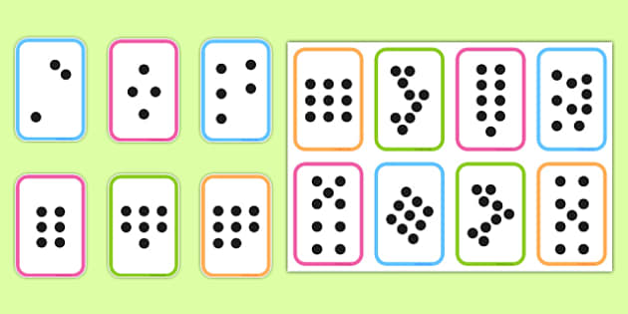
Subitising
Subitising is recognising the number of objects without having to individually count the dots.

Slide 13
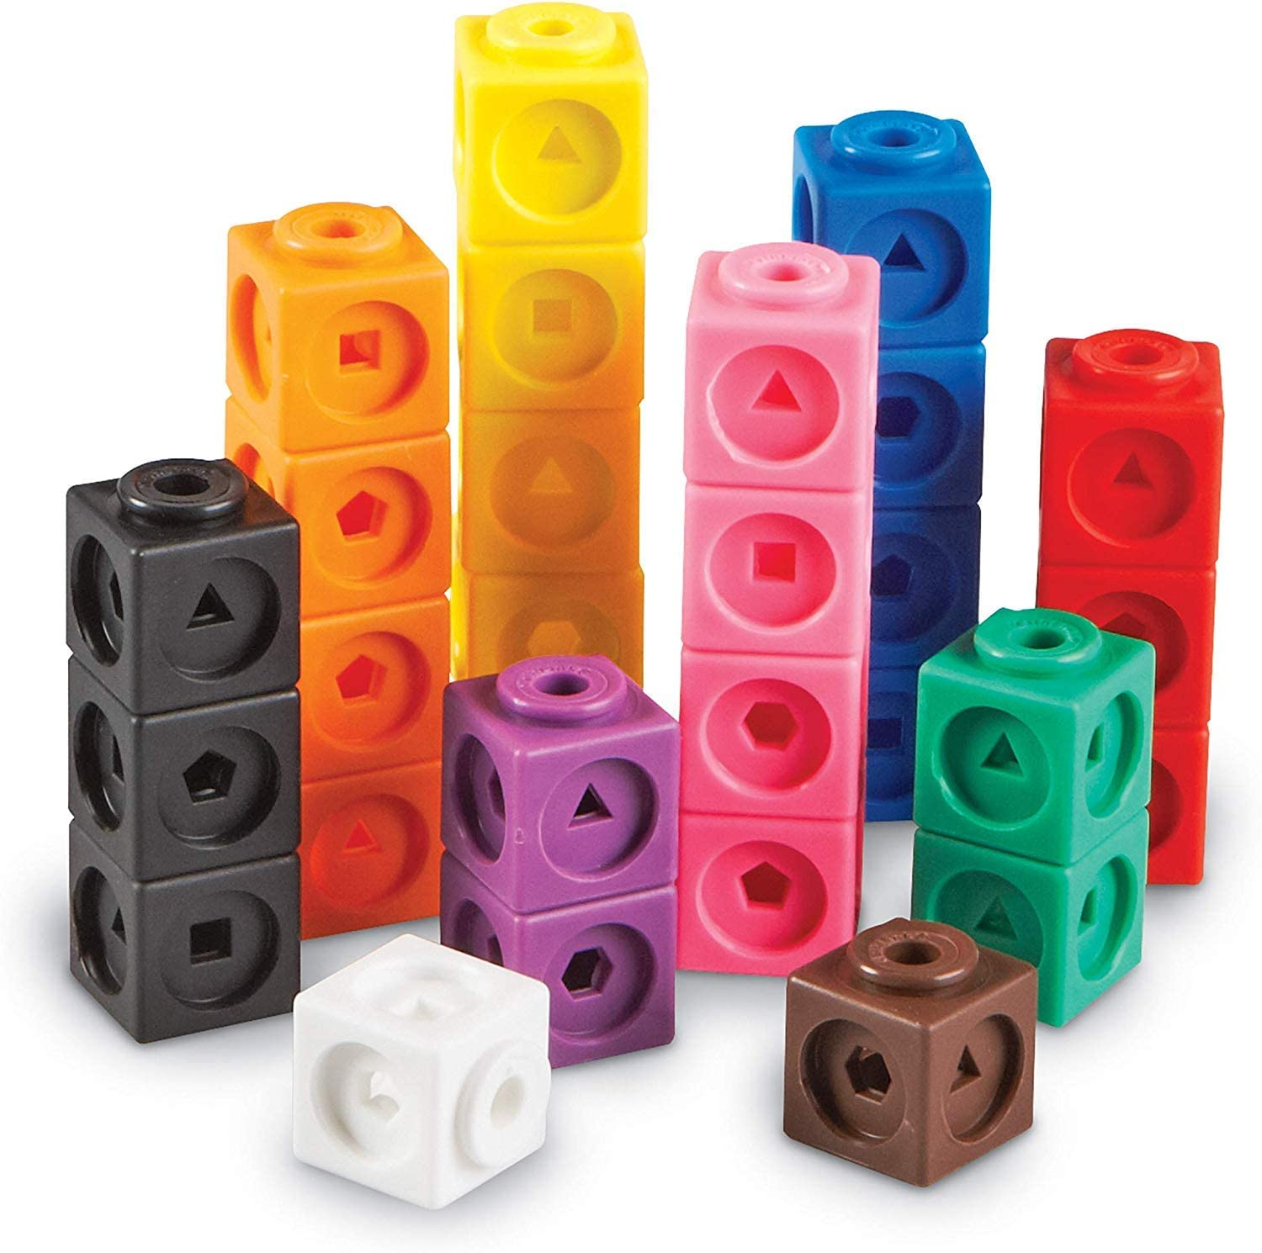
Cubes
We use cubes across Numeracy and Maths. Cubes can be used for counting, addition and subtraction. They can also be used for creating patterns, weighing and measurement.

Slide 14
Dienes
Dienes are wooden or plastic cubes/sticks. They are used when understanding the value of a number and in addition and subtraction.

Slide 15
Numeracy and Maths Outside

Slide 16
Outdoor Numeracy & Maths

Slide 17
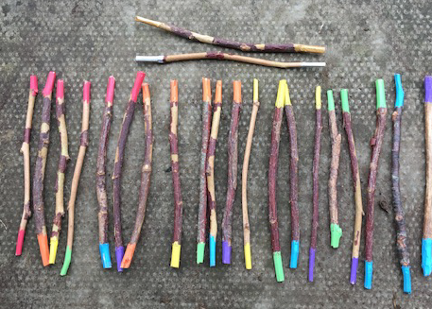
Outdoor Learning resources
Sticks can be used to investigate numbers, shapes and patterns.

Slide 18
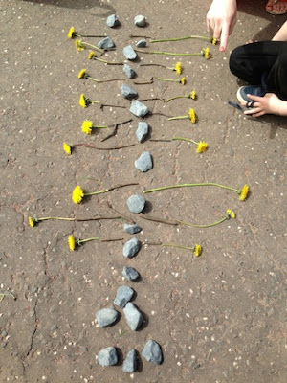
Counting to 20 using natural objects.
Creating patterns using the number 20.
This can be done with any number or any natural resource.

Slide 19
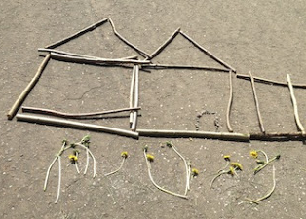
Children have created a house and a garden with 20 sticks and 20 flowers.

Slide 20
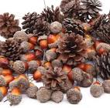
Natural resources can be used for a variety of fun maths activities.
For example, acorns can be used for exploring, developing maths vocabulary, counting, addition and subtraction sums.

Slide 21
Maths vocabulary in Early Years
Number before, number after
Adding
Taking away
Greater than > less than < – the crocodile eats the biggest number.
More than - less than
Bigger than - smaller than

Slide 22
Games
Multiplication Hopscotch
Number Line Run
Different Ways to Count
What's the Time Mr Wolf
The game of Nim
Nature Mandalas

