Slide 1
RERC
Monday 8th March
Learning Intention:
To listen, understand and reflect on The Word of God.
To write a message of love.
Success Criteria:
Can I explain what love means to me?
Can I share my love with someone special?
Can I present my work neatly and make it clear to read?

Slide 2
This week’s Gospel comes from John 3:14-21
As Moses lifted up the bronze snake on a pole in the desert, in the same way the Son of Man must be lifted up, so that everyone who believes in him may have eternal life. For God loved the world so much that he gave his only Son, so that everyone who believes in him may not die but have eternal life. For God did not send his Son into the world to be its judge, but to be its saviour.
Those who believe in the Son are not judged; but those who do not believe have already been judged, because they have not believed in God's only Son. This is how the judgment works: the light has come into the world, but people love the darkness rather than the light, because their deeds are evil. Those who do evil things hate the light and will not come to the light, because they do not want their evil deeds to be shown up. But those who do what is true come to the light in order that the light may show that what they did was in obedience to God.

Slide 3
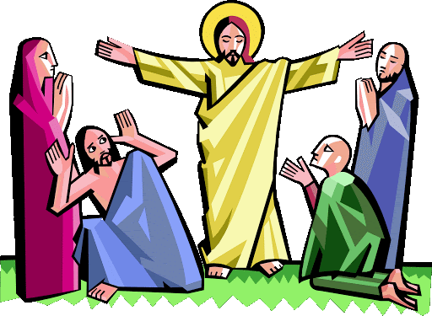
God does not just love you or me or our mothers, God loves everybody. God loves all people whether they are rich or poor, no matter where they live or where they come from, no matter whether they are healthy or ill, fat or thin. We are all part of God’s global family.
God asks us to share this love and to also care for others no matter who they are or where in the world they live. God calls us to care for our global family and to share generously with them all that we have been given. When we do this we are sharing God’s love.

Slide 4
In today’s gospel reading we hear that God loved the world so much that he gave us Jesus to show us how to live and to help bring us closer to God.
How does it make you feel to know that God loves us all so much that he was willing to send his only son, Jesus, to be with us here on earth?
Can you tell me two people who love you? And two people that you love? Is one of them your mum, or another special woman in your family?
What does it mean to love someone? How should we treat someone that we love?

Slide 5
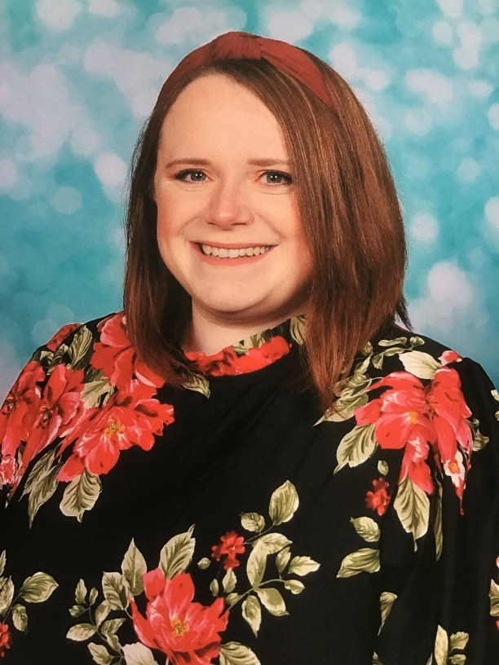
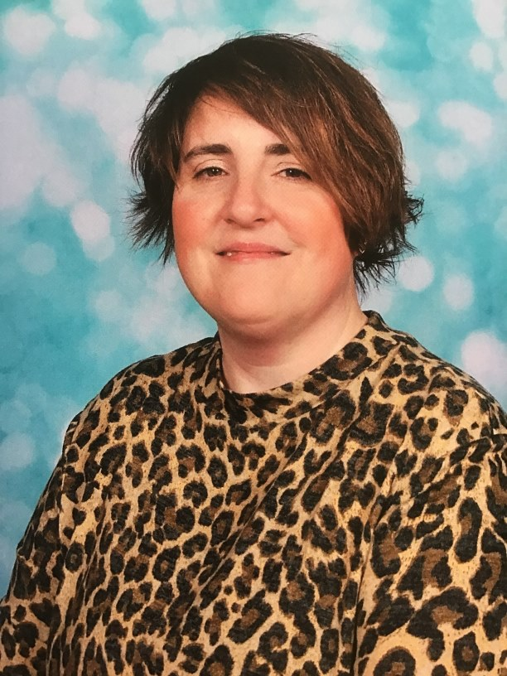
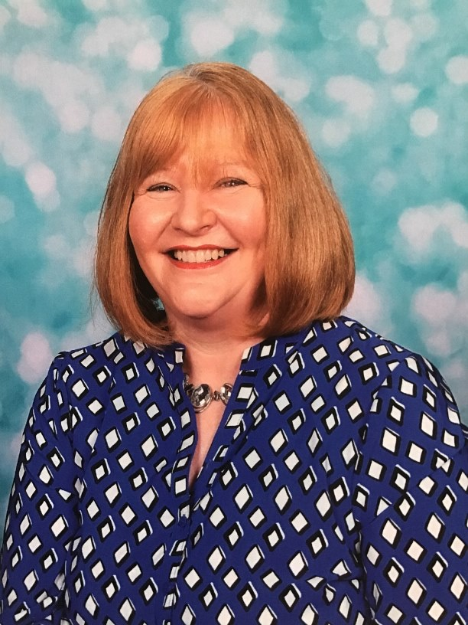
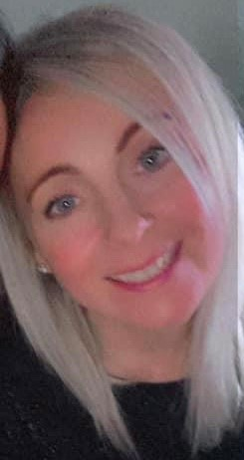
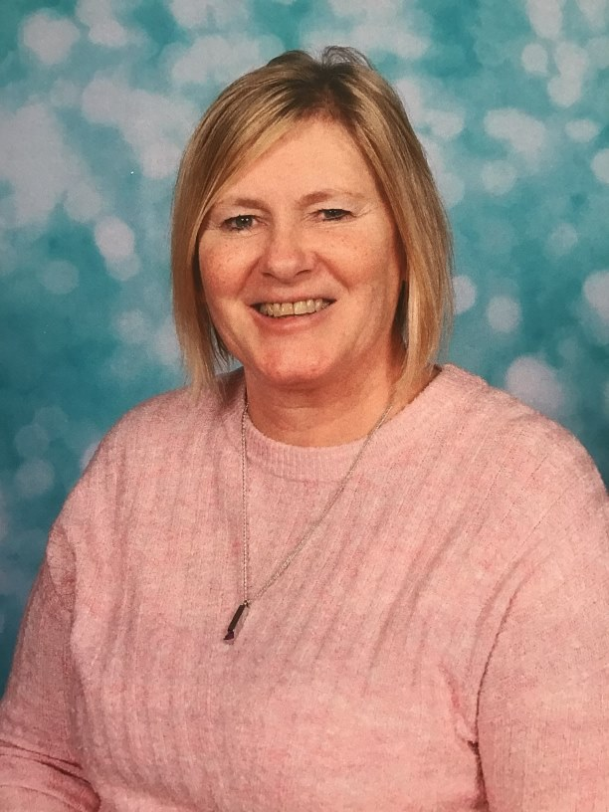
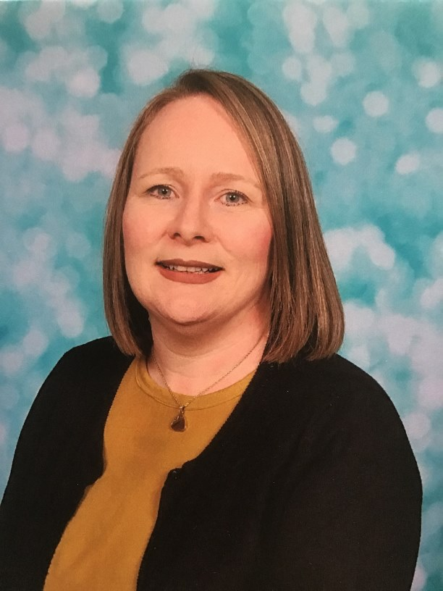
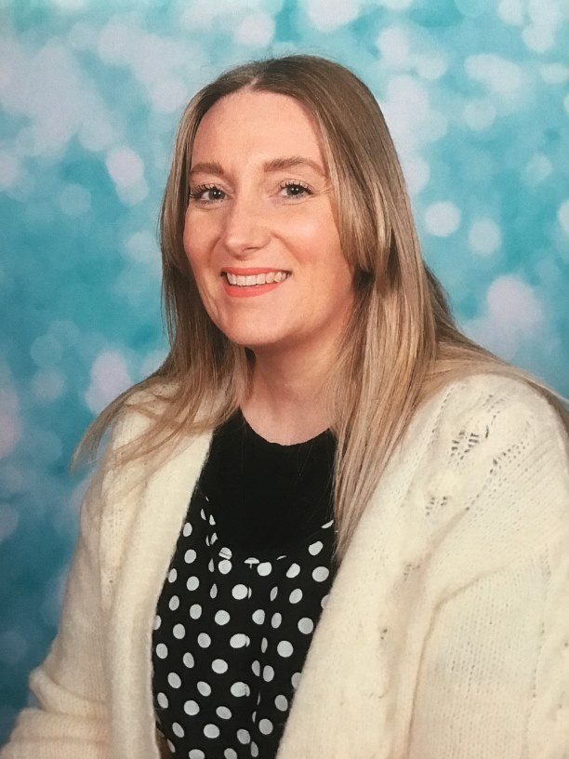
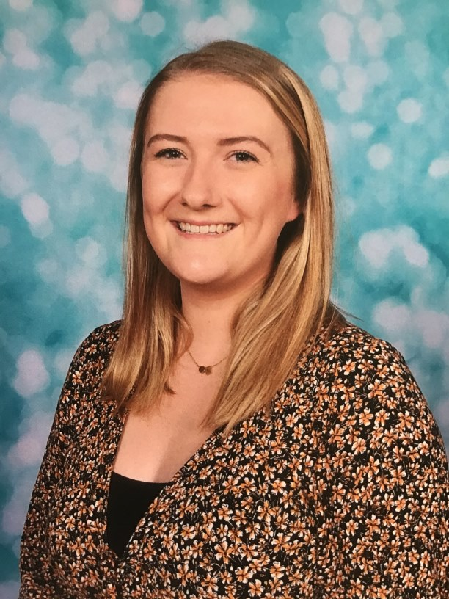
We have lots of fantastic teachers and support staff at St Mary’s Primary School who care about you and all of our St Mary’s family. We can’t wait to all be back together very soon.

Slide 6
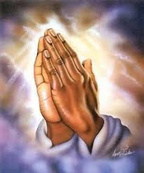
First Prayer
We pray for the Church around the world: that it may be a place of welcome and love for all people no matter who they are or where they come from. Lord, have mercy…
We pray for all people who are finding life hard because of poverty or illness, especially coronavirus: that they may find comfort in the love of those around them. Lord, have mercy…
We pray for our mothers, may we always show them love and be helpful and kind. Lord, have mercy…

Slide 7
Last Prayer
.
Loving God, show us how to reach out to others around the world in love and to support them to build a better future, free from poverty. Amen.

Slide 8
Task: Writing a love note.
Think about someone you love.
As it is Mother’s Day on Sunday 14th, we take this time today to think about the special women in our lives.
How do they show their love? How do you show it back?
How should we treat the people we love?
Love is when you appreciate someone for who they are and enjoy them for it.
To Mum,
Thank you for being the best woman I know. You love and support me through everything and I can’t thank you
enough.
All my love,
R xxx
Your task
Draw a heart shape.
Choose: 1 – Write a prayer to say thank you for the love in your life.
2 – Write “Love is when you…”, and answer the question.
Write a message of love for your mother or someone else very important to you in your life.
Give it to someone and tell them about what you have learned.
Use my example to help you ☺

