Slide 1
Television
Unit Focus: British Inventions
Text Focus: Information Text

Slide 2
Today we are learning to…
identify synonyms
explain and justify using evidence from the text
retrieve simple facts, match figures, answer true and false questions

Slide 3
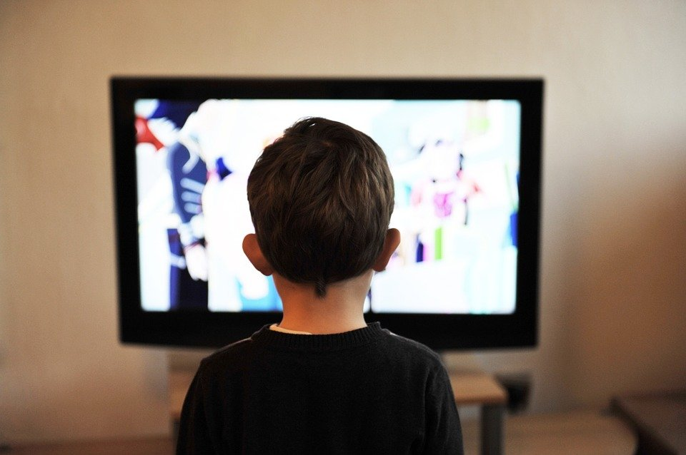
Before reading…
How many of you have a television? How many hours of television do you think you watch a day? A week?

Slide 4
Task 1: Read ‘Television’ in pairs
While you are reading, you may wish to:
Underline and identify any new, unknown words
Underline any interesting facts
Challenge:
What is the most interesting fact you’ve learnt?
Was there anything puzzling or confusing?
Notes:
You may wish to read this first and have the children follow along and then read on their own.

Slide 5
Task 2: Fluency and Expression Read this extract from the text. Think carefully about how to make this extract engaging!
The video was of the head of a ventriloquist’s dummy called “Stooky Bill”. At one point, a man named William accidentally stepped in front of the camera and became the first person ever televised.
Notes:
Discuss pace, volume, expression. Do any words need emphasising?

Slide 6
Task 3: Spelling Check What do you think the prefix ‘tele’ means?
Television is a big part of people’s lives today. With hundreds of channels in the UK alone, it’s hard to remember the technology is less than a hundred years old…
Time yourself one minute. How many words with the prefix ‘tele’ can you write down? For example: telepathic…

Slide 7
Task 4: Vocabulary Check Complete this table to show your understanding of these words
Word | Have you heard the word before? | What do you think it means? | Definition
transferred
interrupted
components
Notes:
Children could use a scale to indicate if they have heard the word before – 1 indicating no, I’ve never heard it before and 5 indicating yes, I know this word well.

Slide 8
Task 5: Vocabulary Synonyms
When he was a boy, he rigged up a telephone wire to his friend’s bedroom…
What does the word rigged up mean in this sentence? Tick one.
 | Tick one
mast
tore down
bedizen
fitted up/out

Slide 9
Task 5: Vocabulary Synonyms
The first moving image was transmitted using Baird’s system on 2nd October 1925…
What does the word transmitted mean in this sentence? Tick one.
 | Tick one
received
changed
communicated
deleted

Slide 10
Task 5: Vocabulary Synonyms
These were more efficient and easier to build…
What does the word efficient mean in this sentence? Tick one.
 | Tick one
expensive/costly
productive/effective
viscous/claggy
steady/slow

Slide 11
Task 6: Multiple choice
Circle the correct answer!
1) Who was Stooky Bill?
ventriloquist’s dummy
first human to be televised
William
Baird’s friend in Scotland
Notes:
You could set a timer and give the children 1 minute to find the answers.

Slide 12
Task 6: Multiple choice
Circle the correct answer!
2) When was the first still image transferred over wires?
1923
1862
1926
1935
Notes:
You could set a timer and give the children 1 minute to find the answers.

Slide 13
Task 6: Multiple choice
Circle the correct answer!
3) Where did Baird move to after being kicked out by his landlord?
First World War
his friend’s bedroom
Scotland
London
Notes:
You could set a timer and give the children 1 minute to find the answers.

Slide 14
Task 6: Multiple choice
Circle the correct answer!
4) Which word in the final paragraph means ‘developing and changing’?
technology
adapting
the norm
nowadays
Notes:
You could set a timer and give the children 1 minute to find the answers.

Slide 15
Task 7: True or false? Using information from the text, tick one box in each row to show whether each statement is true or false.
STATEMENT | TRUE | FALSE
Baird moved to the South of England in 1933.
A man called William was the first person to ever be televised.
Baird did start an engineering degree, but this was soon derailed by the start of war.
The first moving image was transmitted using Baird’s system on 2nd October 1945.
Notes:
Challenge: Can children make up their own true/false statements to test a partner?

Slide 16
Task 8: Inference Using information from the text, tick one box in each row to show whether each statement is a fact or an opinion.
STATEMENT | FACT | OPINION
Baird’s invention was nowhere near as good as Alexander Bell’s invention.
The television was originally called the televisor.
Due to his poor health, Baird was unable to fight in the First World War.
Notes:
Content domain: 2d – make inferences from the text / explain and justify inferences with evidence from the text. Award 1 mark for all three correct.

Slide 17
Task 8: Summarise!
Complete these sentence stems, using information from the text!
Baird moved to the south of England because…
Baird moved to the south of England, but…
Baird moved to the south of England, so…
Notes:
Encourage children to justify and explain.

Slide 18
Task 9: Odd one out!
Which is the odd word out and why?
Baird Bell William Stooky Bill
Use evidence from the text and your own ideas to support your opinion. There are no right or wrong answers!

Slide 19
Task 10: Discussion
What are the positive and negative effects of owning a television? Perhaps you could record your ideas in a table!
Use evidence from the text and your own ideas to support your opinion.

Slide 20
You have reached the end of the lesson!
What do you think one of the main themes in this text is? Why?
Use evidence from the text to support your ideas.
Notes:
Encourage children to justify and explain.

