Slide 1
While we wait for other players to join you need to find:
A toilet roll
A dry unused tea bag and mug
A step/ stairs

Slide 2
Learning Intention
I can perform different challenges
to improve my skills.
Success Criteria
Can I set myself a target?
Can I follow the rules of the game?
Can I beat The Cube?
Rules of the game
There are 7 games. If you win each one, you can win more money.
You have 9 lives. If you unsuccessfully complete a challenge, you lose a life.
You can preview the game and then decide to play or not. If you play, you risk losing your lives and winning nothing. If you choose to not play, you go home with whatever you have won.
You can only use a simplify twice. But you also have one swap.
The seventh and final game is worth a jackpot of £1,000,000; contestants who complete this game are said to have "beaten the Cube". It is the most difficult challenge of them all.

Slide 3
Let’s build play
The Million Pound CUBE!

Slide 4
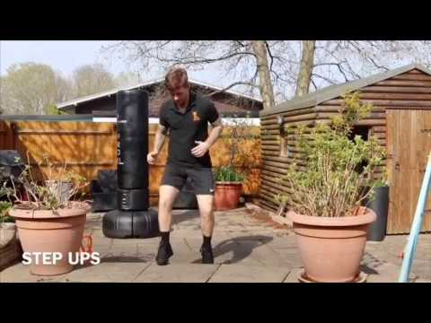
Speed Step Ups
To win £2,000
Speed Challenge
Instructions:
You will need a set of stairs/ step or something sturdy to step up and down on
You have to complete 30 step ups in 30 seconds
Each time your feet touch the stairs it counts as 1. (Both feet must go on the step and back down for it to count)
Simplify:
You must complete 20 step ups in 30 seconds

Slide 5
£2,000

Slide 6
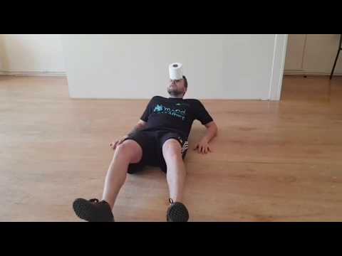
Toilet roll balance
To win £5,000
Balance Challenge
Instructions:
Stand up and balance a toilet roll on your forehead
Then proceed to sit down and lay flat on your back, still balancing the toilet roll
Finally stand all the way back up without dropping the toilet roll
Simplify:
· Sit down and stand back up whilst balancing the toilet roll instead of lying flat on your back

Slide 7
£5,000

Slide 8
Figure of 8 between legs
To win £10,000
Coordination Challenge
Instructions:
You will need a Toilet roll for this
You must perform 30 figures of 8 in 30 seconds
Simplifier
Complete 20 figures of 8 in 30 seconds

Slide 9
£10,000

Slide 10
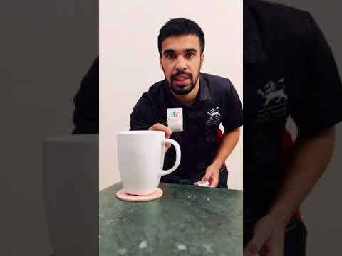
Tea Bag throw
To win £25,000
Coordination Challenge 2
Instructions:
Position a Tea cup on your side, then collect a tea bag
Walk three big steps – this is now your throwing line
Throw your tea bag in to the cup
Simplifier:
You can change your tea cup with a bowl/ box/ larger target

Slide 11
£25,000

Slide 12
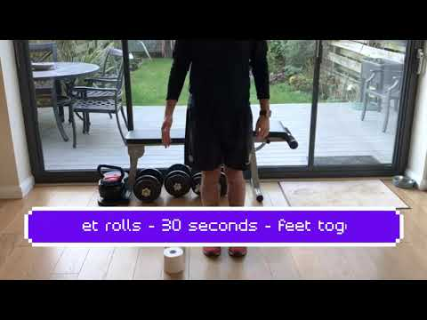
Speed bounce
To win £100,000
Power Challenge
Using a toilet roll you must:
Place the toilet roll on the floor standing upright
Stand on one side of the toilet roll with feet together and jump over the toilet roll to the other side
Land with feet together

Slide 13
£100,000

Slide 14
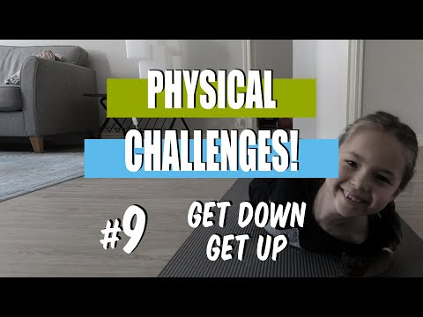
No hands flexibility task
To win £250,000
Flexibility Challenge
Go down to the floor without using your arms
Roll along the floor and get back up without using your arms.

Slide 15
£250,000

Slide 16
Challenge: Muscular Endurance
To win £1,000,000
Muscular Endurance
**VERY HARD**
Instructions:
When you hear “Bring sally Up” push up, when you hear “Bring Sally down” lower your press up
Simplifier:
Perform Squats instead of Press ups
https://www.youtube.com/watch?v=41N6bKO-NVI&t=12s

Slide 17
=
£1,000,000
Congratulations! You defeated The CUBE and won...

