Slide 1
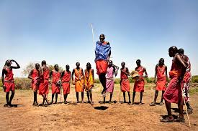
Maasai warrior dancing
Miss Petrie

Slide 2
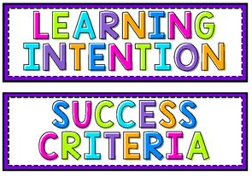
Learning Intention
I can compare traditions from a part of Africa with my own in Scotland.
Success Criteria
Can I do Maasai warrior dancing?
Can I explain why the warriors dance this way?
Can I complete my work to the best of my ability?

Slide 3
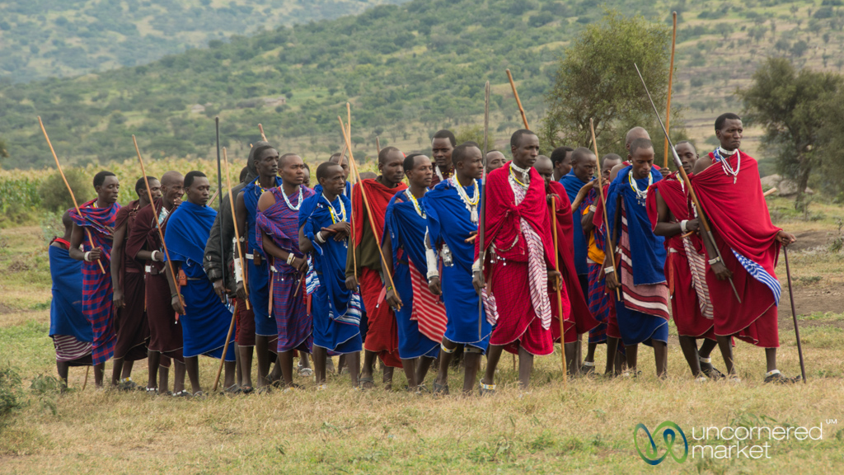
For the Maasai, important rites of passage in life are marked by ceremonies filled with song and dance.
Boys are divided into age groups and throughout their life are identified with and by those stages.
As they move from one stage, there’s a rhythm and movement to welcome them into the next step of their lives.

Slide 4
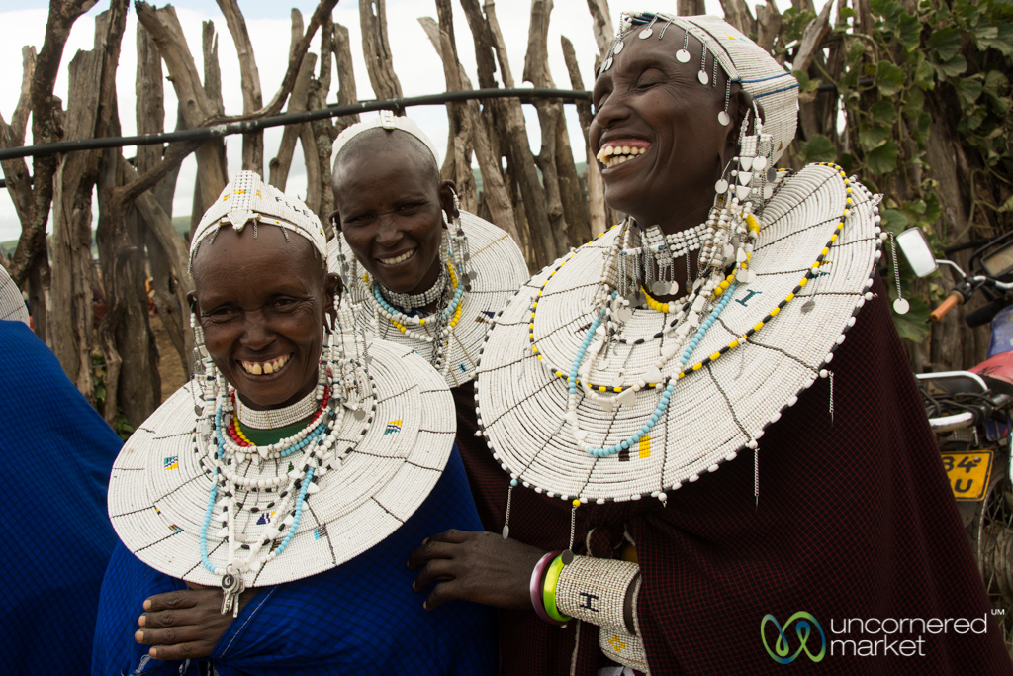
Song-and-dance-filled Maasai celebrations last for days on end, and offer an opportunity to bring people together and assemble members of the different clans from around the region.

Slide 5
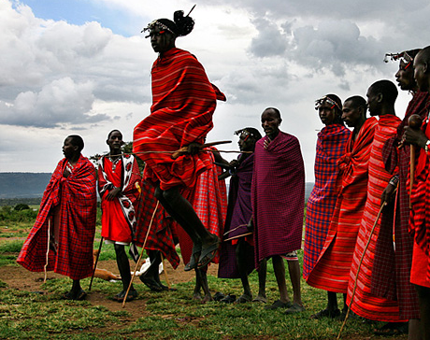
Many travellers to Tanzania and Kenya visit a Maasai village and have the opportunity to take part in the adamu, the dance affectionately referred to as the “jumping dance.”
It’s an impressive dance, not only for its energy but also for its deceptively simple appearance.
Watch the Maasai do it; they make it look so easy. When it’s your turn, you realize it’s much harder than it looks. Everyone has a good laugh, including the Maasai.

Slide 6
Watch this and try and have a go at doing it yourself!
Send me a video of you doing it to my email address:
ddrpetrie598@glow.sch.uk

Slide 7
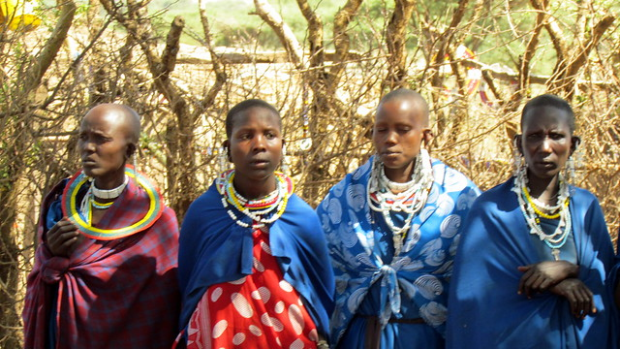
The adamu appears rudimentary in its movement, but carries deeper meaning and reason. It's a way for a young Maasai man who has just become a warrior to demonstrate his strength and attract a bride.
Traditionally, the adamu takes place during the Eunoto ceremony that marks the transition of morani (junior warriors) becoming senior warriors — after the morani live up to 10 years together in an emanyatta (warrior’s camp) away from their home villages. During this time, they learn how to take care of their animals, protect their family, and carry the obligations of a Maasai warrior.

Slide 8
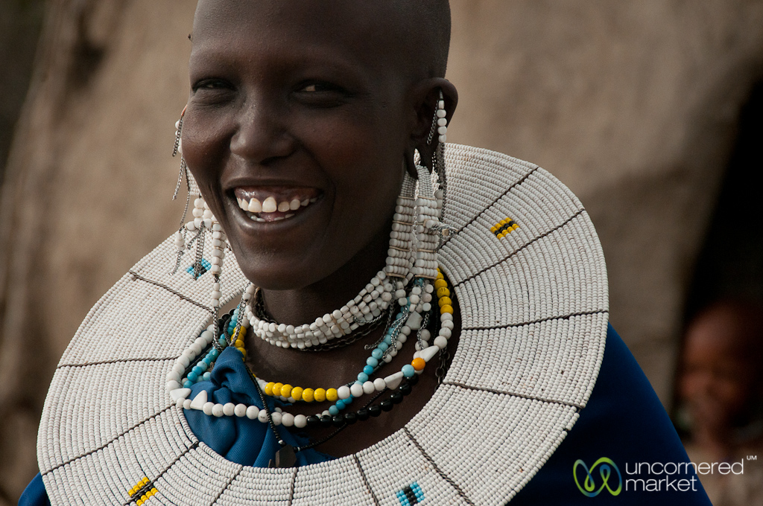
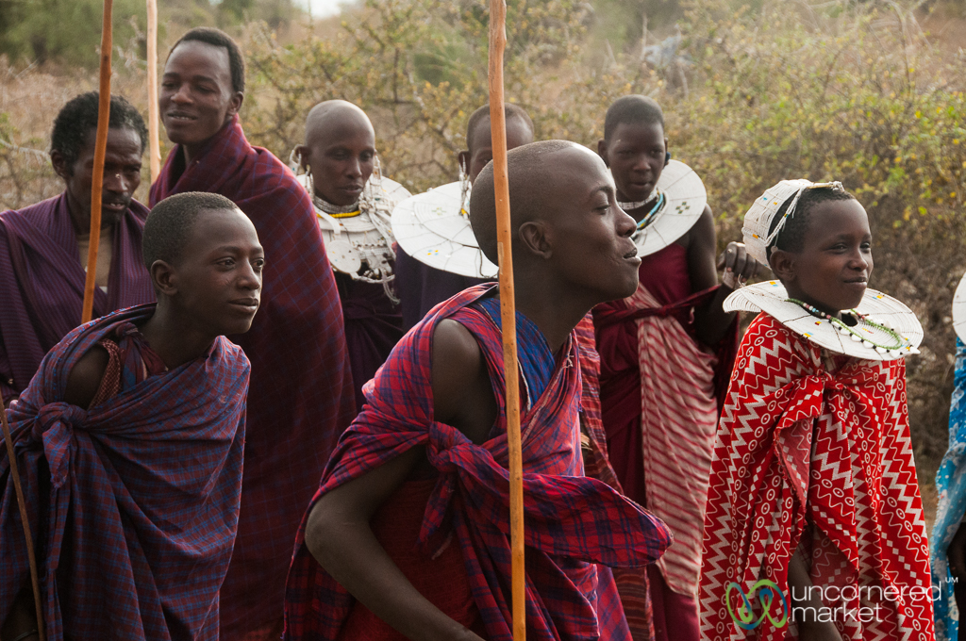
The Eunoto not only marks a change in a warrior’s status, but also makes him eligible for marriage. The circle that the young warriors gather in for adamu, allows each warrior to demonstrate his strength and skills to attract a bride. They have continually practiced these moves since they were young, in a sort of life-arcing preparation for this moment.
The more graceful and higher the jump, the more appealing the warrior is to the eligible women watching.
All the while, the warriors forming the circle sing, matching the pitch and volume of their voices to the height of their leaps. The crescendo of peer pressure encourages the men to go even higher. The mothers of the warriors sing, too — to celebrate the bravery and strength of their sons.

Slide 9
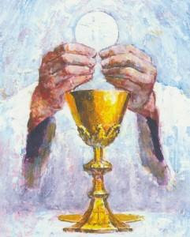
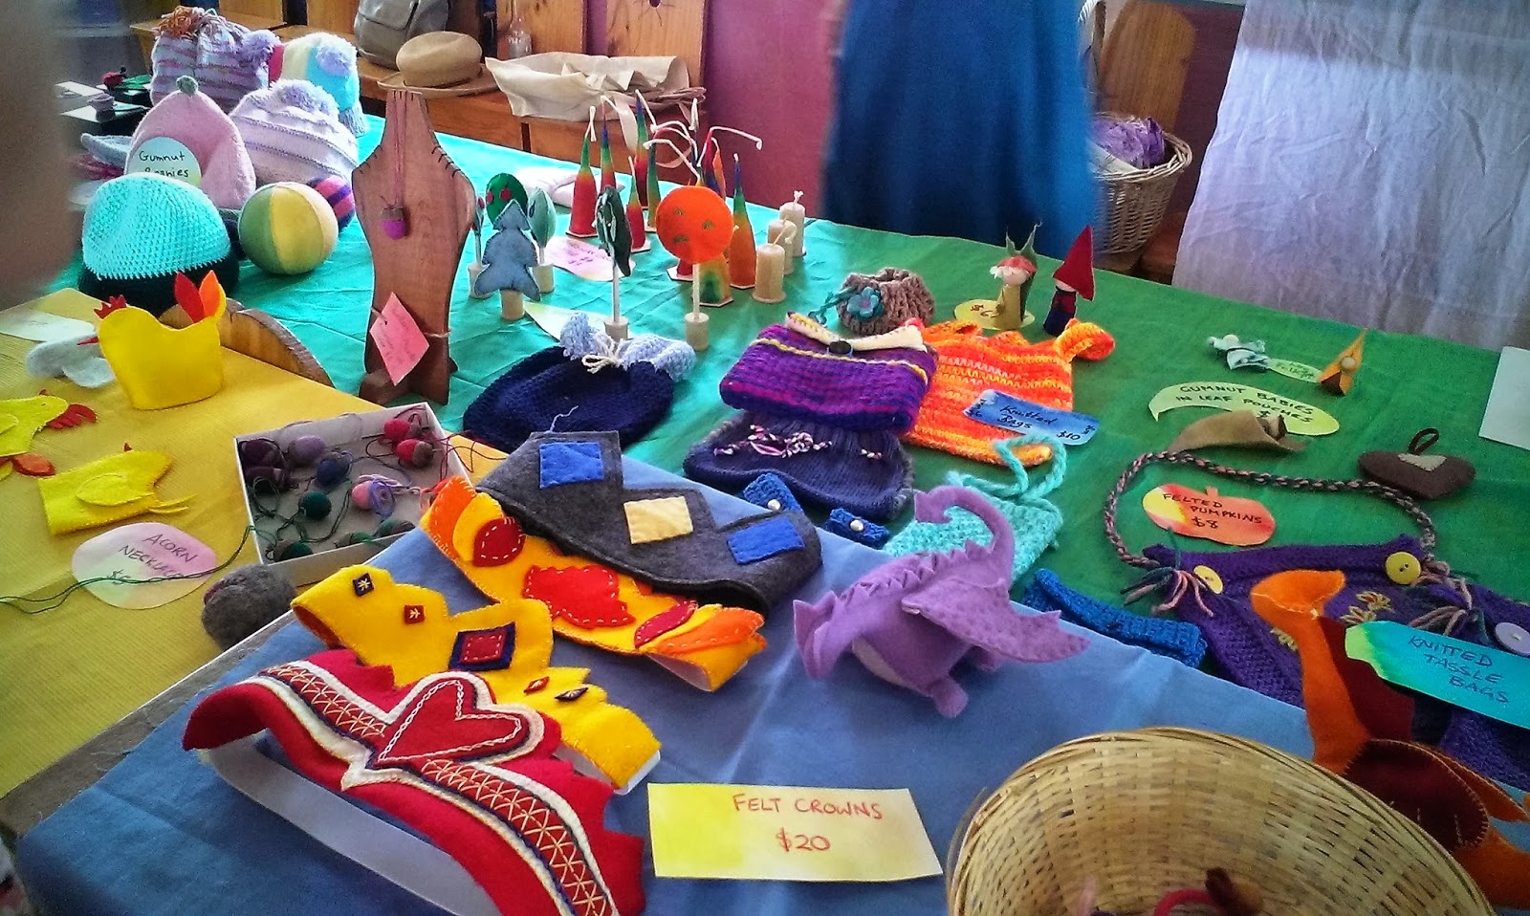
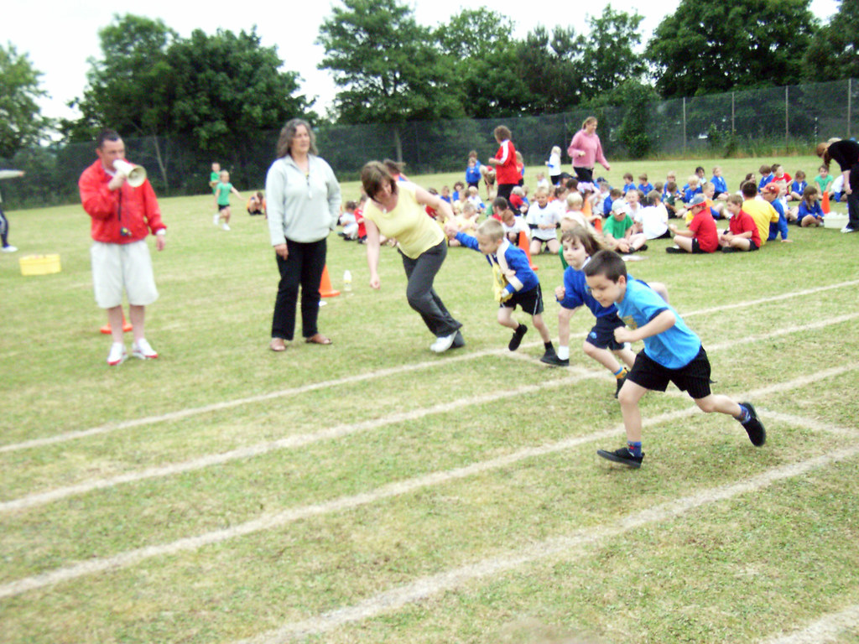
This is a tradition of the Maasai culture.
What traditions do we do in our school?

Slide 10
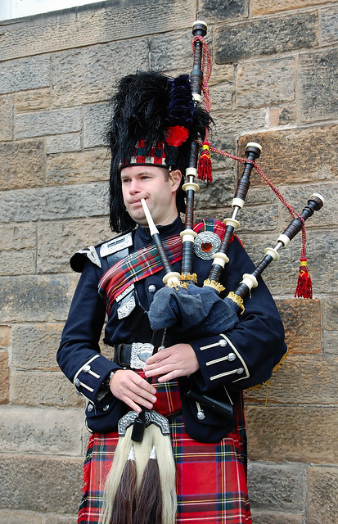
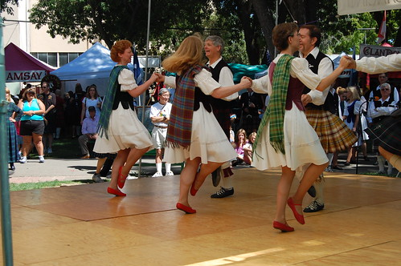
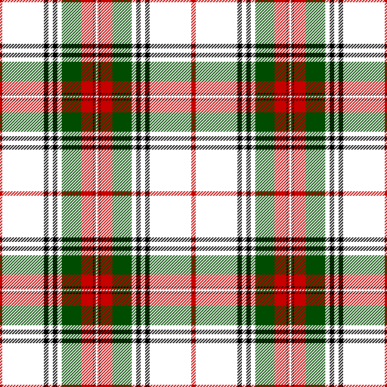
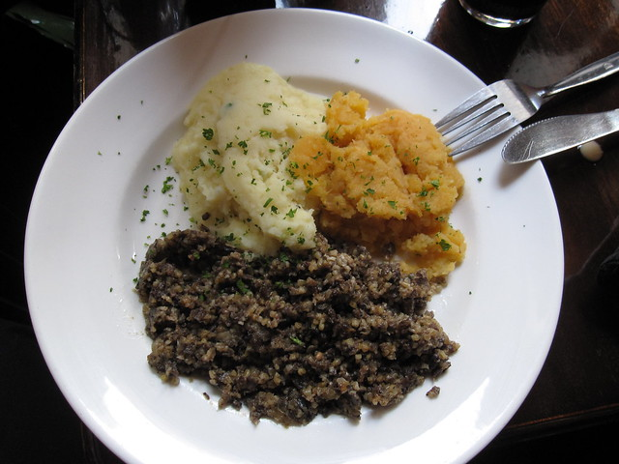
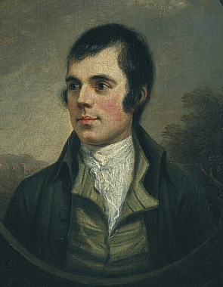
What traditions do we have in Scotland?

Slide 11
Task
If you were to think of a tradition that you participate in, how would you explain it to someone from Africa?
I want you to tell me about an example of a tradition that we have in Scotland, preferably one that you have participated in. Can you compare it with the tradition of the Maasai warrior dancing and jumping?
You can:
Take pictures
Video yourself talking about it
Make a fact file
Draw a poster
Write a leaflet… or if you can think of something more creative, go for it!
I look forward to seeing your work. ☺

