Slide 1
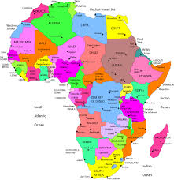
Capital Cities in Africa

Slide 2
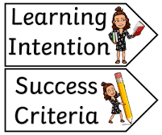
Learning Intention
I can name some capital cities in Africa.
Success Criteria
Can I match capital cities to their country?
Can I complete research?
Can I draw pictures of my findings?

Slide 4
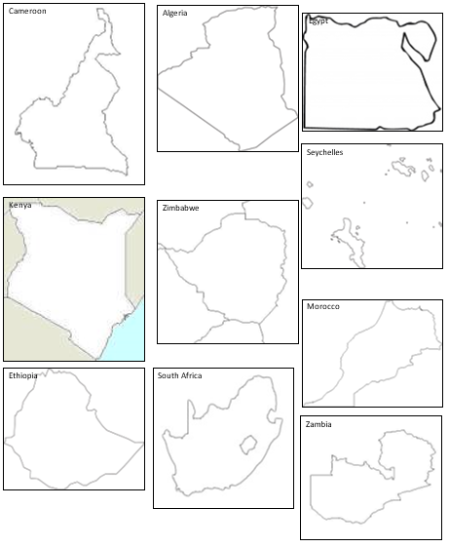
Task 2
Match the picture of the capital city to the picture on the map.
You might need to use Google to help you. ☺
A
B
1
2
C
3
4
F
E
I
D
5
6
7
10
8
9
J
G
H

Slide 5
Task 3
Research 4 other capital cities mentioned in the video (and not in the last slide).
Find a landmark or something interesting from that city.
Draw a picture of that landmark or interesting thing and list the name of the city and country it is from.

