Slide 1
Wednesday 3rd March 2021
Spanish
Favourite school subjects
Learning Intention
I can improve my Spanish fluency by learning new words and phrases.
Success Criteria
Can you pronounce the words?
Can you match the words to the English?
Can you learn the words to a song?
Can you use them in a sentence?

Slide 2
Please watch this and try to learn the words.

Slide 3
Revision
Me gusta _____
No me gusta _____
May goo sta ___
No may goo sta ___
I like ____
I don’t like ____

Slide 4
Let’s learn revise the words from the video and learn some new ones.
dime
dee may
tell me
¿Cual es tu materia favorita?
Kwhal ess too ma ter ee a fa vor eeta
Which is your favourite subject?

Slide 5
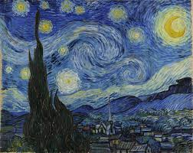
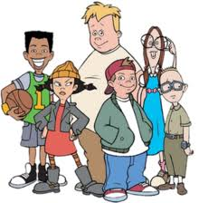
el arte
el ar tay
art
el recreo
el reh cray oh
playtime

Slide 6
el escrito
el ess cree toe
writing
el español
el es pan yol
Spanish

Slide 7
la lectura
la lec toor a
reading
la ciencia
la see en see a
science

Slide 8
la ortografía
la or toe graph eea
spelling
la educación física
la eh doo cath eeon fee see ca
PE/gym

Slide 9
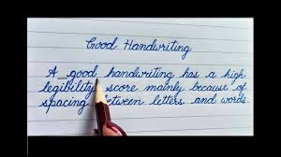
la informática
la en for Mati ca
ICT
la caligrafía
la cah lee graph eea
handwriting

Slide 10
los estudios sociales
los ess too deeos so thee ah les
social studies
las matemáticas
las Mati mateek as
maths

Slide 11
Activity 1
QUIZ TIME!
You will see 6 subjects in Spanish. Write down the English and Draw a picture to match each word. You will see the answers after all 6 phrases.

Slide 12
los estudios sociales
2. la ciencia
3. el arte
4. las matemáticas
5. el español
6. la caligrafía

Slide 13
Social studies -
2. Science -
Answers
3. Art -
4. Maths -
5. Spanish -
6. Handwriting -

Slide 14
Activity 2 : Can you work out what vowels are missing and put them back?
(use the box below to help you.)
l_ l_ct_r_ 2) _l r_cr__
3) _l _scr_t_ 4) l_ _nf_rm_t_c_
5) l_ _rt_gr_f__ 6) l_ _d_c_c__n f_s_c_
la informática
la lectura
la ortografía
el escrito
la educación física
el recreo
Then, write a sentence telling me one subject you like and dislike.

Slide 15
Activity 3
One more time through the song.

