Slide 1
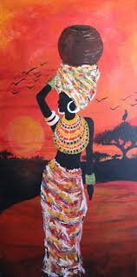
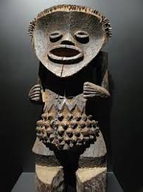
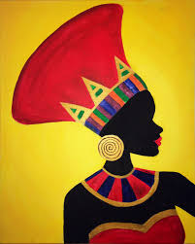
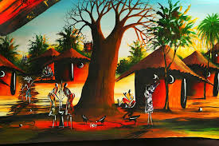
Africa – Art Makonde Tree of Life

Slide 2
Learning Intention
I can recreate a Makonde Tree of Life.
Success Criteria
Can I recall a fact about the Makonde art?
Can I create my own version of Makonde art?
Can I use sketching to make my creation?

Slide 3
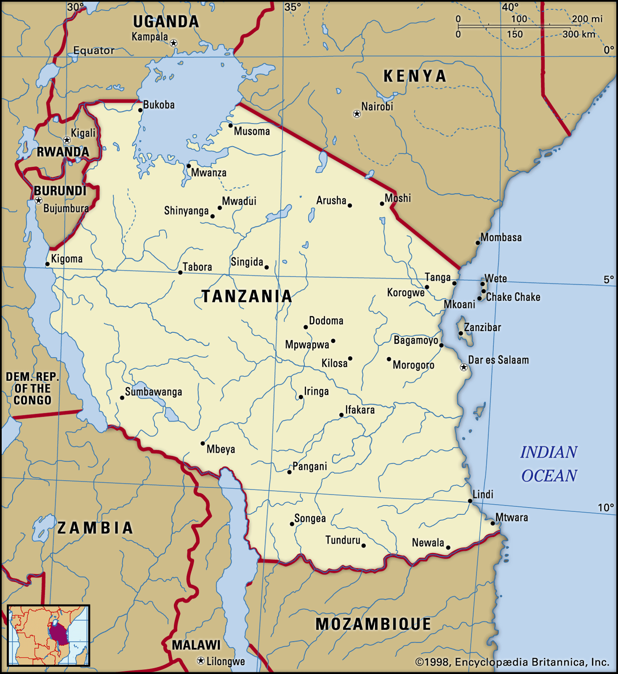
Makonde art is a native art form of the Makonde people, an ethnic tribe residing in southeast Tanzania and northern Mozambique.

Slide 4
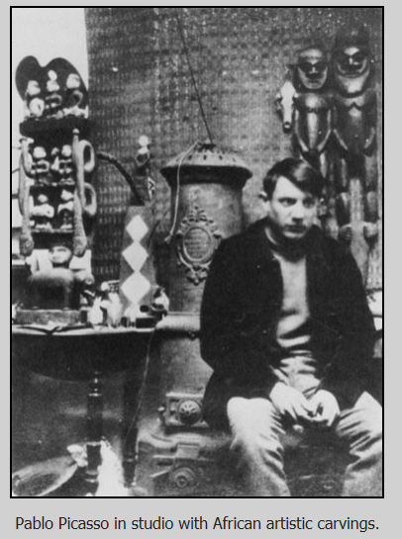
While their ancient tradition of creating intricate carvings is believed to predate the 1700s, some of the methods and materials they used changed after the 1930s, when Makonde art became an important part of contemporary African art.

Slide 5
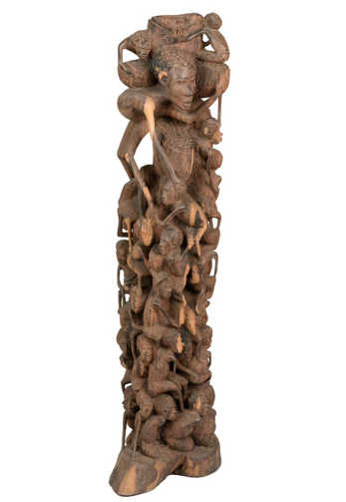
One of the most famous types of Makonde sculptures is the 'Tree of Life' sculpture.
Its origin dates back to the 1950’s.
The early sculptures done in this style typically showed a winner of a wrestling match, carried shoulder high by a cluster of figures.

Slide 6
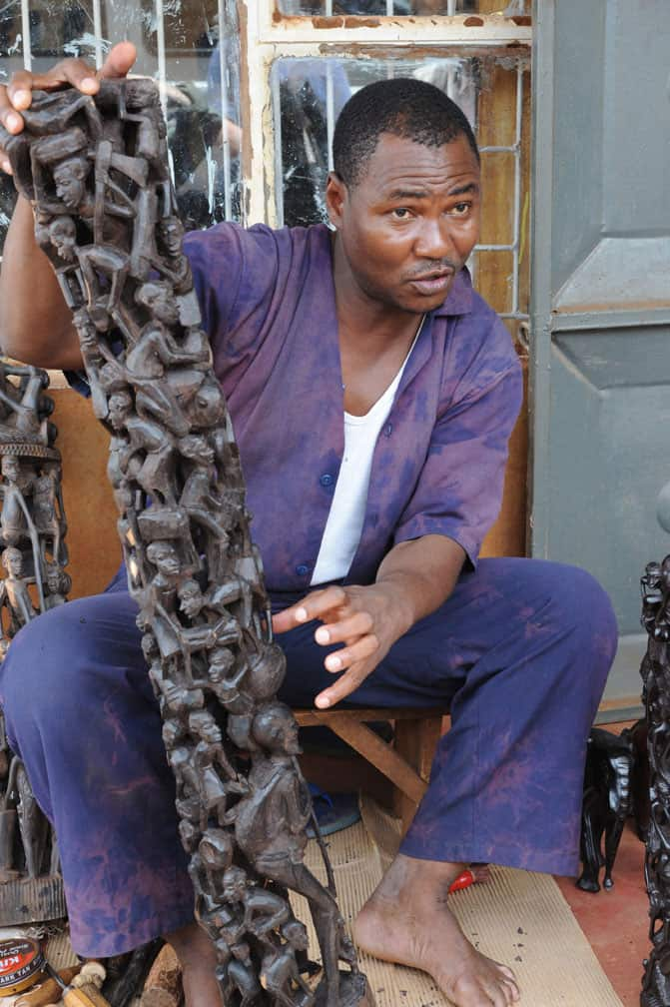
Today, the Tree of Life sculptures usually depict several interlocking human figures, as a symbol of unity and continuity. In some versions, a lady will be seen at the very top of the cluster of figures.
The Tree of Life sculptures are also known as Dimoongo or Ujamaa sculptures.
These sculptures from Tanzania make for a worthy collectible.

Slide 7
Watch this video to learn about sketching.

Slide 8
Task
I would like you to sketch your own version of the Tree of Life.
Think:
Are you going to make it more of a original or a more modern version?
Are you going to plan your placement of figures?
Are you going to take care and sketch your design?

