Slide 1
RERC
Monday 1st March
Learning Intention:
To listen, understand and reflect on The Word of God.
To distinguish between fair and unfair.
Success Criteria:
Can I draw a table?
Can I organise my ideas clearly?
Can I make better choices to make the world fairer?

Slide 2
This week’s Gospel comes from John 2:13-25
It was almost time for the Passover Festival, so Jesus went to Jerusalem. There in the Temple he found people selling cattle, sheep, and pigeons, and also the moneychangers sitting at their tables. So, he made a whip from cords and drove all the animals out of the Temple, both the sheep and the cattle; he overturned the tables of the moneychangers and scattered their coins; and he ordered those who sold the pigeons, “Take them out of here! Stop making my Father's house a marketplace!” His disciples remembered that the scripture says, “My devotion to your house, O God, burns in me like a fire.”
The Jewish authorities came back at him with a question, “What miracle can you perform to show us that you have the right to do this?”
Jesus answered, “Tear down this Temple, and in three days I will build it again.”
“Are you going to build it again in three days?” they asked him. “It has taken forty-six years to build this Temple!”
But the temple Jesus was speaking about was his body. So when he was raised from death, his disciples remembered that he had said this, and they believed the scripture and what Jesus had said.
While Jesus was in Jerusalem during the Passover Festival, many believed in him as they saw the miracles he performed. But Jesus did not trust himself to them, because he knew them all. There was no need for anyone to tell him about them, because he himself knew what was in their hearts.

Slide 3
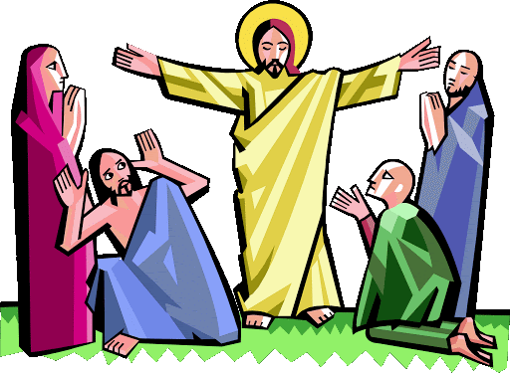
Jesus arrived in Jerusalem for a feast called Passover and went to the Temple. There he found people selling cattle, sheep and doves, which the people used as offerings to God. There were also many money-changers, so that pilgrims from different lands could change their money and buy the offerings.
Why do you think that seeing all this made Jesus angry?
The Temple was where people went to say prayers, but some people were buying and selling things instead.
Jesus drove them all out of the Temple. How do you think all the people felt when they saw this?

Slide 4
Jesus was standing up for what he believed in. He saw something that he did not think was fair or right and so he acted to change the situation.
Can you think of some things that you have seen that are unfair or which are not right?
For example, have you seen people being unkind to others or not treating other people as they should? What did you do about it?
Do you think it is fair that some people are so poor that they can’t afford to buy enough food?
What can you do to change the things in the world that are unfair?

Slide 5
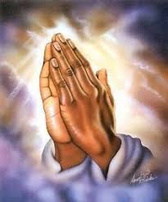
Prayer
Christ Jesus, show us how to be brave enough to stand up for what is right and fair.
Give us the courage to change the things we know are wrong and help us to make the world a fairer place for our brothers and sisters around the world.
Amen.

Slide 6
Task: Sorting fair and unfair.
A friend saying they don’t want to play with you because you are wearing different shoes than everyone else.
Donating your old toys to charity.
Only half the class needs to do a spelling test.
People need to pass a driving test in order to get their license.
Teachers pick partners for a task by random lolly sticks.
Everyone gets the same mark in a maths test.
Think about fairness.
What do you do when you see something that you know is wrong or unfair?
What will you do this week to make the world a fairer place and how will you stand up for what you believe in?
Your task
Draw a table.
Sort these sentences into fair and unfair. Add your own one.
Discuss your answers with a partner when you are finished. Do they have the same as you? Why are they fair or unfair?
Write a sentence to tell me how you are going to make the world a fairer place.
Fair | Unfair

