Slide 1
Fairy Tale Writing
LI: To write a Fairy Tale using the traditional conventions.

Slide 2
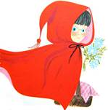
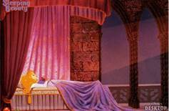
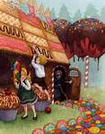
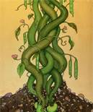
What fairy tales can you think of?
Notes:
AHa

Slide 3
Did you think of some of these?
Snow White and the Seven Dwarfs
3 Little Pigs
Jack and the Beanstalk
Goldilocks and the 3 Bears
Little Red Riding Hood
Cinderella
Sleeping Beauty

Slide 4
What do we expect from a fairy tale?
Fairy Tales
Notes:
AHa

Slide 5
The Elements of a Fairy Tale
• Special beginning and/or ending words - Once upon a time...and they lived happily ever after.
• Good character
• Evil character
• Royalty and/or a castle usually present
• Magic happens
• Animals talk and come to the rescue
• Love is in the air
• Problem and a Solution
• Things often happen in "threes" or "sevens

Slide 6
Most Fairy Tales follow a pattern
Fairytale | Characters | Setting | Complication(s) | Resolution
Cinderella | Cinderella Ugly stepsisters & step mother Prince Fairy godmother | Ball | Cannot go to ball At midnight – everything returns to normal Prince wants to find his true love | Fairy god mother helps Cinderella runs away from ball Prince finds Cinderella by way of the glass slipper
Three little pigs | 3 pigs Big bad wolf | Country village | Wolf blows each house down as they are NOT strong | Pot of hot water at bottom of chimney

Slide 7
Twisted Fairy Tales
Recently some authors have taken original Fairy Tales and given them a twist. Here are some examples:
Three Little Wolves and the Big Bad Pig
The classic fight between pigs and wolves as you’ve never seen it before! A subversive and hilarious take on the well-loved fairy tale.
The three little wolves erect first a solid brick house. The big bad pig comes along and when huffing and puffing fails to work, he uses a sledgehammer to bring the house down. Next they build a home of concrete: The pig demolishes it with his pneumatic drill. The three little wolves choose an even stronger design next time round: They erect a house, made of steel, barbed wire, armour plates and video entry system, but the pig finds a way to demolish it too. It is only when the wolves construct a rather fragile house made of cherry blossoms, daffodils, pink roses, and marigolds that the pig has a change of heart

Slide 8
More Twisted Fairy Tales
Goldilocks and Just the One Bear
Many years have passed since Goldilocks caused chaos at the Bears' house in the woods, but what happens when Little Bear as was wanders out of his fairytale and into the big city where Goldilocks now lives? Goldilocks is now grown up with a family and a rather smart apartment, so how will she react to coming home and finding that a very lost bear has been scoffing porridge, breaking chairs and sleeping in beds? Will she be cross, or is finally time to make amends?

Slide 9
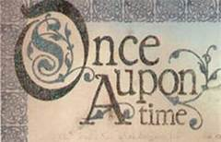
Your Task
Will you make the hero a villain? Will you get rid of the love interest? Will you change the main character from a boy to a girl?
Choose a traditional Fairy Tale and complete the planning sheet with all of the details. Then complete the 2nd sheet detailing what changes you are going to make to create your Twisted Fairy Tale. You will write this story next week.

