Slide 1
RERC
Friday 26th
February
Learning Intention:
To listen, understand and reflect on The Word of God
To make a cloud of change.
Success Criteria:
Can I reflect on my choices?
Can I present my ideas clearly and neatly?
Can I decorate my work with bright colours?

Slide 2
This week’s Gospel comes from Mark 9:2-10
Six days later Jesus took with him Peter, James, and John, and led them up a high mountain, where they were alone. As they looked on, a change came over Jesus, and his clothes became shining white—whiter than anyone in the world could wash them. Then the three disciples saw Elijah and Moses talking with Jesus. Peter spoke up and said to Jesus, “Teacher, how good it is that we are here! We will make three tents, one for you, one for Moses, and one for Elijah.” He and the others were so frightened that he did not know what to say.
Then a cloud appeared and covered them with its shadow, and a voice came from the cloud, “This is my own dear Son—listen to him!” They took a quick look around but did not see anyone else; only Jesus was with them.
As they came down the mountain, Jesus ordered them, “Don't tell anyone what you have seen, until the Son of Man has risen from death.” They obeyed his order, but among themselves they started discussing the matter, “What does this ‘rising from death’ mean?”

Slide 3
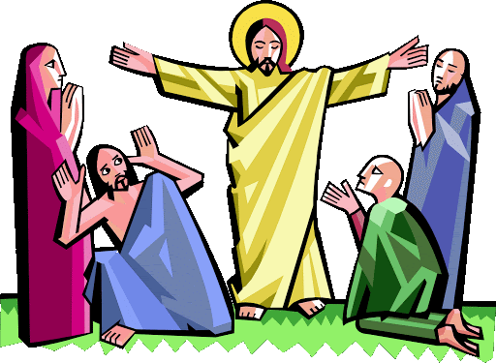
Jesus went up a mountain to be alone with his friends, the disciples Peter, James and John. While he was on the mountain, a great change came over him. His clothes became bright and shining white and Elijah and Moses appeared and talked to him. Do you know who they were?
How did Peter, James and John feel when they saw the change that had happened to Jesus? Why were they frightened?
Then a cloud came over and Jesus’s friends heard a voice, saying “This is my Son, the Beloved. Listen to him.” Whose voice do you think this was? What do you think Peter, James and John must have felt when they heard God speaking to them from the cloud?

Slide 4
On the mountain the disciples saw Jesus’s true loving self shining like the rays of the sun. If we listen to Jesus and spend time with God in our hearts then we too can let our true light shine brightly. For example, we could be kinder to other people, or extra helpful.
You can hear so much more when you really take time to listen. So how do you think we can best listen to what Jesus has to say to us in our lives? Could we, for example, pray more often, or perhaps listen to the gospel stories very carefully?
God asks us to be kind and generous to others and treat them as we would like to be treated. Do you think you could listen to God more this Lent? How? What will you do to try and live more as God wants?
In Lent we spend extra time praying and we think about how we can help other people, and in this way let our true light shine out from inside us.

Slide 5
Task: Cloud of Change.
Think about Abdul and Abdella from our last lesson.
- How could you help change the lives of children like these during Lent?
How can you change yourself? What could do you better?
I can help people in need by…
Use the cloud for bullet point 1 and the strips for bullet point 2.
Your task
Make a cloud template.
Write or draw your ideas on a cloud.
Decorate it with bright colours to make it dazzling and bright, like Jesus was on the top of the mountain.

