Slide 1
RERC
Monday 22nd
February
Learning Intention:
To listen, understand and reflect on The Word of God
To make a campaign.
Success Criteria:
Can I reflect on the teachings of the gospel?
Can I share the importance of water?
Can I think of ways to save water for others?

Slide 2
This week’s Gospel comes from Mark 1:12-15
At once the Spirit made Jesus go into the desert, where he stayed forty days, being tempted by Satan. Wild animals were there also, but angels came and helped him.
After John had been put in prison, Jesus went to Galilee and preached the Good News from God. “The right time has come,” he said, “and the Kingdom of God is near! Turn away from your sins and believe the Good News!”

Slide 3
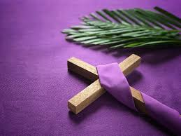
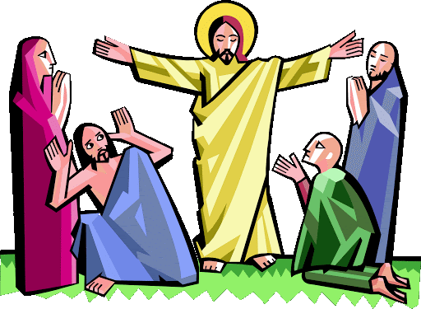
Yesterday was the first Sunday of Lent. What is Lent?
Lent is a special time when we prepare for Easter. We take time in Lent to pray more, and to think about how we live our lives. This time can help us to change for the better and grow in our faith.
As we grow closer to God, we also realise that we are called to put our faith into action, and to live our lives as God wants us to, loving and caring for all people and for the earth.

Slide 4
Jesus goes out into the desert for 40 days. He had hardly any food to eat or water to drink. The UK is often very rainy. What do you think it would be like to live in a very dry land? How do you think Jesus felt while he was in the desert?
Water is one of the most precious and important things in the world. We know it is important because we use it so much. Can you think of some of the different ways we use water every day?
How do you get water when you need it? Do you or your grown-ups just turn on the tap?
Imagine what it would be like if you turned on the tap and no water came out. What would you do?

Slide 6
Reflection
Lent lasts for 40 days, just like Jesus’ time in the desert. This Lent, let’s remember in our prayers all the people in the world like Abdul and Abdella who do not have clean water to drink.
And let’s do what we can to reach out and help, as we grow in our faith this Lent and try to live as God calls us to.

Slide 7
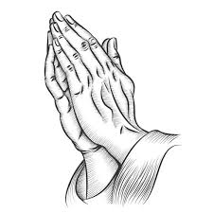
Prayer
We pray for world leaders: that they may work together to make sure all people have the things that they need – clean safe water, food and somewhere to live. Lord, have mercy...
We pray for all those who must spend hours each day walking to fetch water, and who dream of a better future. Through God’s grace, may our actions this Lent help to make those dreams a reality. Lord, have mercy...
We pray for our parish, family and friends: that we may make changes to our lives this Lent that will change the lives of others around the world. Lord, have mercy...
Amen.

Slide 8
Task: Saving Water Campaign.
Think about Abdul and Abdella who do not have clean water to drink.
What can you do to save water?
Why is it important to save water?
How can you convince others to do the same?
Your task is to make a campaign for saving water.
You must create a persuasive speech (like a president or prime minister) about:
- A few reasons for saving water
- Different ways of doing so
- Include a tagline that says “I’m saving water because…”
You can send me a written copy of your speech or a video of you doing the speech to my email address: ddrpetrie598@glow.sch.uk

