Slide 2
Aim
I can use the written method of short division to calculate decimal remainders.
Success Criteria
I can use the written method of short division to calculate decimal remainders in the context of distance.
I can use recall of my times tables facts to help me complete short division.

Slide 3
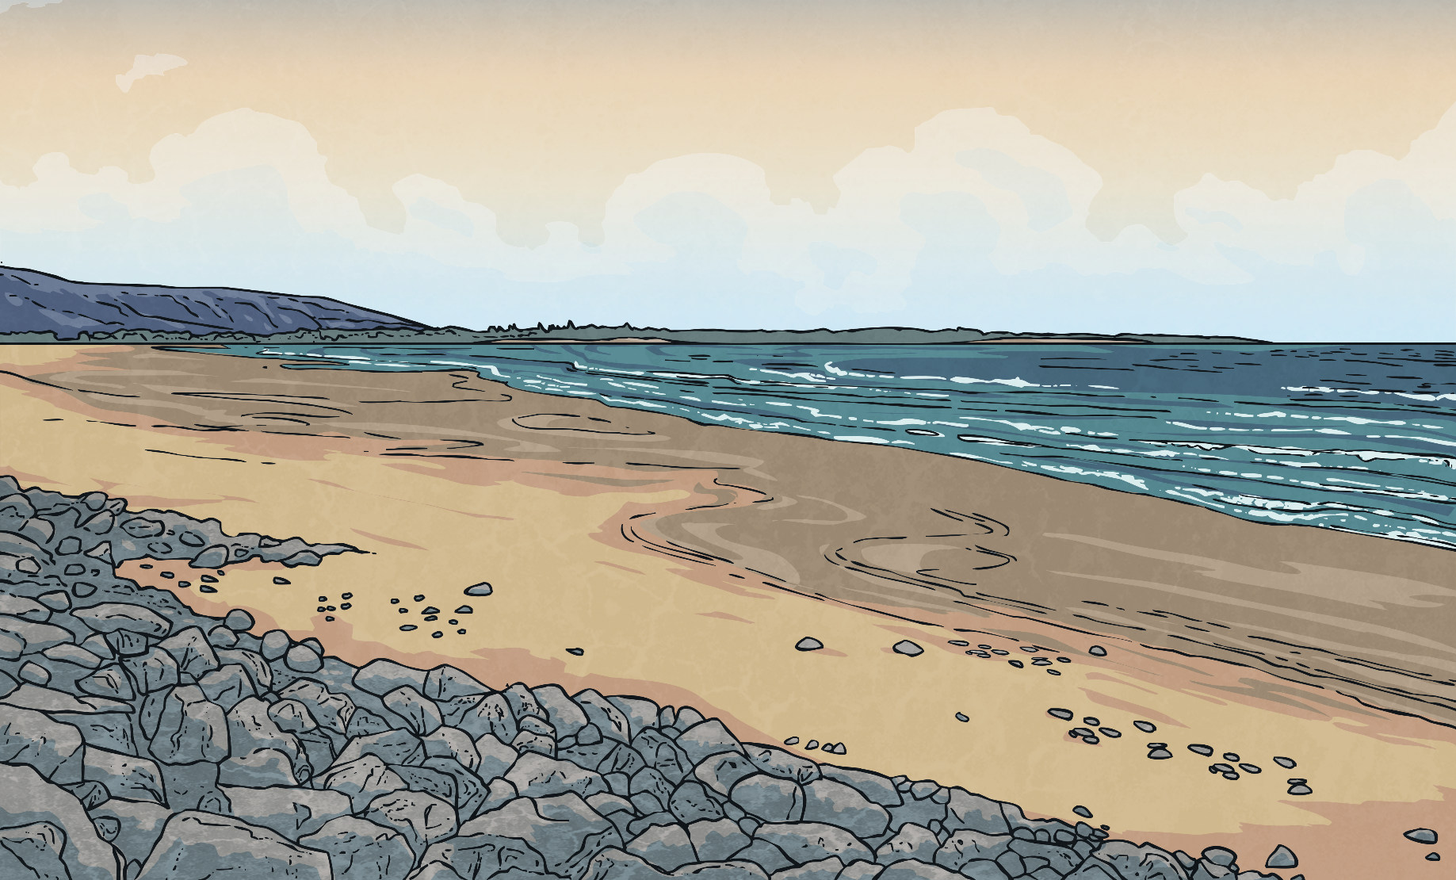
What’s My Number?
Clue 1: When you divide me by 7, I have a remainder of 4.
Clue 2: When you divide me by 3, I have a remainder of 2.
Clue 3: When you divide me by 5, I have a remainder of 2.
I am a 2-digit number. What number am I?
32

Slide 4
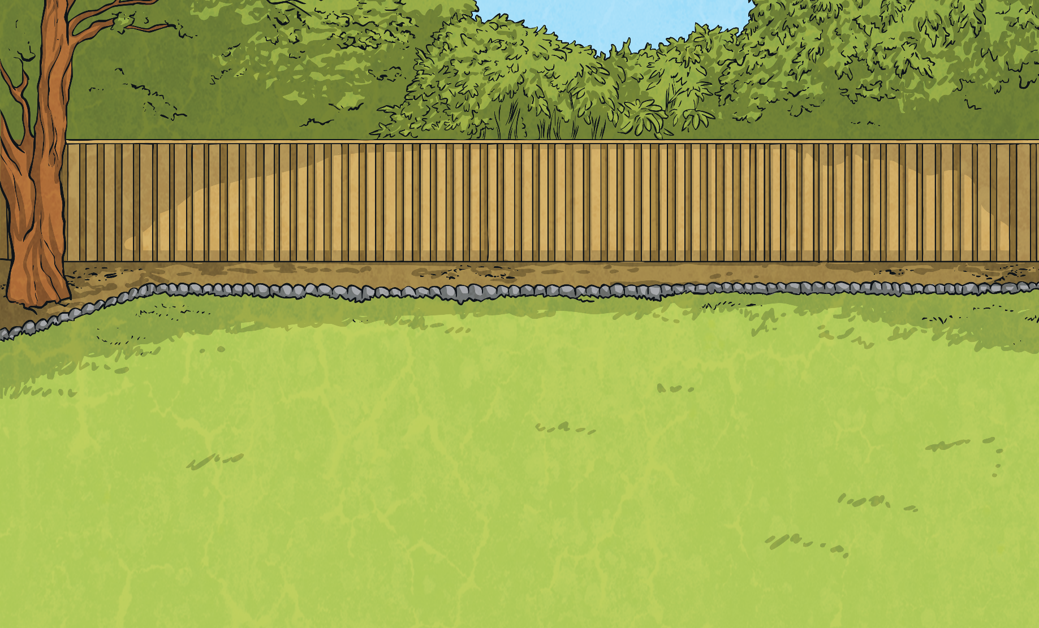
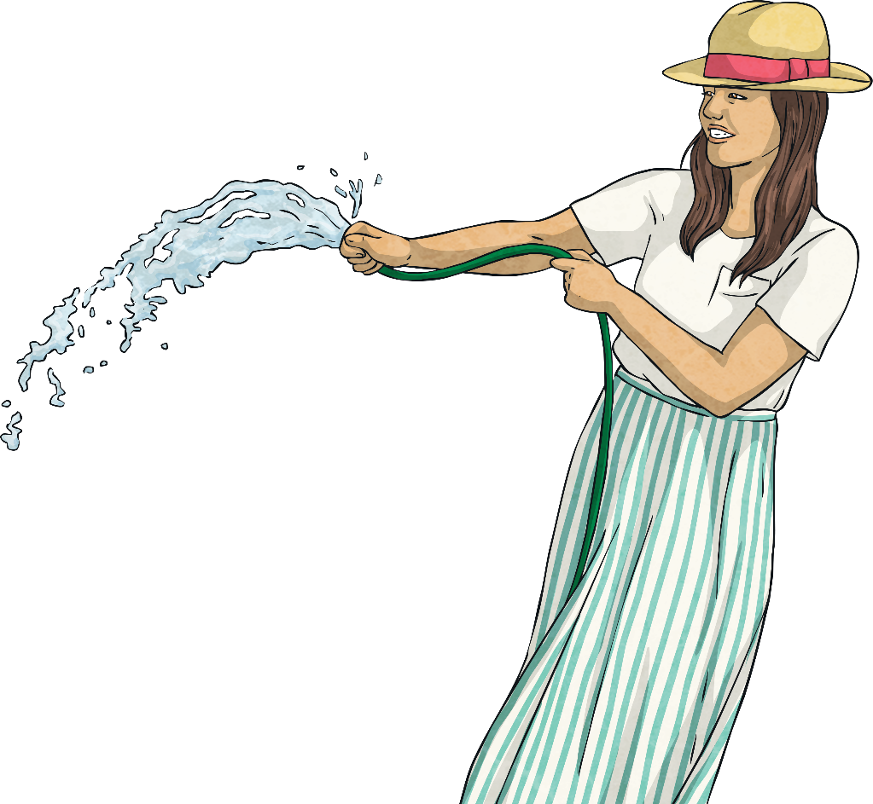
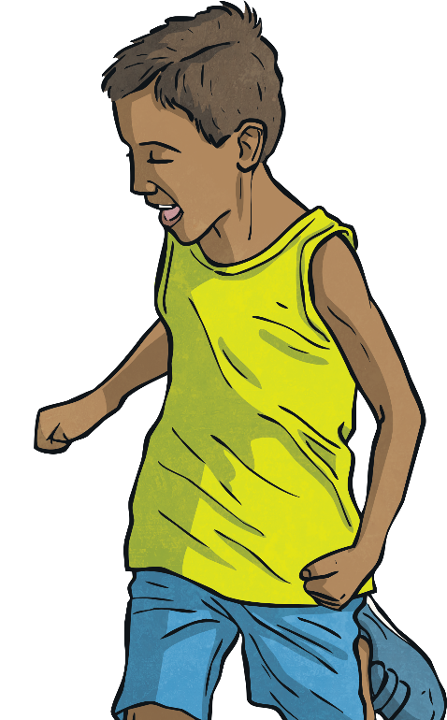
What’s My Number?
Clue 1: When you divide me by 8, I have a remainder of 7.
Clue 2: When you divide me by 3, I have a remainder of 2.
Clue 3: When you divide me by 5, I have a remainder of 3.
I am a 2-digit number. What number am I?
23

Slide 5
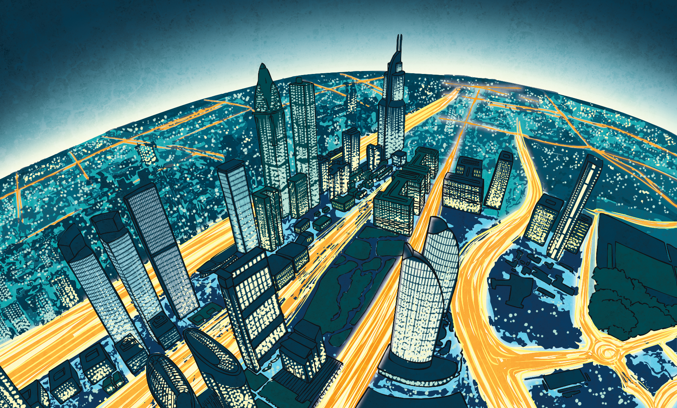
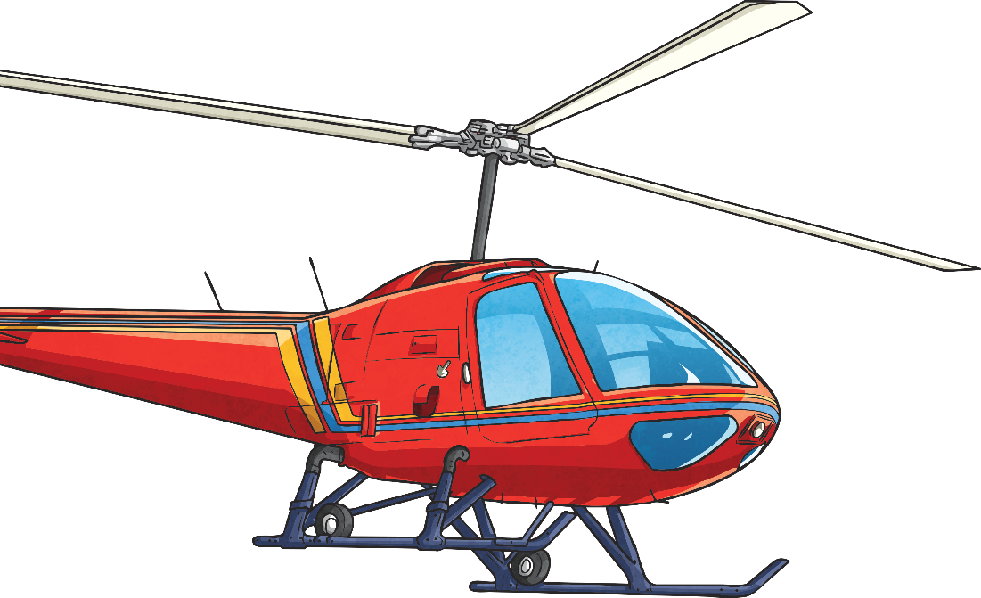
What’s My Number?
Clue 1: When you divide me by 4, I have a remainder of 1.
Clue 2: When you divide me by 6, I have a remainder of 1.
Clue 3: When you divide me by 10, I have a remainder of 1.
I am a 2-digit number. What number am I?
61

Slide 6
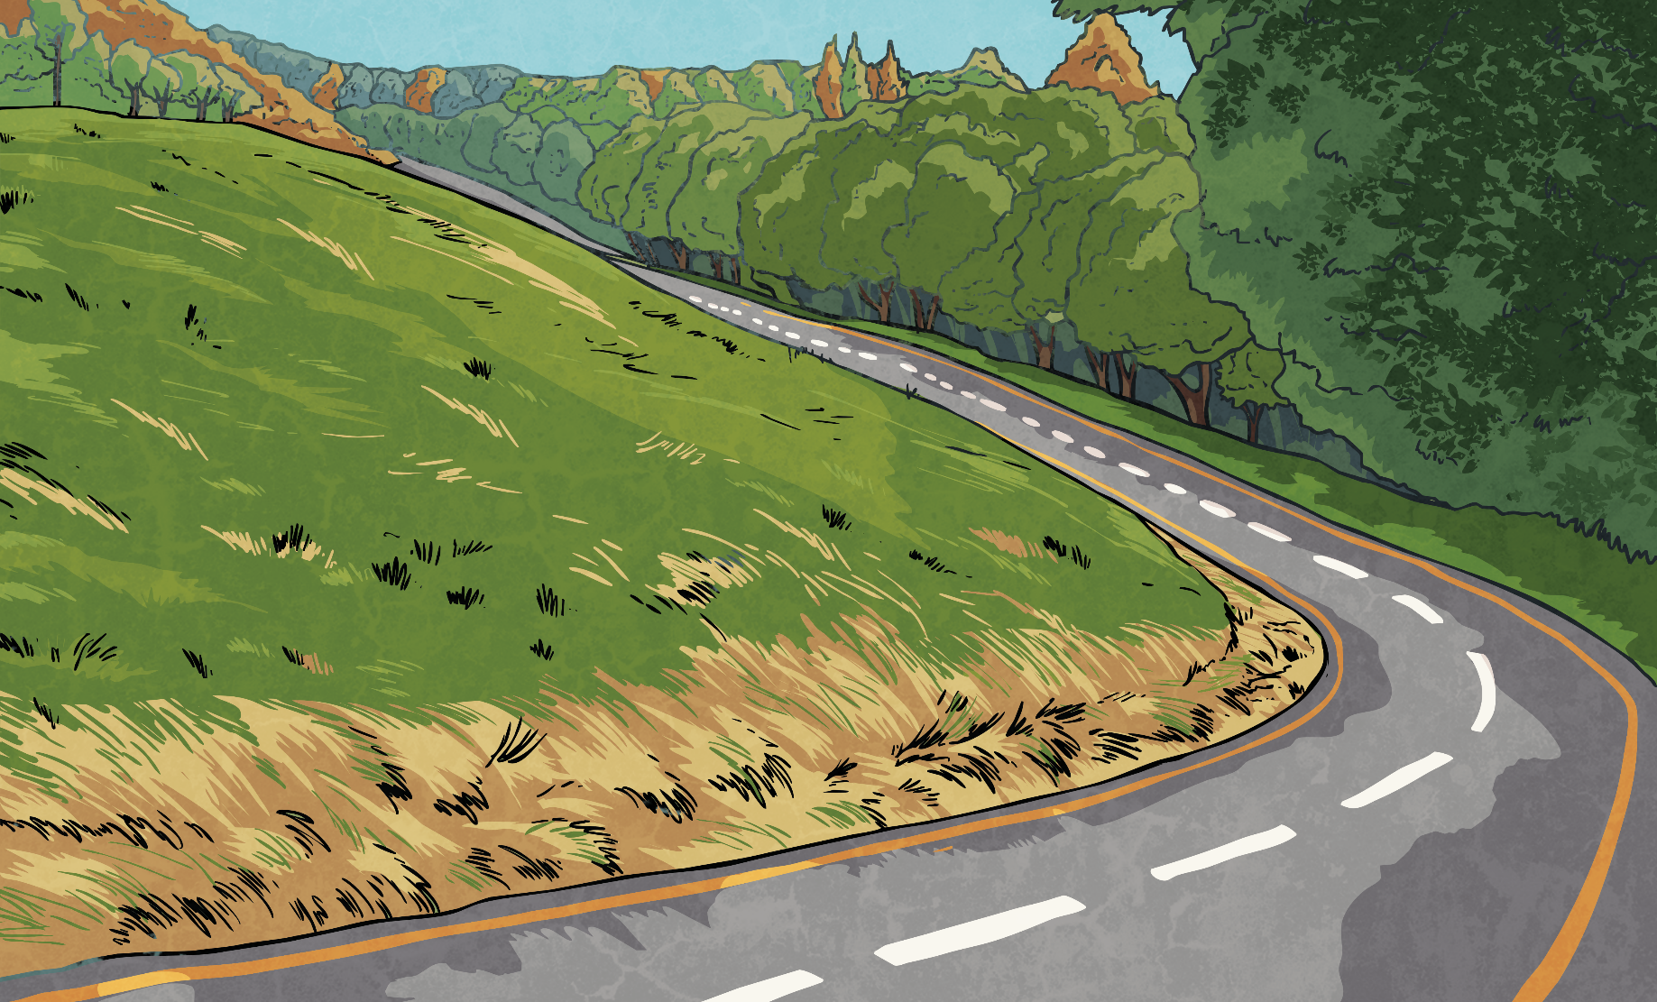
Decimal Remainders
Any whole number can be partitioned into ones, tens, hundreds and thousands, etc.
Digits after the decimal point are fractions of whole numbers.
thousands
hundreds
tens
ones
The decimal point separates whole numbers from fractions of whole numbers.

Slide 7
Decimal Remainders
11 ÷ 4 =
2r3
Look at this division problem:
We know that there is going to be a remainder for this calculation as 11 isn’t divisible by 4.
The remainder is part of a whole group. It is a fractional amount.
11 ÷ 4 =
Therefore, we can write the remainder as a decimal:
11 ÷ 4 =
2.75

Slide 8
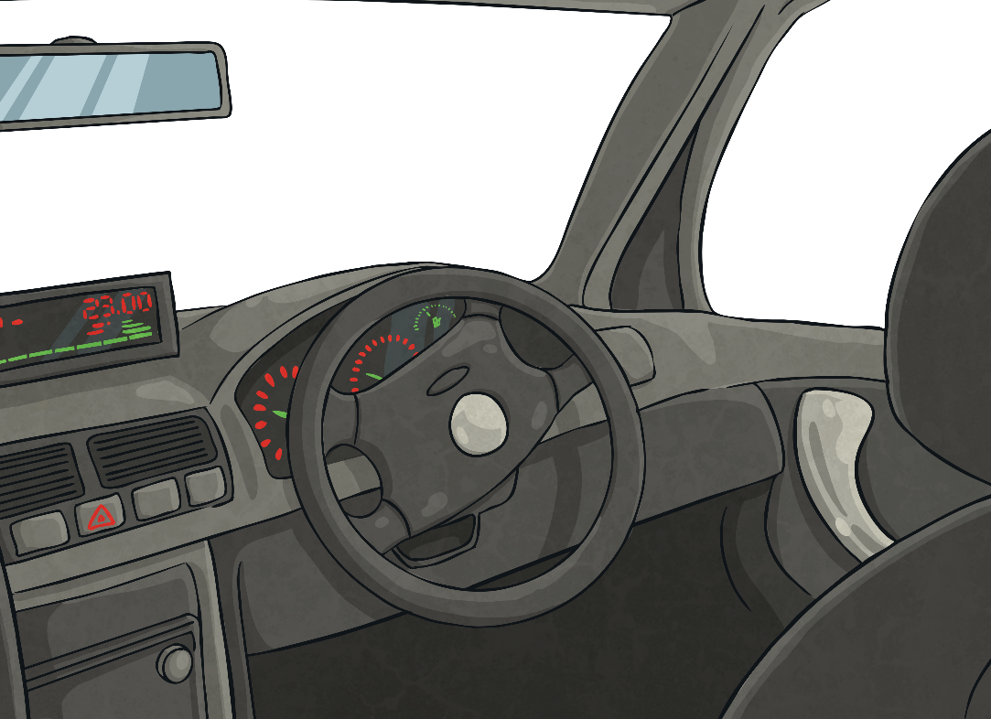
Taxi Driver Remainders
Here is a division problem using larger numbers:
Over 5 days, a taxi driver drove 1228 miles.
How many miles did the taxi driver drive on average each day?
Before beginning to calculate, we can see that the answer is going to have a remainder as we know that 28 isn’t divisible by 5. We want to write the remainder as a decimal, so first we put a decimal point after the dividend and in the answer box above it. Then, we put zeros in the tenths and hundredths position ready for calculating the decimal remainder.
To answer this problem, we need to calculate 1228 ÷ 5.
We can calculate the answer to this problem using short division. We set out a short division calculation like this:
5
1
2
2
8
0
0

Slide 9
Short Division
Let’s remind ourselves how to use the formal written method of short division to calculate how far on average the taxi driver drove each day.
2
4
5
6
We have calculated that the taxi driver drove 245.6 miles on average each day.
2
2
3
5
1
2
2
8
0
0
Step 1: Calculate 12 ÷ 5 = 2r2
Write the whole number in the top box and write the remainder in front of the next digit.
Step 3: Calculate 28 ÷ 5 = 5r3
Write the whole number in the top box and write the remainder in front of the zero after the decimal point.
Step 4: Calculate 30 ÷ 5 = 6
Write the whole number in the top box. There is no remainder, so this is the end of the calculation.
Step 2: Calculate 22 ÷ 5 = 4r2
Write the whole number in the top box and write the remainder in front of the next digit.

Slide 10
Aeroplane Decimal Remainders
Work with a partner to answer this word problem that involves decimal remainders using short division.
Over 4 days, a pilot flew his aeroplane 2779 miles.
How many miles did the pilot fly on average each day?
6
9
4
7
5
The pilot flew 694.75 miles on average each day.
3
1
3
2
4
2
7
7
9
0
0

Slide 11
Aim
I can use the written method of short division to calculate decimal remainders.
Success Criteria
I can use the written method of short division to calculate decimal remainders in the context of distance.
I can use recall of my times tables facts to help me complete short division.

