Slide 2
Aim
I can multiply one-digit numbers with up to two decimal places by whole numbers.
Success Criteria
I can use the written method of short multiplication to multiply decimals in the context of money.
I can use recall of my times tables facts to help me multiply decimals.
I can choose a suitable method to help me multiply decimals by whole numbers.

Slide 3
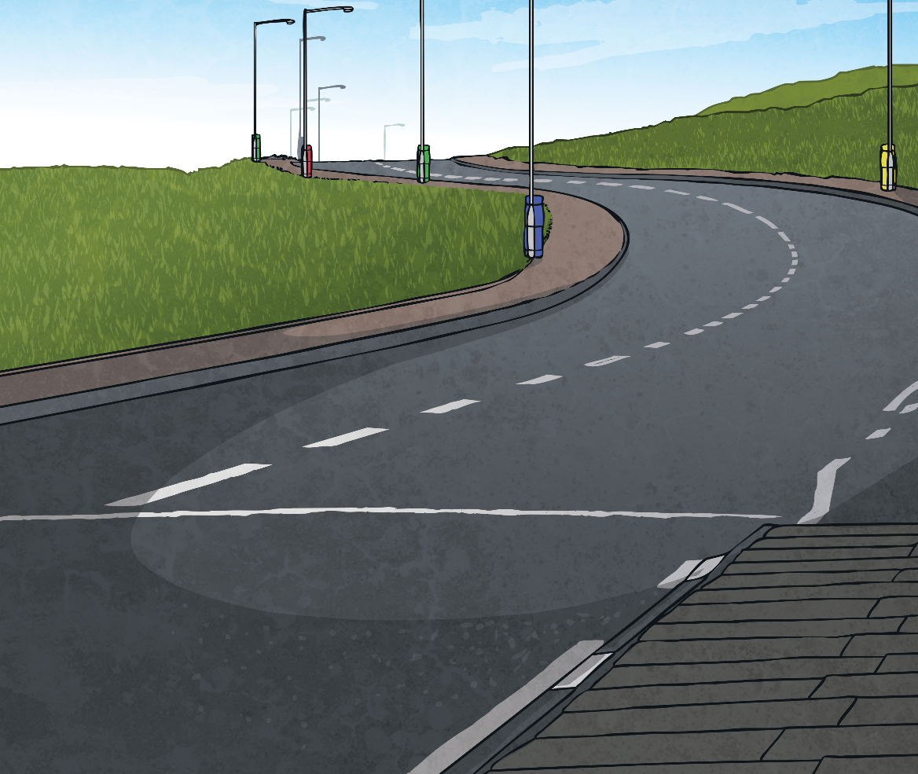
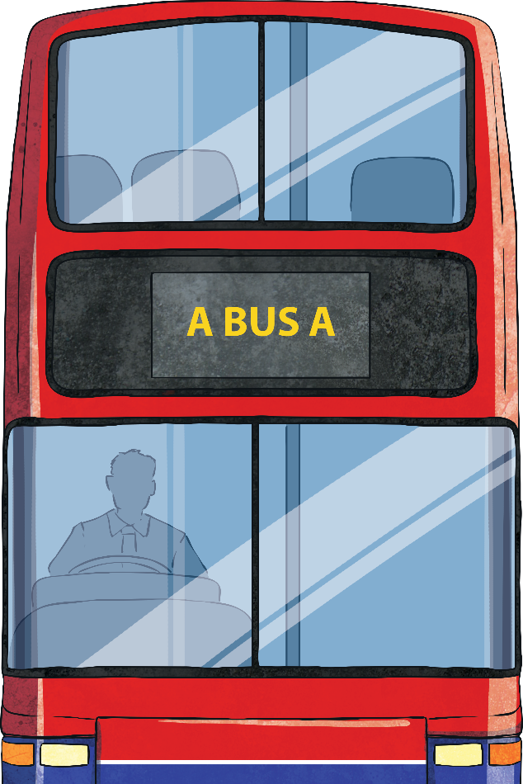
Bus Ticket Decimals
Look at this word problem involving multiplication:
Rhys is going into town on the bus with his five friends.
Each bus ticket costs £1.54.
How much will six bus tickets cost altogether?
Which method would you use to calculate the answer?
The calculation we need to complete to answer the question is:
£1.54 × 6

Slide 4
Short Multiplication
Let’s remind ourselves how to use the formal written method of short multiplication to calculate the cost of the bus tickets.
£ | 1 | 5 | 4
× |  |  | 6
£
First, set your calculation out correctly with one number in each square. Use a ruler to draw your lines.
Step 1: Calculate the hundredths digit.
Multiply the 4 hundredths by 6.
4 × 6 = 24 hundredths.
We can only put hundredths in the hundredths column.
We write the 4 hundredths in the hundredths column.
We need to regroup the 20 hundredths into 2 tenths.
We write the 2 under the bottom line of the tenths column.
4
2

Slide 5
Short Multiplication
Let’s remind ourselves how to use the formal written method of short multiplication to calculate the cost of the bus tickets.
First, set your calculation out correctly with one number in each square. Use a ruler to draw your lines.
£ | 1 | 5 | 4
× |  |  | 6
£
Step 2: Calculate the tenths digit.
Multiply the 5 tenths by 6.
5 × 6 = 30 tenths.
We need to add on the 2 tenths that we wrote under the line.
30 + 2 = 32 tenths.
We can only put tenths in the tenths column.
We write the 2 tenths in the tenths column.
We need to regroup the 30 tenths into 3 ones.
We write the 3 under the bottom line of the ones column.
2
4
3
2

Slide 6
Short Multiplication
Let’s remind ourselves how to use the formal written method of short multiplication to calculate the cost of the bus tickets.
£ | 1 | 5 | 4
× |  |  | 6
£
First, set your calculation out correctly with one number in each square. Use a ruler to draw your lines.
Step 3: Calculate the ones digit.
Multiply the 1 by 6.
1 × 6 = 6.
We need to add on the 3 ones that we wrote under the line.
6 + 3 = 9.
We write the 9 ones in the ones column.
We have used a written formal method to calculate £1.54 × 6 = £9.24
9
2
4
3
2

Slide 7
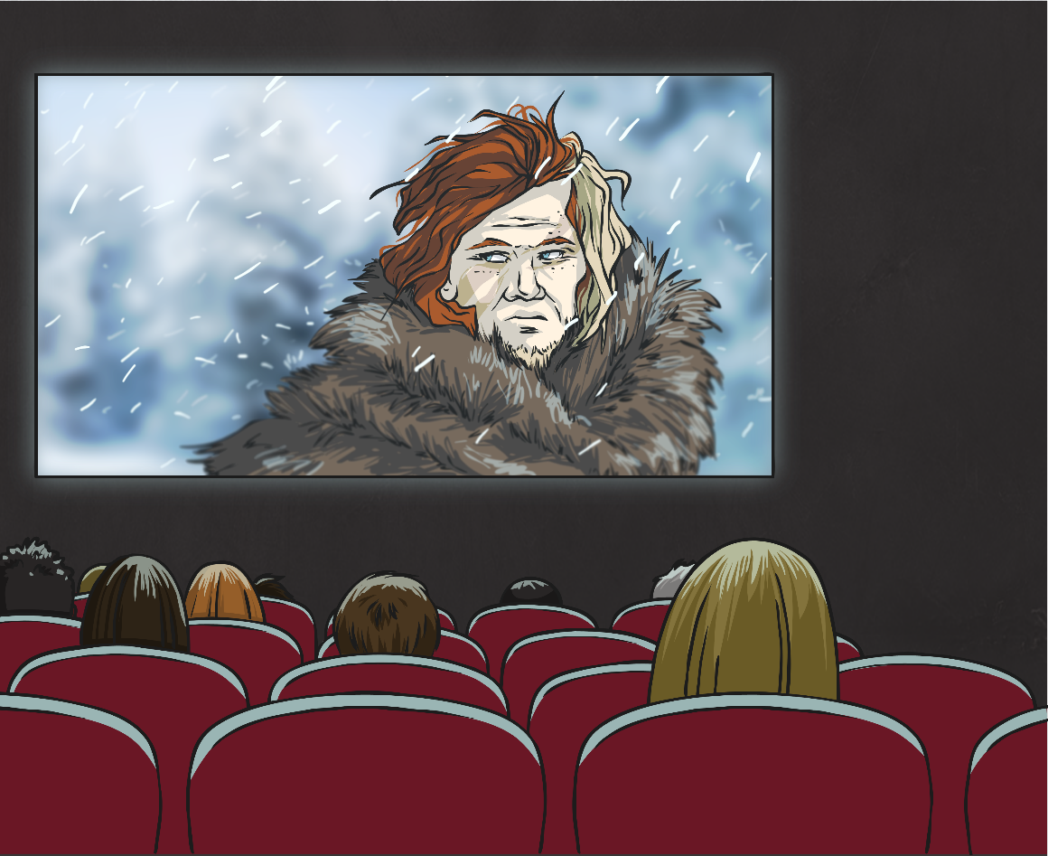
Popcorn Decimals
Answer this next word problem involving multiplying a decimal by a whole number:
Aneesha went to the cinema with her seven friends.
They each bought a bag of popcorn; one bag costs £2.86.
How much will eight bags of popcorn cost altogether?

Slide 8
Popcorn Decimals
Aneesha went to the cinema with her seven friends.
They each bought a bag of popcorn; one bag costs £2.86.
How much will eight bags of popcorn cost altogether?
£ |  | 2 | 8 | 6
× |  |  |  | 8
£
8 bags of popcorn =
£2.86 × 8 =
£22.88
2
2
8
8
6
4

Slide 9
Aim
I can multiply one-digit numbers with up to two decimal places by whole numbers.
Success Criteria
I can use the written method of short multiplication to multiply decimals in the context of money.
I can use recall of my times tables facts to help me multiply decimals.
I can choose a suitable method to help me multiply decimals by whole numbers.

