Slide 2
Aim
To determine the value of each digit in decimal numbers.
Success Criteria
I can use visual and abstract methods to identify the value of digits in a decimal number.
I can identify how to alter a digit in a decimal number.
I can solve problems involving different digits in a decimal number.

Slide 3
Composing Numbers With Decimals
Composing numbers that include decimals is easier when we group together units of the same place value.
100
1 000
100
10
1
0.1
0.01
1
1
100
100
0.1
10
1
0.1
0.01
10
1
100
In this example, the number 1845.22 is seen.
100
100
10
1
0.1
1 000
1
100
100
10
1
1
0.01
100
10
0.01
100
100
1
100
100
10
100
10
100

Slide 4
Composing Numbers With Decimals
Numbers with decimals are sorted from right to left in a place value grid, the same way as whole numbers.
In this example, the number 1845.22 is seen within a place value grid.
How many tenths are represented in the tenths column?
Thousands | Hundreds | Tens | Ones | tenths | hundredths
1 000
100
100
10
10
1
1
0.1
0.1
0.01
0.01
100
100
10
10
1
1
1
100
100
100
100

Slide 5
Composing Numbers With Decimals
Use place value counters to compose the number. Which is the correct answer?
0.01
0.1
0.1
1
0.1
1
0.1
0.1
1
10
0.1
10
1
Thousands | Hundreds | Tens | Ones | tenths | hundredths
10
10
1
1
0.1
0.1
0.01
1
1
0.1
0.1
0.1
0.1
124.61
24.61
24.61
204.61

Slide 6
Composing Numbers With Decimals
Use place value counters to compose the number. Which is the correct answer?
0.1
0.1
1
0.1
1
0.01
1
0.01
0.1
0.01
1
Thousands | Hundreds | Tens | Ones | tenths | hundredths
1
1
0.1
0.1
0.01
0.01
1
1
0.1
0.1
0.01
4.43
4.43
4.234
4.34

Slide 7
Composing Numbers With Decimals
Use place value counters to compose the number. Which is the correct answer?
0.1
0.1
1
0.1
0.1
0.01
0.01
1
0.01
0.1
0.01
0.01
Thousands | Hundreds | Tens | Ones | tenths | hundredths
1
1
0.1
0.1
0.01
0.01
0.1
0.1
0.01
0.01
0.1
0.01
two point five five
two point five five
two point six five
two point four five

Slide 8
Decimal Digits
Each digit in a decimal number has a value according to its place in the number.
Using a place value grid can help us identify the value of each digit.
Ones | tenths | hundredths | thousandths

Slide 9
Decimal Digits
What is the value of the 4 in the number 3.248?
We can find out by entering the number into the place value grid.
Remember to make sure that the decimal point lines up with the decimal point
on the place value grid.
Ones | tenths | hundredths | thousandths
3
2
4
8
We can now see that the value of the 4 is 4 hundredths.
We write this as 0.04 in digits.

Slide 10
Decimal Digits
Enter 0.601 into your place value grid to find the value of the digit 6.
Ones | tenths | hundredths | thousandths
0
6
0
1
The digit 6 represents 6 tenths, or 0.6.

Slide 11
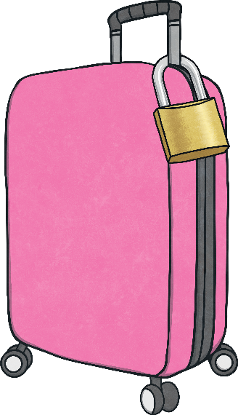
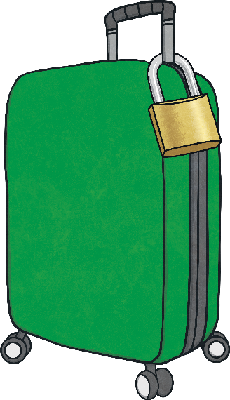
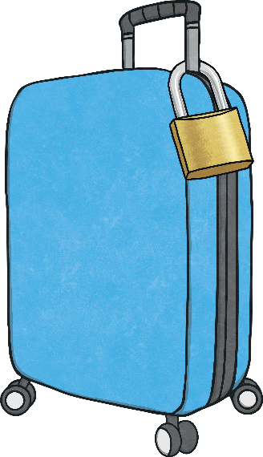
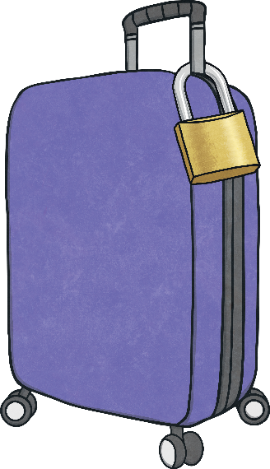
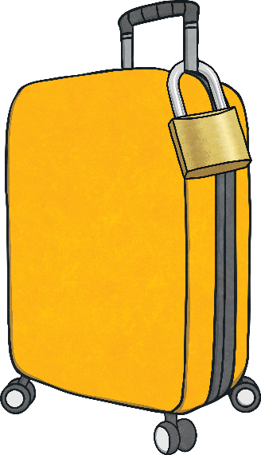
Pick the Lock
The padlocks on these suitcases all have different decimal number codes.
Which suitcase has a padlock with the lowest digit in the ones place?
The yellow suitcase has a padlock with the lowest digit in the ones place.
6.203
14.98
27.13
5.316
2.098
2.098

Slide 12
Which Key?
To open the padlocks on the suitcases, one of the digits needs to be turned into a zero.
Let's look at the pink case as an example.
To open this padlock, we need to make the tenths digit into a zero.
Which digit is in the tenths place?
6.233
14.98
27.13
5.316
2.098

Slide 13
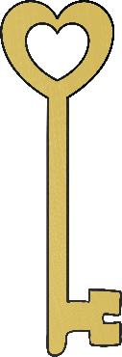
Which Key?
The digit 2 is in the tenths place.
We should use the triangle key to subtract 2 tenths, or 0.2.
This will change the digit 2 into a zero, and will open the suitcase!
We need to change this digit into a zero using one of the keys.
We can do this by subtracting 2 tenths.
Which key should we use?
- 6.203
- 0.02
- 2
- 0.2
6.233
6.033

Slide 14
Which Key?
To open the green suitcase, we need to change the 9 digit into a zero.
Which key should we use?
The 9 is in the tenths place, so we should use the heart key to subtract nine tenths or 0.9.
-9
-0.9
-0.009
-0.09
14.08
14.98

Slide 15
Which Key?
To unlock the blue suitcase, we need to change the 7 into a zero.
Which key will unlock it?
As the 7 is in the ones place, we should use the square key to subtract 7 ones, or 7.
-0.7
-0.007
-7
-0.07
20.13
27.13

Slide 16
Which Key?
To unlock the purple suitcase, we need to change the 1 into a zero.
Which key will unlock it?
We can use the circle key to open this suitcase.
The 1 is in the hundredths place, so we should subtract 1 hundredth, or 0.01.
-0.01
-0.001
-0.1
-1
5.206
5.216

Slide 17
Which Key?
To open the yellow suitcase, we need to change the 8 into a zero.
Which key should we use?
The 8 is in the thousandths place, so we need to subtract 8 thousands.
We should use the square key, showing -0.008.
-0.8
-8
-0.008
-0.08
2.098
2.090

Slide 18
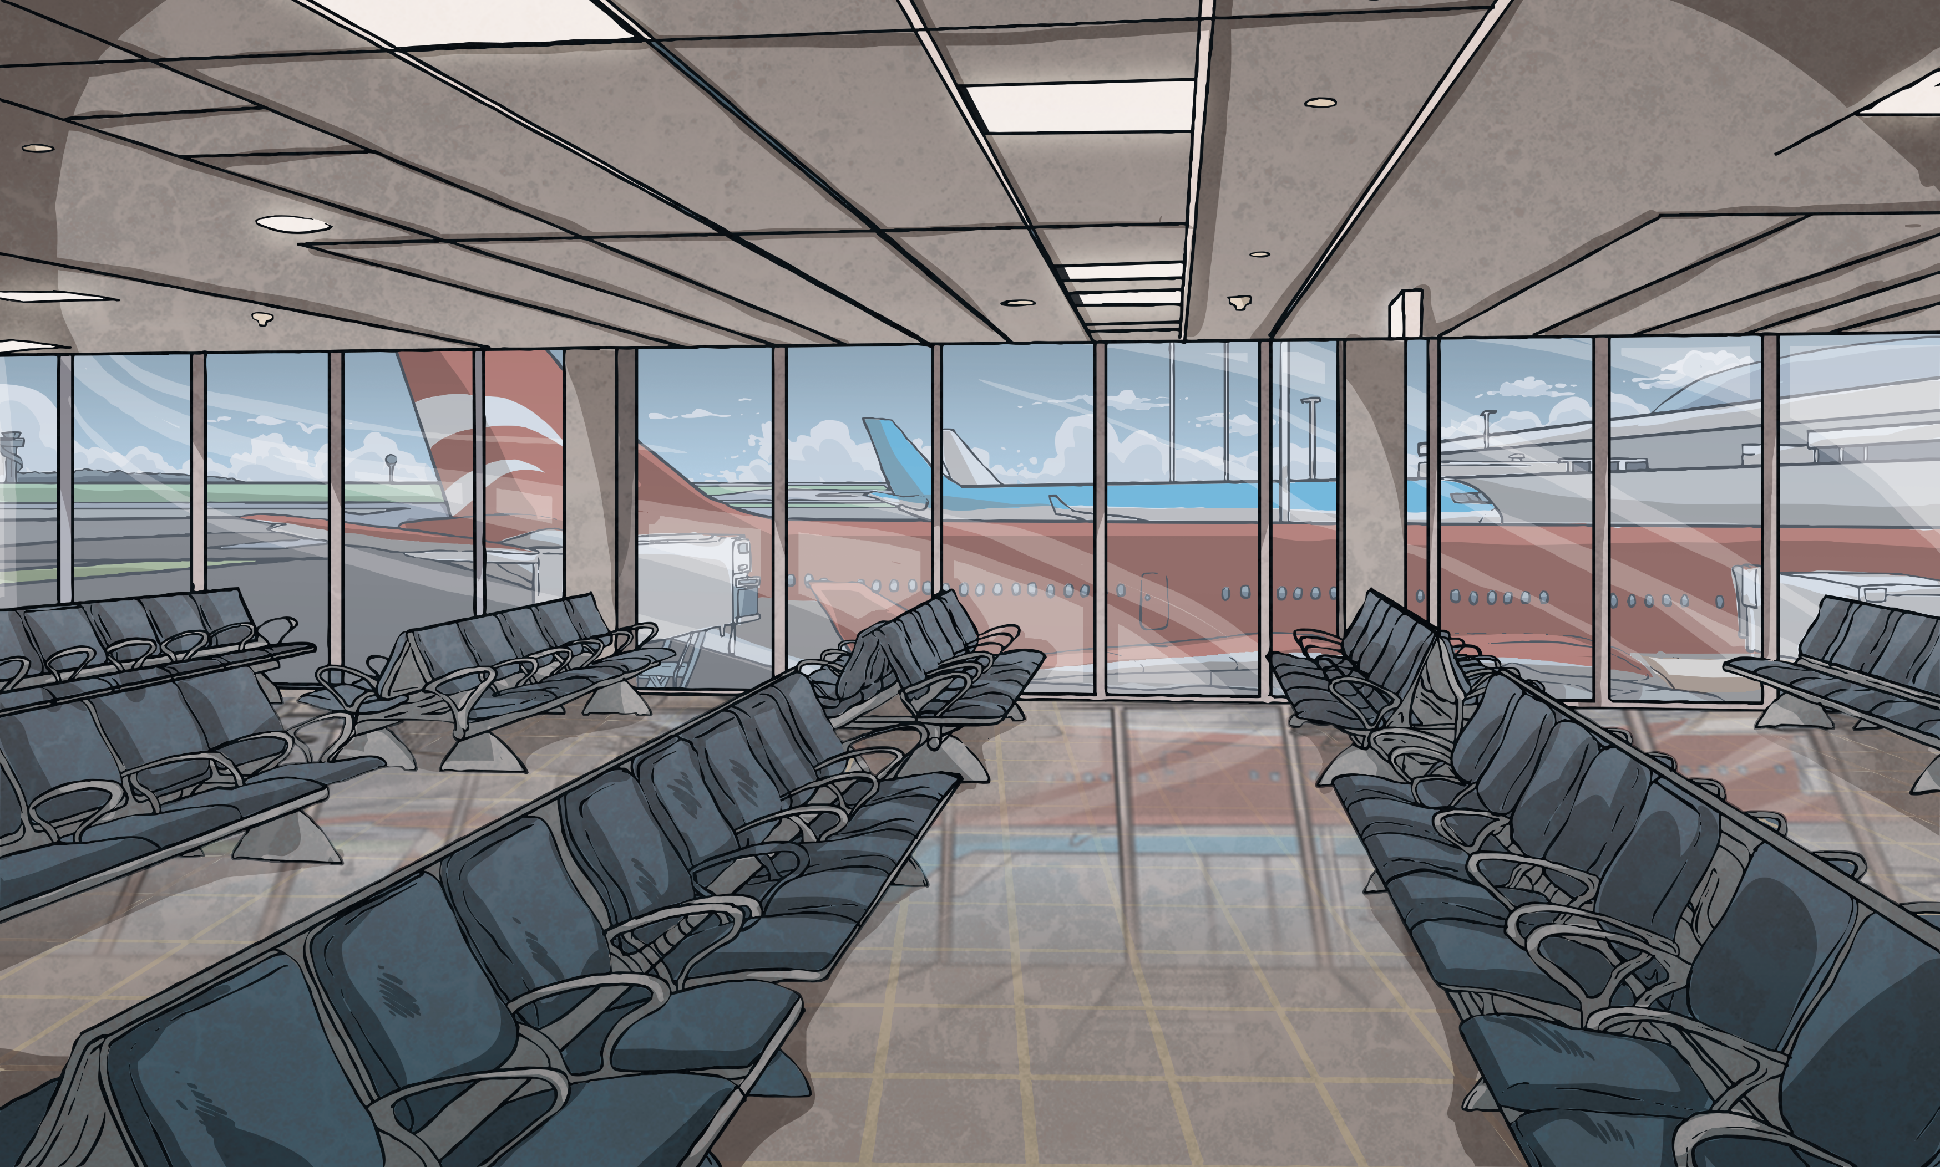
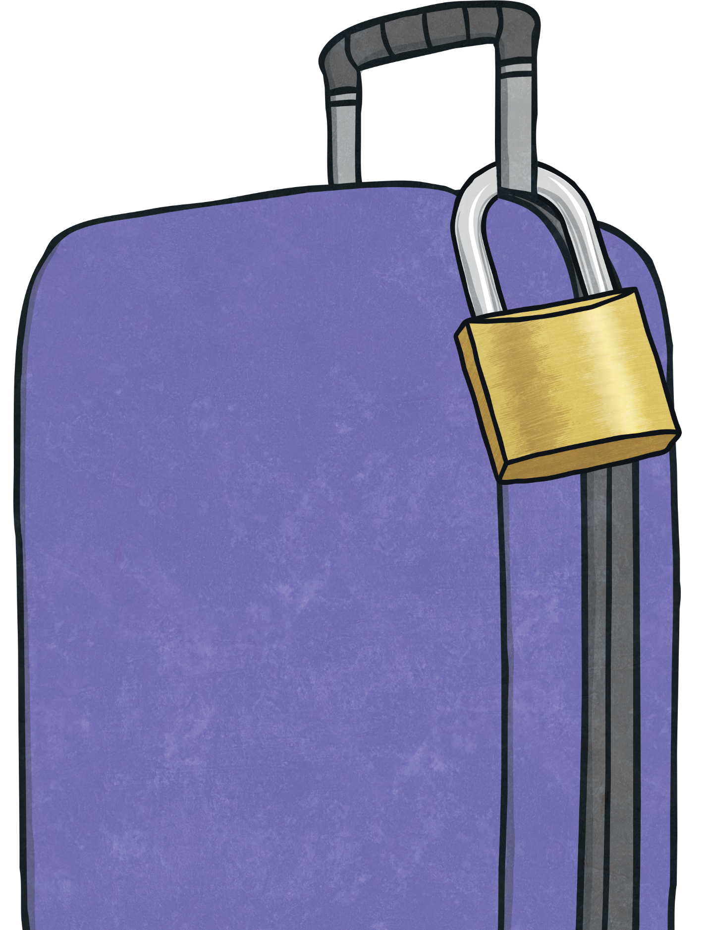
Which Key?
Match the correct suitcase to the correct statement.
This suitcase has a zero in the thousandths place.
This suitcase has a 7 in hundredths place.
This suitcase has a 4 in the tenths place.
If I added one thousandth to this suitcase, it would then show one hundredth.
2.45
14.709
14.67
7.003
2.140

Slide 19
Aim
To determine the value of each digit in decimal numbers.
Success Criteria
I can use visual and abstract methods to identify the value of digits in a decimal number.
I can identify how to alter a digit in a decimal number.
I can solve problems involving different digits in a decimal number.

