Slide 1
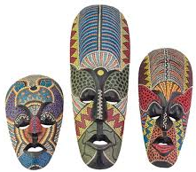
African Masks
Miss Petrie

Slide 2
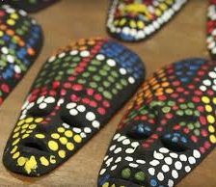
Learning Intention We are learning about the culture of African masks. We are learning to recreate an African mask.
Success Criteria
Can you remember a fact about African mask culture?
Can you use pointillism?
Can you add colour, pattern and detail to your mask?

Slide 3
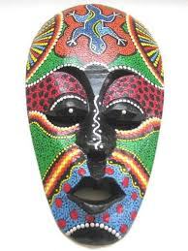
Facts
Masks serve an important role in rituals or ceremonies with varied purposes like ensuring a good harvest, addressing tribal needs in time of peace or war, or conveying spiritual presences in initiation rituals or burial ceremonies.
African masks are usually shaped after a human face or some animal's muzzle, albeit rendered in a sometimes highly abstract form.
Common animal subjects include the buffalo (usually representing strength, as in the Baoulé culture), crocodile, hawk, hyena, warthog and antelope.

Slide 4
Facts
Another common subject of African masks is a woman's face, usually based on a specific culture's ideal of feminine beauty. Female masks of the Punu people of Gabon, for example, have long curved eyelashes, almond-shaped eyes, thin chin, and traditional ornaments on their cheeks, as all these are considered good-looking traits.
The most commonly used material for masks is wood, although a wide variety of other elements can be used, including light stone, metals such as copper or bronze, different types of fabric, pottery, and more. Some masks are painted. A wide array of ornamental items can be applied to the mask surface; examples include animal hair, horns, or teeth, sea shells, seeds, straw, egg shell, and feathers. Animal hair or straw are often used for a mask's hair or beard.
Some of the masks are made to wear on your face, some are to be worn on the top of your head and some are to wear around your chest rather than on your face.

Slide 5
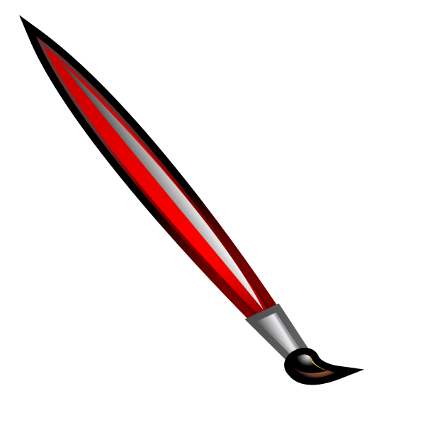
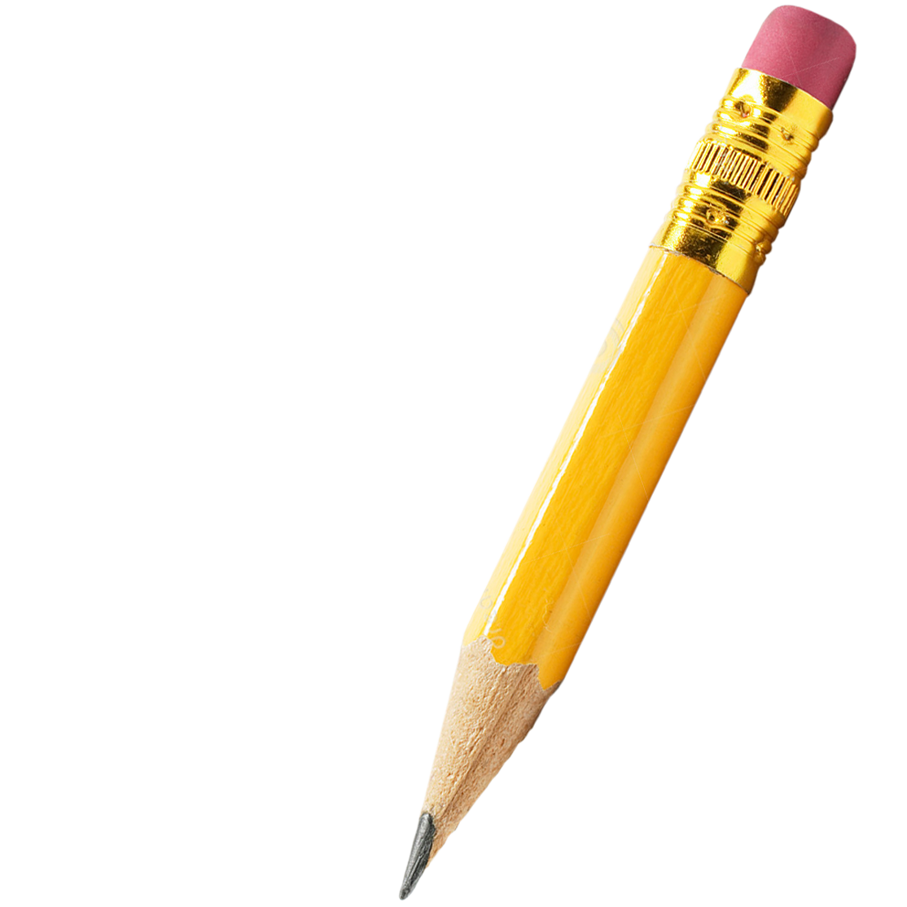
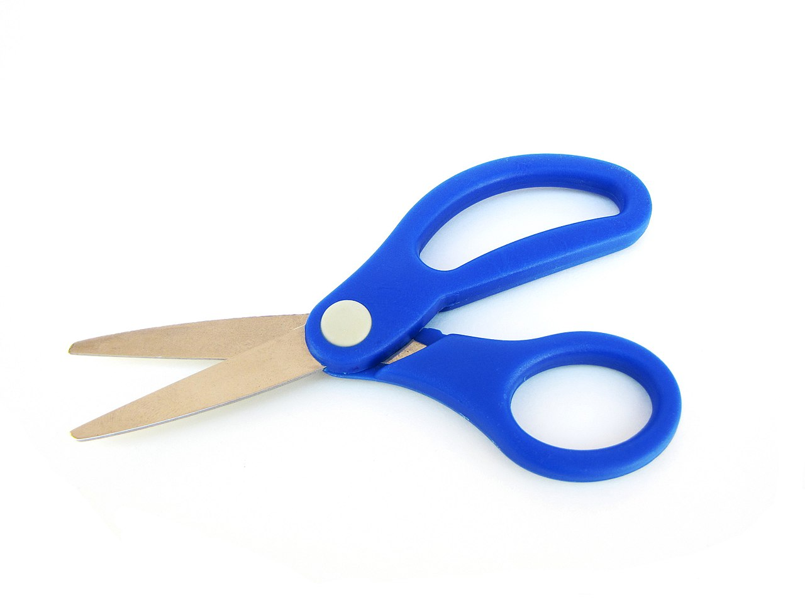
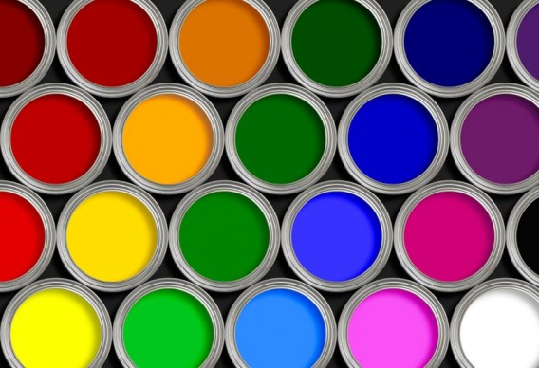
Art time!
You will need:
Paper (white or brown)
Coloured paints (or pens or pencils)
A black or a white paint or thick pen
Thin paintbrush
Scissors
Pencil

Slide 6
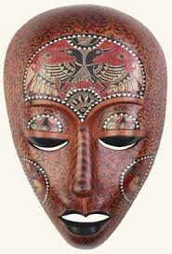
Inspiration for our lesson Today

