Slide 2
Aim
I can order numbers with up to three decimal places.
Success Criteria
I can read and write numbers with up to three decimal places.
I can compare the value of digits in the same place value position.
I can order numbers with different numbers of decimal places.

Slide 3
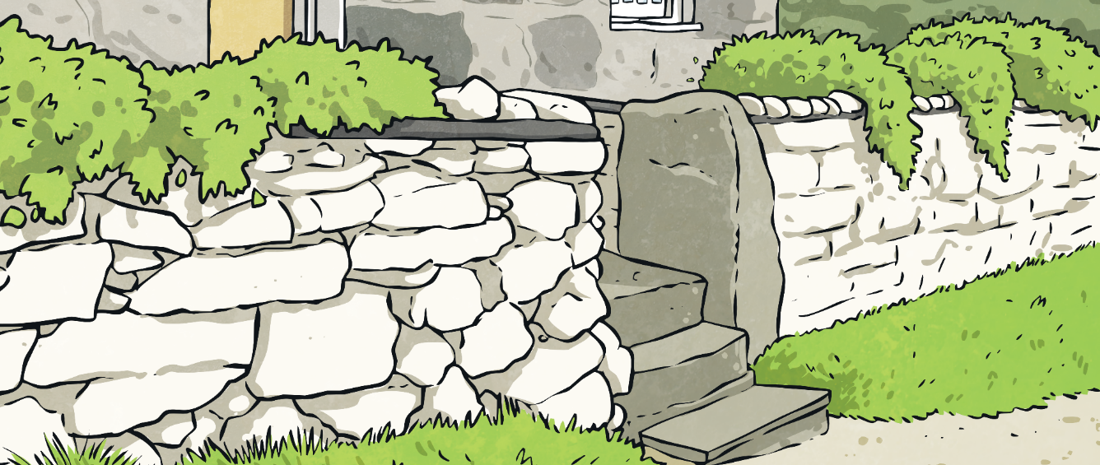
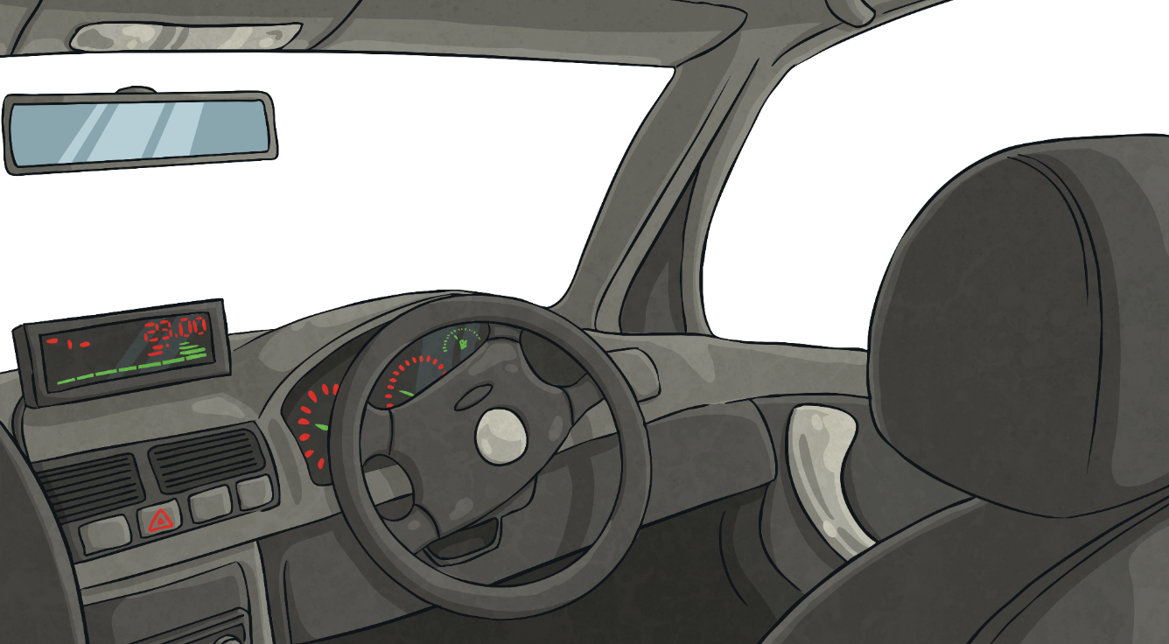
Decimal Subtraction Missing Numbers
0.42
What is the missing number in this decimal number subtraction calculation?
1 - ? = 0.58
0.74
1 - ? = 0.26
How can we use our number bonds to 100 to help find the missing number?
0.91
1 - ? = 0.09
0.27
1 - ? = 0.73

Slide 4
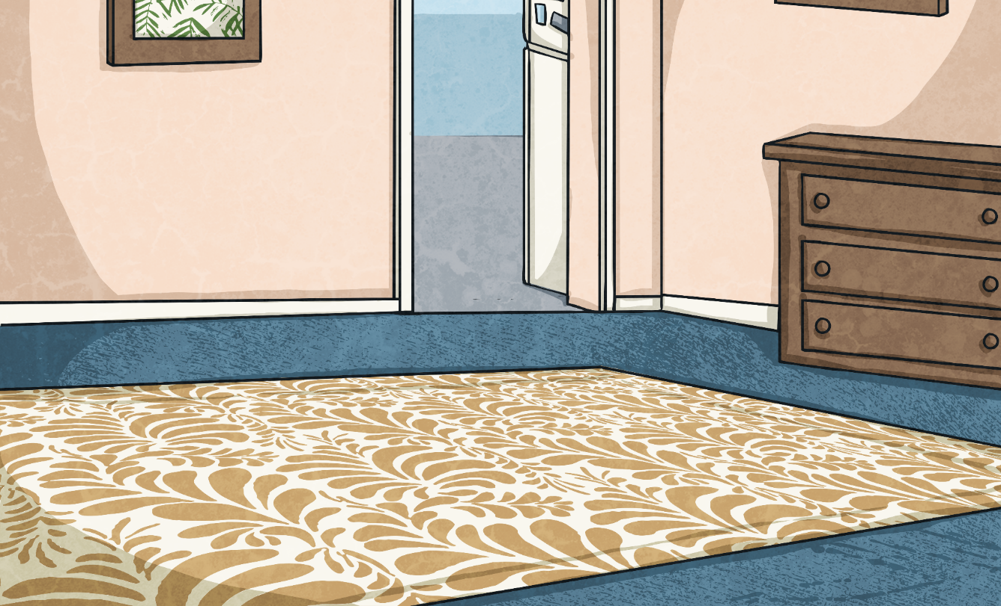
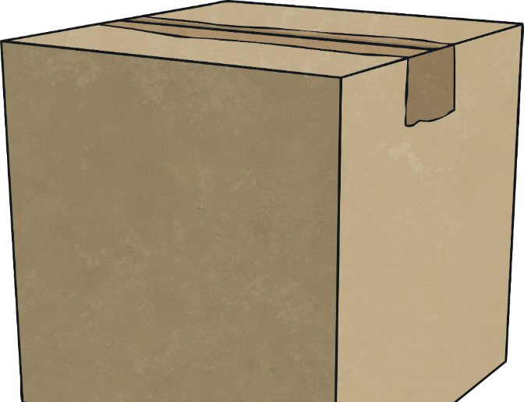
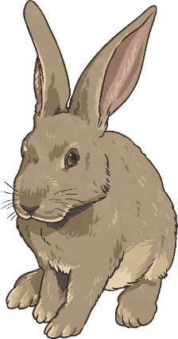
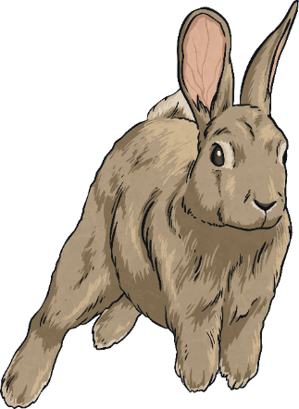
Ordering Decimals
To order decimal numbers we compare the place value of the digits in each number, starting with the digits in the largest place value position.
If the numbers have the same digit in a place value position, we look at the digit in the next place value position to the right until we find a difference.

Slide 5
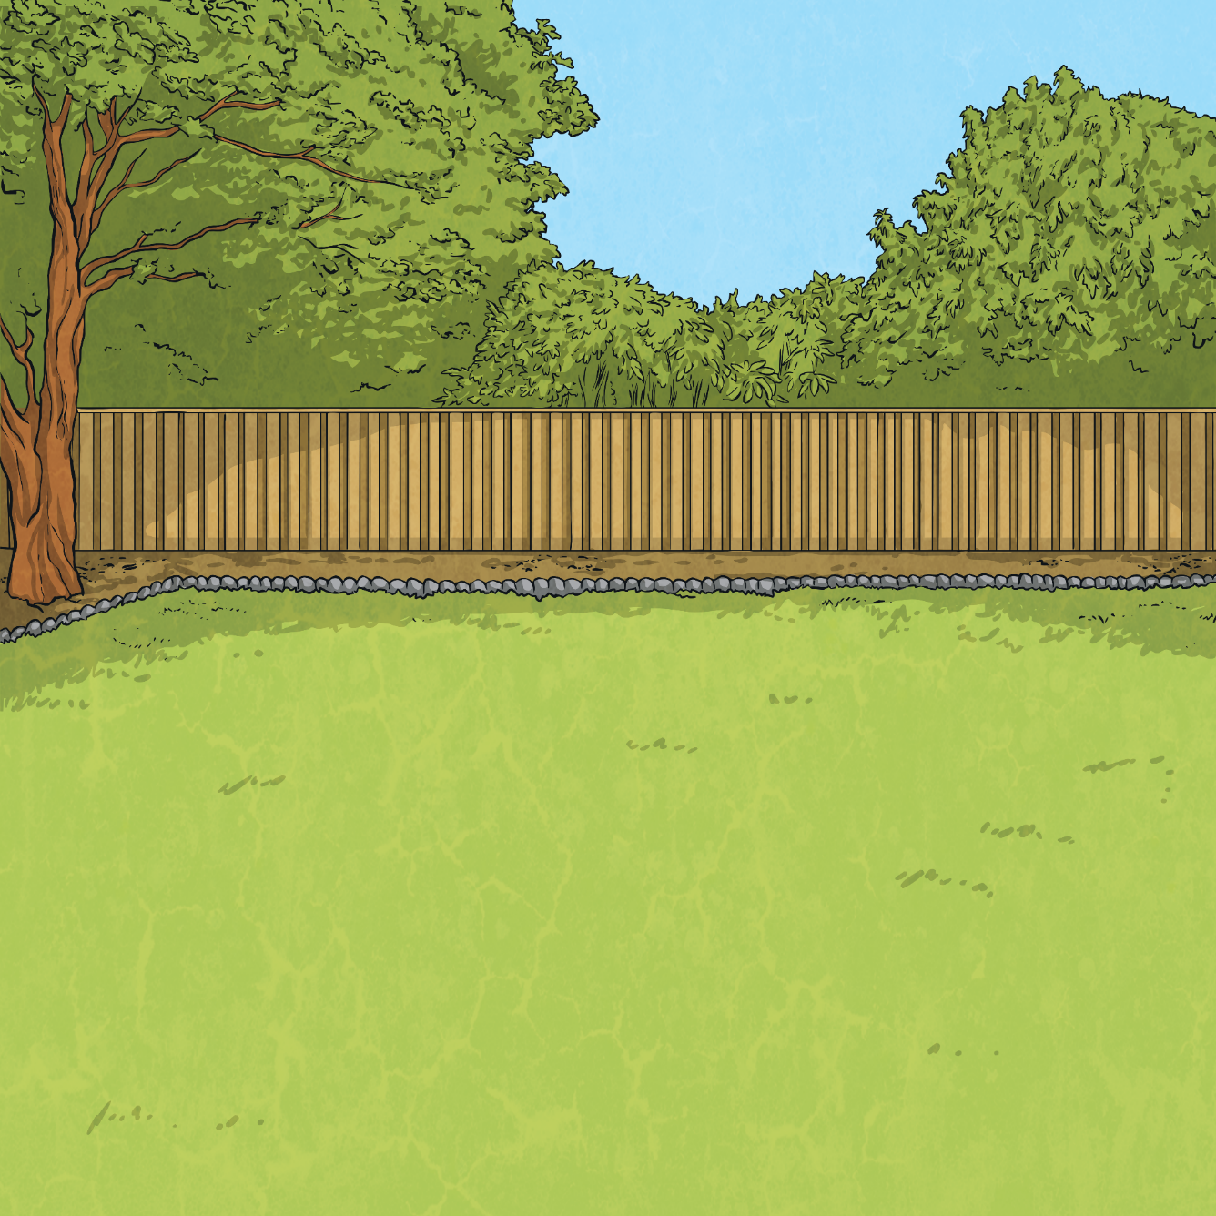
Ordering Decimals
8.6
8.06
8.63
8.36
Finally, compare the digits in the hundredths columns. What do you notice?
Next, compare the digits in the tenths columns.
Which number has the fewest tenths?
Continue to compare the digits in the tenths columns. What do you notice?
Continue to compare the digits in the tenths columns.
Which number has the next fewest tenths?
To order this group of decimals, first compare the digits in the ones columns. What do you notice?
8.6 has zero hundredths and 8.63 has three hundredths. Therefore, 8.63 is the biggest number.
The two remaining decimals both have six tenths.
8.06 has zero tenths, which is fewer tenths than the other numbers. Therefore, we know it is the smallest.
8.36 has three tenths, whereas the other two numbers have six tenths. Therefore, we know it is the second smallest number.
They all have eight ones.
8.06
8.36
8.6
8.63
smallest
largest

Slide 6
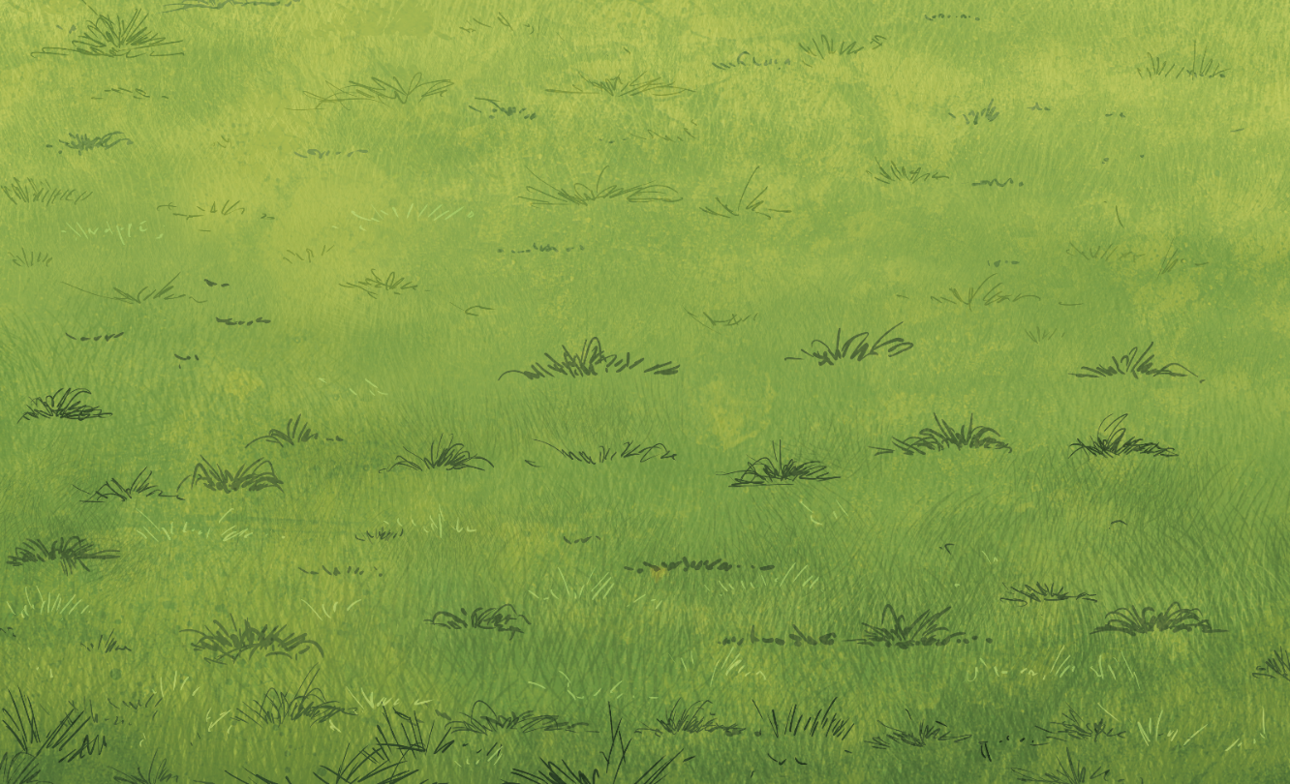
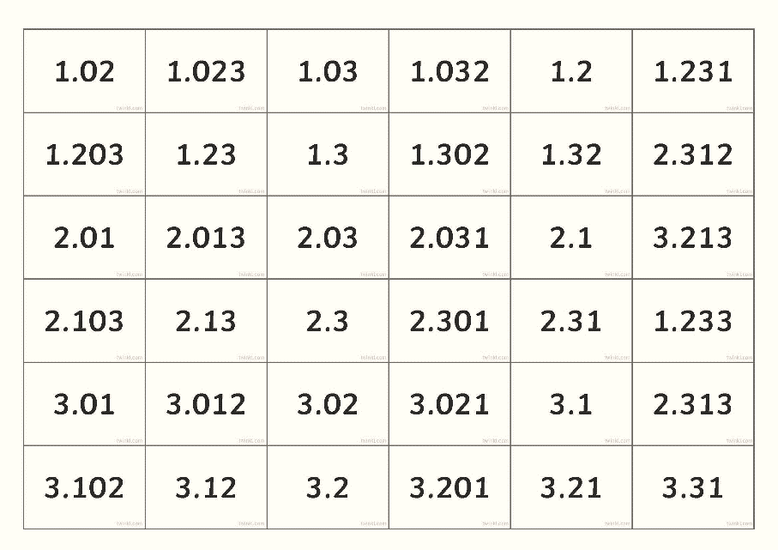
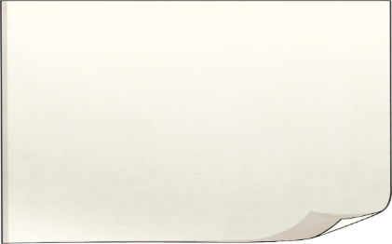
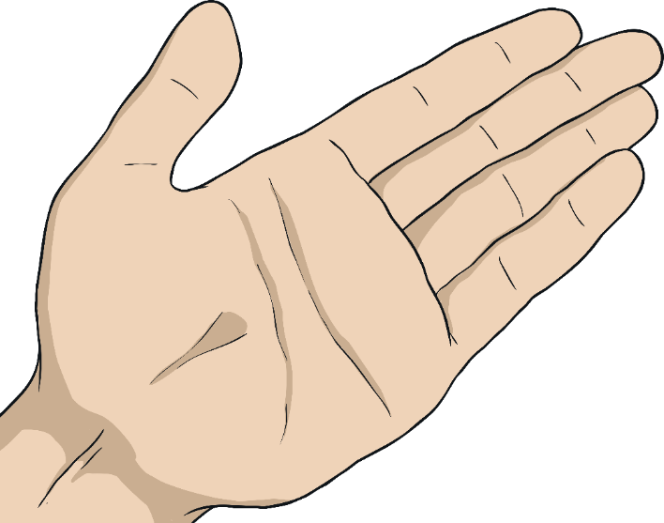
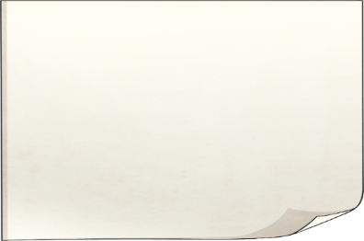
Line Them Up
Work together to line up the cards in order from smallest to biggest.
Explain your reasoning using the language of tenths, hundredths and thousandths.

Slide 7
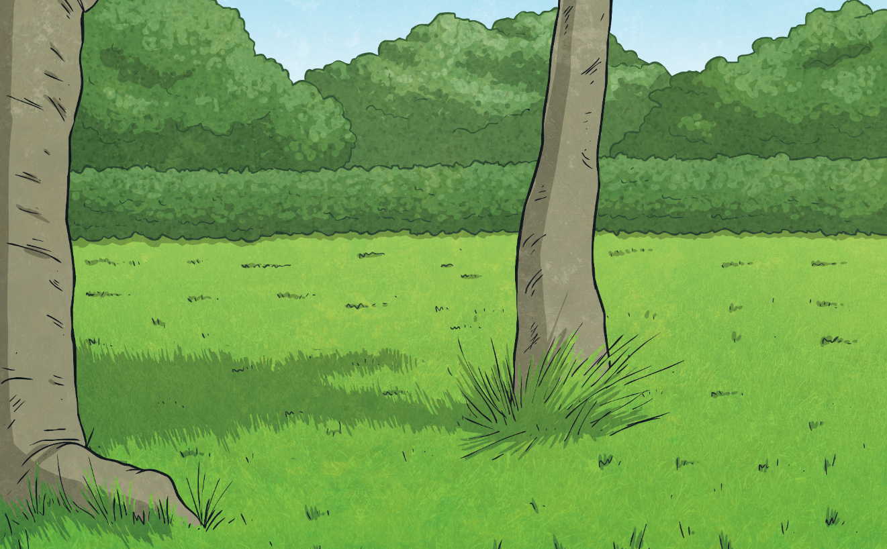
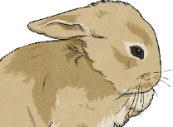
Decimal Number Puzzle
Three mystery decimal numbers appear somewhere on this number line. Use the clues to work out what the numbers are, then position them in order on the number line.
13.633
13.636
13.638
13.63
C
A
B
13.64
Mystery Number A
rounds to 13.64 when rounded to the nearest hundredth. It is two thousandths less than mystery number B.
Mystery Number B
is two thousandths less than 13.64.
Mystery Number C
is three thousandths less than mystery number A.

Slide 8
Aim
I can order numbers with up to three decimal places.
Success Criteria
I can read and write numbers with up to three decimal places.
I can compare the value of digits in the same place value position.
I can order numbers with different numbers of decimal places.

