Slide 2
Aim
I can compare numbers with up to three decimal places.
Success Criteria
I can read and write numbers with up to three decimal places.
I can compare the value of digits in the same place value position.
I can use < and > to compare numbers.
I can compare numbers with different numbers of decimal places.

Slide 3
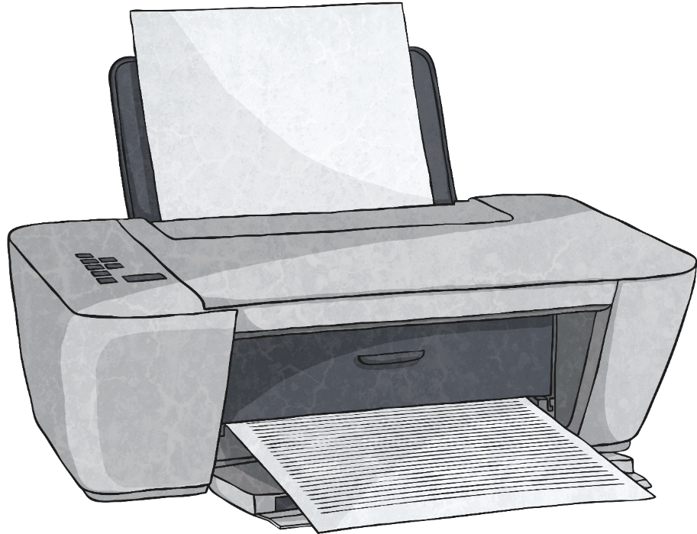
Decimal Missing Numbers
How can we use our number bonds to 10 to help find the missing number?
What is the missing number in this decimal number addition calculation?
?
0.6 + = 1
0.4
?
0.7
0.3 + = 1
0.9
?
0.1 + = 1
0.8 + = 1
0.2
?
Missing
Missing

Slide 4
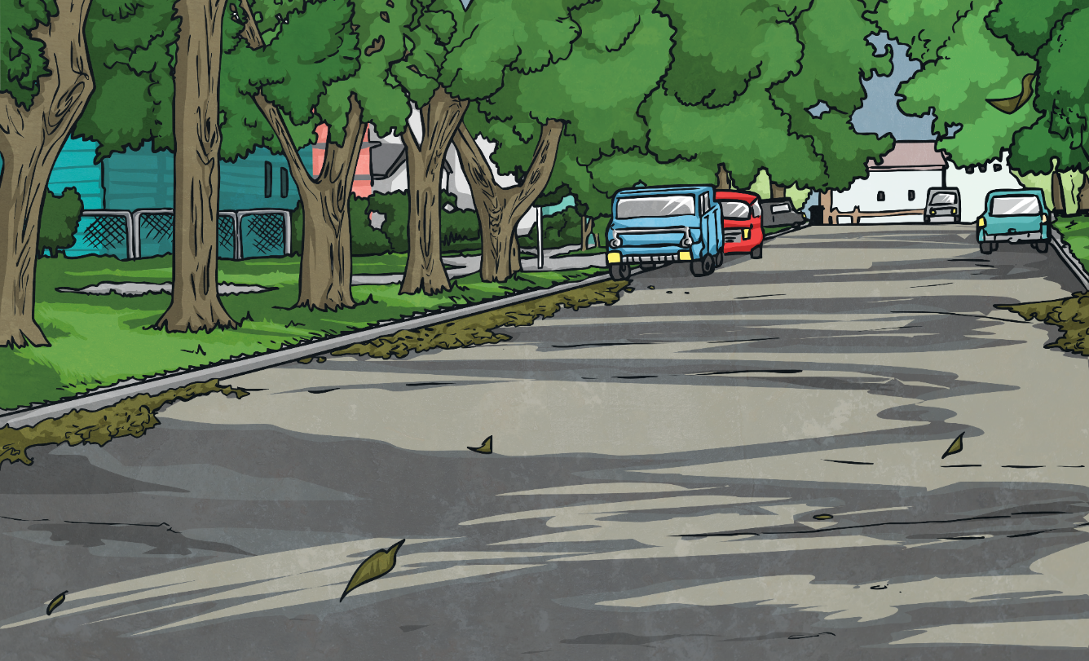
Decimal Missing Numbers
What is the missing number in this decimal number addition calculation?
Missing
How can we use our number bonds to 100 to help find the missing number?
?
0.75
0.25 + = 1
?
0.16
0.84 + = 1
?
0.58
0.42 + = 1
?
0.09
0.91 + = 1

Slide 5
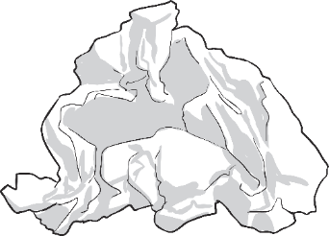
Comparing Decimals
To compare decimal numbers, we look at the place value of the digits in each number, starting with the digits in the largest place value position.
For example, to compare 45.23 and 45.25, we look at the largest digit, the tens, first:
T | O | t | h
4 | 5 | 2 | 3
same | same | same | is less than
4 | 5 | 2 | 5
When comparing numbers, we can use symbols to show which is the smaller or larger number.
45.23 < 45.25
If the numbers have the same digit in a place value position, we look at the digit in the next place value position to the right until we find a difference.
<
>
is less
than
is greater
than

Slide 6
Comparing Decimals
Choose the correct symbol to compare these decimals.
>
0.456
0.426
>
<
>

Slide 7
Comparing Decimals
Choose the correct symbol to compare these decimals.
>
0.213
0.211
>
<
>

Slide 8
Comparing Decimals
Choose the correct symbol to compare these decimals.
<
1.705
1.725
<
>
<

Slide 9
Comparing Decimals
Choose the correct symbol to compare these decimals.
>
3.184
2.184
>
<
>

Slide 10
Comparing Decimals
Choose the correct symbol to compare these decimals.
<
16.392
16.401
<
>
<

Slide 11
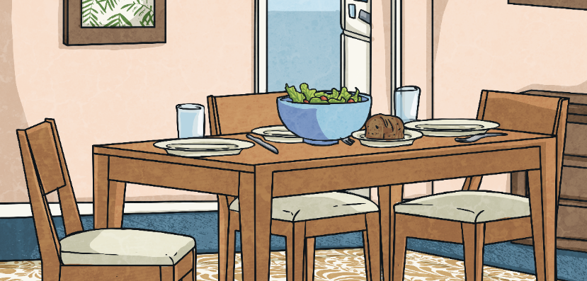
Comparing Decimals
<
>
If the numbers that we want to compare have different numbers of digits, we need to be careful to make sure that we compare the digits that are in the same place value position.
Do we need to compare the digits in any of the other places?
No, because there is already a difference in the largest place value position.
5.234 < 52.34
is less
than
is greater than
For example, to compare 5.234 and 52.34, we could imagine that there are zeros holding the extra spaces in the place value grid.
T | O | t | h | th
0 | 5 | 2 | 3 | 4
is less than
5 | 2 | 3 | 4 | 0

Slide 12
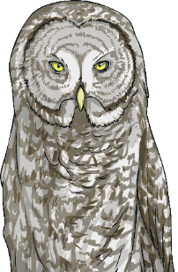
Decimal Number Comparing
Which symbols are needed to complete these maths statements?
We can write longer maths statements using the comparison symbols:
5.635 | > | 5.634 | < | 5.642
26.033 |  | 26.008 |  | 26.03
>
<
25.51 |  | 25.506 |  | 25.056
5.65 | > | 5.465 | > | 5.409
<
>

Slide 13
Aim
I can compare numbers with up to three decimal places.
Success Criteria
I can read and write numbers with up to three decimal places.
I can compare the value of digits in the same place value position.
I can use < and > to compare numbers.
I can compare numbers with different numbers of decimal places.

