Slide 2
We are learning to;
Solve problems involving increasingly harder fractions to calculate quantities.

Slide 3
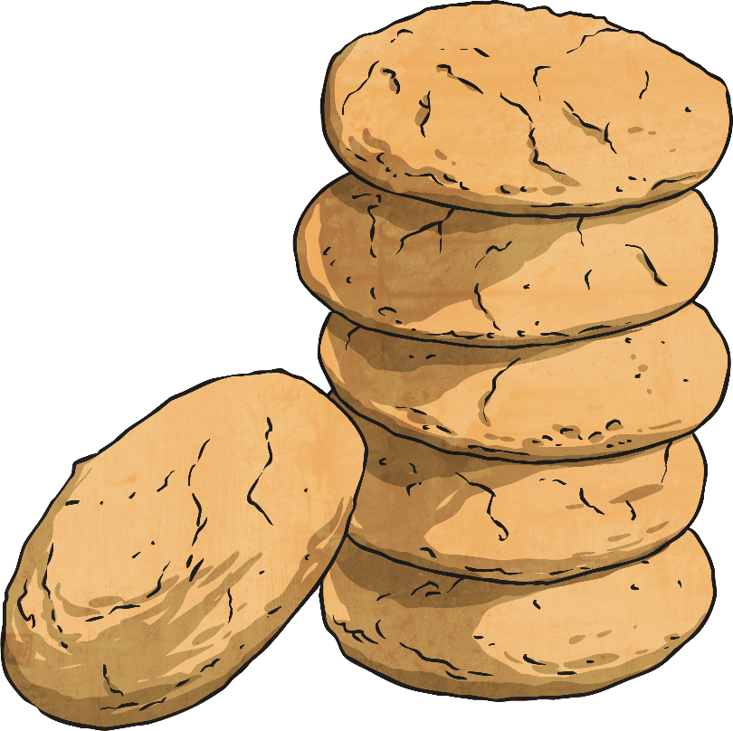
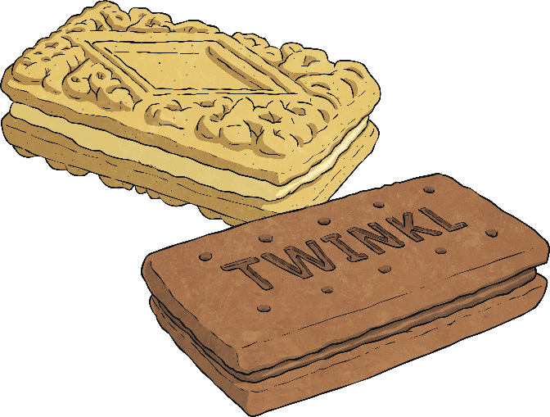
Calculate Fractions of a Quantity
Diving
Chen has 20 biscuits.
Use the counters above to represent Chen’s biscuits and find:
1 2
of 20 =
10
1 4
of 20 =
5
1 5
of 20 =
4
1 10
of 20 =
2

Slide 4
Calculate Fractions of a Quantity
Diving
Use the answers from the previous question to help find:
2 2
of 20 =
20
3 4
of 20 =
15
4 5
of 20 =
16
6 10
of 20 =
12
1 2
of 20 =
10
1 4
of 20 =
5
1 5
of 20 =
4
1 10
of 20 =
2

Slide 5
Calculate Fractions of a Quantity
Diving
Draw this bar model to find and represent:
36
36
9 | 9 | 9 | 9
36
9 | 9 | 9 | 9
36
9 | 9 | 9 | 9
36
9 | 9 | 9 | 9
1 4
of 36 =
36 ÷ 4 =
9
2 4
of 36 =
18
3 4
of 36 =
27
4 4
of 36 =
36

Slide 6
Calculate Fractions of a Quantity
Diving
Draw a bar model to help solve this problem.
3
8
Mary uses of a 400g bag of flour to make some cakes.
a) How many grams of flour did Mary use?
150g
b) How many grams of flour were left in the bag?
250g
400
50 | 50 | 50 | 50 | 50 | 50 | 50 | 50

Slide 7
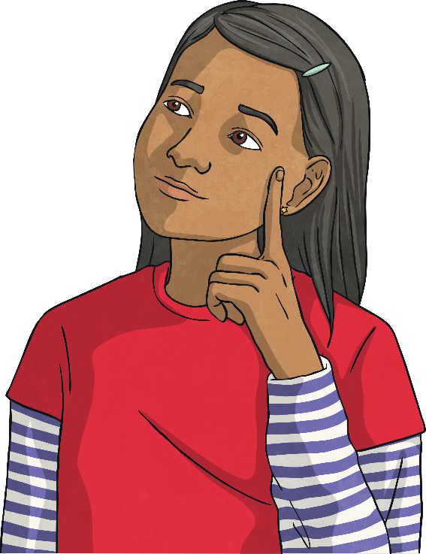
Calculate Fractions of a Quantity
Deeper
Which is the odd one out and why?
a)
3
5
of 30 =
18
The odd one out is c) because it equals 8. Both a) and b) equal 18.
b)
2
9
of 81 =
18
c)
2
6
of 24 =
8

Slide 8
Calculate Fractions of a Quantity
Deeper
5
10
Explain the mistake.
Draw a bar model to help.
of 80 = 8
This is incorrect. They have divided the quantity (80) by the denominator (10). They have worked out the value of one tenth, which is 8, but then have forgotten to carry out the second calculation to find the value of five-tenths. They should have then multiplied 8 by the numerator (5) to make 40.
80
8 | 8 | 8 | 8 | 8 | 8 | 8 | 8 | 8 | 8
5
10
of 80 = 40

Slide 9
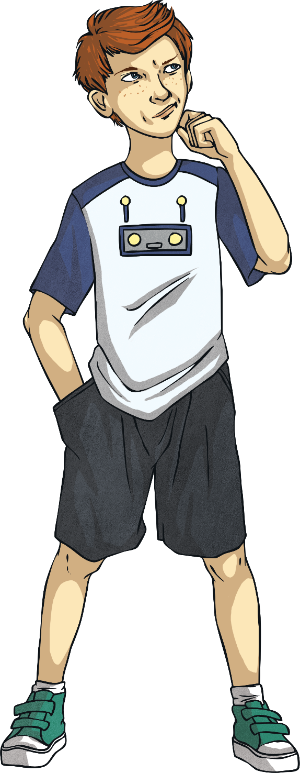
Calculate Fractions of a Quantity
Deeper
6
6
3
4
of 30 is less than of 44.
True or false? Convince me.
30
5 | 5 | 5 | 5 | 5 | 5
66
True, is the same as a whole. of 30 = 30 and of 44 = 33 making of 30 is less than of 44.
66
3
4
66
3
4
44
11 | 11 | 11 | 11

Slide 10
Calculate Fractions of a Quantity
Deeper
Complete the calculations.
2
of 33 = 22
3
5
9
36
of = 20

Slide 11
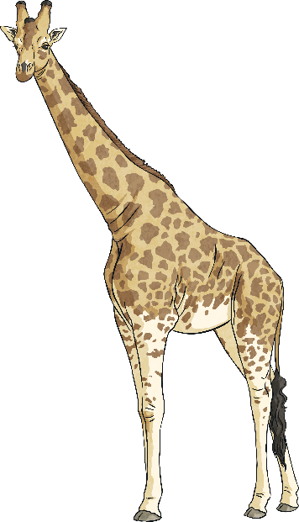
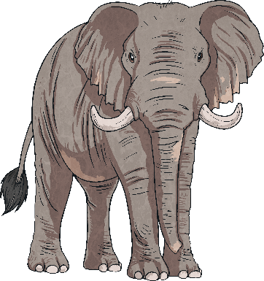
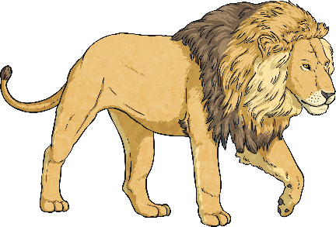
Calculate Fractions of a Quantity
Deepest
Solve this problem.
Flavia saw 64 animals whilst on safari in Africa.
Some of the animals she saw were elephants, of the animals she saw were lions and of the animals she saw were giraffes.
What fraction and quantity of the 64 animals she saw were elephants?
1
4
64
8 | 8 | 8 | 8 | 8 | 8 | 8 | 8
64
8 | 8 | 8 | 8 | 8 | 8 | 8 | 8
64
8 | 8 | 8 | 8 | 8 | 8 | 8 | 8
5
8
64
8 | 8 | 8 | 8 | 8 | 8 | 8 | 8
1
4
2 8
lions = = = 16
5 8
giraffes = = 40
1 8
1 8
= 8 of the animals are elephants.
elephants = = 8

Slide 12
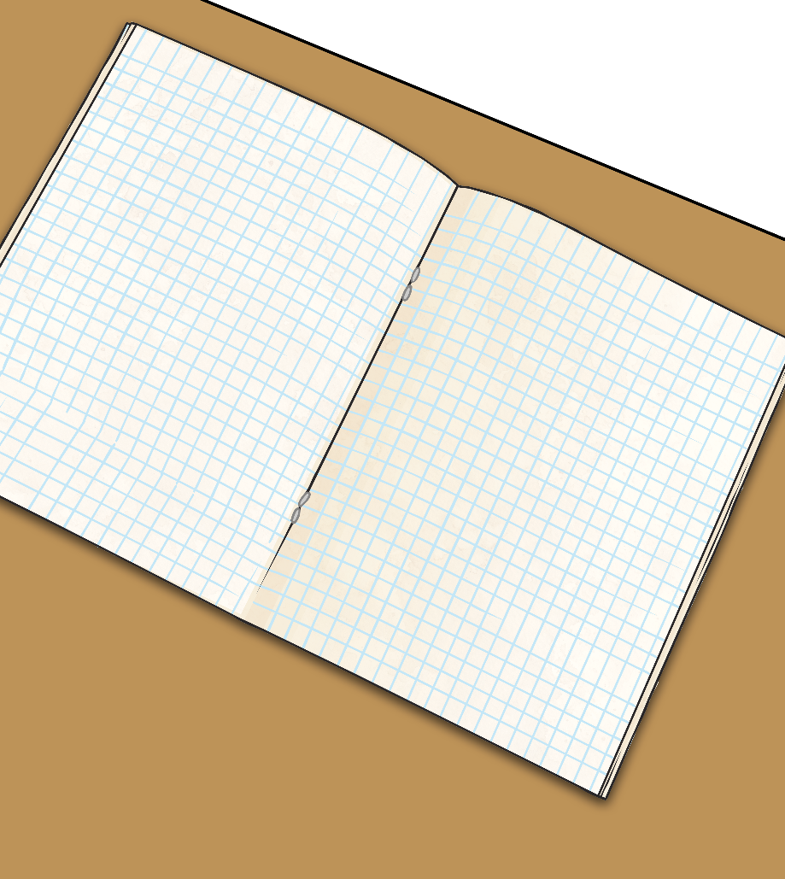
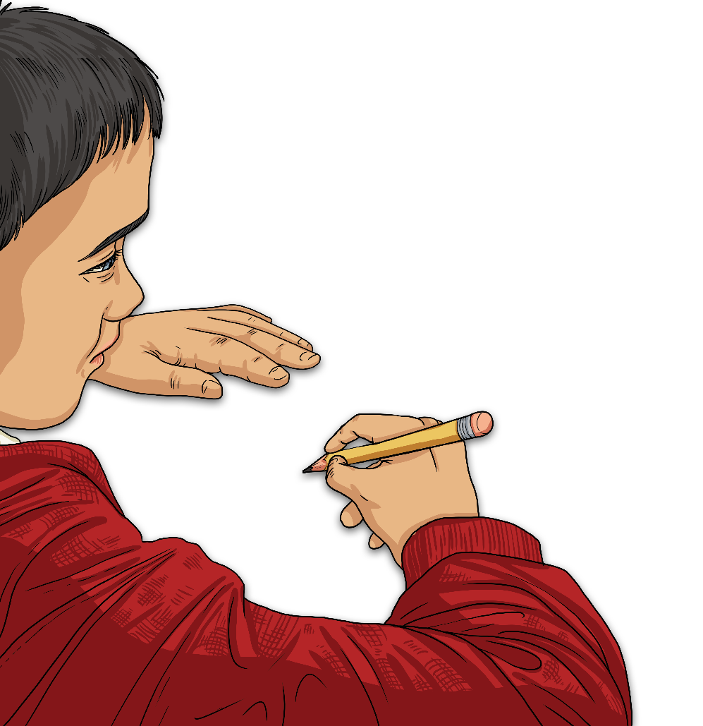
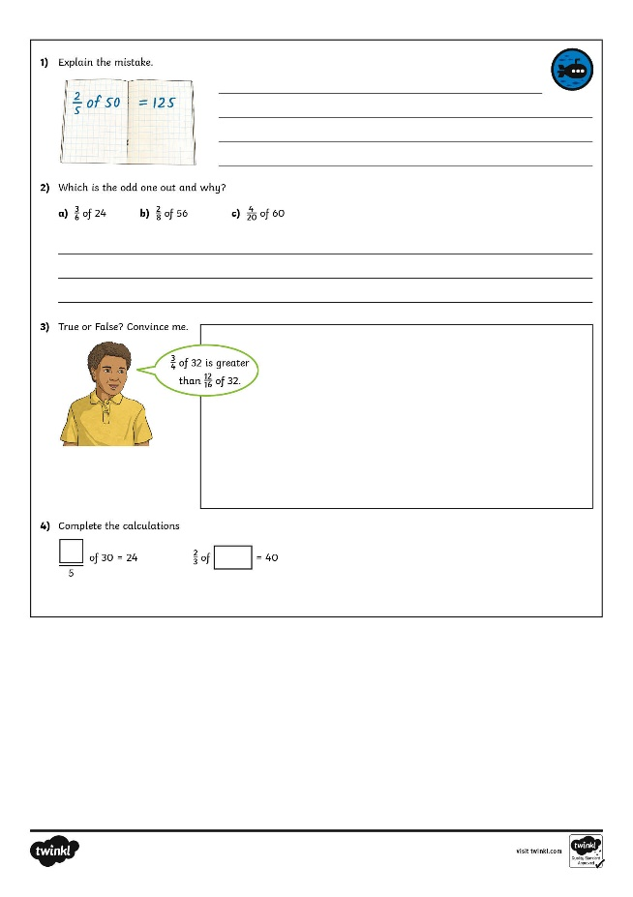
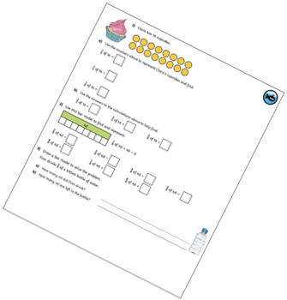
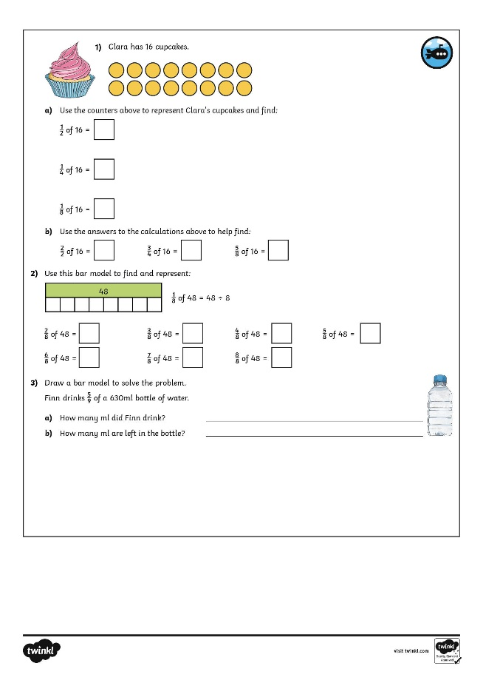
Calculate Fractions of a Quantity
Dive in by completing your own activity!

