Slide 1
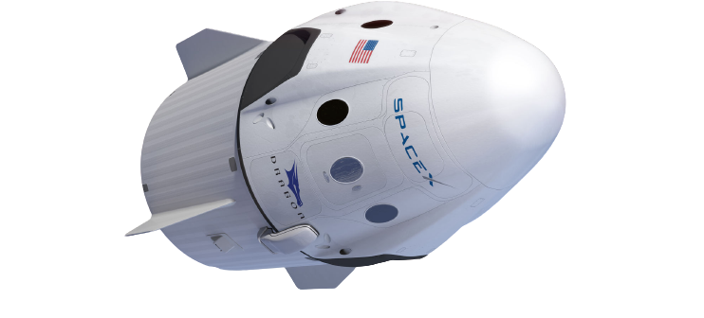
DRAGON ROARS INTO SPACE
Text Focus: Newspaper

Slide 2
Today we are learning to…
identify new words when you read and discuss their meaning in context
explain and justify using evidence from the text
retrieve simple facts

Slide 3
Before beginning…
What can you remember about the features of a NEWSPAPER ARTICLE?
Newspaper
Notes:
Draw children’s attention to 5Ws, past tense, headlines, captions, photographs, interviews, witness statements.

Slide 4
Task 1: Read ‘Dragon Roars into Space’
While you are reading, you may wish to:
Underline and identify any new, unknown words
Underline any interesting facts
Challenge:
What does ‘remained in the realm of science fiction fantasy’ mean?
Notes:
You may wish to read this first and have the children follow along and then read on their own.

Slide 5
Task 1: Read ‘Dragon Roars into Space’ Read this extract from the text. Think carefully about punctuation and how to make the speech sound engaging!
As they left the Earth’s atmosphere, Behnken said that Earth was, “a single planet with a shared atmosphere. It’s our shared place in this universe.”

Slide 6
Task 2: Quick-fire retrieval
Write the answers to these!
1) Who spoke these famous words? “One small step for man. One giant leap for mankind.”
2) When did the first-ever private spacecraft dock with the International Space Station?
3) Who owns SpaceX?
4) Where did SpaceX Demo-2 launch from?
Notes:
You could set a timer and give the children 5 minutes to find the answers.

Slide 7
Task 2: Quick-fire retrieval ANSWERS
1) Who spoke these famous words? “One small step for man. One giant leap for mankind.” Neil Armstrong
2) When did the first-ever private spacecraft dock with the International Space Station? 31st May 2020
3) Who owns SpaceX? Elon Musk
4) Where did SpaceX Demo-2 launch from? Cape Canaveral in Florida
Notes:
You could set a timer and give the children 5 minutes to find the answers.

Slide 8
Task 3: Vocabulary Check Complete this table to show your understanding of these words
Word | Have you heard the word before? | What do you think it means? | Use in a sentence of your own
realm
immortal
frontiers
Notes:
Children could use a scale to indicate if they have heard the word before – 1 indicating no, I’ve never heard it before and 5 indicating yes, I know this word well.

Slide 9
Task 4: Vocabulary Synonyms
The idea of sending civilians into space, or colonising Mars…
What does the word colonising mean in this sentence?
Tick one.
 | Tick one
controlling
loading
populating
coding

Slide 10
Task 4: Vocabulary Synonyms
Look at: It was created in 2002 with the eventual aim of sending civilians into space.
What does the word aim mean in this sentence?
Tick one.
 | Tick one
goal
time
targeted
journey

Slide 11
Task 5: True or false? Using information from the text, tick one box in each row to show whether each statement is true or false.
STATEMENT | TRUE | FALSE
Reusable technology will make future space flight more expensive and more less efficient.
The SpaceX Demo-2 was the first crewed ship to launch from American soil since 2011.
On the 31st May 2017, the first-ever private spacecraft docked with the International Space Station
Doug Hurley has spent over 683 hours in space.
Notes:
Challenge: Can children make up their own true/false statements to test a partner?

Slide 12
Task 6: Inference Using information from the text, tick one box in each row to show whether each statement is a fact or an opinion.
STATEMENT | FACT | OPINION
The Falcon 9 rocket that launched the shuttle is one of the world’s most reusable rockets.
Doug Hurley is an amazing, wonderful person.
The Dragon shuttle, SpaceX Demo-2, launched from Cape Canaveral in Florida on the 30th May.
Notes:
Content domain: 2d – make inferences from the text / explain and justify inferences with evidence from the text. Award 1 mark for all three correct.

Slide 13
Task 7: Summarise
As they let the Earth’s atmosphere, Behnken said that Earth was, “a single planet with a shared atmosphere. It’s our shared place in this universe.”
What do you think astronaut Robert Behnken meant be this?

Slide 14
You have reached the end of the lesson!
Summarise this newspaper text in one word and explain your word choice.
What features of a newspaper text can you find in ‘Dragon Roars into Space’? What features are missing?
Can you think of a new headline for this newspaper article?
Notes:
Encourage children to justify and explain.

