Slide 2
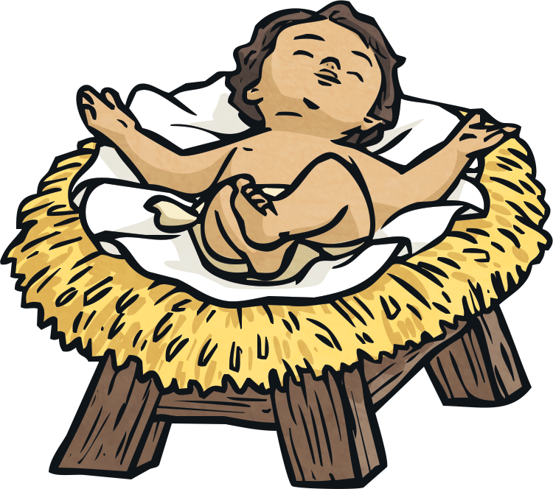
What is Epiphany?
Epiphany is a Christian feast day of celebration.
The earliest mention of Epiphany as a Christian feast was in A.D. 361 by Ammianus Marcellinus, who was a Roman soldier.
The word epiphany comes from the verb “to appear.” The feast of Epiphany is the celebration of baby Jesus being revealed or seen by the visitors who traveled a great distance.
Who do you think these visitors were?

Slide 3
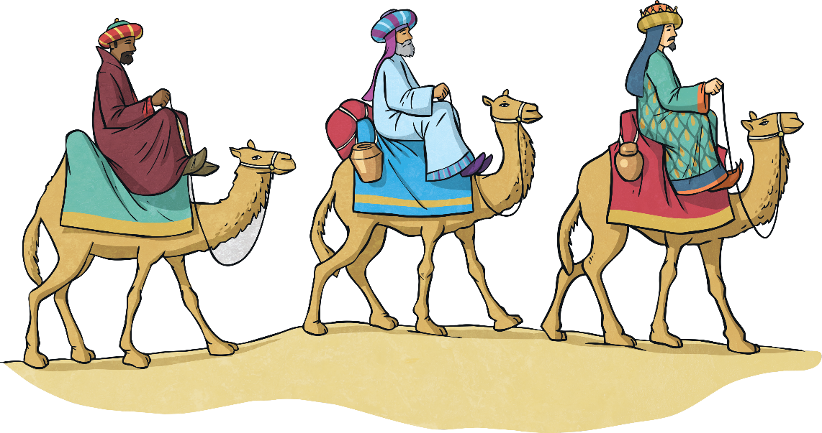
The Visitors
The visitors were the Three Wise Men. They are sometimes called the Three Kings.
They studied the stars and constellations. In those days, people “read” the stars and interpreted what they meant.
These men lived in the East. They were possibly from Persia, which is now called Iran.
Did you know?
The Wise Men are often called Magi, which was a word given to describe priests and clever men.

Slide 4
The Meaning of the Star
The Three Wise Men were very clever and understood the religious writings that were written many years before.
These religious writings told them that one day there would be a great star seen in the sky. This star would signify that a new King had been born.
When they saw this star, the men decided to pack up their belongings and follow the star to wherever it led them.
What do you think this tells us about these men?

Slide 5
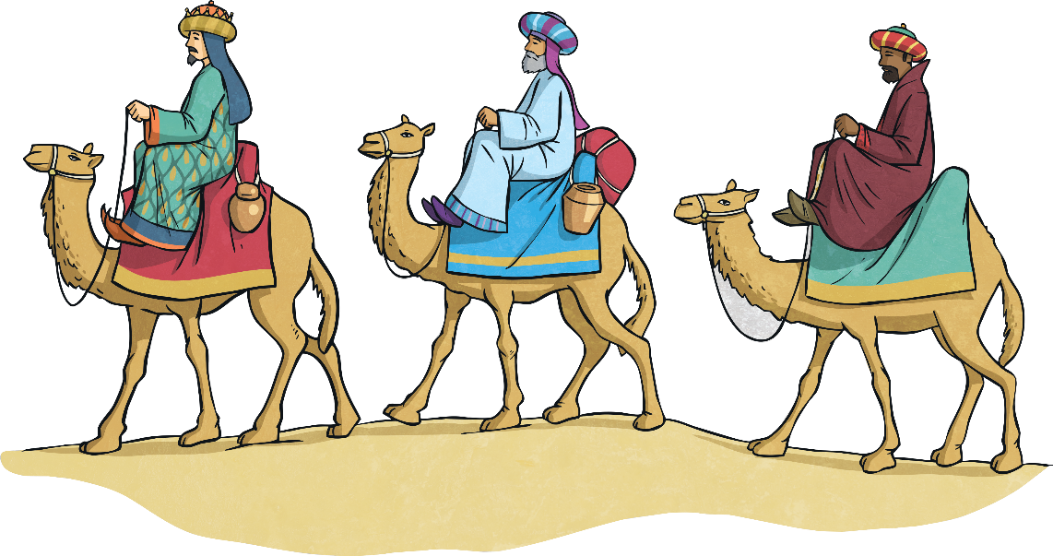
The Journey
The journey would have been very long and challenging.
The Wise Men probably traveled on camels, across deserts, and over mountains, in extreme weather.
The star led them to the town of Bethlehem in Israel.
What difficulties do you think they might have faced on their journey?

Slide 6
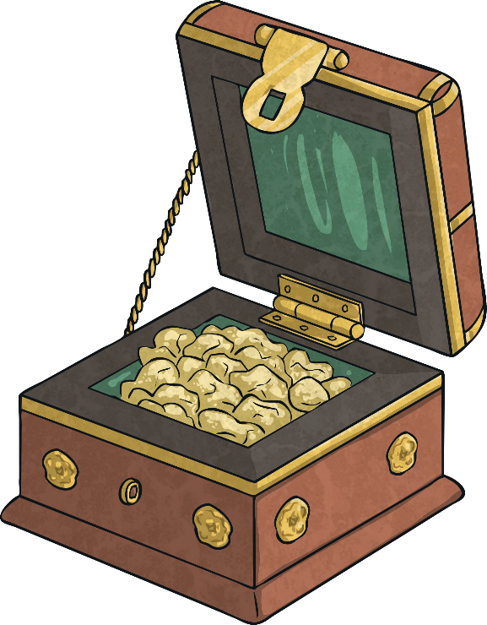
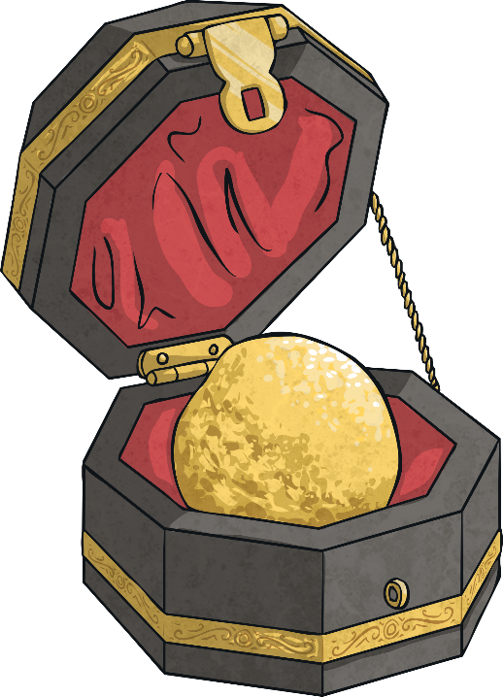
The Three Gifts
The Wise Men brought expensive gifts with them. These gifts were suitable for a King.
They brought frankincense, which was a sign of their faith.
They brought gold, which was a sign of their love.
Gold was a very precious and expensive metal.
Frankincense was an expensive sap from an African tree. It could be burned to release a calming scent.

Slide 7
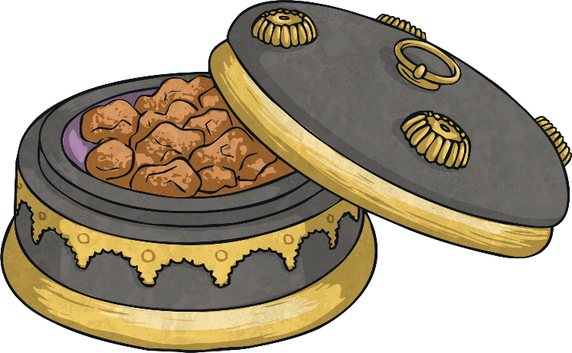
The Three Gifts
The Wise Men brought expensive gifts with them.
They also brought myrrh, which was a sign of obedience to the King.
Why do you think the Wise Men are often called the Three Kings?
Myrrh was also the sap from an African tree. The tree grew in rocky, shallow ground. Holiness is symbolized through the anointing or rubbing of myrrh oil.

Slide 8
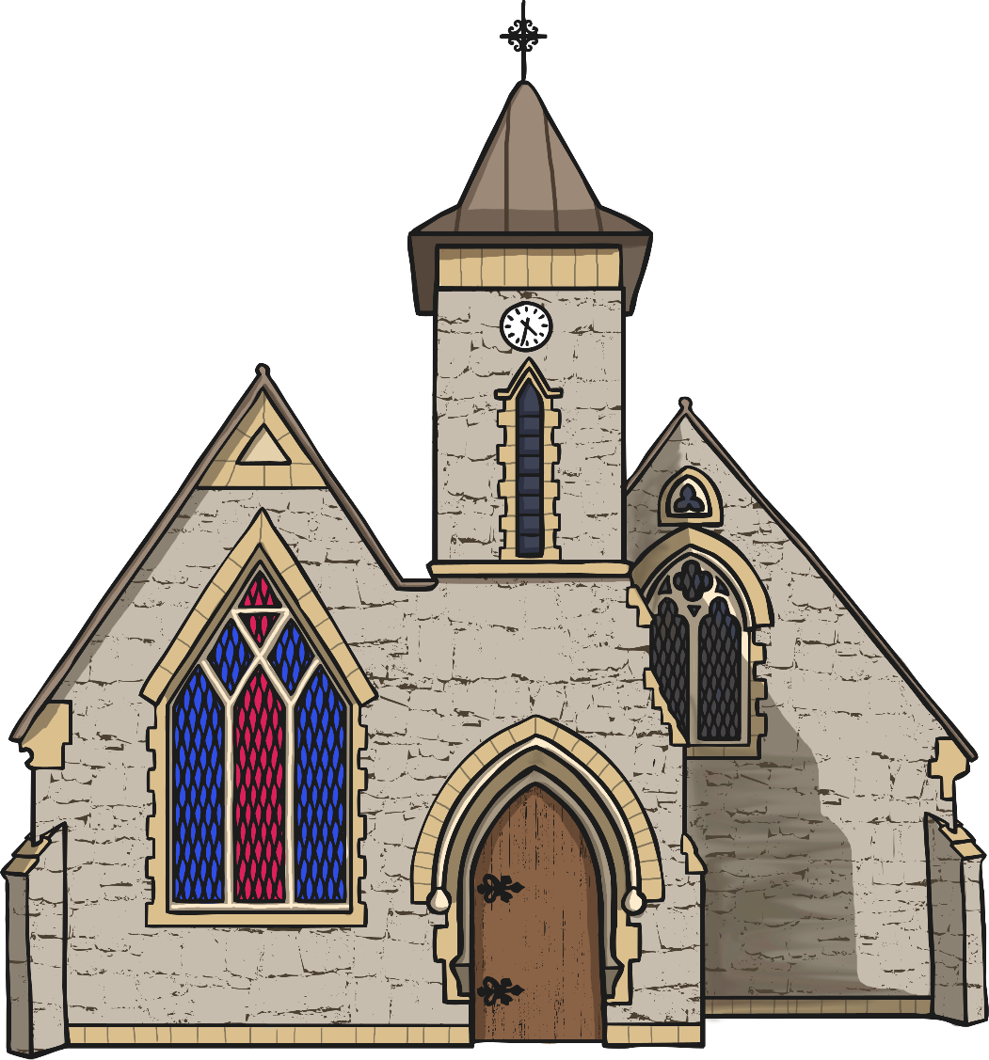
The Feast of Epiphany
The feast of Epiphany is celebrated in Christian churches, usually on January 6 or the Sunday nearest this date.
How do we know about this story?

