Slide 1
St Mary’s RC primary school Thursday 11.03.21
P4 & P5

Slide 2
Morning Prayer
Father in heaven you love me
You are with me night and day
I want to love you always
In all I do and say
I’ll try to please you Father
Bless me through this day
Amen

Slide 4
Literacy - writing
Learning Intention:
We are learning to write a poem.
Success Criteria:
I understand the main ideas involved in creating a poem.
I can create my own word plans for my poem
I can plan the key words of my poem using my senses as a guide.

Slide 5
St Mary’s & sky Poetry Competition
for
World Poetry Day 2021 – Part 1

Slide 6
What has been happening around the world to stop us from being at school?

Slide 7
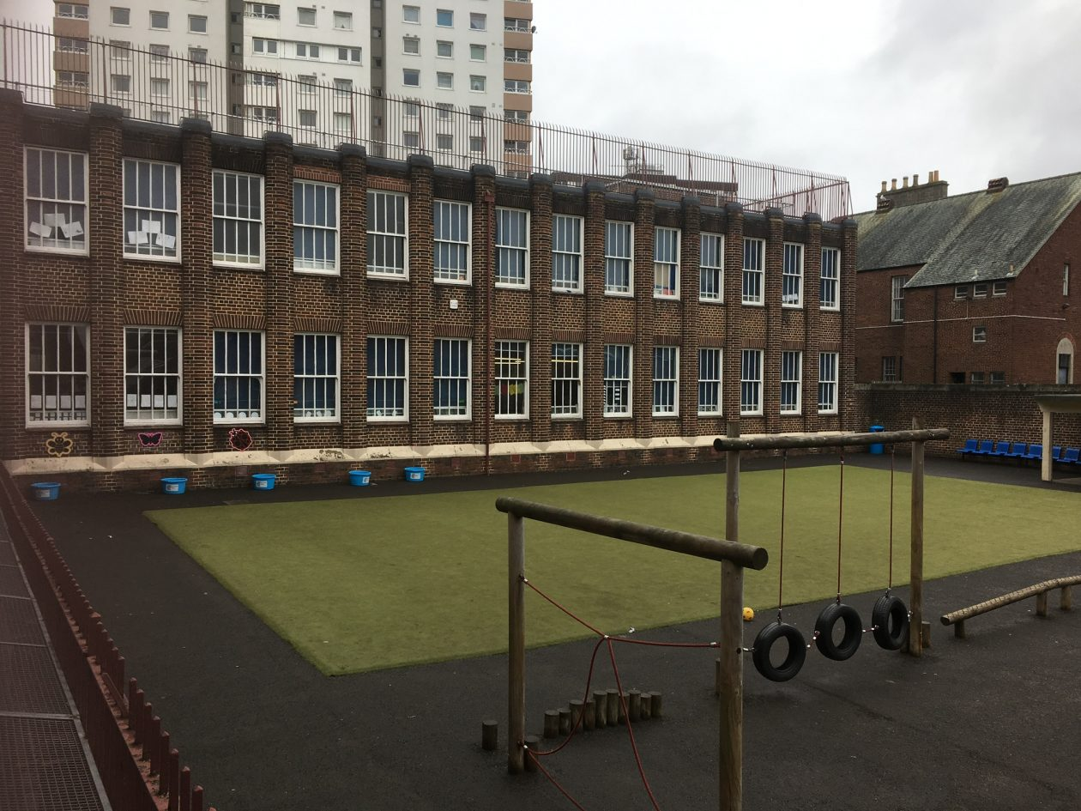
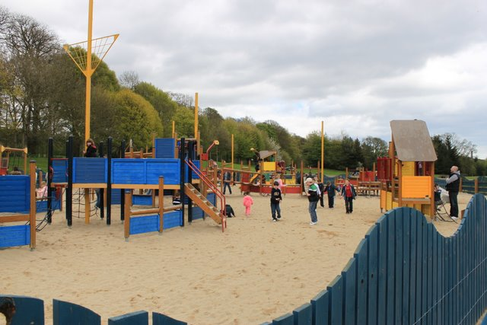
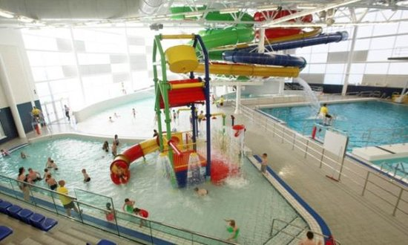
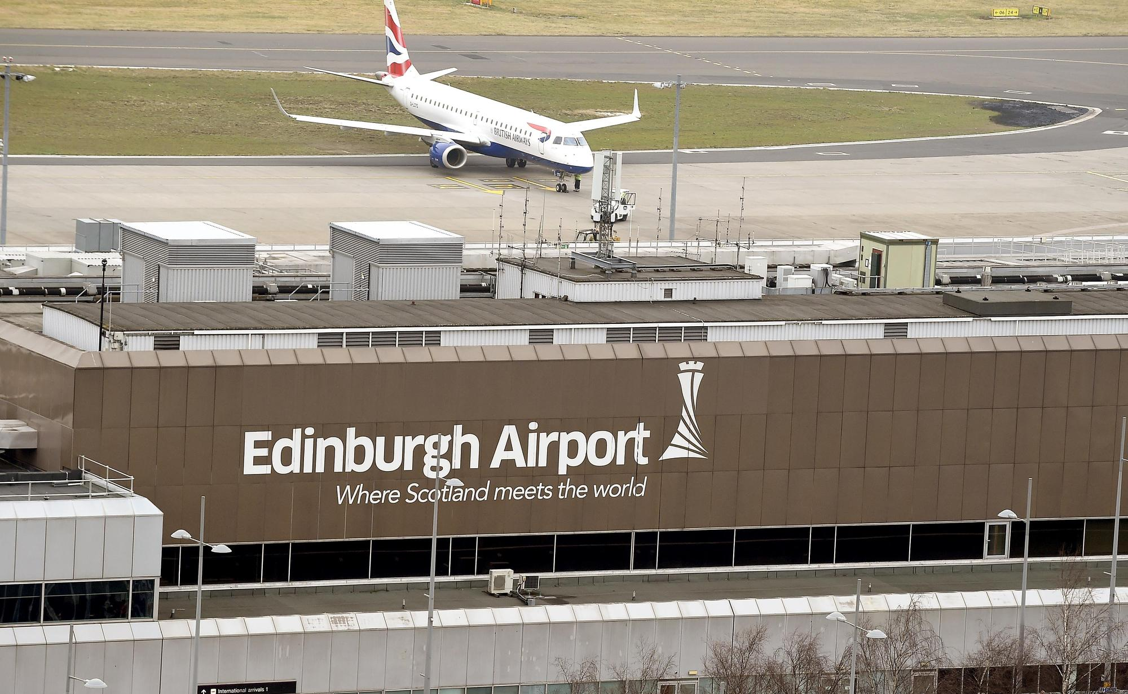
What were we not allowed to do?

Slide 8
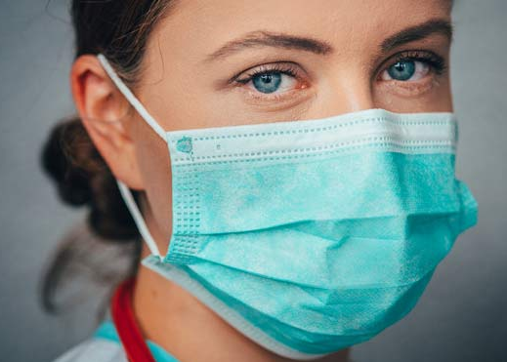
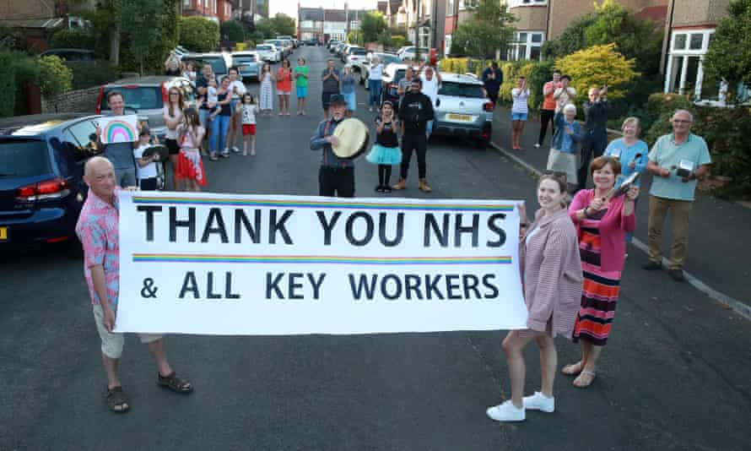
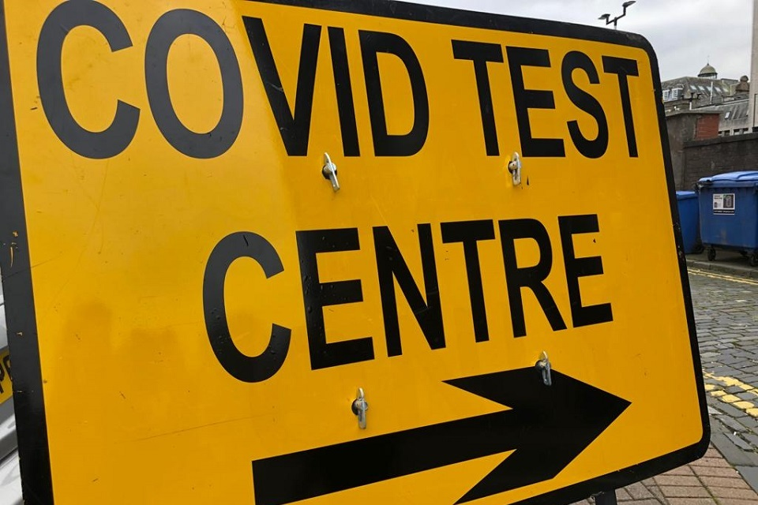
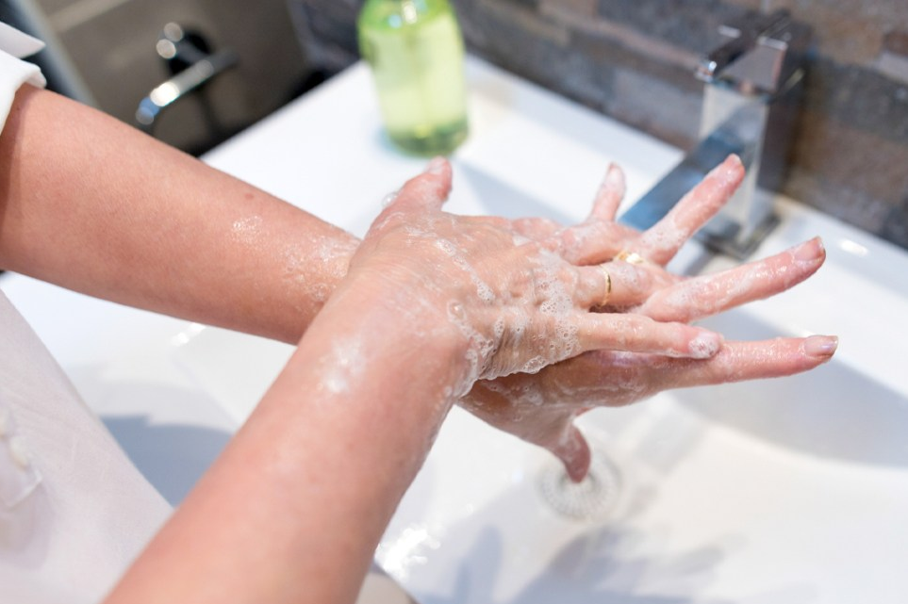
What were we asked to do?

Slide 9
Life has changed for everyone because of Covid but the power of words hasn’t changed at all.
To celebrate World Poetry Day on 21 March, want the teachers of St Mary’s to inspire students to express themselves with their words.
want us to inspire YOU to write poetry.

Slide 10
What is poetry?
Poetry is language that is written following specific patterns, rhythms, structures, and/or rhymes to express the poets ideas and emotions.
Poetry is usually used to express deep, dramatic, exaggerated, and intense feelings, emotions, or ideas. Oftentimes, poetry is used to explore ideas or feelings that may be more difficult than simple language can explain.

Slide 11
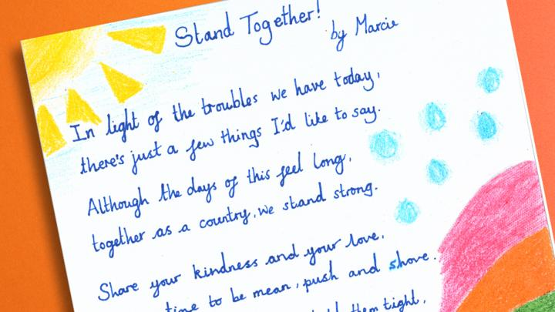
So, what are poems?
Well, a poem is a piece of writing that uses imaginative words to share ideas, emotions or a story with the reader.
A person who writes a poem is called a poet.
Many poems have words or phrases that sound good together when they are read aloud.
Most poems for children rhyme or they have rhythm (just like music) or repetition. But a poem doesn’t have to rhyme!
They can all look very different. Take a look at some examples.

Slide 12
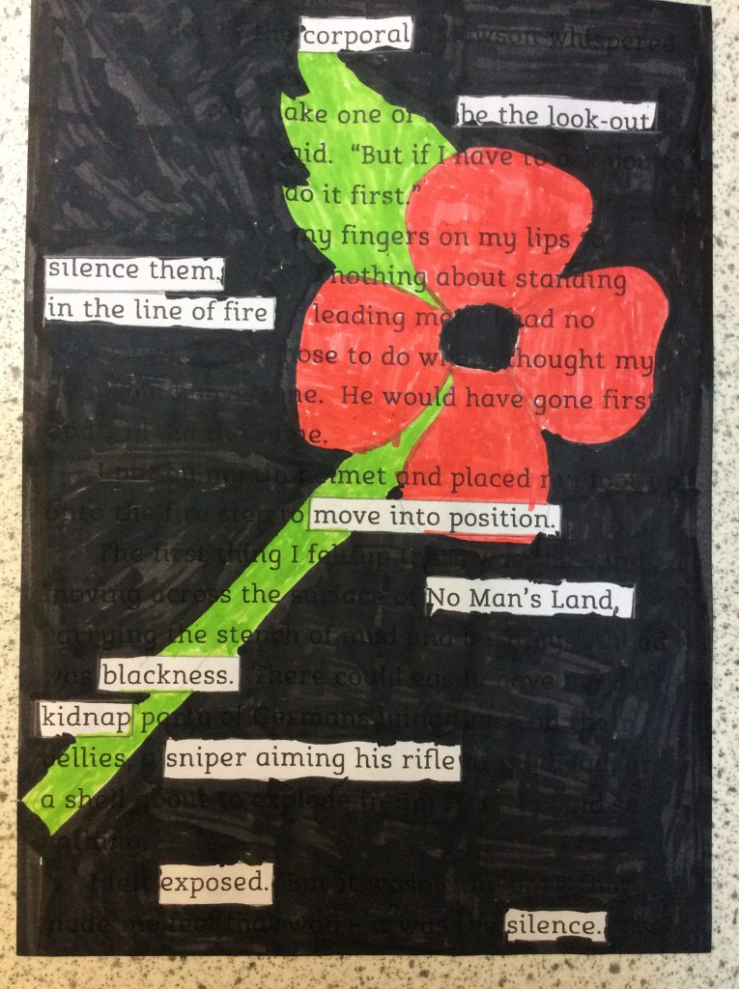
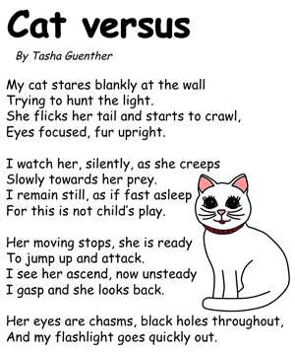
Examples of Poems

Slide 13
People have been writing poetry for over 4,000 years, but they were probably making up verses to recite in front of audiences long before that.
Poetry is important because:
It builds creativity, communication and teamwork skills which essential for working in the future.
It provides young people to have an opportunity to express themselves and supports their mental wellbeing.
It teaches children the basis of spoken language with song, rhymes and story creation.

Slide 14
Why is sky involved?
, a company we know for providing us with a
variety of different TV channels to watch our favourite programs, are working with a company called Apples and Snakes to create a Cento. A Cento is a piece of poetry made up of verses or passages by a number of poets. It can become a huge piece.
Imagine all the words of the pupils at St Mary’s put together to create one big piece of poetry.

Slide 15
Apples and Snakes, the company working with supports performance poetry and spoken word in the UK. Here is a short video that shows how they started and explains the Short History of Spoken Word Poetry
https://youtu.be/2_uEptEFlAU

Slide 16
So, what do I need to do?
‘s competition invites all pupils at St Mary’s to learn about writing poetry.
They would like you to think about your thoughts and feelings during lockdown, and for you to express/share them in a poem.

Slide 17
What is the prize?
Here’s what you could win:
Your poetry featured in a Cento made by Apples and Snakes
Your poetry on the TV - featured in a broadcast on a Sky channel
A certificate for your poem

Slide 18
Skills for Poetry
Getting started
STEP 1: We start our poems by brainstorming our ideas.
TASK: Grab a piece of paper and in the centre of your page write ‘LOCKDOWN’ and put a bubble around it.

Slide 19
Create Prompts
STEP 2: Split your page into 4 parts. Then write the first 4 words that you think of, good or bad when you think about the word 'Lockdown’ as titles in each section.
Word 1
Word 2
Word 3
Word 4

Slide 20
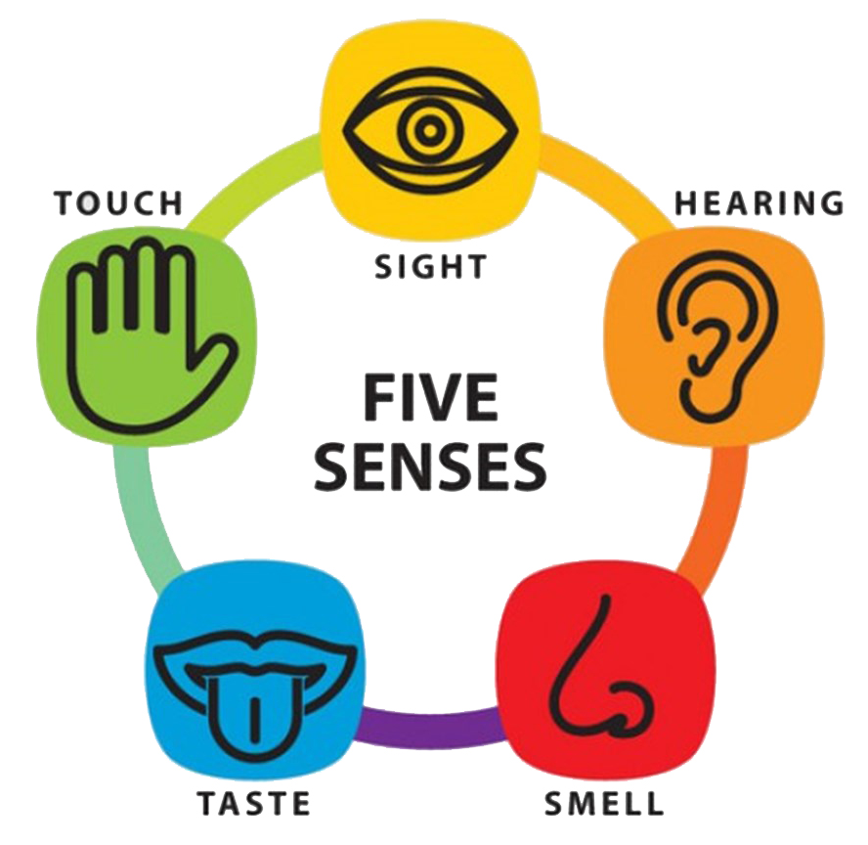
Using your senses
STEP 3: Think of your five senses (see, hear, touch, taste, smell) and try to link them to how the words you found make you feel.
Word 1
Word 2
Word 3
Word 4

Slide 21
Using your senses
Using a yellow pen, write something in each of the 4 sections that you could see which made you write those words.
Word 1
Word 2
If you were stuck in your house, what things stand out in your memory that you could always see?
Word 3
Word 4

Slide 22
Using your senses
Using a green pen, write something in each of the 4 sections that you could touch which made you write those words.
Word 1
Word 2
Think of the things that kept your hands busy, was it the plastic of pens? Your game controller? Did you often sit in the same place?
Word 3
Word 4

Slide 23
Using your senses
Using a orange pen, write something in each of the 4 sections that you could hear which made you write those words.
Word 1
Word 2
What sounds stick out in your memory?
Ticking of a clock in your kitchen, the sound rain hitting the ground outside?
Word 3
Word 4

Slide 24
Using your senses
Using a red pen, write something in each of the 4 sections that you could smell which made you write those words.
Word 1
Word 2
What smells come to mind?
Your parent’s washing? The smell of your animals. Fresh air on daily walks?
Word 3
Word 4

Slide 25
Using your senses
Using a blue pen, write something in each of the 4 sections that you could taste which made you write those words.
Word 1
Word 2
What tastes do your chosen words remind you of? Was it a delicious breakfast later than usual? Cooking or baking with people at home?
Word 3
Word 4

Slide 26
Next up is to write your poem
You will be completing this in another lesson

Slide 27
Numeracy
Learning Intention
We are learning to use our mathematical functions.
Success Criteria
I can add two numbers together.
I can subtract one number from another.
I can multiply two numbers together..

Slide 28
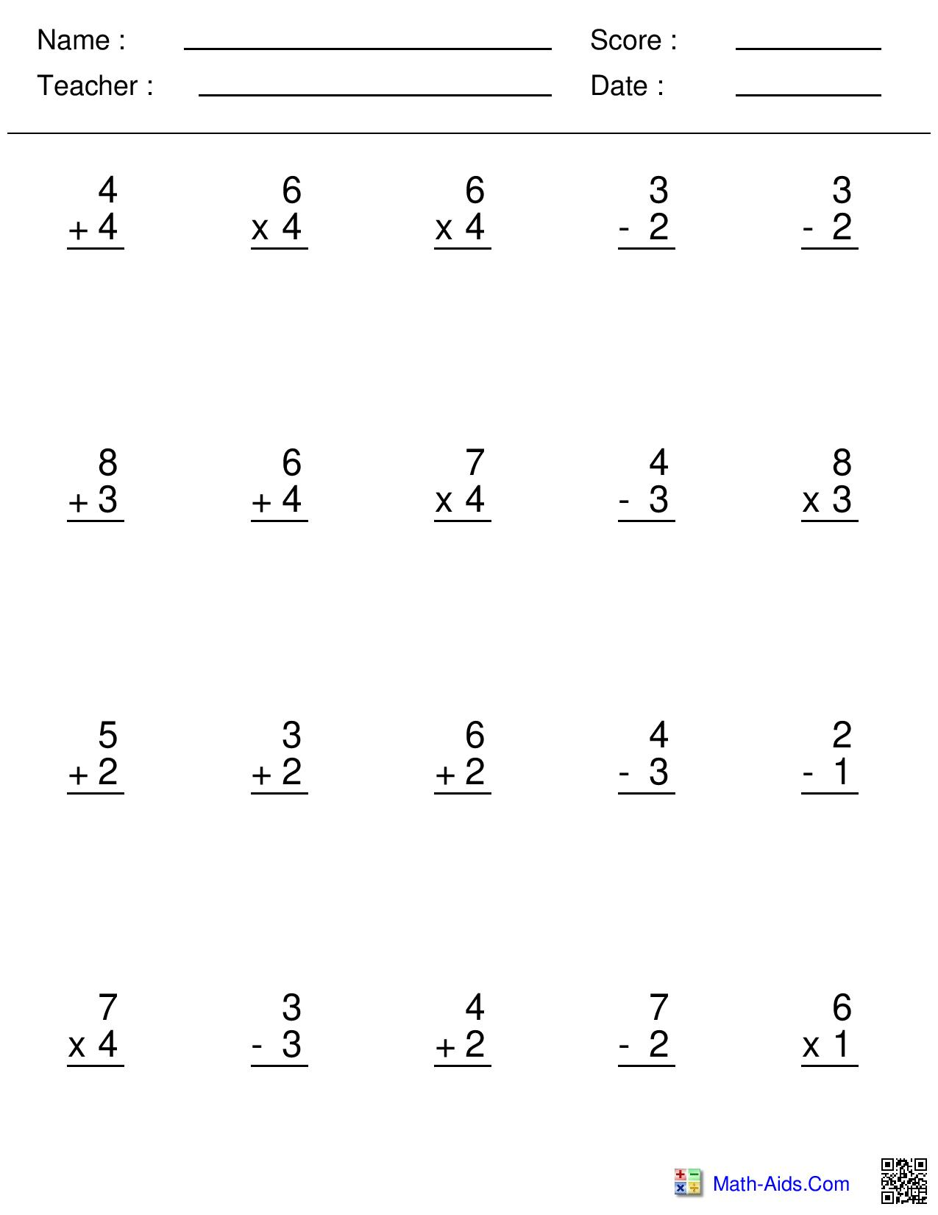
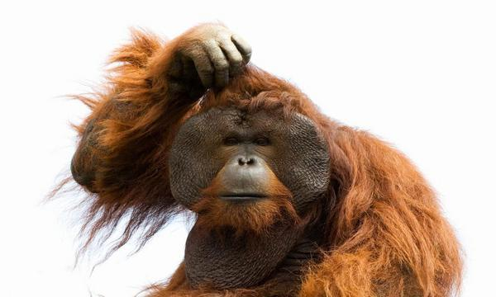
In your jotter please copy and complete the following questions in your jotter.

Slide 29
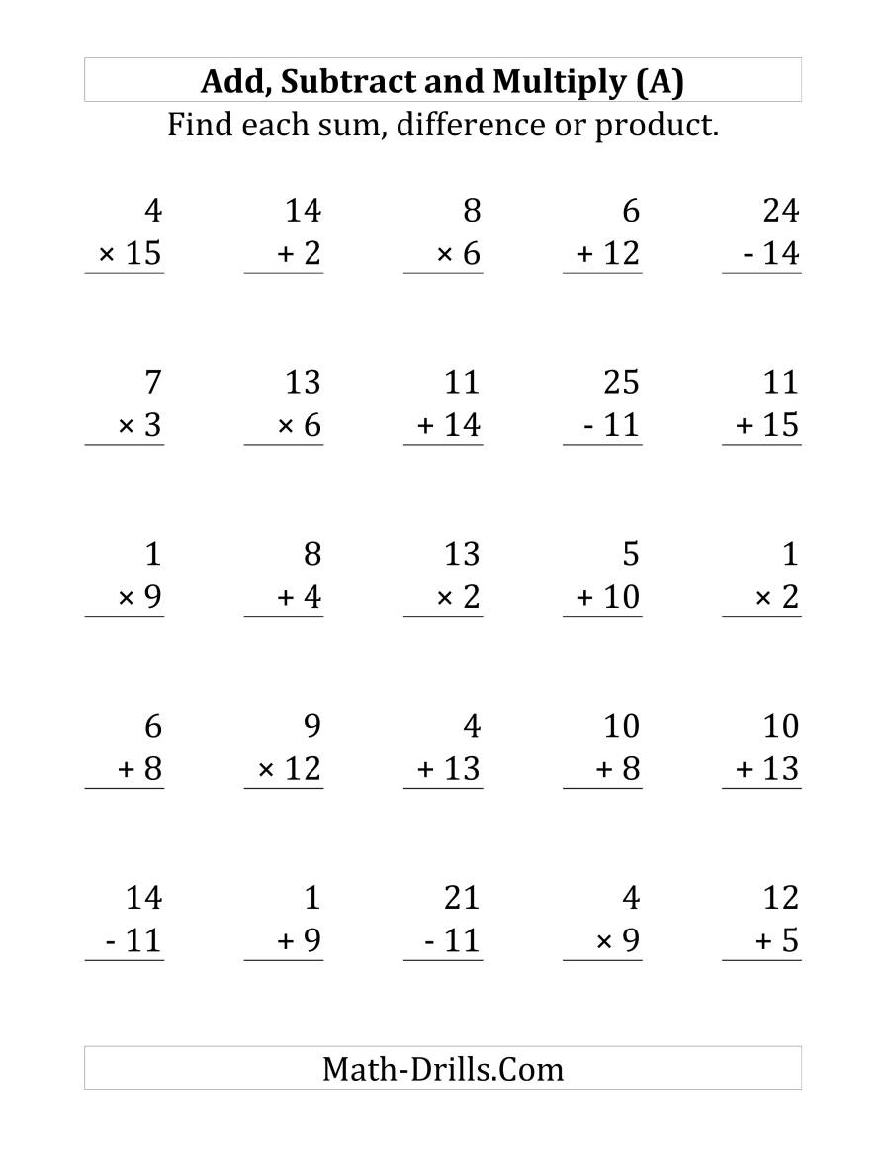
In your jotter please copy and complete the following questions in your jotter.

Slide 30
In your jotter please copy and complete the following questions in your jotter.

Slide 31
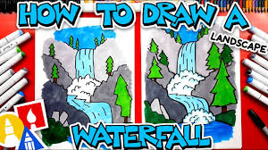
Art
Click the link below and follow the instruction to learn how to draw a Waterfall landscape.
https://www.youtube.com/watch?v=lIOjk00njxM

Slide 32
Night time prayer
God our Father, I come to say thank you for your love today.
Thank you for my family and all the friends you give to me.
Guard me in the dark of night and in the morning send your light.Amen.

