Slide 1
Science
Bodies Of Water

Slide 2
Today…
Learning Intention – We are learning about different bodies of water.
Success Criteria –
I can name different bodies of water.
I can give the properties of each body of water.
I can create a piece of work that shows the difference between the bodies of water.

Slide 3
What is a Body of Water?
A body of water or waterbody is any significant accumulation of water, generally on a planet's surface.

Slide 4
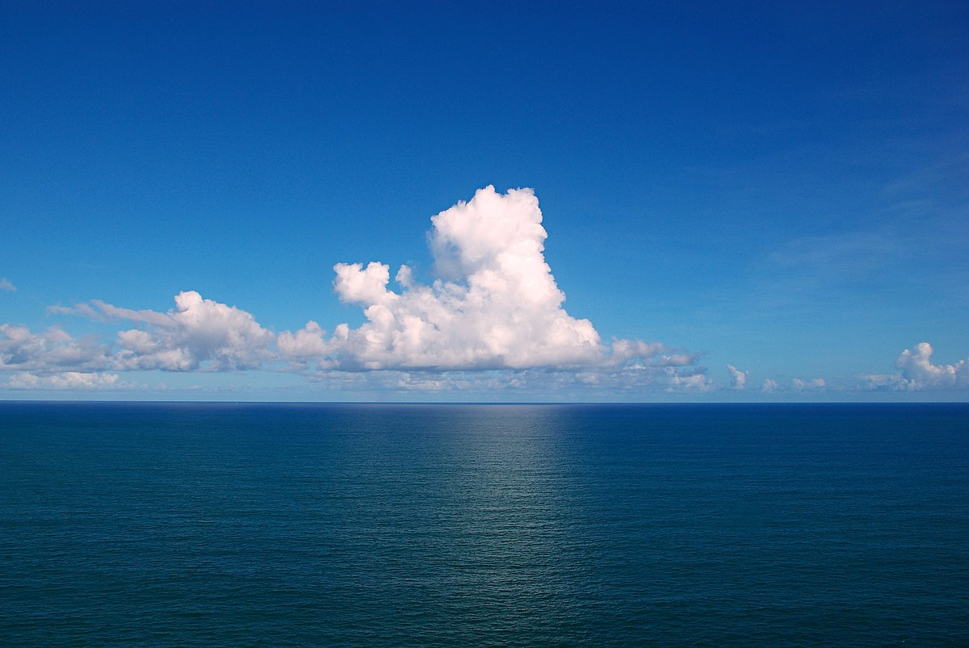
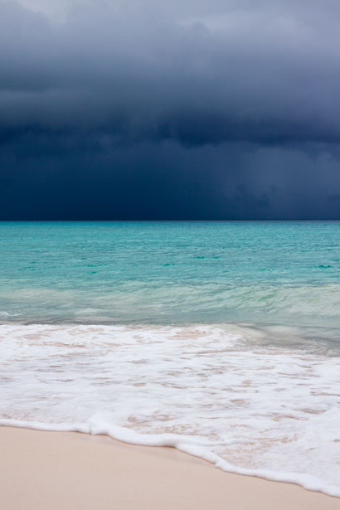
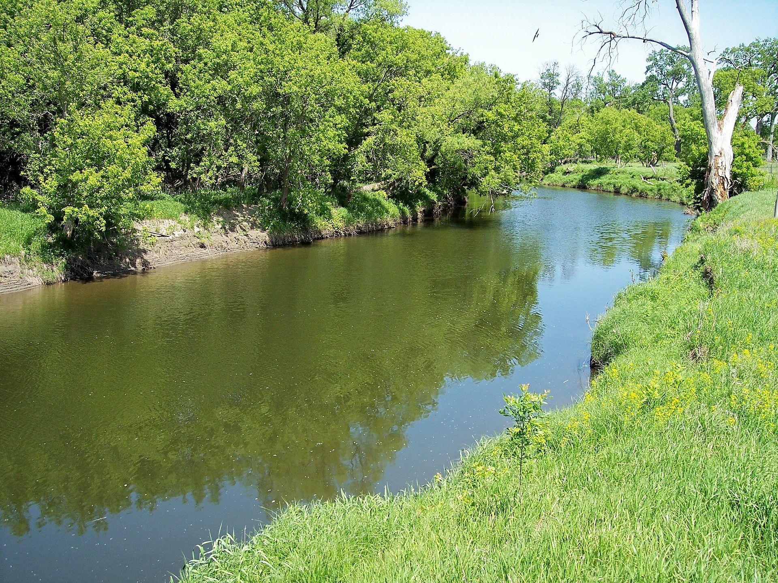
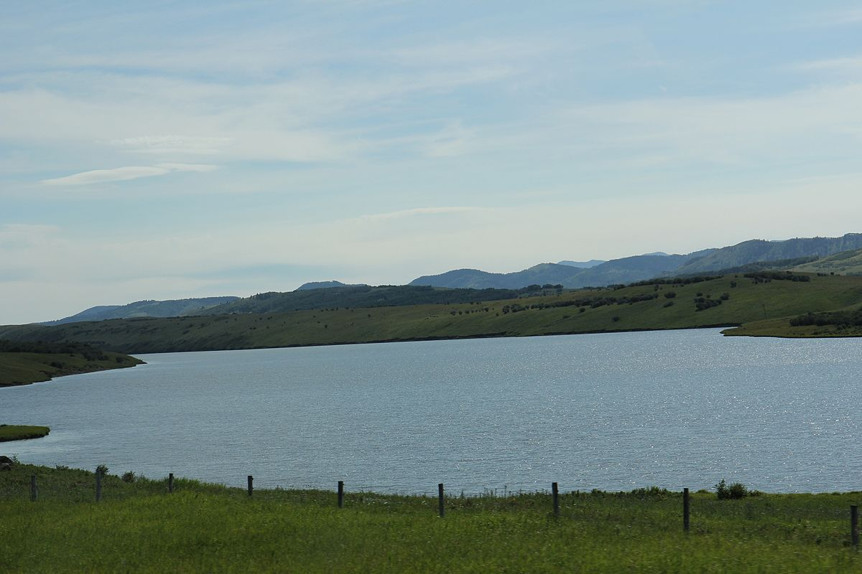
Different Bodies of Water
Oceans
Seas
Lakes
Rivers

Slide 5
The Ocean
Oceans covers more the 70% of The Earth’s surface.
Salty water – not suitable to drink.
Can you remember the names of the oceans from Monday with Mrs Raeper?
Arctic Ocean
Atlantic Ocean
Pacific Ocean
Indian Ocean
Antarctic Ocean

Slide 6
The Sea
The Sea is found where the land meets the ocean.
Smaller than the ocean.
Part of the ocean – like the Mediterranean Sea.
Think of the beach

Slide 7
Rivers
A strip of water that flows through many places.
It begins on mountains or hills where melted snow and rainwater gets collected.
The beginning of the river is called the source.
The end of the river is known as the mouth.
Rivers contain fresh water, so it is suitable to drink.

Slide 8
Lakes
A lake is a large area of water which is surrounded by land.
Formed when water finds its way into a basin.
Can be formed from rain or underground water.
Need a continuous source of new water otherwise they will dry up.

Slide 9
Watch this video to show you different bodies of water

Slide 10
Today’s activity…
From what you have learned about different bodies of water, I would like you to create a piece of work that show what these look like.
You can use whatever you like to create your body of water – pencils, coloured pencils, pens, paint, tissue paper or you could even create the body of water using actual water!
Send your pictures in to Mrs Raeper.

Slide 11
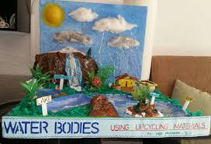
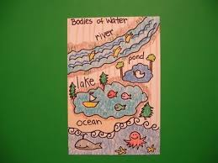
Some examples of what you might want to do
You can do the bodies of water separately or all together

