Slide 1
Literacy
Comprehension

Slide 2
Today…
Learning Intention – We are learning to answer questions about a passage.
Success Criteria –
I can read the passage.
I can answer the questions from what I have read in the passage.
I can infer what’s not there in a passage.

Slide 3
Activity
Choose which task you’re doing – One Chilli or Two Chilli's.
Answer the questions which come after.
Remember, if you can, to write in full sentences.
Don’t panic if you are not sure! Just try your very best ☺

Slide 4
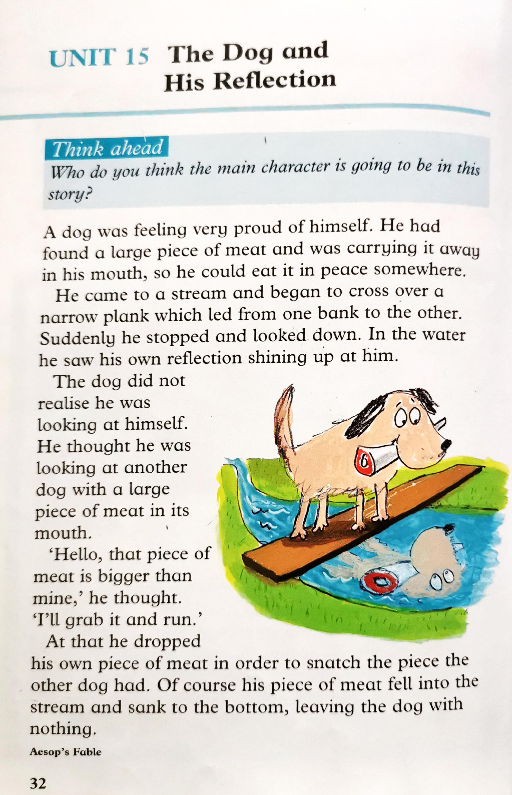
Group 1

Slide 5
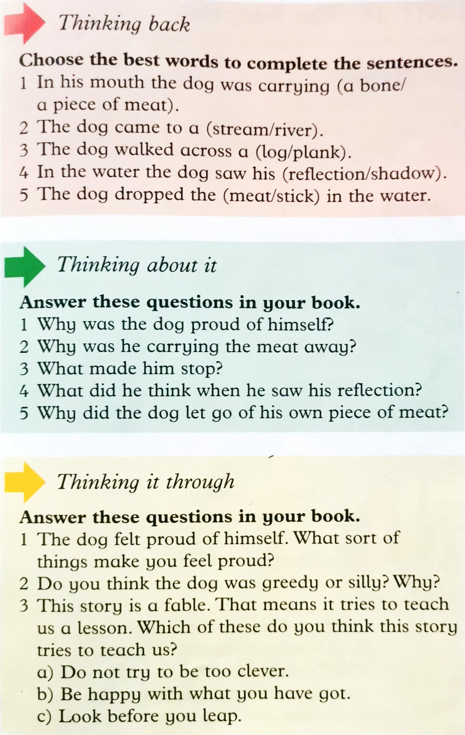
Group 1 - Questions

Slide 6
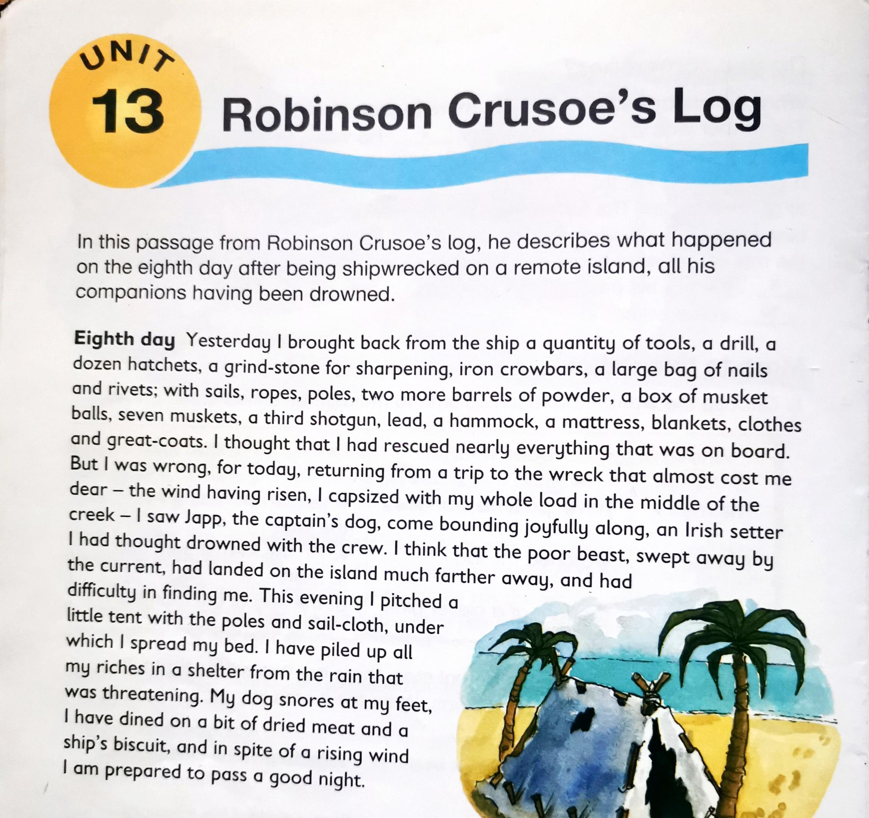
Group 2

Slide 7
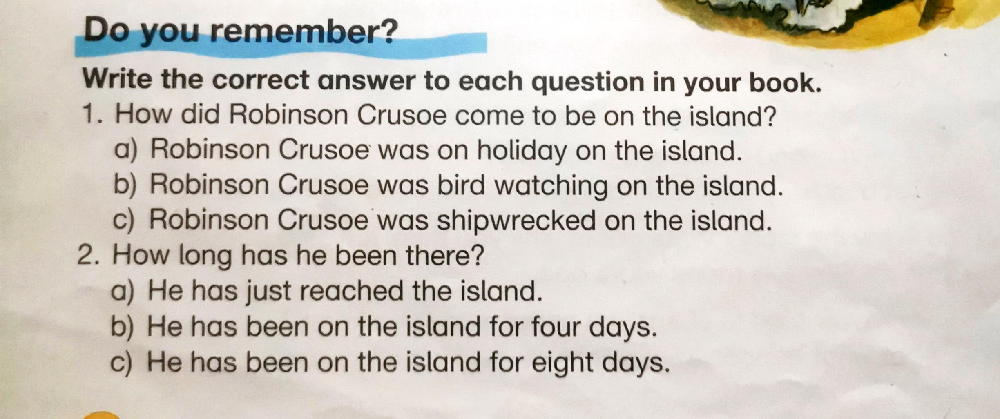
Group 2

Slide 8
Group 2 – Questions

