Slide 1
Literacy
Handwriting

Slide 2
Today…
Learning Intention – We are learning to improve our handwriting.
Success Criteria –
I can make my capital letters touch both lines.
I can make my lowercase letters half the size as my capital letters.
I can make sure the tail of my letter passes the line.
I can make the stem of my letter touch the top line.

Slide 3
Today’s Activity
Today, I would like you to write a diary entry all about our time doing home learning!
You should include things such as your thoughts or feelings, what you got up to, if you missed anything about school and how you are feeling about returning to school on Monday.
Today’s focus is on handwriting, so take your time and make it as neat as you can.

Slide 4
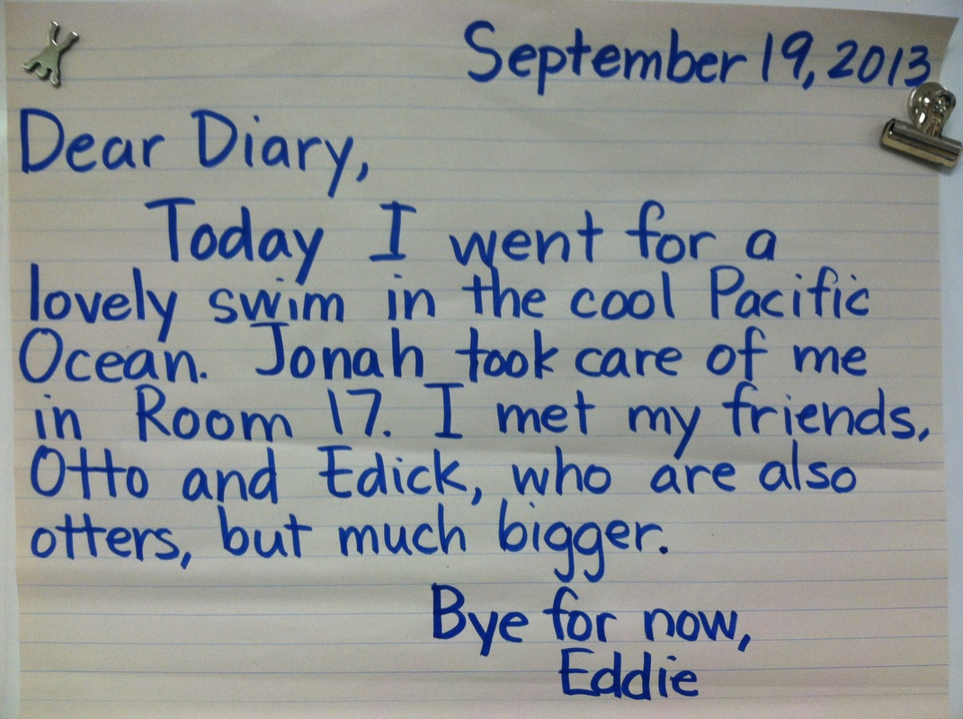
Today’s Activity
Here is an example of a diary.
You can use this to help structure your diary but we need lots more detail!

Slide 5
Letter Formation
On the next few slides are pictures of letters.
Use these pictures to help with your handwriting.
Notice the capital letters are touching both of the lines.
The lowercase letters are half the size of the capital letters.
The tails of letters are passed the bottom line.
The stem of letters are touching the top line.
Make sure you try to write like this in your letter

Slide 6
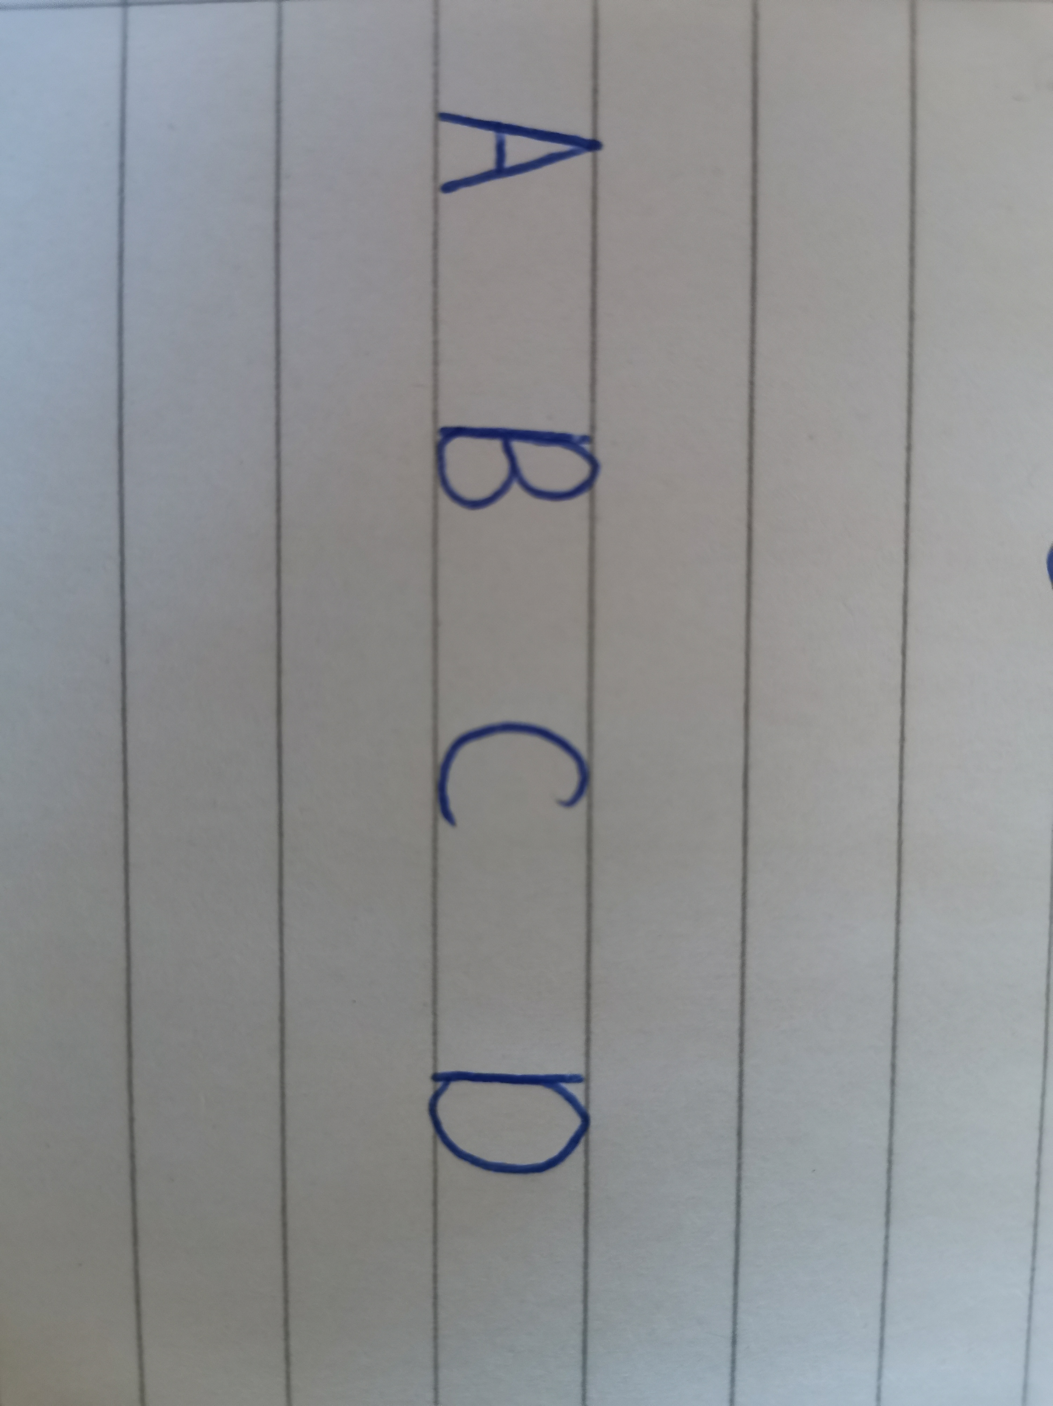
Capital Letters

Slide 7
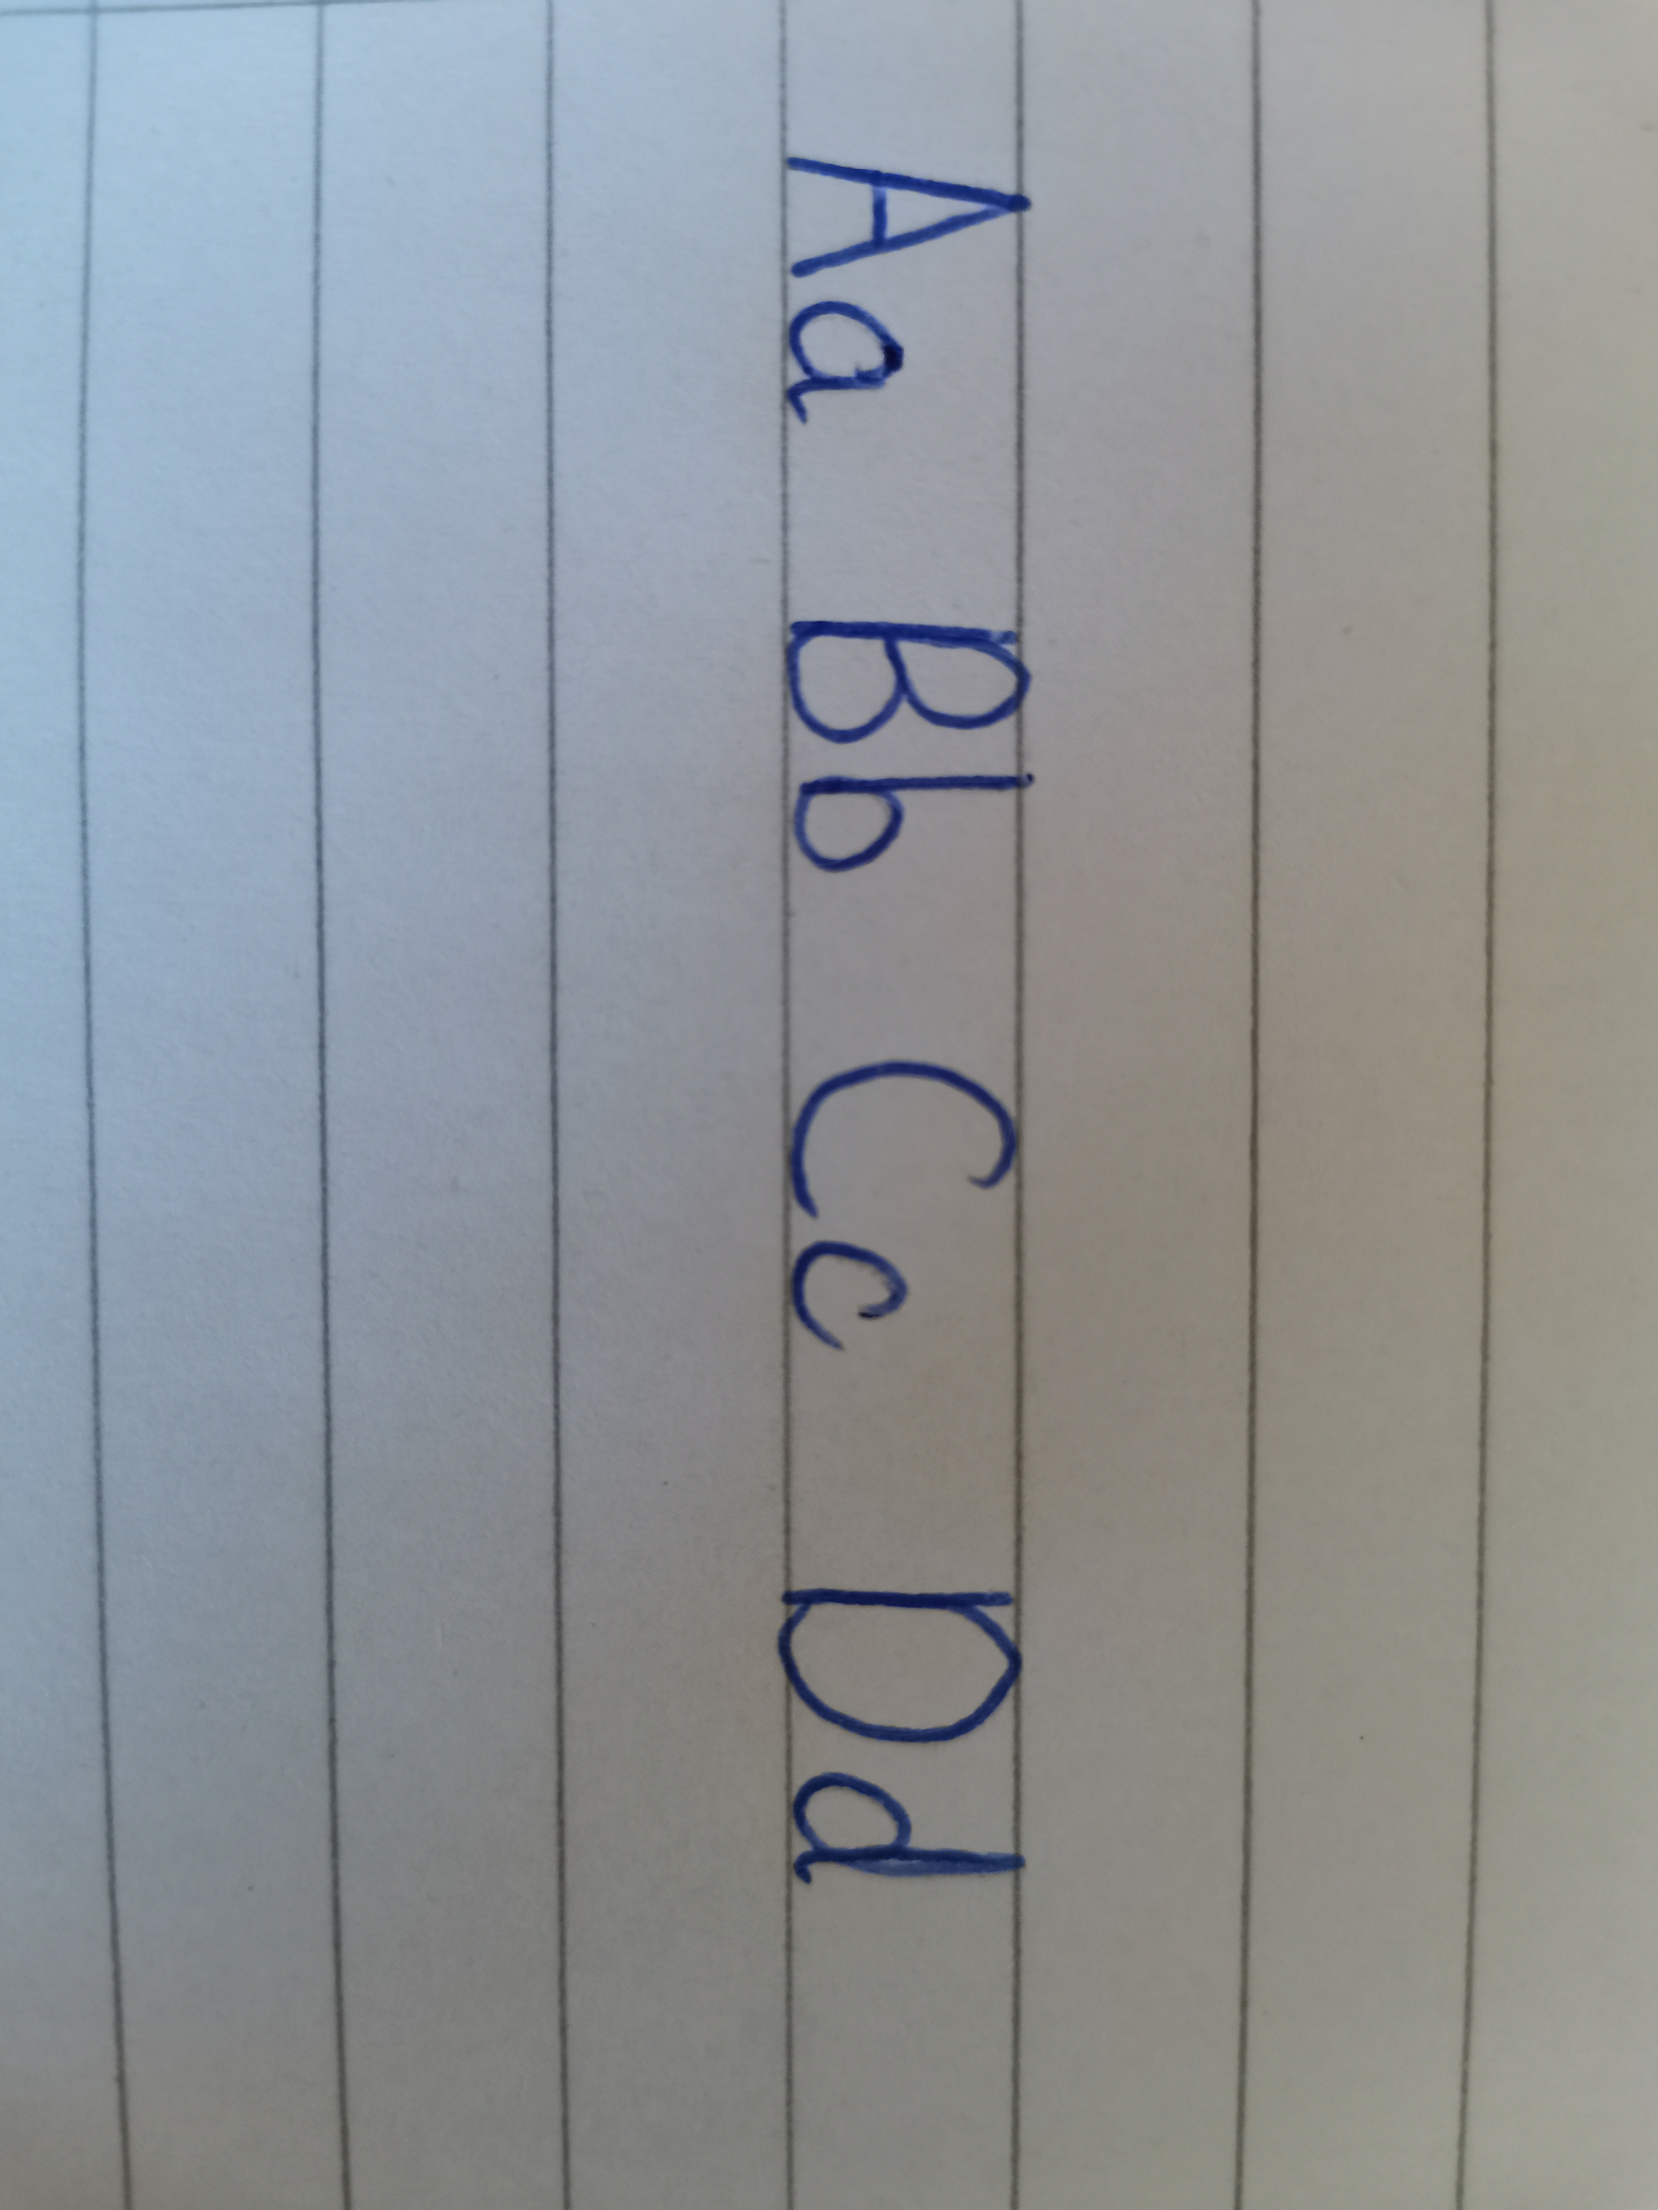
Capital and Lowercase Letters

Slide 8
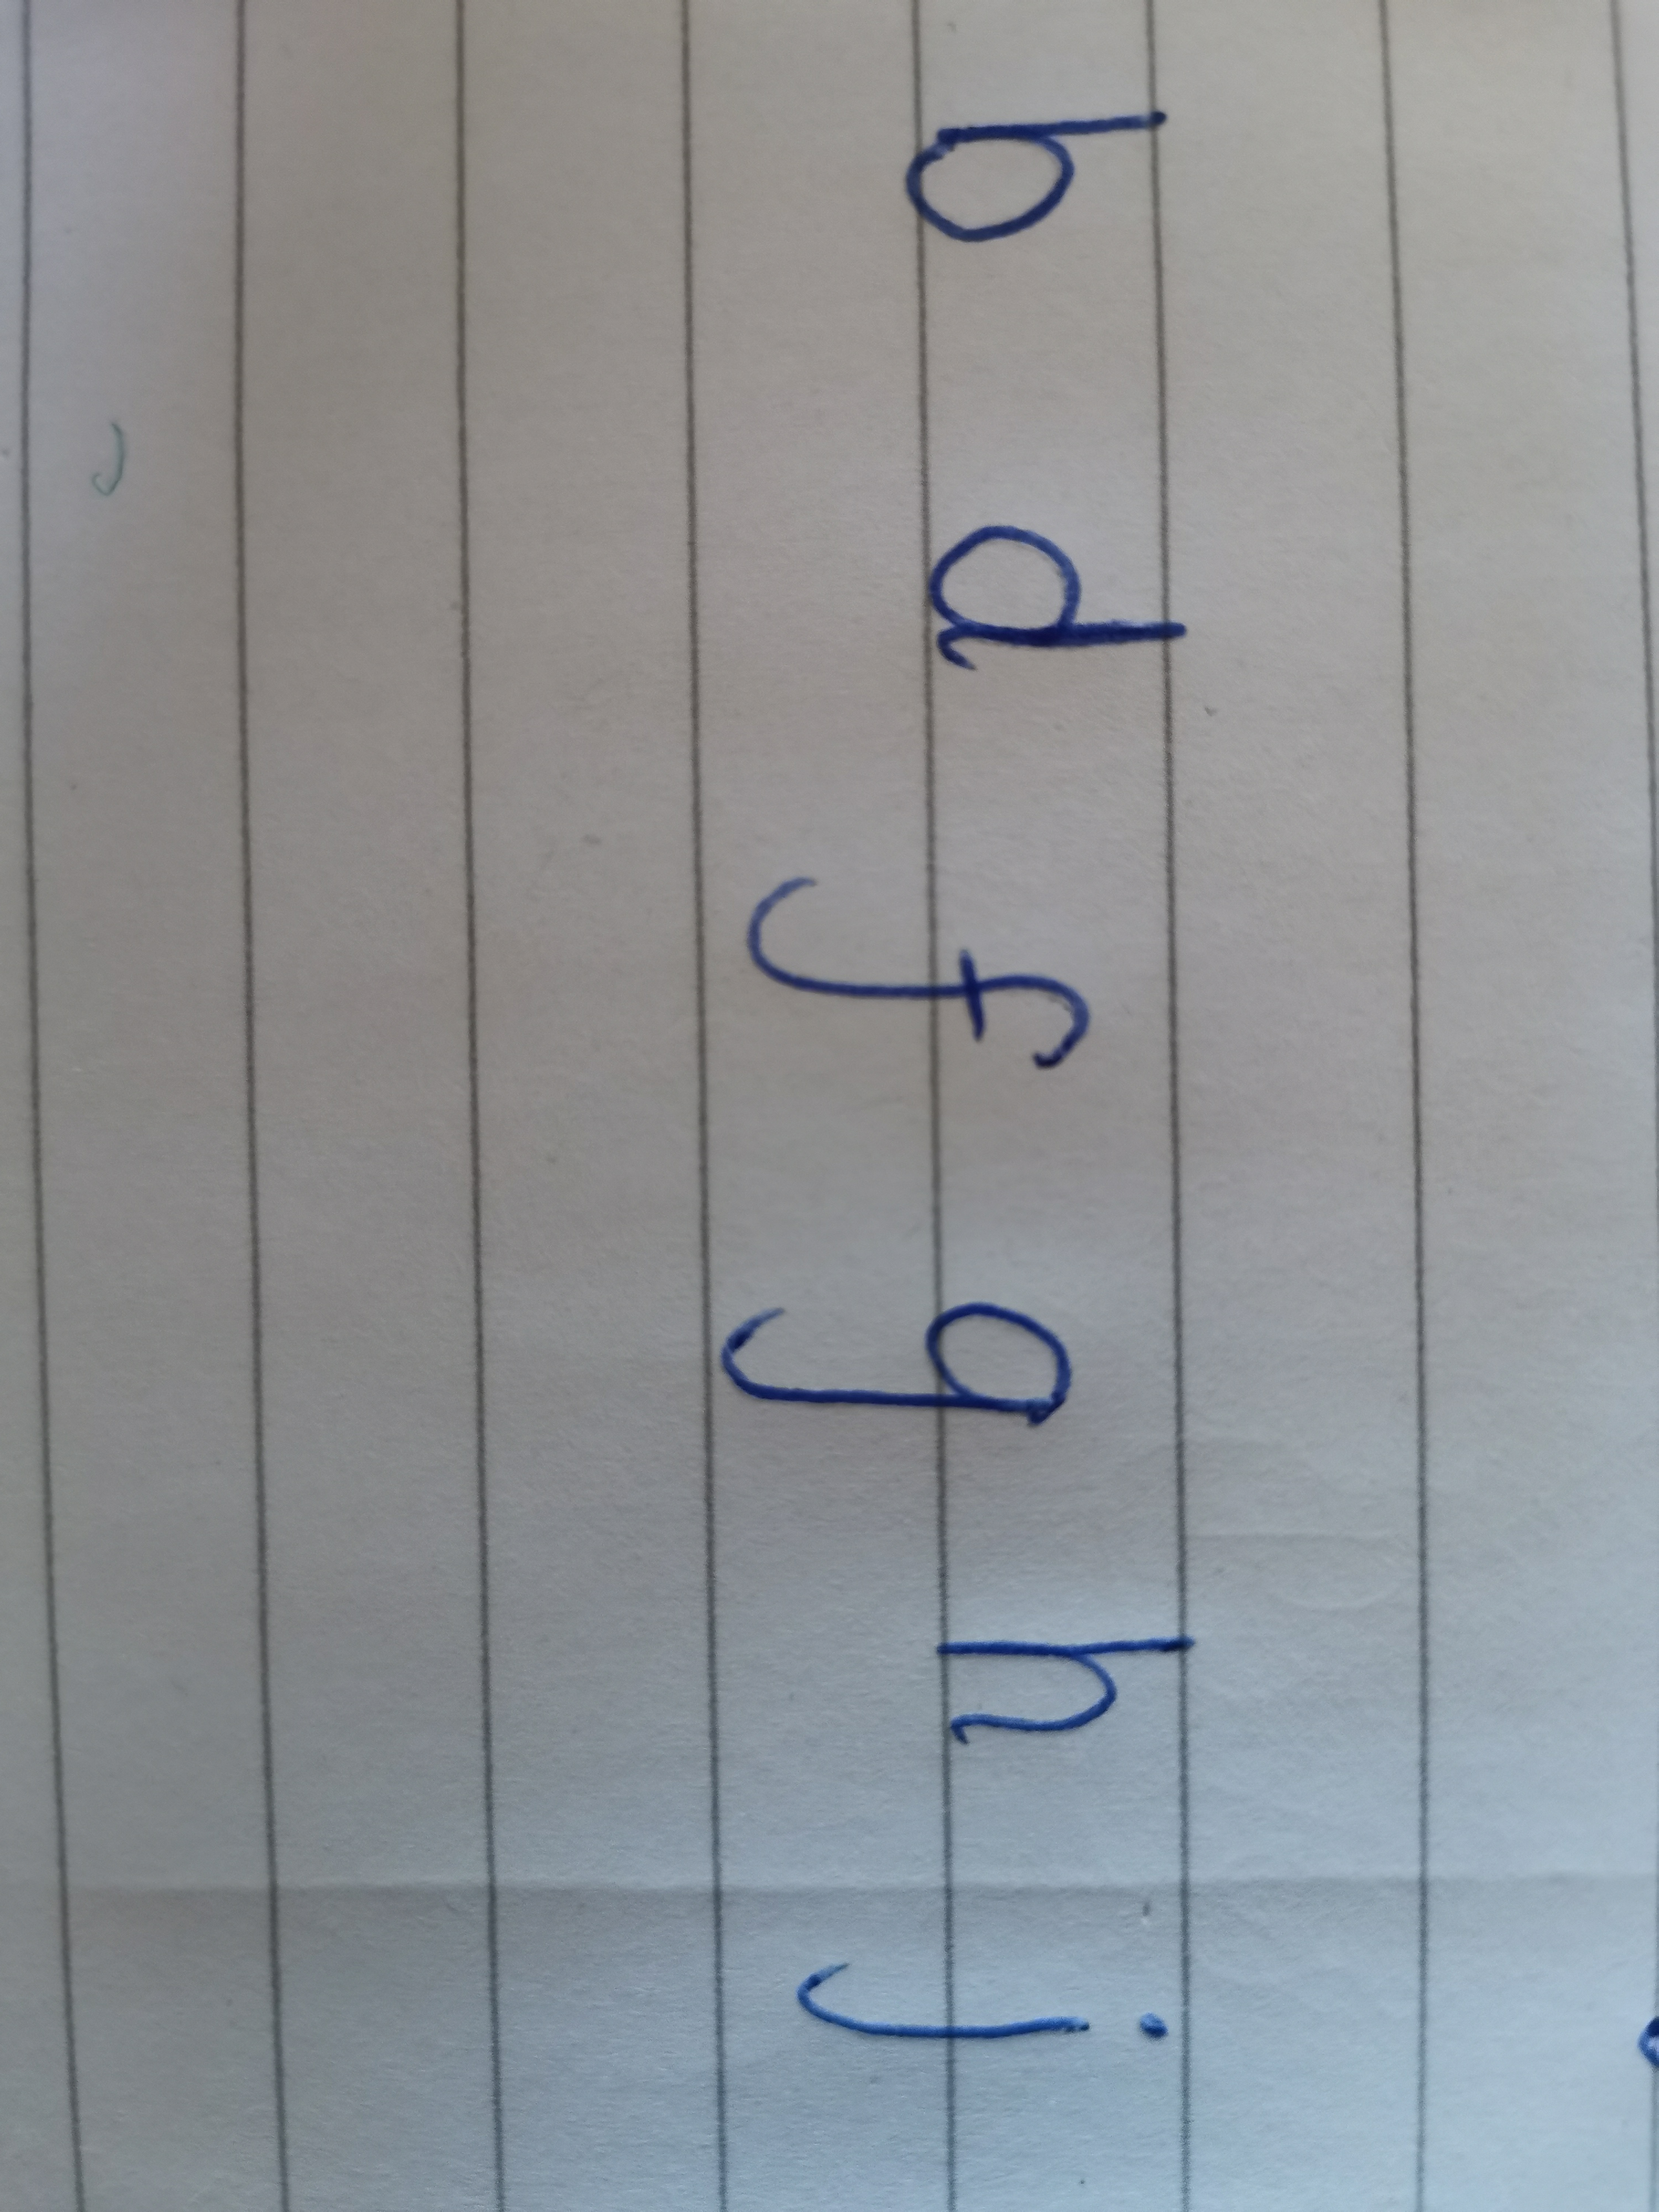
Tail and Stem Letters

