Slide 1
Georgia O'Keeffe

Slide 2
Learning Intention and Success Criteria!
We are learning who Georgia O'Keeffe is and recreating some of her most famous work.
I can explain who Georgia O'Keeffe is and why she is famous.
I can describe some of her famous work.
I can try to recreate a piece of her most famous work.

Slide 3
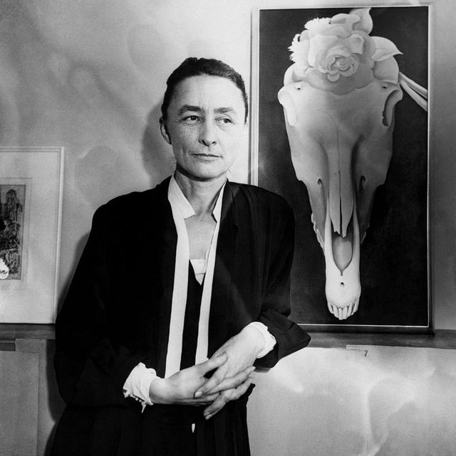
Who is Georgia O'Keeffe?
She was an American artist who was born in1887
She finished school and went to study art, becoming an artist!
She used art as a way to describe how she was thinking and feeling through the colours, shapes and designs which she drew!

Slide 4
Have a watch!
https://www.youtube.com/watch?v=vyRzUii-pSc

Slide 5
Have a watch!
https://www.youtube.com/watch?v=v3FFzPu97lo

Slide 6
Her Work!
Georgia O'Keeffe was an amazing artist who focussed on nature in her art!
She drew things very large and colourful
Let’s have a little look at some of her work!
Have a think about the colours, shapes and styles of her art!

Slide 7
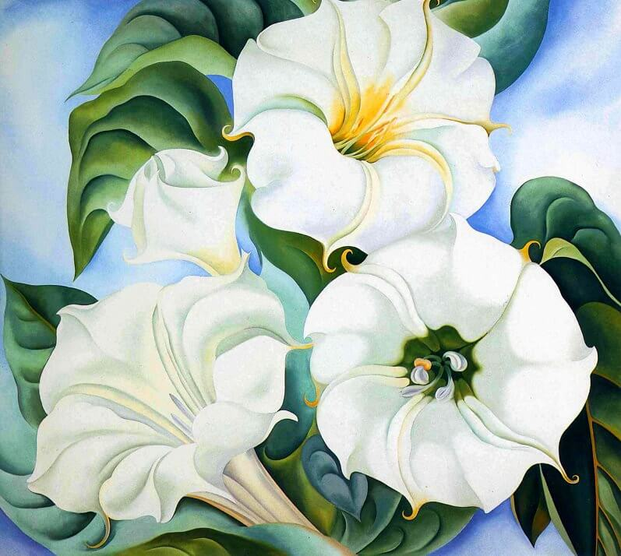
Jimson Weed
https://www.georgiaokeeffe.net/paintings.jsp

Slide 8
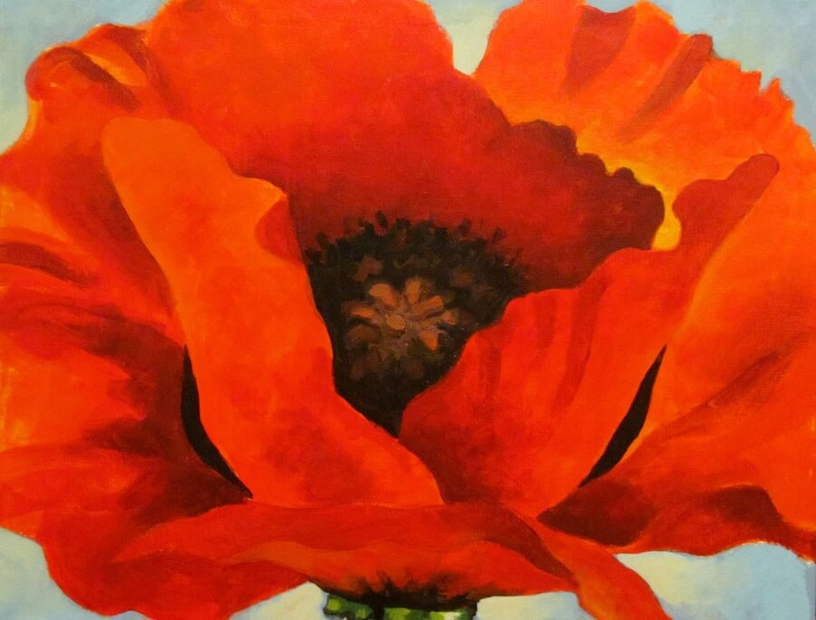
Red Poppy
https://www.georgiaokeeffe.net/paintings.jsp

Slide 9
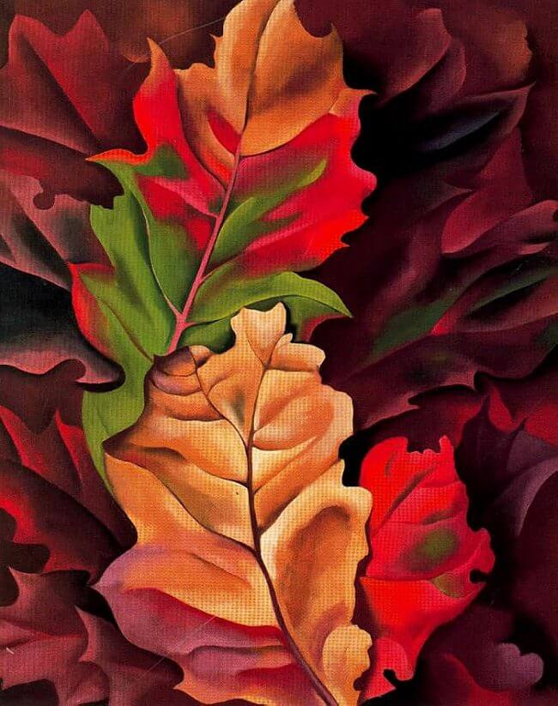
Autumn Leaves
https://www.georgiaokeeffe.net/autumn-leaves.jsp

Slide 10
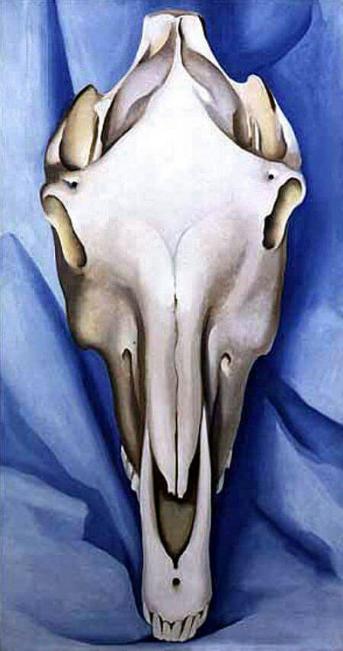
The Horse’s Skull on Blue
https://www.georgiaokeeffe.net/the-horse-skull-on-blue.jsp

Slide 11
Your job!
Your task is to create a piece of nature art just like Georgia O'Keeffe!
Think about the type of things which she drew such as flowers, leaves and things you would find in nature!
If you are stuck for an idea, have a look outside in the garden or the park for inspiration!
Have a think about the colours and designs which she used!
If you would like a little extra help then check the next slide!

Slide 12
Extra Help
You don’t have to use paint! You can use coloured pencil instead!
https://www.youtube.com/watch?v=rs-bBf8PoCg

