Slide 1
2D and 3D Shapes
This is a little recap of shape as it is our last week of home learning!

Slide 2
Today…
Learning Intention – We are recapping what we have learned so far in 2D and 3D shapes.
Success Criteria –
I can name 2D and 3D Shapes.
I can find 2D and 3D shapes around me.
I can identify a shape by its properties.

Slide 3
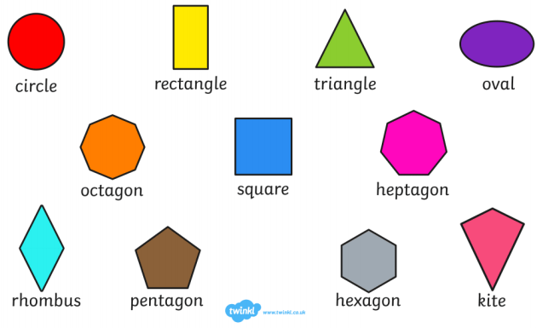
2D Shapes

Slide 4
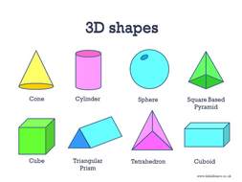
3D Shapes

Slide 5
Have a watch of this video!
https://www.youtube.com/watch?v=OVItzLoovLc&feature=emb_logo

Slide 6
Have a look at the video on this page!
https://www.bbc.co.uk/bitesize/topics/zjv39j6/articles/zgqpk2p

Slide 7
Activity 1
Your first activity is on Kahoot! Click the link to access!
Make sure you leave your name so we can see how well you do on our leader board for today!
Give it your best shot and if you don’t know, have a think then a guess!
You never know, you may get lucky!
https://kahoot.it/challenge/06498526?challenge-id=1060462d-294d-48cc-b652-f35cef96db83_1614856004644

Slide 8
Activity 2
Have a go at this online quiz that we did on lesson1!
I know we haven’t covered all of it but it should give you an idea of how much you have learned!
Some of this you may not know and that is okay! That let’s Mr White, Miss Keesing and Mr Samson know what you still need to learn when you come back to school! Don’t panic!
https://forms.gle/KubSD5vBqFzBgRSc6

