Slide 1

St Mary’s RC primary school
Friday 5th March 05.03.21
P4 and P5

Slide 2

Morning Prayer
Father in heaven you love me
You are with me night and day
I want to love you always
In all I do and say
I’ll try to please you Father
Bless me through this day
Amen

Slide 3


Slide 4
Literacy - Writing
Learning Intention:
We are learning to improve our handwriting.
Success Criteria:
Understand what is meant by a verb.
Understand what a noun is.
Understand what an adverb is.
Understand what an adjective is.

Slide 5
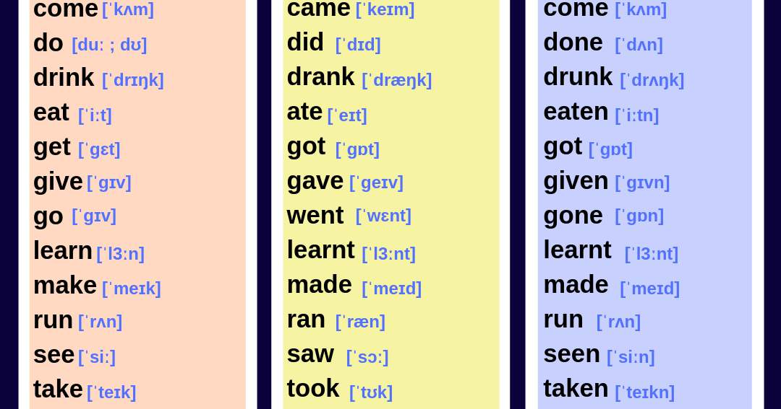
Verbs
What are verbs?
A verb is a word that expresses: A physical action (e.g., "to swim," "to write," "to climb").
A mental action (e.g., "to think," "to guess," "to consider").
A state of being (e.g., "to be," "to exist," "to appear").
You might find it useful to think of verbs as "doing" words.

Slide 6

Nouns
A noun is a word that represents a person, place, or thing. Everything we can see or talk about is represented by a word. That word is called a "noun." You might find it useful to think of a noun as a "naming word."
Often a noun is the name for something we can touch (e.g., "lion," "cake," "computer"), but sometimes a noun names something we cannot touch (e.g., "bravery," "mile," "joy").

Slide 7
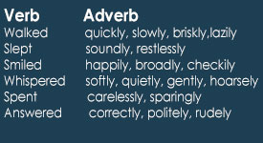
What is an adverb?
An adverb is a word that can modify a verb, an adjective, or another adverb. Lots of adverbs end "-ly." For example:She swims quickly.
(Here, the adverb "quickly" modifies the verb "swims.")She is an extremely quick swimmer.
(The adverb "extremely" modifies the adjective "quick.")She swims extremely quickly.
(The adverb "extremely" modifies the adverb "quickly.")

Slide 8
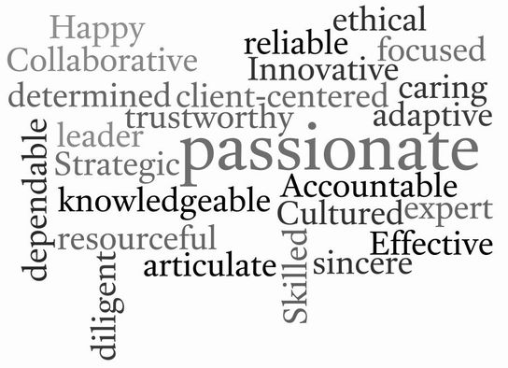
Adjectives
Adjectives are words that describe nouns (or pronouns). "Old," "green," and "cheerful" are examples of adjectives. (It might be useful to think of adjectives as "describing words.")
This infographic shows where an adjective sits in relation to the noun it describes

Slide 9
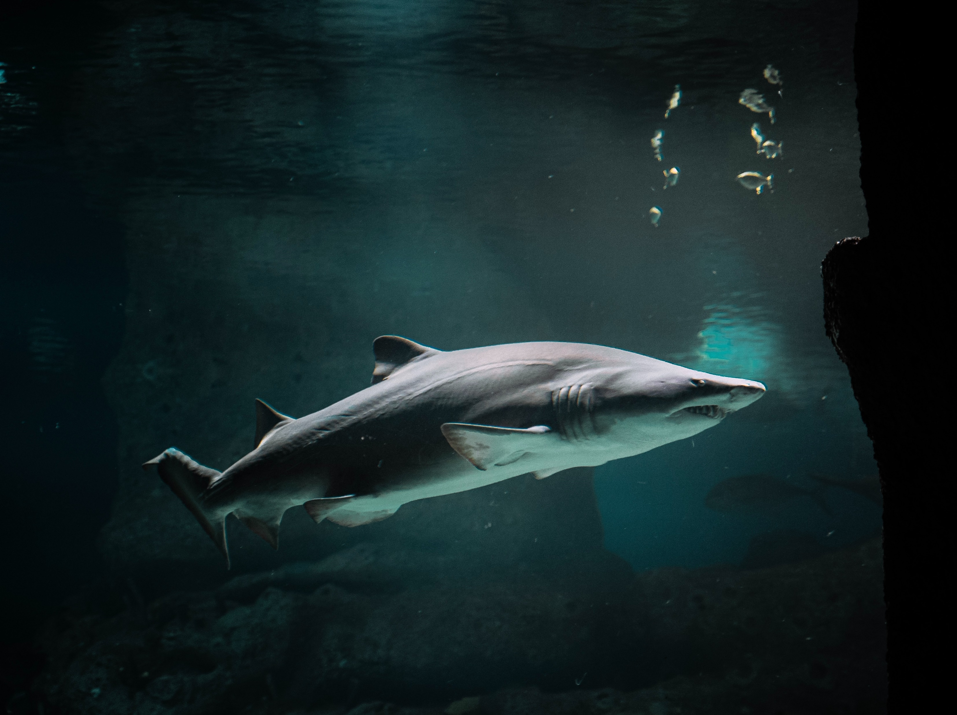
Now in your jotter right your 10 word poem by selecting:
1 Noun
2 Adjectives
3 Adverbs
4 Verbs
Now piece these together to generate a 10 word poem you can insert more words if you need to for your poem to sound nicer.
Noun – Shark
Adjectives – Gigantic Graceful
Adverbs - Speedily Smoothly Aggressively
Verbs – Swimming Hunting Feeding Surviving
Shark, gigantic and graceful. Speedily smoothly and aggressively swimming, hunting, feeding and surviving.

Slide 10

Numeracy
Learning Intention
We are learning to use addition.
Success Criteria
Complete the following number tasks on Topmarks.
Choose the Mild, Hot or Spicy Chilli challenge.
Don’t worry if you do have internet access, complete a number activity in your home learning pack.

Slide 11
Numeracy https://www.topmarks.co.uk/maths-games/daily10
Mild | Hot | Spicy
Choose level 2. Choose Subtraction. Choose Two-Digit Numbers. Choose manual so you can control the time limit. Mark your answers at the end. | Choose level 2. Choose Subtraction. Choose Two-Digit Numbers with Decomposition. Choose manual so you can control the time limit. Mark your answers at the end. | Choose level 3 Choose Subtraction Choose Two-Digit Numbers with Decomposition. Choose manual so you can control the time limit. Mark your answers at the end.

Slide 12


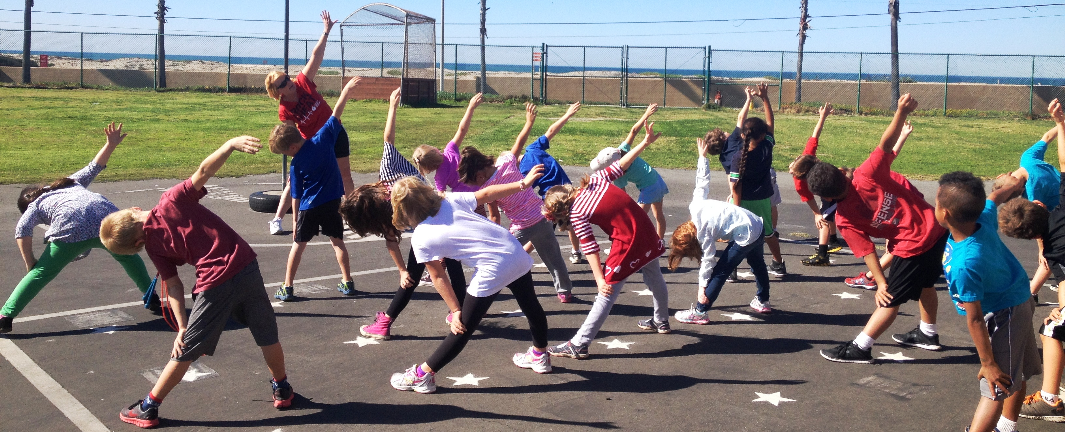

Weekly Journal
For the Weekly Journal we would like to hear about how you are experiencing your learning.
In your jotters please tell us what has been your favourite thing you have done in learning this week and tell us why. Have you enjoyed completing your learning at home with family? Do you enjoy going at your own pace?
We would also like to know if there has been anything you have missed not being in school. Do you miss your friends? Do you miss your teachers?
If you have the know how and would rather make a video of yourself we would be more than happy to receive these to know how you are getting on and see your smiling faces.
This Photo by Unknown Author is licensed under CC BY

Slide 13
Interactive School Assembly
Please follow the link on the P3 and P4 blog for an invite into the school assembly via Microsoft Teams.

Slide 14
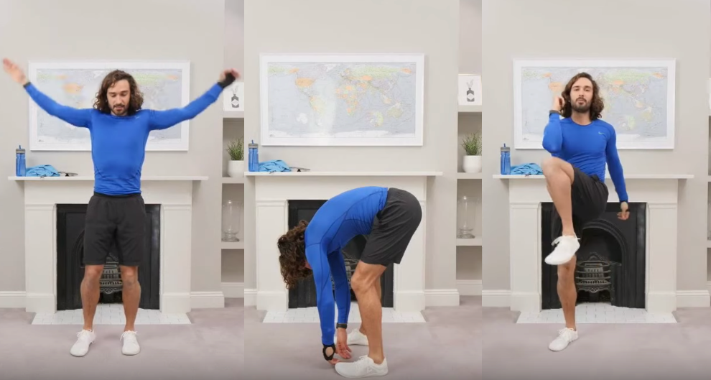
P.E
Follow the link to Joe Wicks P.E Lesson. Watch the video and complete the activities.
https://www.youtube.com/watch?v=l0k6XqfFEUo

Slide 15
Night time prayer
God our Father, I come to say thank you for your love today.
Thank you for my family and all the friends you give to me.
Guard me in the dark of night and in the morning send your light.Amen.

