Slide 1
St Mary’s RC primary school Thursday 04.03.21
P4 & P5

Slide 2
Morning Prayer
Father in heaven you love me
You are with me night and day
I want to love you always
In all I do and say
I’ll try to please you Father
Bless me through this day
Amen

Slide 4
Literacy - writing
Learning Intention:
We are learning to improve our writing.
Success Criteria:
I can use adjectives in my sentences.
I can use connectives in my writing.
I can use a variety of openers in my writing.

Slide 5
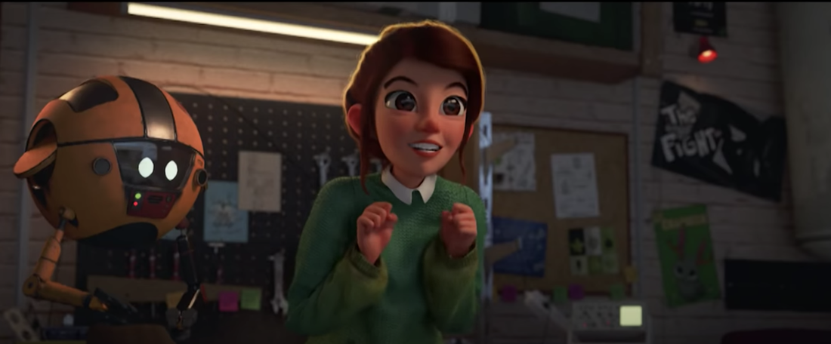
Today we will be writing about a short film. Click the link below to watch the film.
https://www.literacyshed.com/light.html
Select a Mild, Hot or Spicy Chilli Challenge from the following slides.

Slide 6
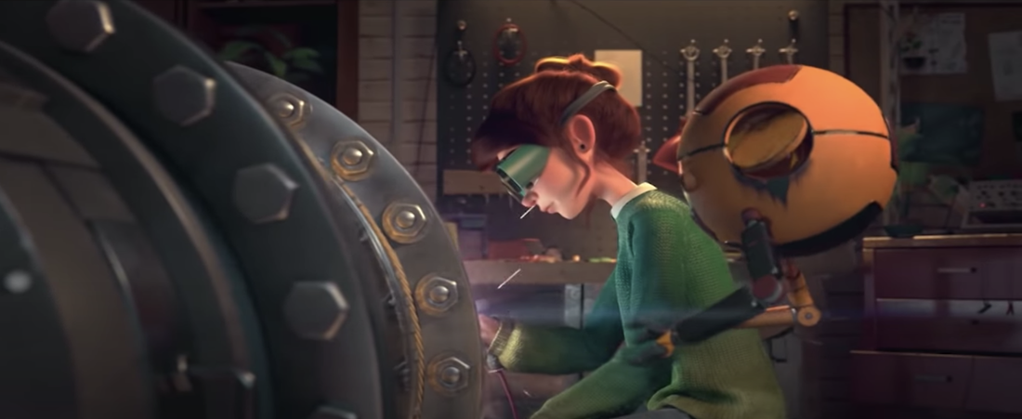
In your jotter answer the following questions by filling in the blanks where needed.
1. The Lady was trying to build something with the help of her______.
Cat/Robot/Children
2. The video takes place in a _______________.
Play park/Farmhouse/Garage
3. The invention ________ work first time.
Did/Didn’t
4. What do you think the invention was for?
5. What do you think is the main message of the story?

Slide 7
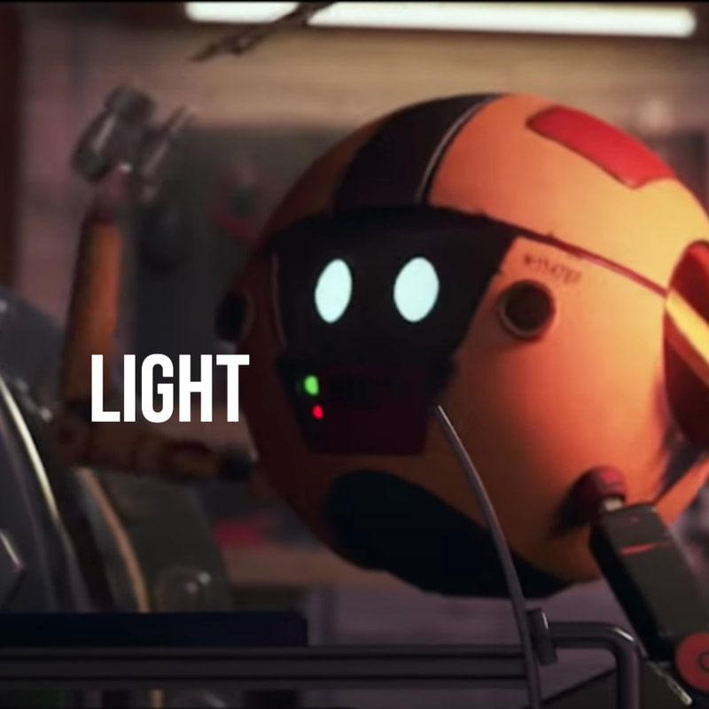
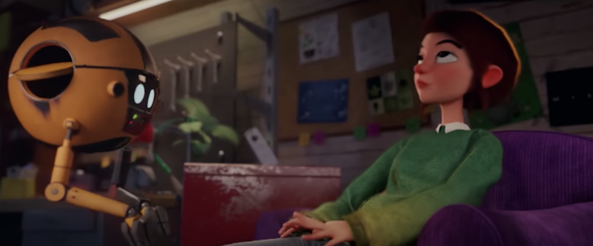
Adjectives:
Big, Small, Scruffy, Bored, Exciting, Tidy, Dirty, Clean, Mischievous, Hard Working.
Connectives:
Because, Also, And, But, So, Then, Although, As well as, however.
In your jotter I would like you to write 2 sentences describing The Inventors Robot.
Each sentence must contain 2 adjectives and be connected with 1 connective.
In your jotter I would like you to write 2 sentences describing the setting of the film.
Each sentence must contain 2 adjectives and be connected with 1 connective and a different opener for each.

Slide 8
Adjectives:
Big, Small, Scruffy, Bored, Exciting, Tidy, Dirty, Clean, Mischievous, Hard Working.
Connectives:
Because, Also, And, But, So, Then, Although, As well as, however.
In your jotter I would like you to write a character description of The Inventors Robot.
Your description must contain 4 adjectives and 2 connectives and a variety of openers.
In your jotter I would like you to write a setting description of the film. Your description must contain 4 adjectives and 2 connectives and a variety of openers.
I would then like you to tell me what you think happens next in the story, like a post credit scene. Be as imaginative as you can this should be at least 4 sentences long including adjectives, openers and connectives.

Slide 9
Numeracy
Learning Intention
We are learning to read information from a table or graph.
Success Criteria
I can answer questions by using tables.
I can answer questions by using the information found in a bar graph.
I can identify the headings of an axis.
I can identify and read a scale accurately.

Slide 10
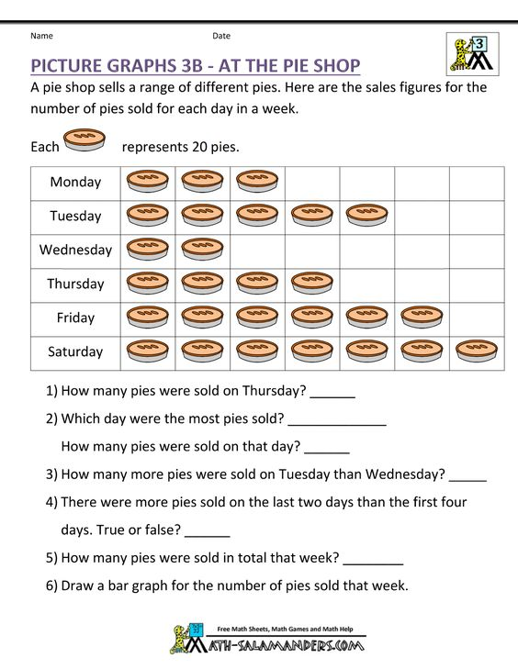

Slide 11
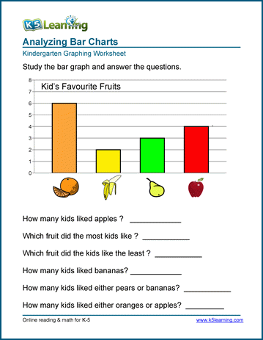

Slide 12
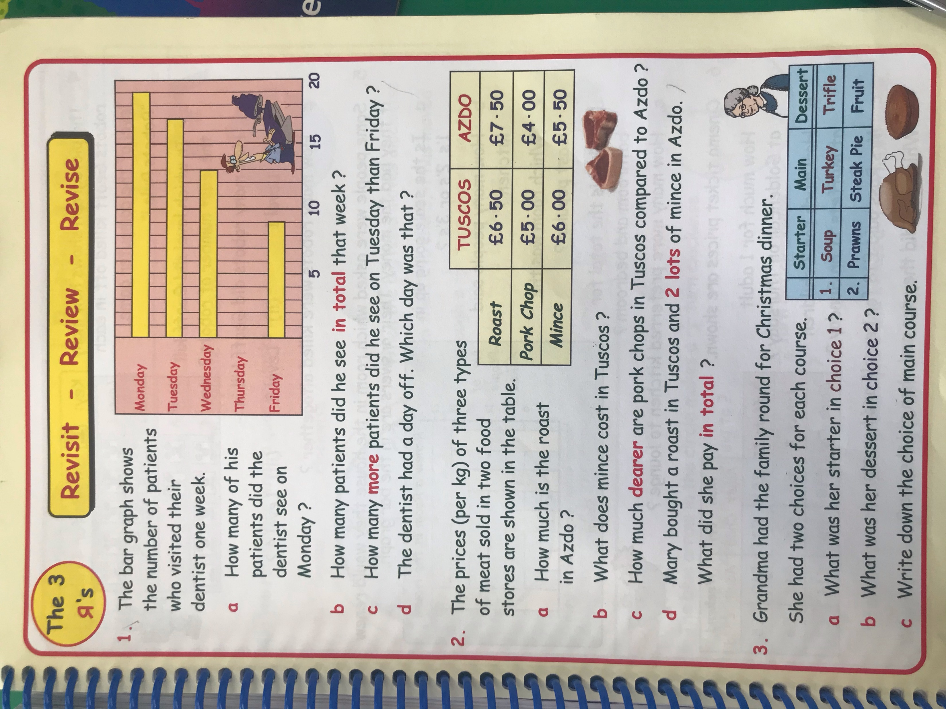
In your Jotters answer the questions using a new line for each question, number each question correctly and display your working out where appropriate.

Slide 13
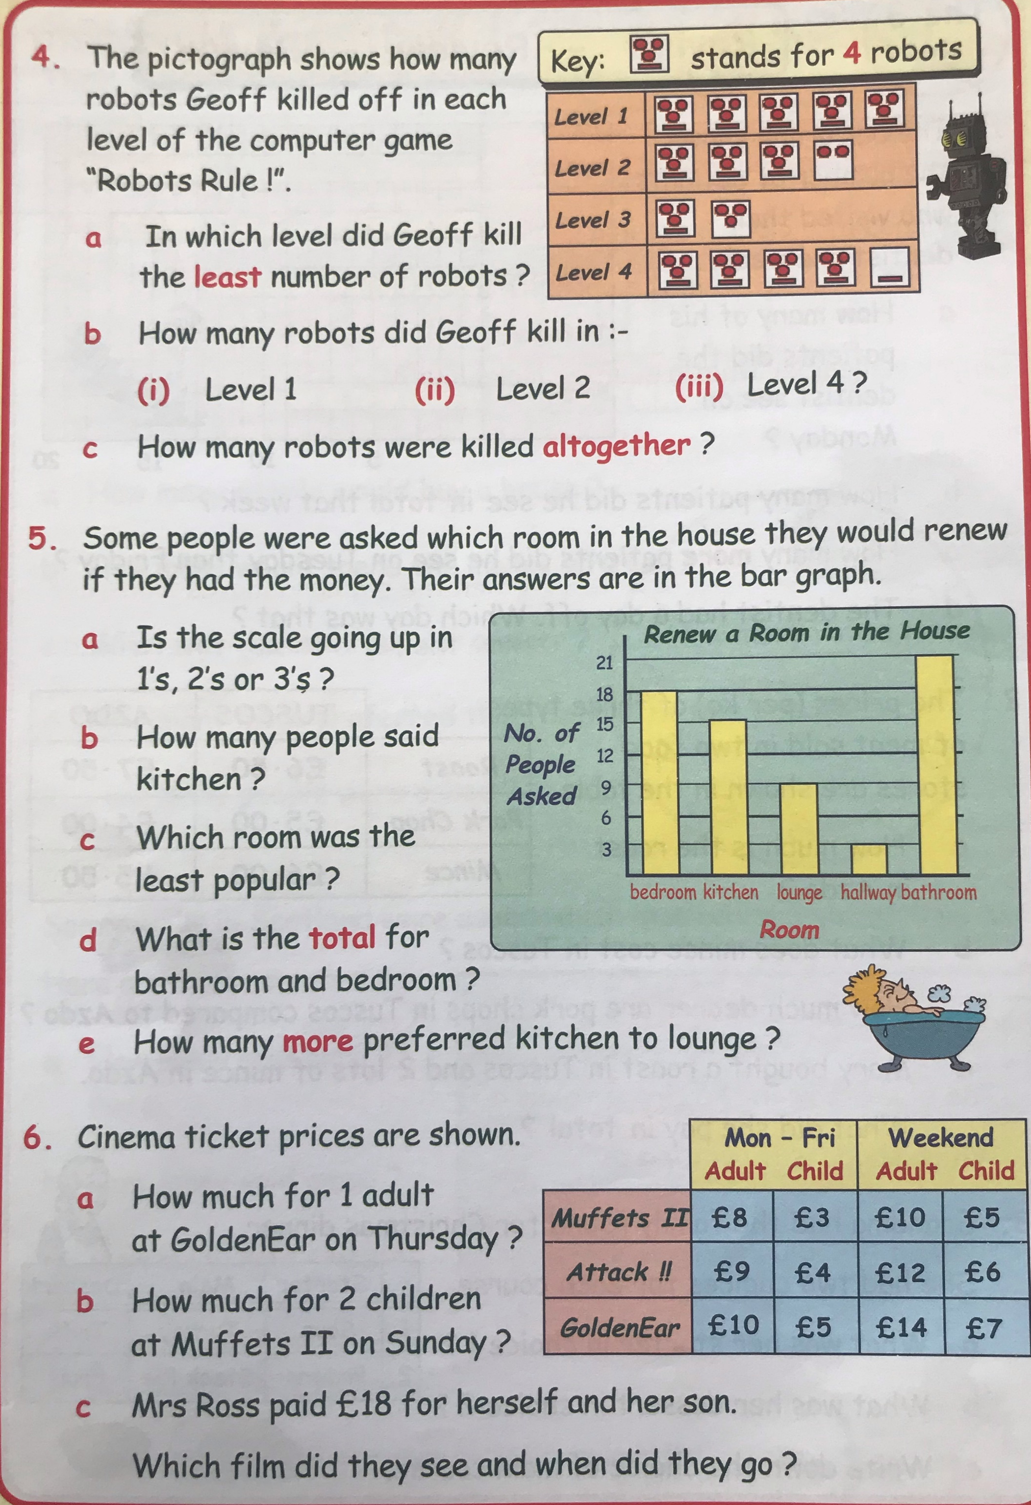
In your Jotters answer the questions using a new line for each question, number each question correctly and display your working out where appropriate.

Slide 14
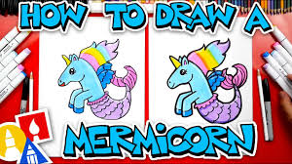
Art
Click the link below and follow the instruction to learn how to draw a mermicorn.
https://www.youtube.com/watch?v=lfgaJQ3z3nE

