Slide 1
Week 4 Preparing for First holy communion St Mary’s Glow blog
With mrs Raeper

Slide 5
Copy and complete in your jotter

Slide 7
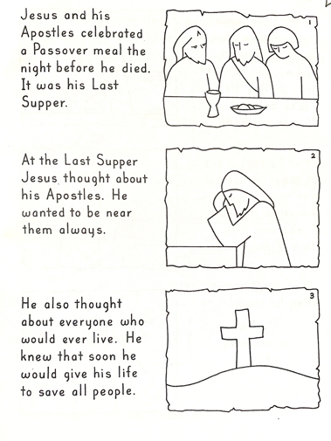
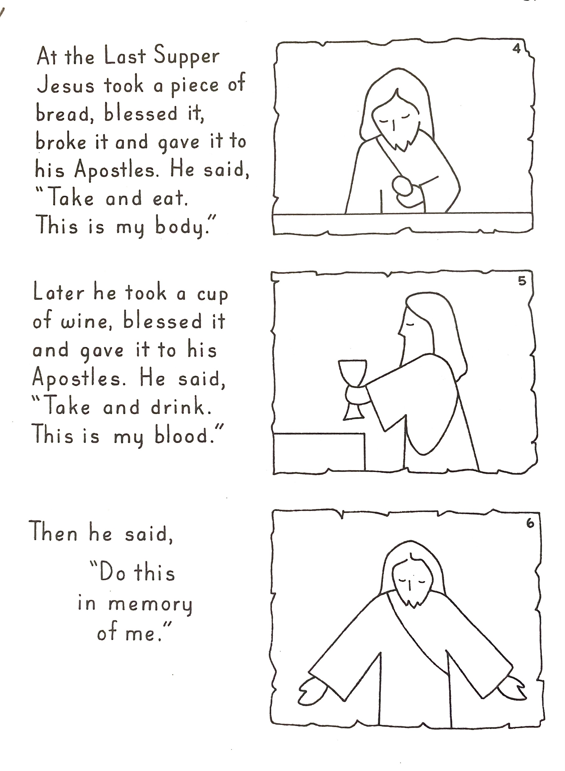
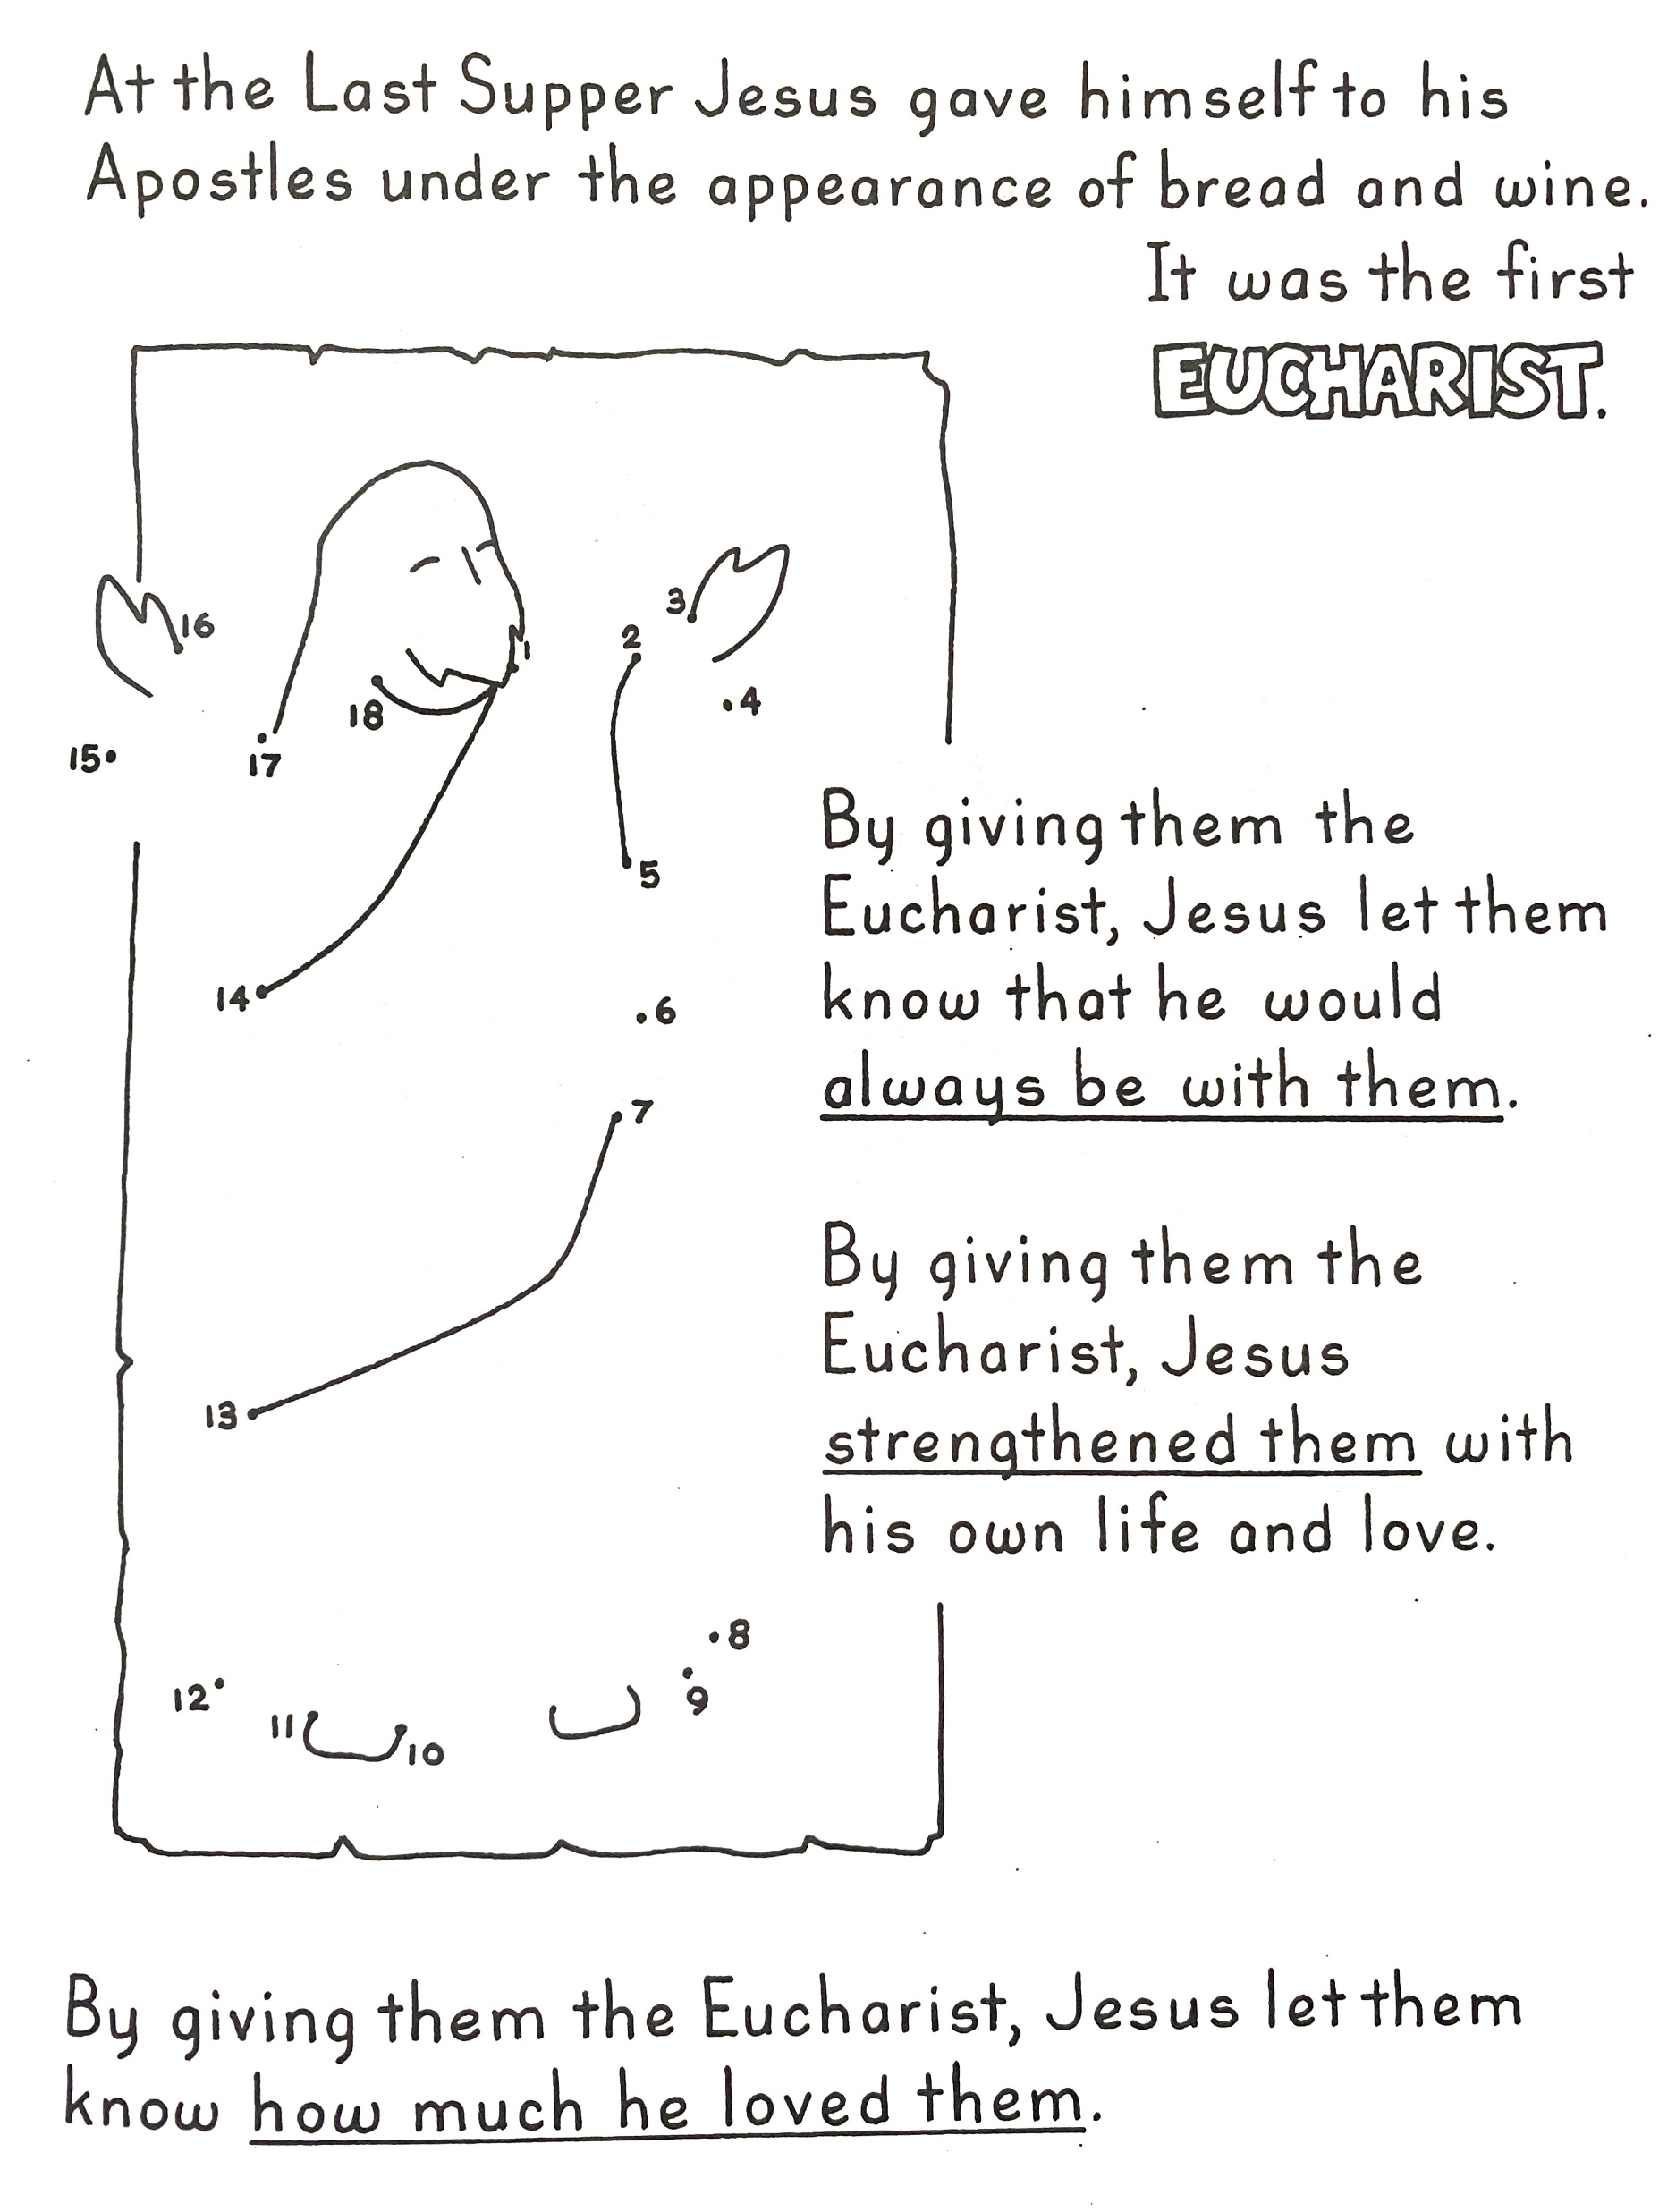

Slide 8
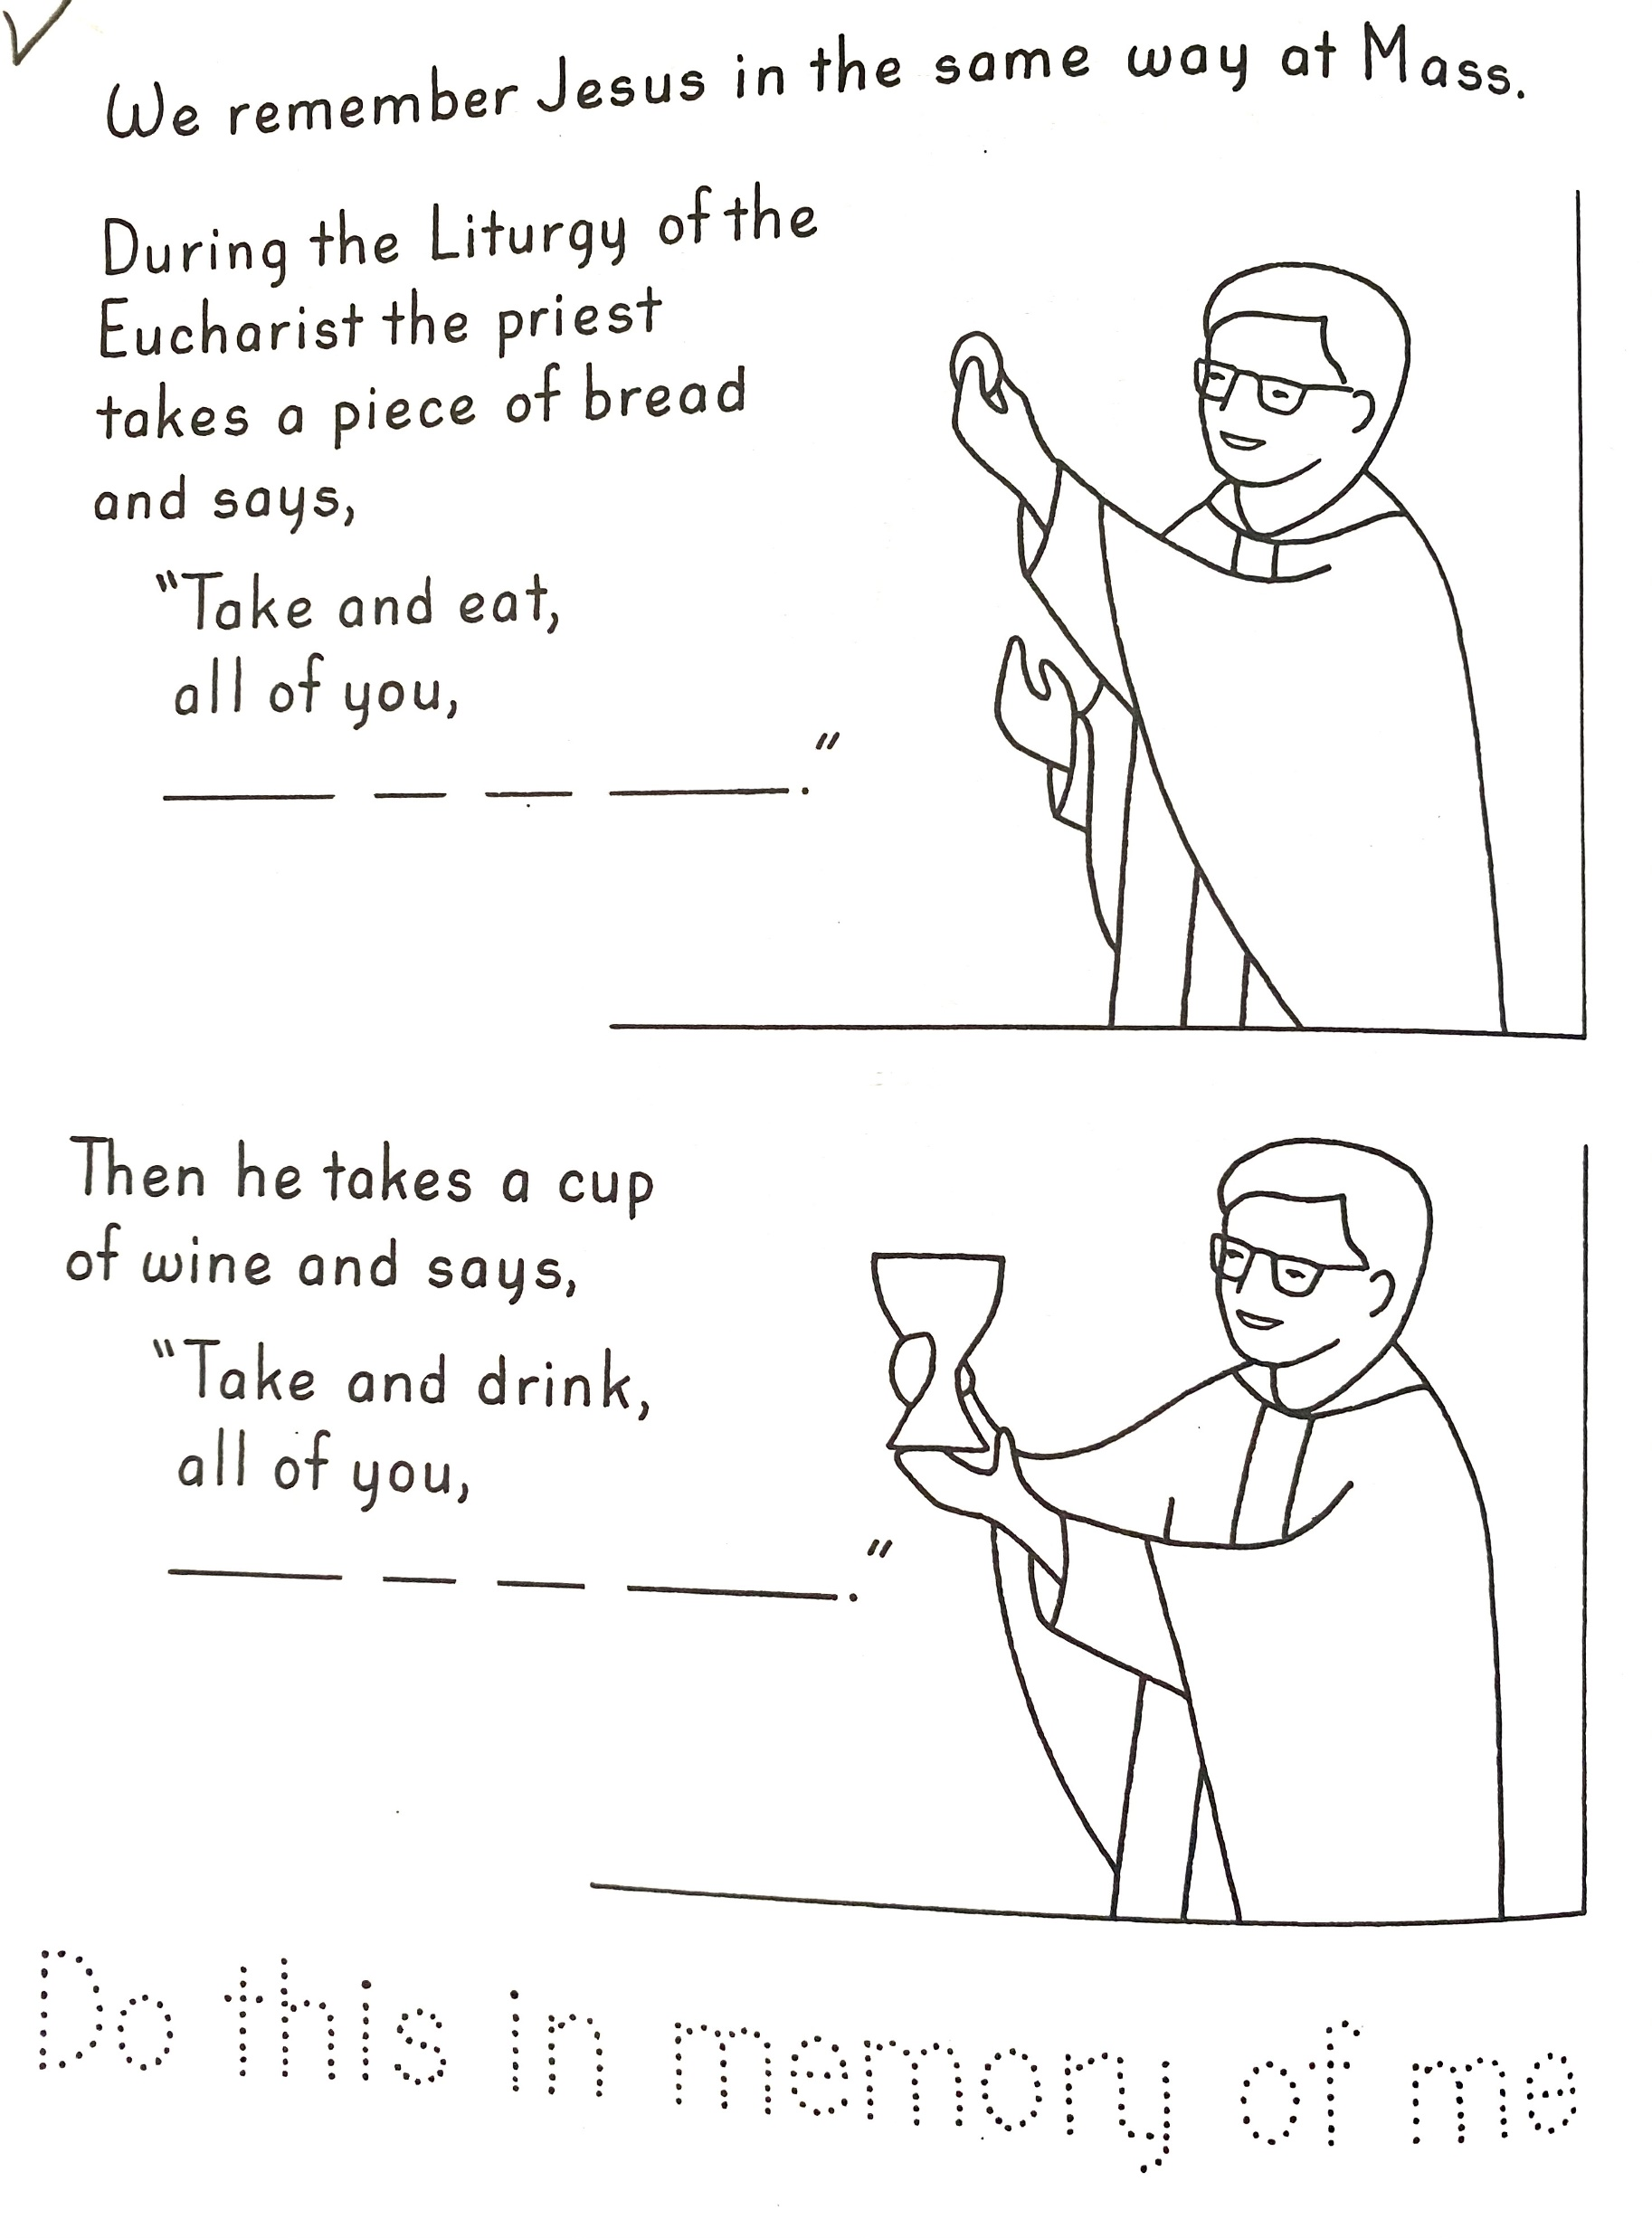

Slide 9
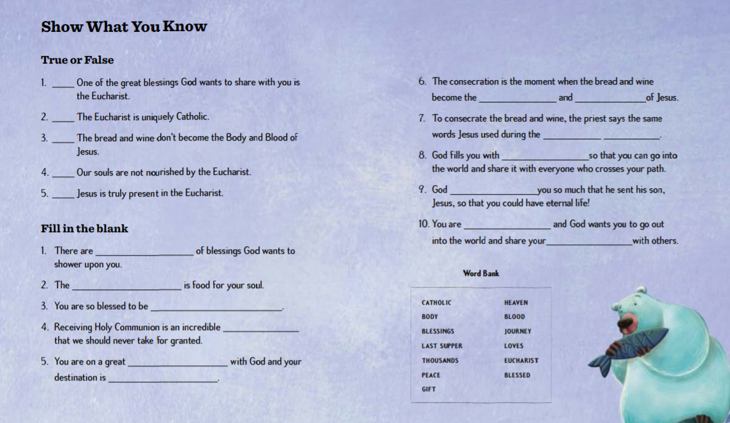
Copy and complete in your jotter

