Slide 1
Leonardo da Vinci

Slide 2
Learning Intention and Success Criteria!
We are learning who Leonardo da Vinci is and recreating some of his most famous work.
I can explain who Leonardo da Vinci is and why he is famous.
I can describe some of his famous work.
I can try to recreate a piece of his most famous work.

Slide 3
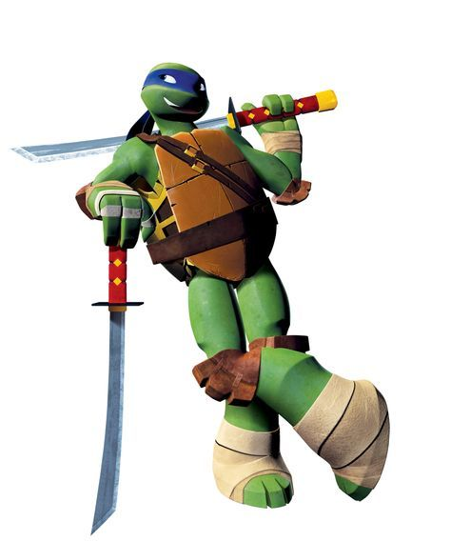
Who is Leonardo?
Not this guy! However, the TMNT was named after the famous artist and inventor!
He was a very smart man who was a scientist, artist, inventor, sculptor and much more!
Have a watch of this next video to see some of the things Leonardo studied!

Slide 4
Have a watch!
https://www.youtube.com/watch?v=eEy0njL4DDI

Slide 5
Topic Secret Skill!
Leonardo created his own way of writing and no one knows why!
He wrote backwards on his paper from the end of the line to the start with all of his letters back to front!
Some people think he did this to keep his hand clean as he was left handed and would have used messy ink! Others think it was because he didn’t want anyone being able to read and steal his ideas!
Why don’t you give this a go? It is super hard! If you hold it up to a mirror then it will appear the correct way – if you have managed it!
It will look like this!

Slide 6
His Work!
Leonardo was a very clever man! Some of his ideas were for the earliest tanks, helicopters, cannons and much more!
He was one of the first people to study and draw the inside of the body!
He also was an artist and we shall have a look at some of his most famous work on the next slides!
Have a think about the colours, shapes and styles of his art!

Slide 7
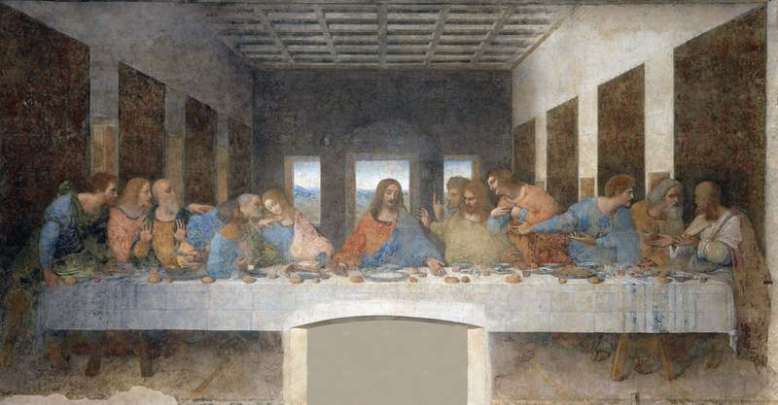
The Last Supper
Images Group/REX/Shutterstock.com

Slide 8
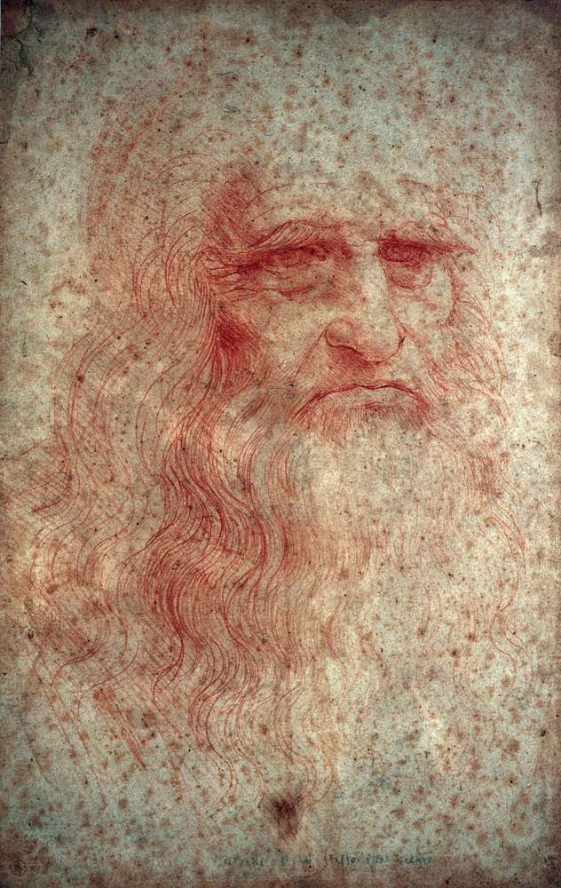
Self Portrait
Photos.com/Jupiterimages

Slide 9
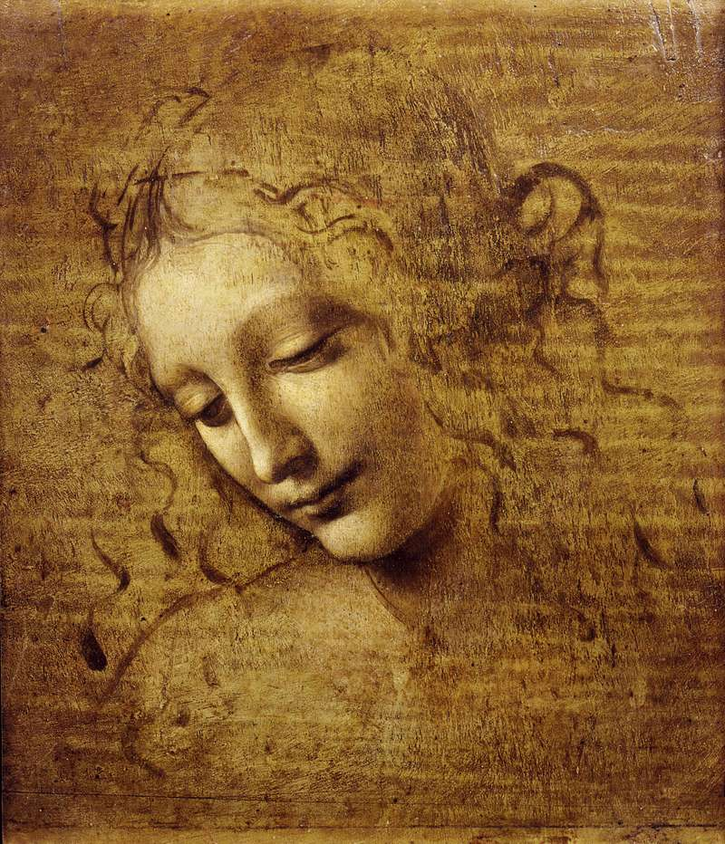
Head of a Woman
© Alfredo Dagli Orti/REX/Shutterstock.com

Slide 10
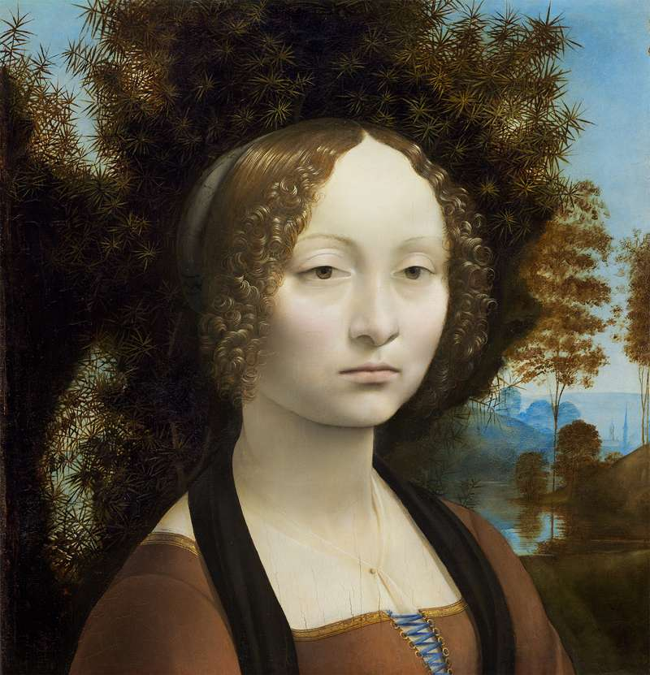
Ginevra de’ Benci
Courtesy National Gallery of Art, Washington, D.C. (Ailsa Mellon Bruce Fund; accession no. 1967.6.1.a)

Slide 11
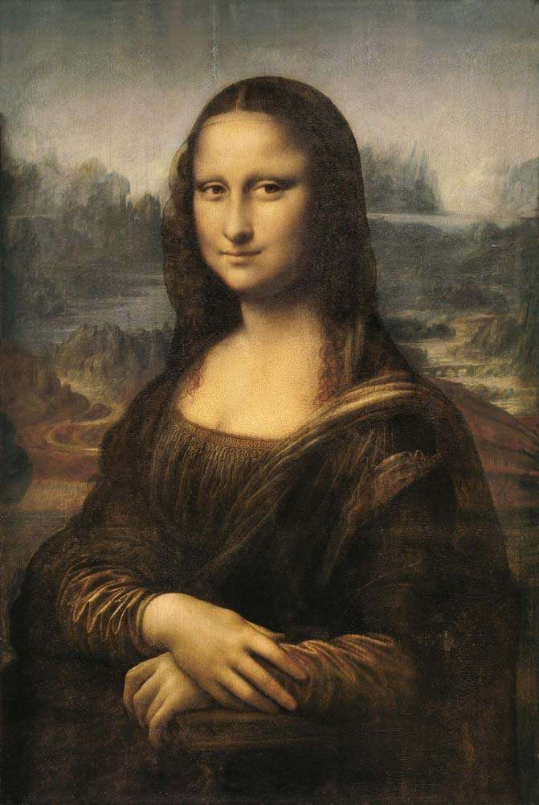
Mona Lisa
© Everett-Art/Shutterstock.com

Slide 12
Your job!
Your task is to recreate the last piece of work!
You can choose if you do a copy of the Mona Lisa or if you decide to replace her with someone you know! It may be yourself, a family member, a friend or someone at school!
Have a think about the colours and designs which he used!
If you would like a little extra help then check the next slide!

Slide 13
Extra Help

