Slide 1
St Mary’s RC primary school Thursday 25.02.21
P4 & P5

Slide 2
Morning Prayer
Father in heaven you love me
You are with me night and day
I want to love you always
In all I do and say
I’ll try to please you Father
Bless me through this day
Amen

Slide 3
Literacy - writing
Learning Intention:
We are learning to improve our writing.
Success Criteria:
I can use adjectives in my sentences.
I can use connectives in my writing.
I can use a variety of openers in my writing.

Slide 4
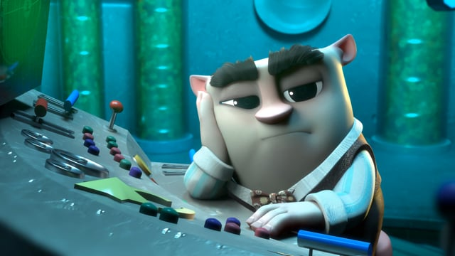
Today we will be writing about a short film. Click the link below and stop the video at 3:38
https://www.literacyshed.com/wishgranter.html
Select a Mild, Hot or Spicy Chilli Challenge from the following slides.

Slide 5
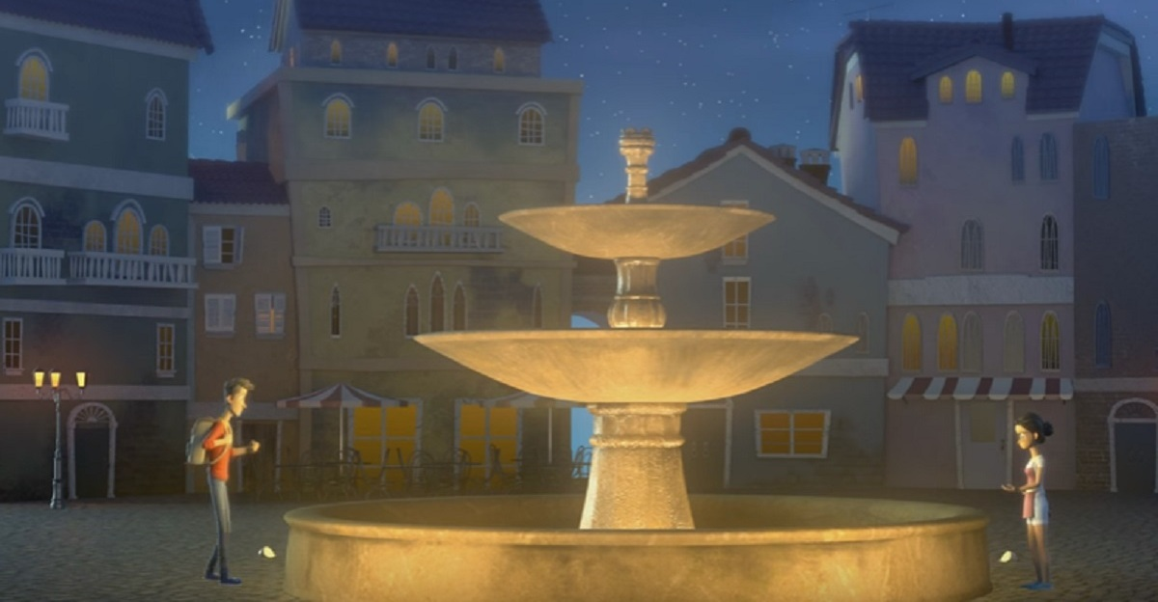
In your jotter answer the following questions by filling in the blanks where needed.
1. People were throwing their money in the fountain to_________.
Make wishes/Wash their coins/Hide their money
2. The video takes place on a _______________.
Stary night/Snowy day/Cloudy hillside
3. The first man made a wish for____________.
Wings/A new car/Money
4. What do you think the two people wished for at the fountain?
5. What do you think happens next in the story?

Slide 6
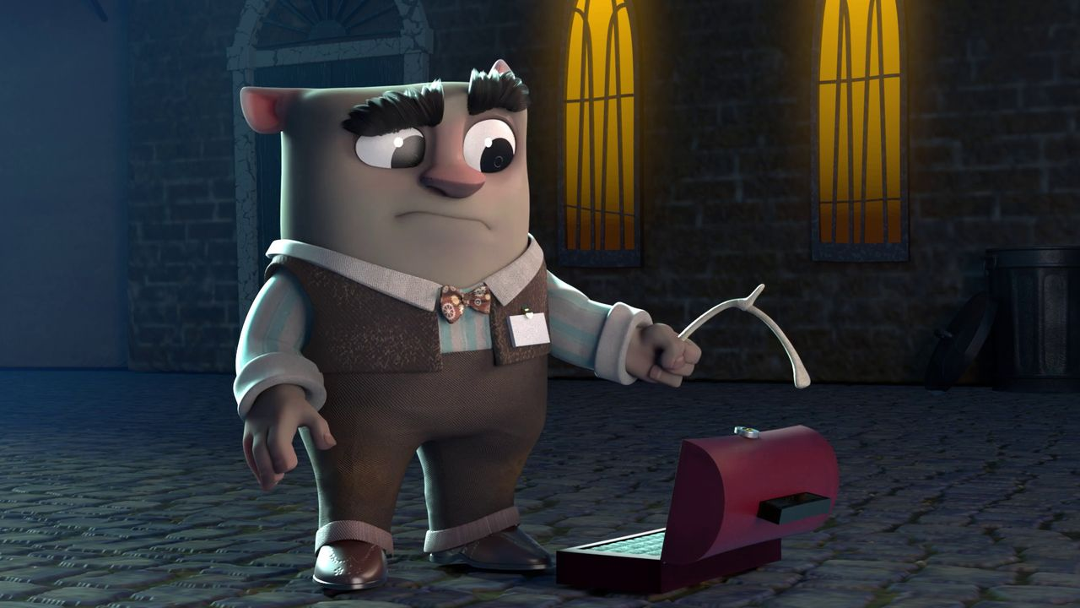
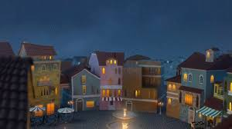
Adjectives:
Big, Small, Scruffy, Bored, Exciting, Tidy, Dirty, Clean, Mischievous, Hard Working.
Connectives:
Because, Also, And, But, So, Then, Although, As well as, however.
In your jotter I would like you to write 2 sentences describing The Wish Granter.
Each sentence must contain 2 adjectives and be connected with 1 connective.
In your jotter I would like you to write 2 sentences describing the setting of the film.
Each sentence must contain 2 adjectives and be connected with 1 connective and a different opener for each.

Slide 7
Adjectives:
Big, Small, Scruffy, Bored, Exciting, Tidy, Dirty, Clean, Mischievous, Hard Working.
Connectives:
Because, Also, And, But, So, Then, Although, As well as, however.
In your jotter I would like you to write a character description of The Wish Granter.
Your description must contain 4 adjectives and 2 connectives and a variety of openers.
In your jotter I would like you to write a setting description of the film. Your description must contain 4 adjectives and 2 connectives and a variety of openers.
I would then like you to tell me what you think happens next in the story, like a post credit scene. Be as imaginative as you can this should be at least 4 sentences long including adjectives, openers and connectives.

Slide 8
Numeracy
Learning Intention
We are learning to recognise the names and properties of 2D shapes.
We are learning to make shapes that tile.
Success Criteria
I can count the sides of a 2D shape.
I can name a 2D shape by knowing the number of sides.
I can create a shape and show how this shape can be tiled leaving no gaps.

Slide 9
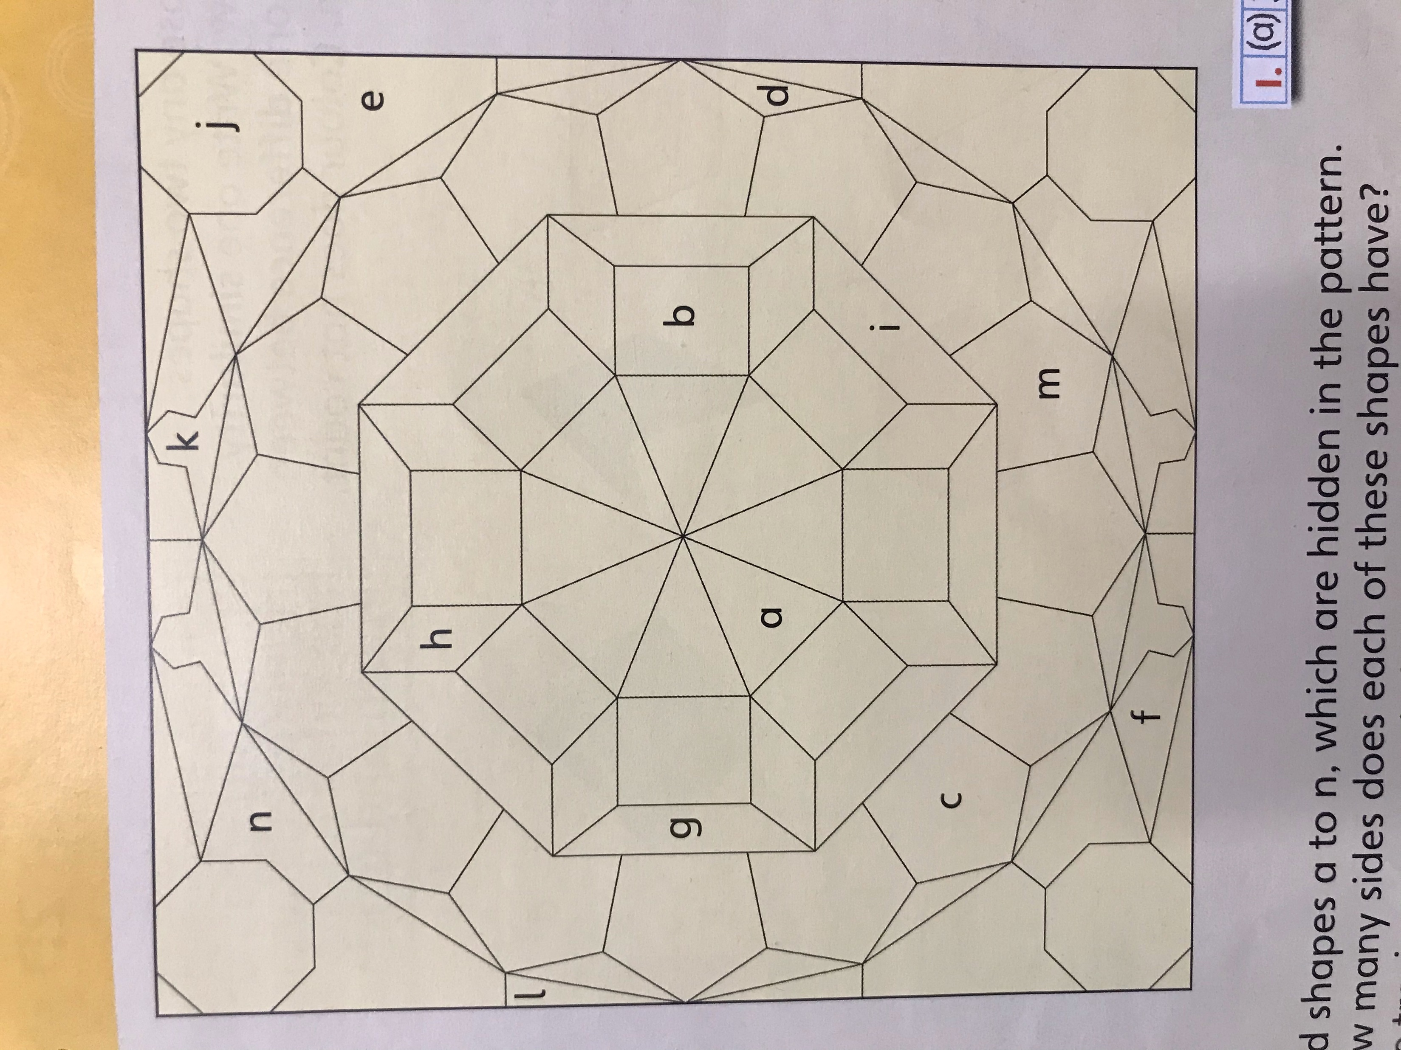
1. Find the shapes a to n, which are hidden in the pattern. How many sides does each of these shapes have? Write your answers in your jotter.
a – 3 sides
2. List the shapes in your jotter which are triangles; pentagons; hexagons.
Triangles – a, d,……
Pentagons – c, ….
Hexagons - …….

Slide 10
Start with your cardboard square.
Cut a triangle from the bottom left hand corner. Use a pencil to plot a cutting line.
Slide the cut-out piece to the top left hand corner of the card.
Stick the piece together using cello tape
Now draw around your new shape to make a tiling pattern.
Move your shape to join as many of your shapes together as you can to make a tiled pattern.
Is there more than one way to make a tiling pattern with your shape?

Slide 11
Science
Learning Intention
We are learning about the processes of the water cycle.
Success Criteria
I can name the processes of the water cycle.
I can explain what key words of the water cycle mean.
I can create my own water cycle experiment.

Slide 12
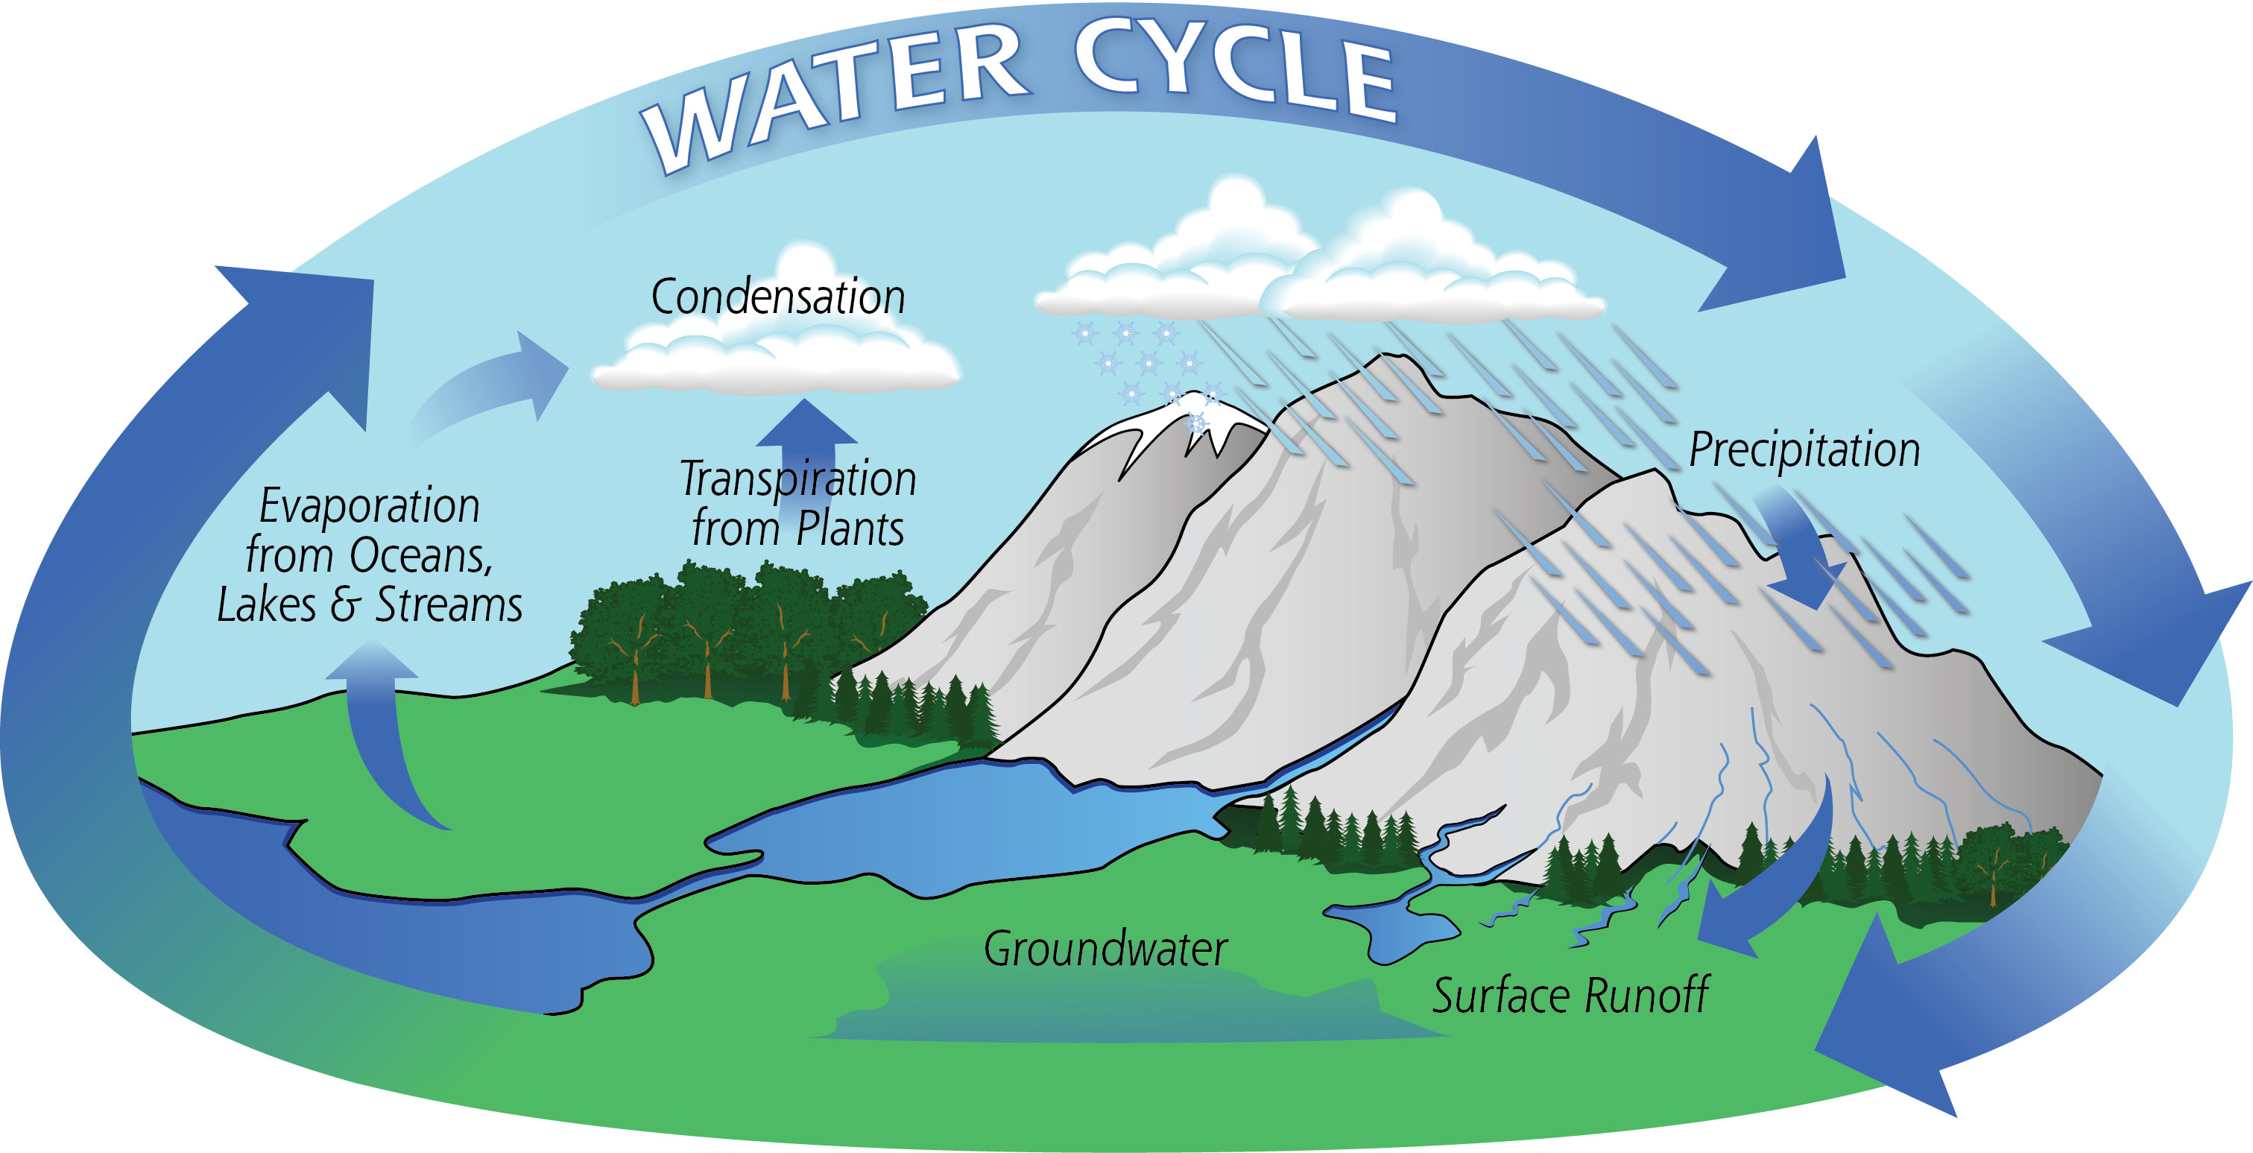
What is the water cycle?
The water cycle is the path that all water follows as it moves around Earth in different states.
Water is found in oceans, rivers, lakes and even underground. The water cycle is the path that all water follows as it moves around our planet…
States ?!?!

Slide 13
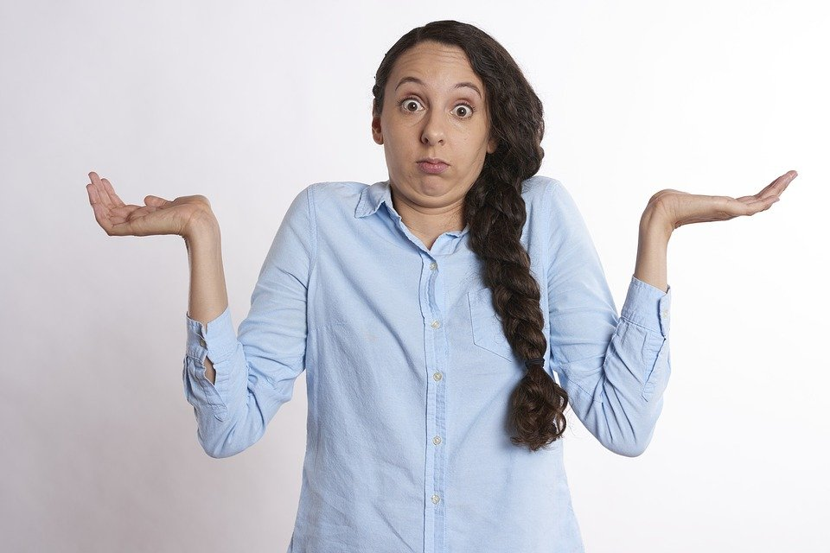
Does Anyone know what states means?

Slide 14
Does Anyone know what states means?
Turn to your partner or have a think quietly to yourself...
You have 20 seconds to think what it might mean.
Don’t worry if you don’t know we are going to discuss it further.

Slide 15
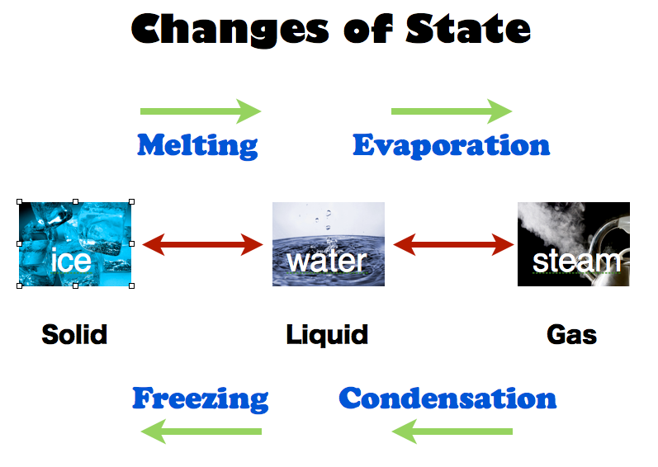
Water can occur in three states.
solid, liquid or gas.
Solid - Ice is frozen water. When water freezes, its molecules move farther apart, making ice less dense than water.
Liquid water is wet and fluid.
Gas – Water vapour is always present in the air around us. Sometimes we can see liquid water turn into a gas when we boil a kettle.

Slide 16
In your Jotters or on a piece of blank paper, Copy the diagram of the next slide and fill in the blanks using the word bank provided.

Slide 17
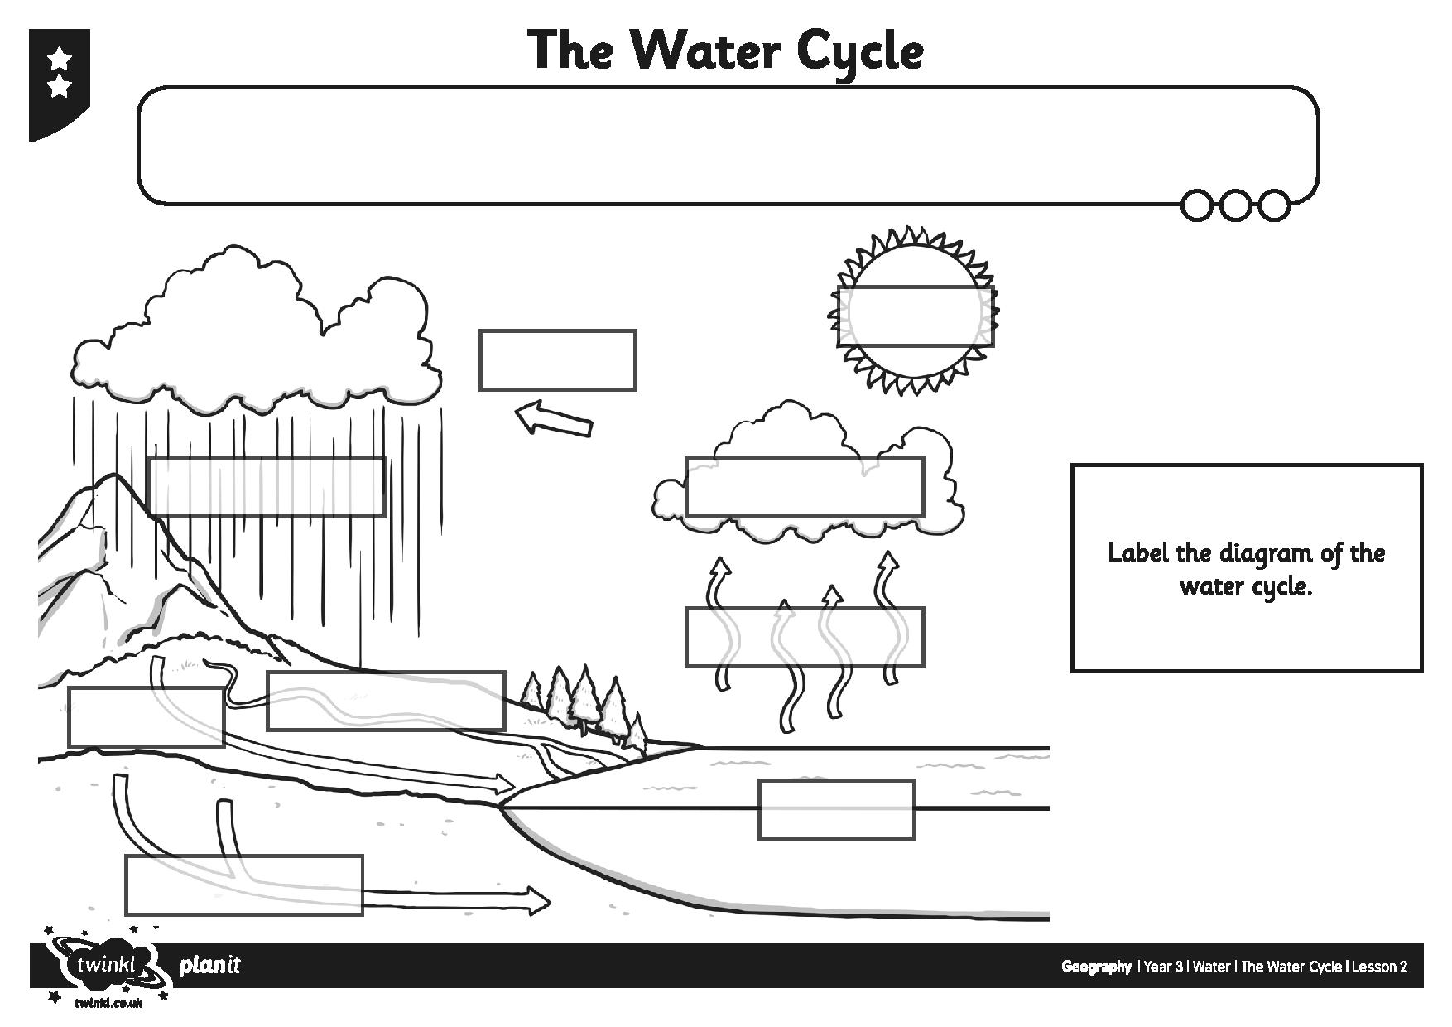
Word Bank
Rivers
Precipitation
Runoff
Underground Water
Sea
Wind
Sun
Evaporation
Condensation

Slide 18
Night time prayer
God our Father, I come to say thank you for your love today.
Thank you for my family and all the friends you give to me.
Guard me in the dark of night and in the morning send your light.Amen.

