Slide 1
Chilli Challenge 1
Calculate how much change you would have if you bought the items below. You have 50p each time.

Slide 2
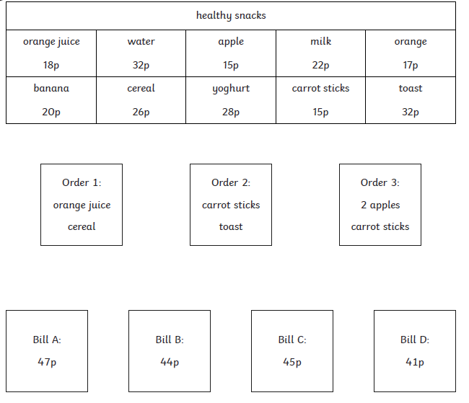
Chilli Challenge 1 Continued
Match each order with the correct bill.

Slide 3
Chilli Challenge 2
James buys a rubber and a sharpener. He pays with a £1.00 coin. How much change does he receive?
Ellen buys a ruler and a rubber. She pays with a £2.00 coin. How much change is she given?
Tom has £5.00. He buys a pack of pens and a rubber. How much money does he have left over?
Sophie buys a packet of coloured pencils and a sharpener. She pays with a £5.00 note. How much change is she given?
Joe buys a packet of coloured pencils and a ruler. He pays with a £5.00 note. How much change is he given?
Emma has £4.20. How much more money would she need to buy the pencil case?

Slide 4
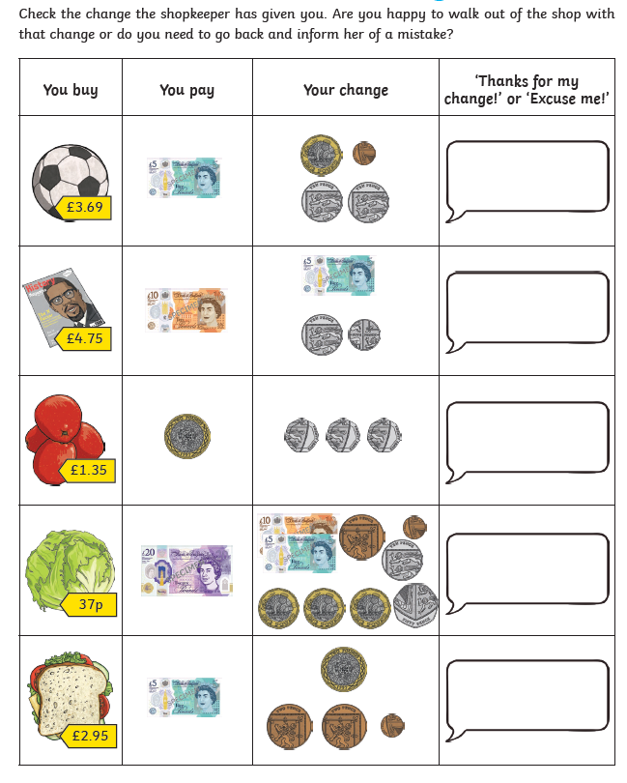
Chilli Challenge 3
Calculating change within £20
Make sure you show your working!

Slide 5
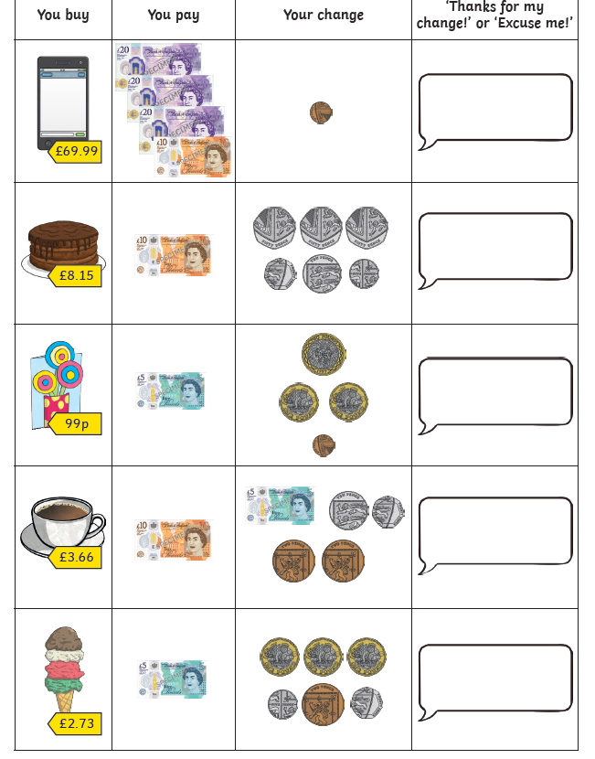
Chilli Challenge 3 Continued
Calculating change within £20
Make sure you show your working!

Slide 6
News Broadcast 3
LI: Write a News Report

Slide 8
Choose 1 artist, research them and
recreate one of
their designs.

