Slide 1
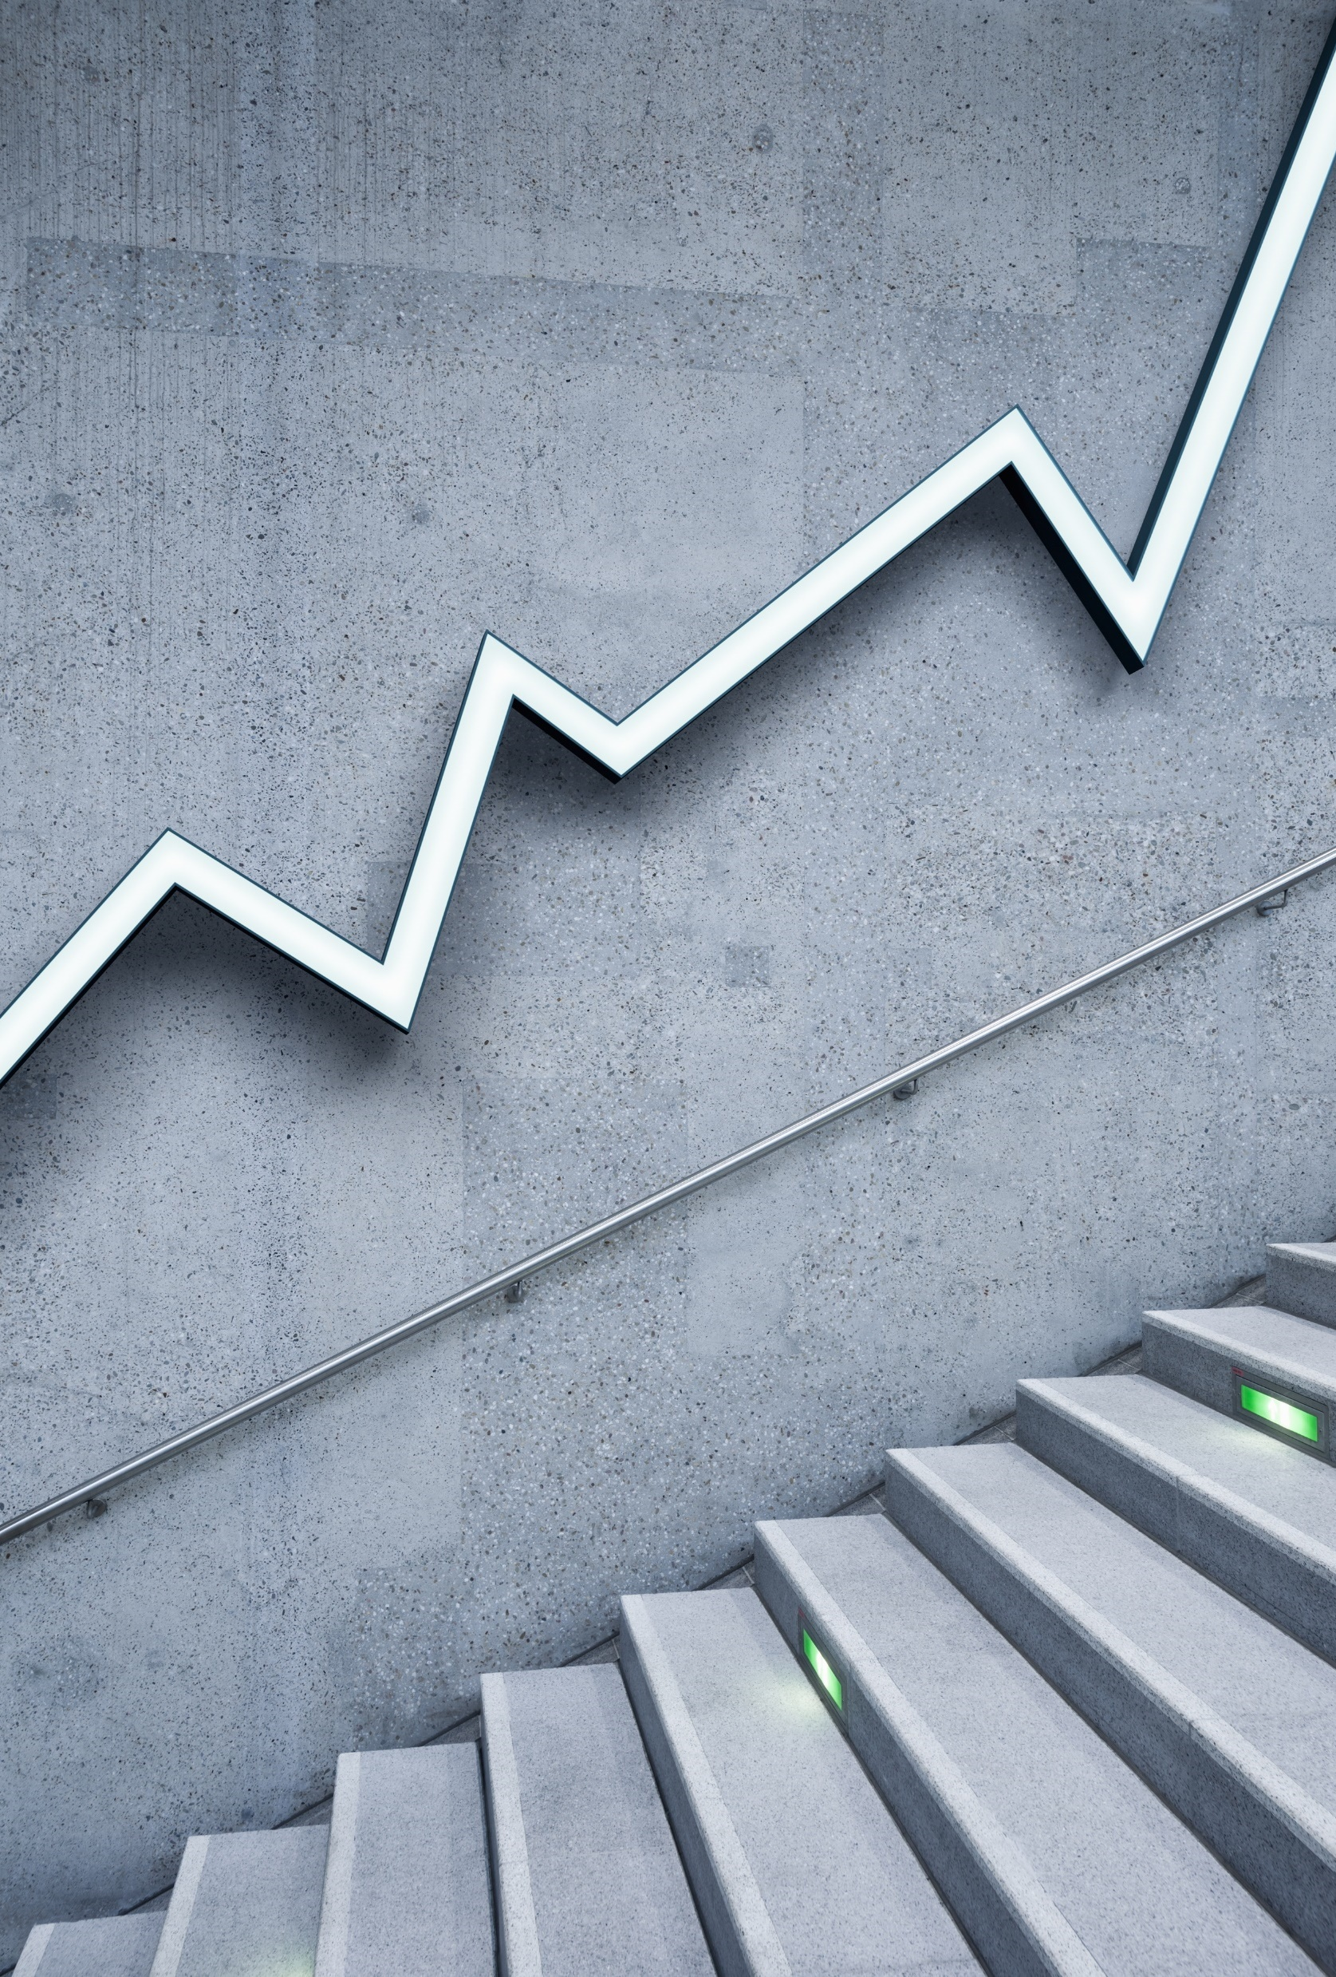
News Broadcast 2
Dragons on the loose!

Slide 2
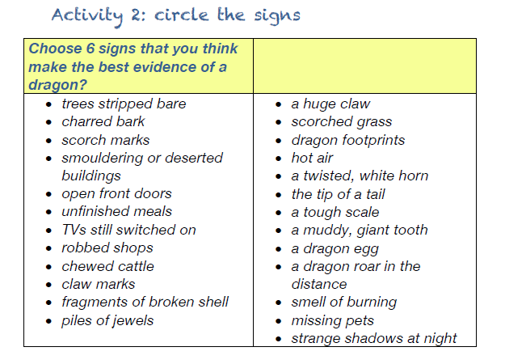

Slide 4
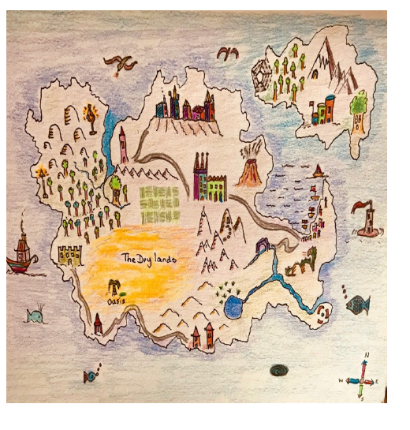
Example Map

Slide 5
Money Calculating change.
You should hear my voice or see a video of me demonstrating a concept throughout this presentation!

Slide 6
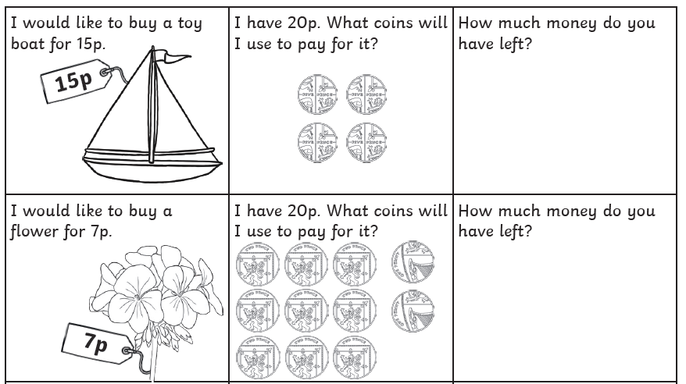
Chilli Challenge 1
Revising
calculating
change
within 20p.
Five pence
One pence
Two pence

Slide 7
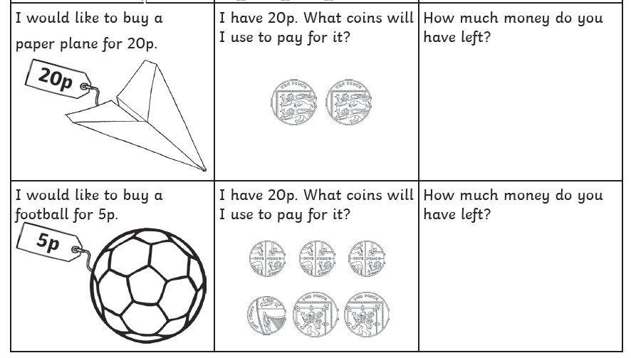
Chilli Challenge 1 Continued
Revising
calculating
change
within 20p.
Ten pence
Five pence
One pence
Two pence

Slide 8
Chilli Challenge 1 Give it a Go (extra challenge!)

Slide 9
Chilli Challenge 2
Revision of calculating change from £1 & £2.
You have £1 to spend on sweets.
Do you have enough to buy:
A toffee apple and a bag of toffees?
2 bags of jelly beans and a bag of toffees?
2 chocolate bars and a lollipop?
A lollipop, a bag of toffees and a fizzy sweet?

Slide 10
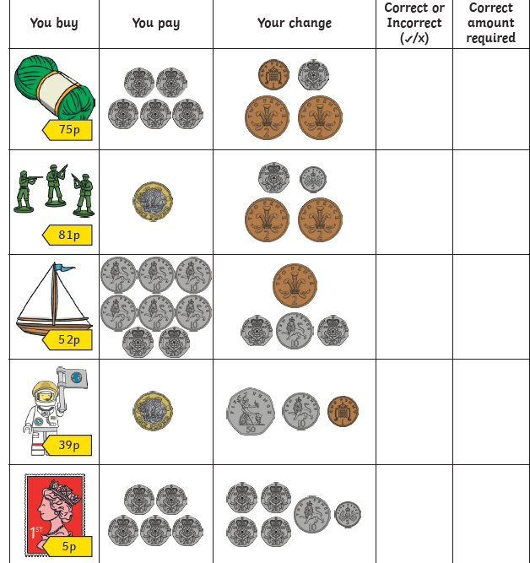
Chilli Challenge 2
Revision of calculating change from £1 & £2.
Extra Challenge: How much change would you have from £2 if you bought:

Slide 11
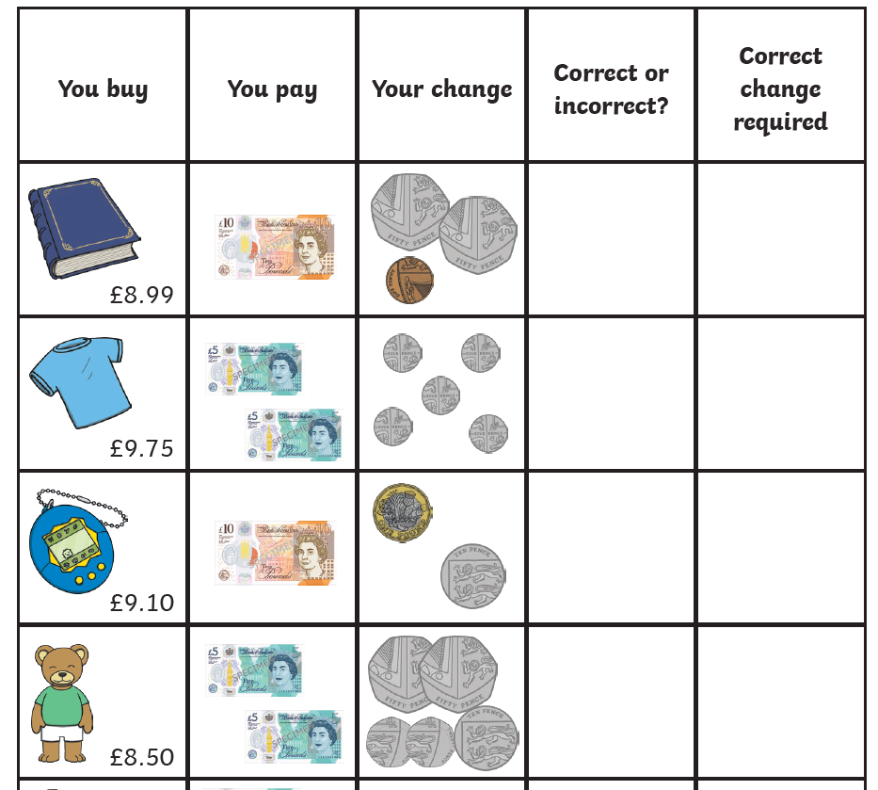
Chilli Challenge 3
Calculating change
Within £10.

Slide 12
Chilli Challenge 3
James buys a rubber and a sharpener. He pays with a £2.00 coin. How much change does he receive?
Ellen buys a packet of coloured pencils and a ruler. She pays with a £5.00 note. How much change is she given?
Tom has £5.00. He buys a pack of pens and a rubber. How much money does he have left over?
Sophie buys a packet of coloured pencils and a sharpener. She pays using 5 £1 coins. How much change is she given?
Joe buys a packet of coloured pencils, a rubber and a sharpener. He pays with a £5.00 note. How much change is he given?
Amy has saved up £10.00. She buys a pencil case and a ruler. How much money does she have left over?
Amy wants to buy two more items with her change. What could she buy? Can you find more than one answer?
Can you write and solve your own word problem, involving adding together the cost of two items and finding change?

