Slide 1
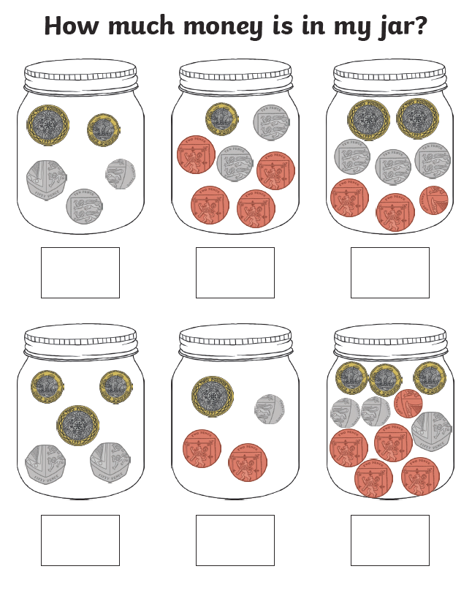
Revision Calculating Totals

Slide 2
Chilli Challenge 1
Calculating change within 20p.
Ten pence
Two pence
Two pence
Five pence
One pence

Slide 3
Chilli Challenge 1 Continued
Ten pence
Two pence
Calculating change within 20p.
Five pence
One pence
Five pence
One pence
Two pence

Slide 4
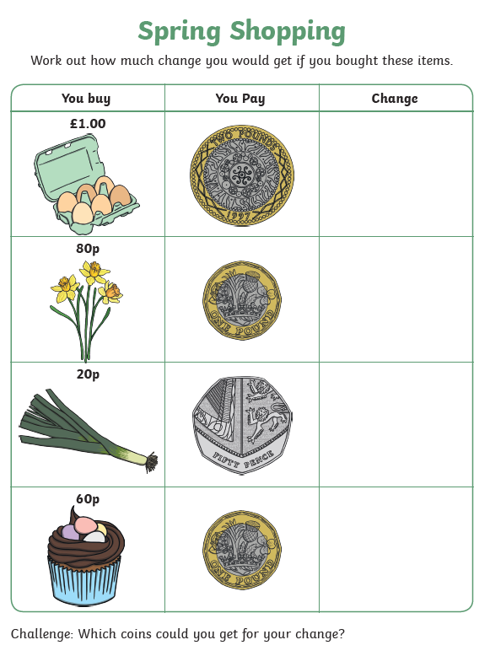
Chilli Challenge 2
Calculating change within £1 & £2.

Slide 5
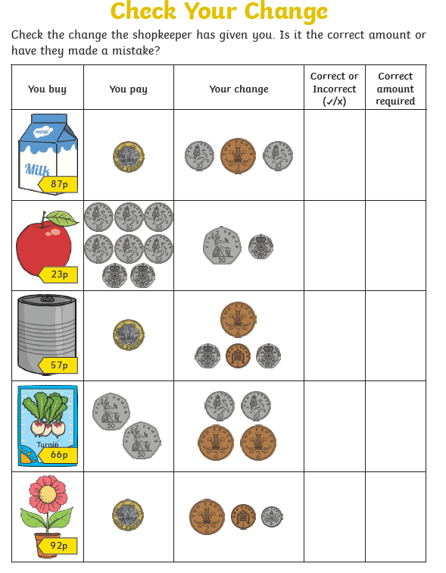
Chilli Challenge 2 Continued
Calculating change within £1 & £2.

Slide 6
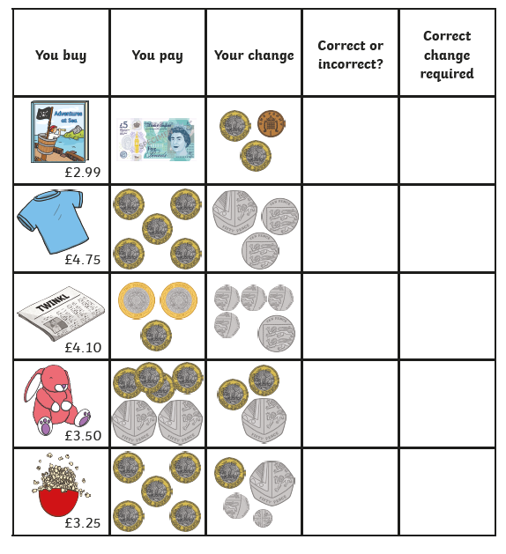
Chilli Challenge 3
Calculating change within £5.

Slide 7
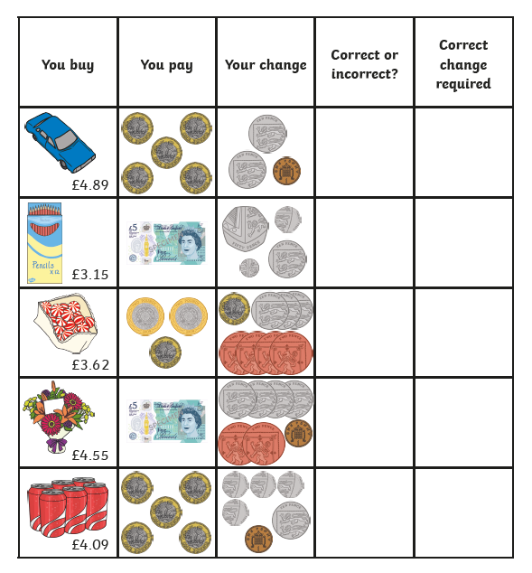
Chilli Challenge 3 Continued
Calculating change within £5.

Slide 8
News Broadcast 1
Literacy Lesson
Dragons on the loose!

Slide 9
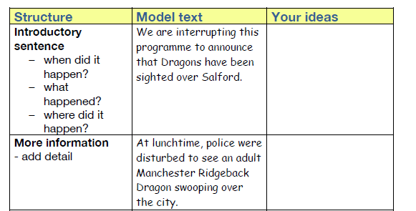

Slide 10
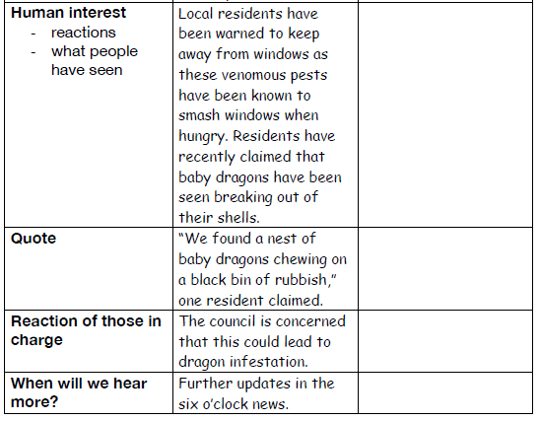

Slide 11
Some sentence starter ideas

Slide 12
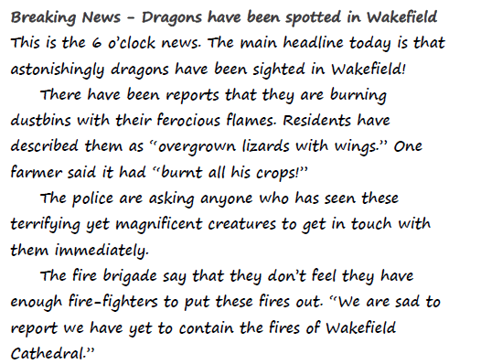
Example…

