Slide 1
Wednesday 17th February
Afternoon Lessons

Slide 2
Science Experiment – Biscuit Dunking (See PDFS on the Blog)
The Biscuit Dunking Experiment will be carried out over two days.
You can finish writing up the experiment on Thursday18th February afternoon.
It would be great if you could video yourself doing the experiment and send it into us!

Slide 3
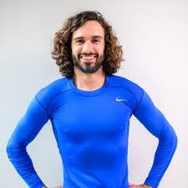
P.E with Joe Wicks
Follow this link to participate in PE with Joe Wicks.
P.E with Joe

