Slide 1
3D Shapes
The properties of 3D shapes

Slide 2
Today…
Learning Intention – We are learning about 3D shapes.
Success Criteria –
I know the name of some 3D Shapes.
I can work out the amount of sides a shape has.

Slide 3
Properties of 3D Shapes
Have a look at the video on this page to discover more about 3D shapes!
https://www.bbc.co.uk/bitesize/topics/zjv39j6/articles/zcsjqty

Slide 4
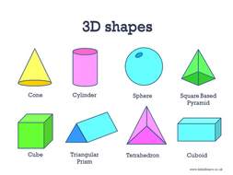
3D Shapes

Slide 5
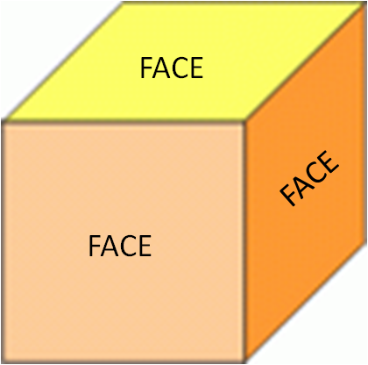
Face of a shape!
Today, we are exploring the faces of 3D shapes!
A face is the number of flat sides on the shape!
So if you can touch the flat side of the shape then that
Is a face!

Slide 6
Properties of a cube
How many faces in total?
6

Slide 7
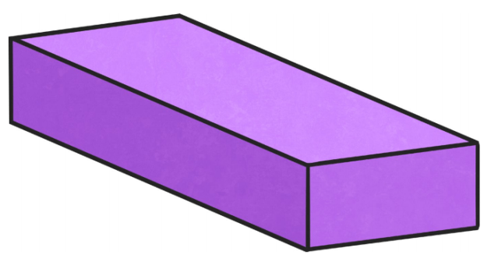
Properties of a cuboid
6
How many faces in total?

Slide 8
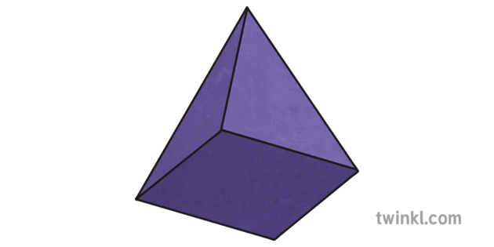
Properties of a square based pyramid
How many faces in total?
5

Slide 9
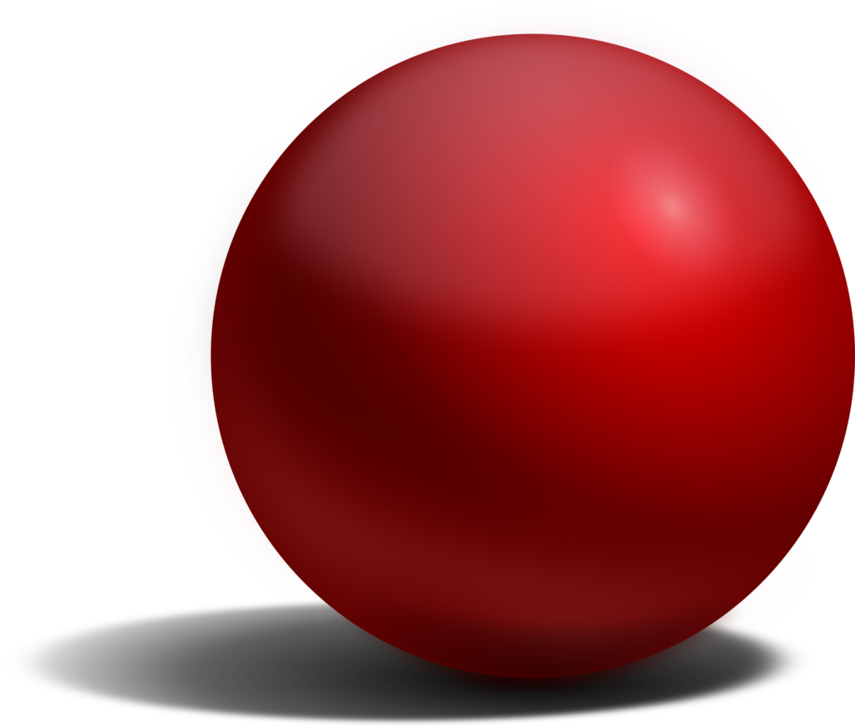
Properties of a Sphere Try this one by yourself!
How many faces in total?
1

Slide 10
Today’s activity!
Complete the activity sheet on the blog.
Fill in the name of the shape if you can work it out and the faces of the shape.
Use the information on this PowerPoint to help you!
Don’t worry if you are not sure, just try your best!!

